Slide 1
Introduction
K-map is the best manual technique for the simplification of Boolean equations, but it becomes difficult to manage when number of variable exceed 5 or 6.
So a technique called map entered variable (MEV) is used to increase the effective size of k-map.
It allows a smaller map to handle a large number of variables.

Slide 2
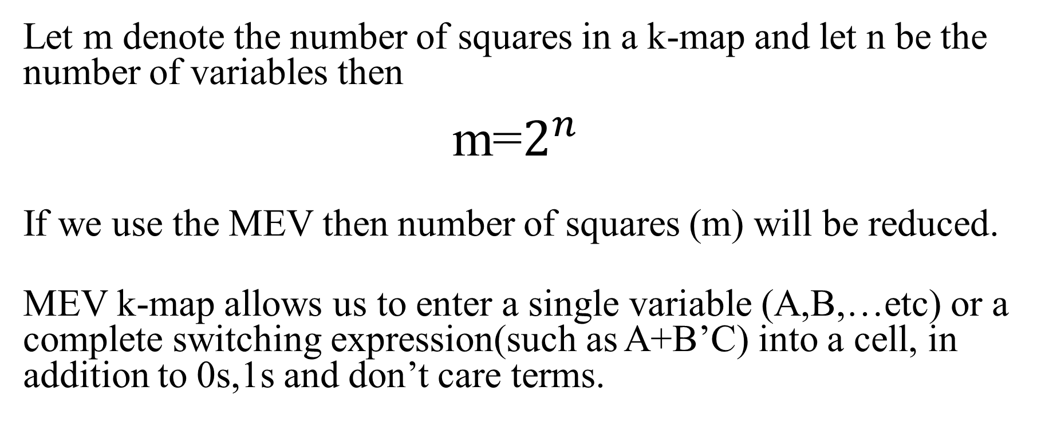
Introduction
Let m denote the number of squares in a k-map and let n be the number of variables then
m=$2^{n}$
If we use the MEV then number of squares (m) will be reduced.
MEV k-map allows us to enter a single variable (A,B,…etc) or a complete switching expression(such as A+B’C) into a cell, in addition to 0s,1s and don’t care terms.

Slide 3
Example
Question:
Simplify y=f(A,B,C,D)=∑m(1,4,5,6,9,12) and y should be zero for inputs 0,2,3,7,10,11 and the remaining possible codes never occur in system using MEV k-map technique. Consider D as MEV.

Slide 4
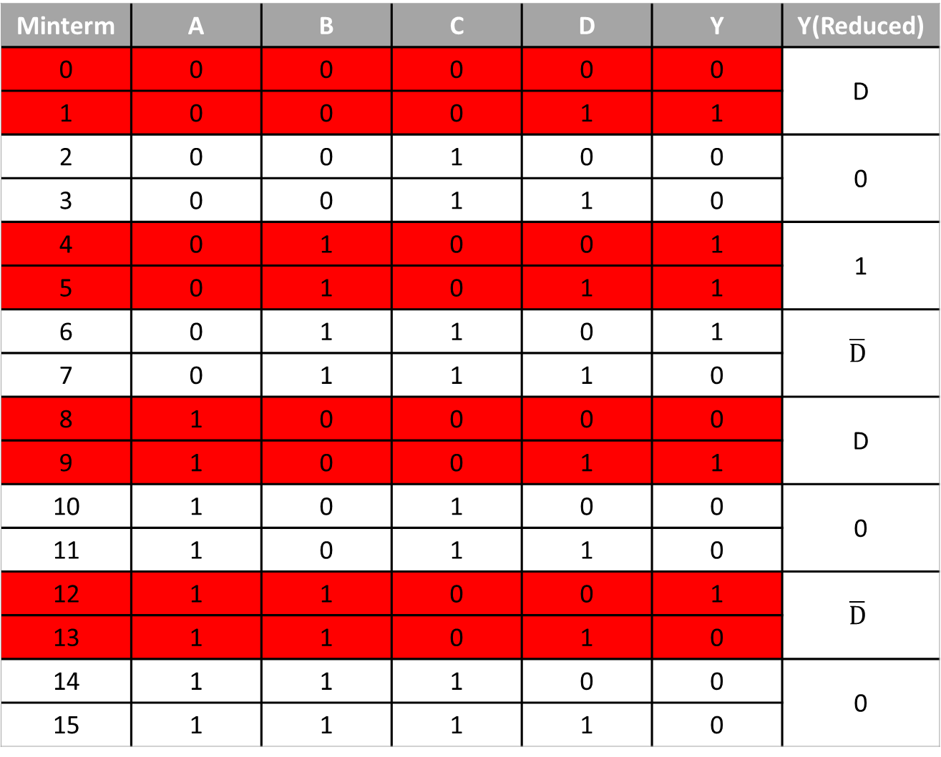
Minterm | A | B | C | D | Y | Y(Reduced)
0 | 0 | 0 | 0 | 0 | 0 | D
1 | 0 | 0 | 0 | 1 | 1
2 | 0 | 0 | 1 | 0 | 0 | 0
3 | 0 | 0 | 1 | 1 | 0
4 | 0 | 1 | 0 | 0 | 1 | 1
5 | 0 | 1 | 0 | 1 | 1
6 | 0 | 1 | 1 | 0 | 1 | $$\overline{D}$$
7 | 0 | 1 | 1 | 1 | 0
8 | 1 | 0 | 0 | 0 | 0 | D
9 | 1 | 0 | 0 | 1 | 1
10 | 1 | 0 | 1 | 0 | 0 | 0
11 | 1 | 0 | 1 | 1 | 0
12 | 1 | 1 | 0 | 0 | 1 | $$\overline{D}$$
13 | 1 | 1 | 0 | 1 | 0
14 | 1 | 1 | 1 | 0 | 0 | 0
15 | 1 | 1 | 1 | 1 | 0
Truth Table

Slide 5
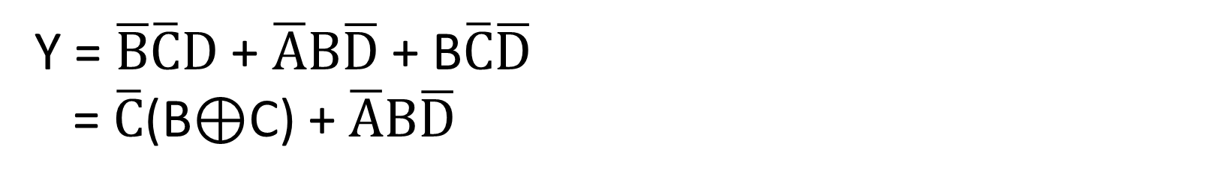
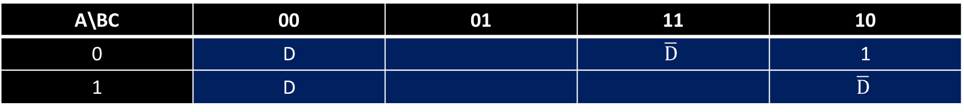
Reduced expression using k-map
A\BC | 00 | 01 | 11 | 10
0 | D |  | $$\overline{D}$$ | 1
1 | D |  |  | $$\overline{D}$$
Y = $\overline{B}\overline{C}D$ + $\overline{A}B\overline{D}$ + B$\overline{C}\overline{D}$
= $\overline{C}$(B⊕C) + $\overline{A}B\overline{D}$

Slide 6
VEM with two MEV
Suppose y=A’B’C’D’+A’B’CD’+ABCD+AB’CD+AB’CD’
then plot VEM by considering C and D as MEV.

Slide 7
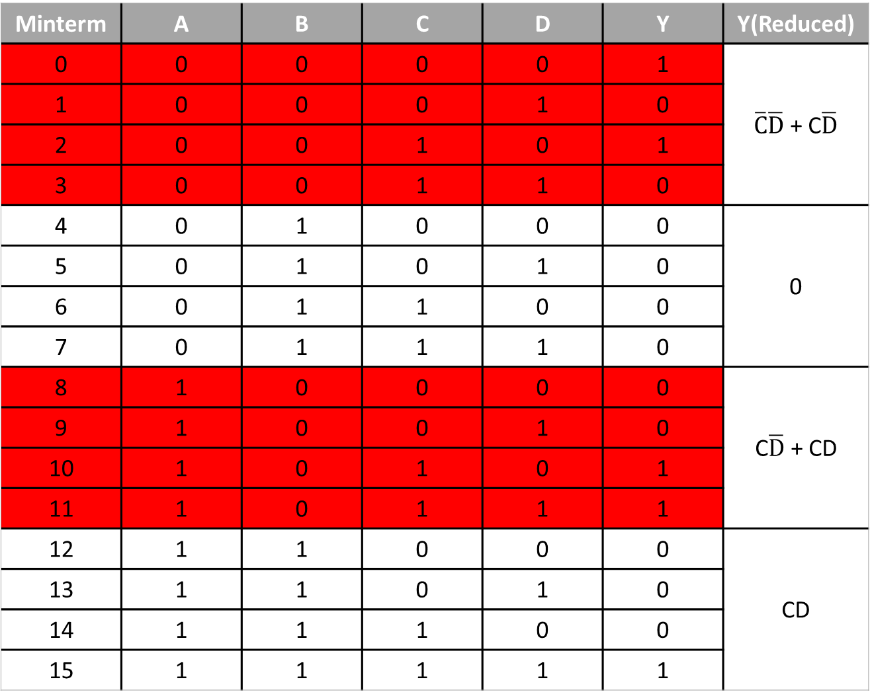
Minterm | A | B | C | D | Y | Y(Reduced)
0 | 0 | 0 | 0 | 0 | 1 | $\overline{C}\overline{D}$ + C$\overline{D}$
1 | 0 | 0 | 0 | 1 | 0
2 | 0 | 0 | 1 | 0 | 1
3 | 0 | 0 | 1 | 1 | 0
4 | 0 | 1 | 0 | 0 | 0 | 0
5 | 0 | 1 | 0 | 1 | 0
6 | 0 | 1 | 1 | 0 | 0
7 | 0 | 1 | 1 | 1 | 0
8 | 1 | 0 | 0 | 0 | 0 | C$\overline{D}$ + CD
9 | 1 | 0 | 0 | 1 | 0
10 | 1 | 0 | 1 | 0 | 1
11 | 1 | 0 | 1 | 1 | 1
12 | 1 | 1 | 0 | 0 | 0 | CD
13 | 1 | 1 | 0 | 1 | 0
14 | 1 | 1 | 1 | 0 | 0
15 | 1 | 1 | 1 | 1 | 1
Truth Table

Slide 8
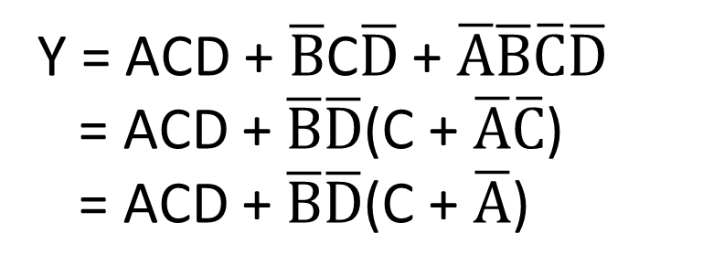

Reduced expression using k-map
A\B | 0 | 1
0 | $\overline{C}\overline{D}$ + C$\overline{D}$
1 | C$\overline{D}$ + CD | CD
Y = ACD + $\overline{B}$C$\overline{D}$ + $\overline{A}\overline{B}\overline{C}\overline{D}$
= ACD + $\overline{B}\overline{D}$(C + $\overline{A}\overline{C}$)
= ACD + $\overline{B}\overline{D}$(C + $\overline{A}$)

Slide 9
Advantages of VEM
The variable entered map can be used to plot an n-variable problem on n-1 variable map.
The variable entered map occurs in design problems involving multiplexers , which can be solved more readily by this approach than by k-maps.

Slide 10
Quine McCluskey Method
Some Facts About Quine McCluskey
Developed in 1956
Also known as Tabulation Method
Used for Minimization of Boolean Functions
Where Karnaugh Map could solve for upto 5 bits, Quine McClusky can solve for more than 5 bits.
Has easy algorithm than Karnaugh, so it is efficient and can be easily implemented in computer algorithms.

Slide 11
Steps
Four main Steps:
1. Generate Prime Implicants
2. Construct Prime Implicants Table
3. Reduce Prime Implicants
4. Solve Prime Implicants table

Slide 12
Example Problem
◆ Σ (0,4,5,7,10,12,13,14,15)
Step-1: Listing the Binary codes of each number.
No Binary
0 | 0000
4 | 0100
5 | 0101
7 | 0111
10 | 1010
12 | 1100
13 | 1101
14 | 1110
15 | 1111
Table 1

Slide 13
Step-2: Listing Binary Numbers according to their number of 1’s as in Table.2
Step-3: Making Table of Duals from Table:2
Step:2 Table 2
Step:3 Table 3
 | ABCD
0 | 0000 | X
4 | 0100 | X
5 | 0101 | X
10 | 1010 | X
12 | 1100 | X
7 | 0111 | X
13 | 1101 | X
14 | 1110 | X
15 | 1111 | X
0,4 | 0_00
4,5 | 010_
4,12 | _100
5,7 | 01_0
5,13 | _101
10,14 | 1_10
12,13 | 110_
12,14 | 11_0
7,15 | _111
13,15 | 11_1
14,15 | 111_
Table:2

Slide 14
Step-4: Generating table of Quads from Table.3
 | ABCD
0,4 | 0_00 | PI
4,5 | 010_ | X
4,12 | _100 | X
5,7 | 01_0 | X
5,13 | _101 | X
10,14 | 1_10 | PI
12,13 | 110_ | X
12,14 | 11_0 | X
7,15 | _111 | X
13,15 | 11_1 | X
14,15 | 111_ | X
ABCD
ABCD
 | ABCD
4,5 12,13 | _10_ | PI
4,12 5,13 | _10_
5,13 7,15 | _1_1 | PI
5,7 13,15 | _1_1
12,13 14,15 | 11__ | PI
12,14 13,15 | 11__
Table:4
Table:3

Slide 15
Step-5: Making table of Prime Implicants
?
Prime
0
4
5
7
10
12
13
14
15
Implicants
0.4
✓
✓
10.14
✓
✓
4.5-12.13
5.13-7.15
12.13-14.15
✓
✓
✓
✓
✓
✓
✓
✓
✓
✓
✓
✓
0.4 + 10.14 + 5.13-7.15 + 4.5-12.13

Slide 16
Step-6: Generating SOP from Prime Implicants
0,4 + 10,14 + 5,13,7,15 + 4,5,12,13
Now Since
PI | ABCD
0,4 | 0_00
10,14 | 1_10
5,14 7,15 | _1_1
4,5 12,13 | _10_
PI
So the minimized SOP is: A’C’D’ + ACD’ + BD + BC’

Slide 17
THANK YOU

