Slide 1
What is SOFTWARE?
SW is
  not only programs
  but also all associated documentation, and
  configuration data
that make these programs operate correctly.
More specifically, a SW system consists of
  separate programs
  configuration files setting up these programs
  system documentation describing the structure of the system in good detail
  user documentation explaining how to use and operate the system.

Slide 2








Computer Programs Associated Documentation
Data structure that enable program to adequately manipulate information
Documents describing operations and use of programs
Both a product and a vehicle for developing a product
Software is engineered not manufactured
Does not wear out but it does deteriorate

Slide 3
Two classes of Software Products
Generic products
  stand-alone systems
  sold on open market to any customer such as
    word processors,
    databases,
    drawing packages
Custom or bespoke products
  systems developed specifically for a customer

Slide 4
What is Software Engineering?
SW engineering is an engineering discipline
  concerned with all aspects of SW production starting from the early stages of system specification through to the maintenance of the system after it has started to be used.
engineering discipline:
  implies solving a well-defined (or in SW engineering vaguely defined) problem optimally using resources (e.g., time, man power and machine power) and remaining within
    organizational (i.e., the customer)
    financial, and
    other possible
  constraints.
all aspects of SW production:
  encompasses
    not only the technical processes
    but also deals with project management, development of tools, methods and theories to support SW production.

Slide 5
What is a Software Process?
Four fundamental activities and associated results which produce a SW product.
  SW (requirements) specification
  SW development ...
    Design phase
    Implementation phase
  SW verification and validation (SW V&V)
  SW evolution

Slide 6
Four fundamental activities and associated results which produce a SW product.
  SW (requirements) specification
  SW development ...
    Design phase
    Implementation phase
  SW verification and validation (SW V&V)
  SW evolution

Slide 7
Software requirement specification
... answers the question: what?
... starts with the definition of requirements by the requirements specification team
... proceeds with requirements engineering process including
  Requirements elicitation & analysis composed of
    Domain understanding / Requirements collection / Classification / Conflict resolution / Prioritization / Requirements checking
  Requirements validation
    ... Shows that the system defined by the above requirements is the actual expectation of the customer,
    ... Complete & consistent, realizable by the existing technology, verifiable?
... ends up with requirements management
  ... is the process of understanding and controlling changes to system requirements.

Slide 8
Software Development
... answers the question: how?
  SW that is expected to meet the specification must be produced.
  Design phase: alternative solutions to how the intended goals are accomplished
  Implementation phase: actual code development

Slide 9
Software Verification and Validation
... answers the following two questions:
  am I doing the right product?
  am I doing the product right?
  SW must be verified & validated to ensure that it does what the customer wants
SW evolution:
  SW must evolve to meet the changing needs of the customer.

Slide 10
Software Evolution
SW must evolve to meet the changing needs of the customer.
... starts after the delivery and on-site installation of SW product
Maintenance is an activity of this phase

Slide 11
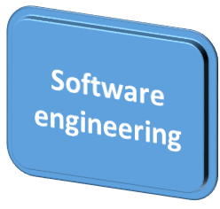
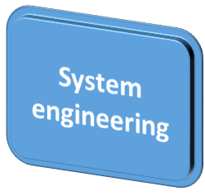

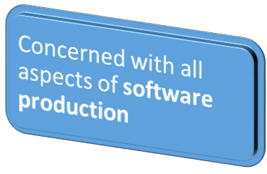
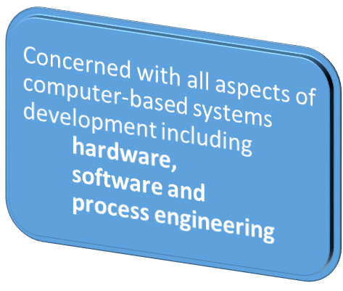
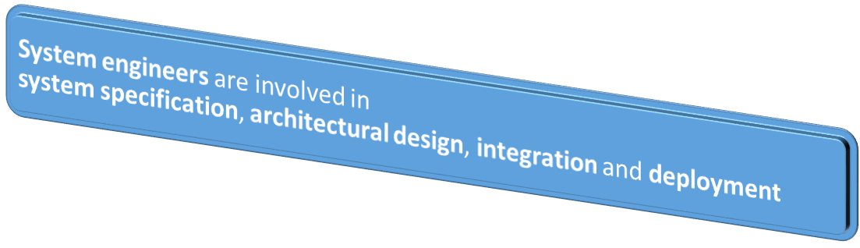
Software Engineering/System Engineering

Slide 12



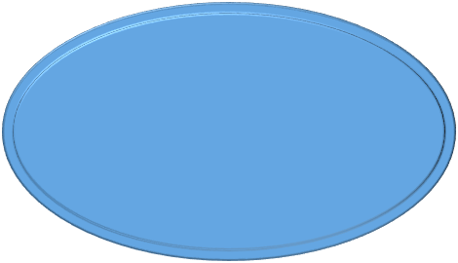


Software Process
Software Process:
set of activities whose goal is development or evolution of software
  Specification - what the system should do and its development constraints
  Evolution - changing the software in response to changing demands
  Development - production of software system
Generic activities in all software processes
  Validation - checking that the software is what the customer wants

Slide 13
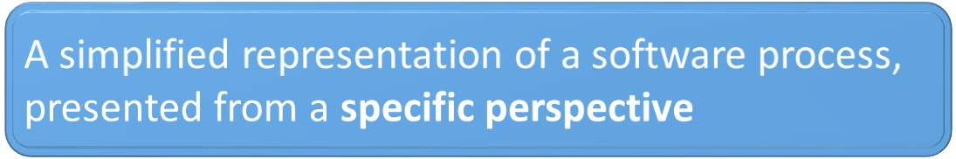
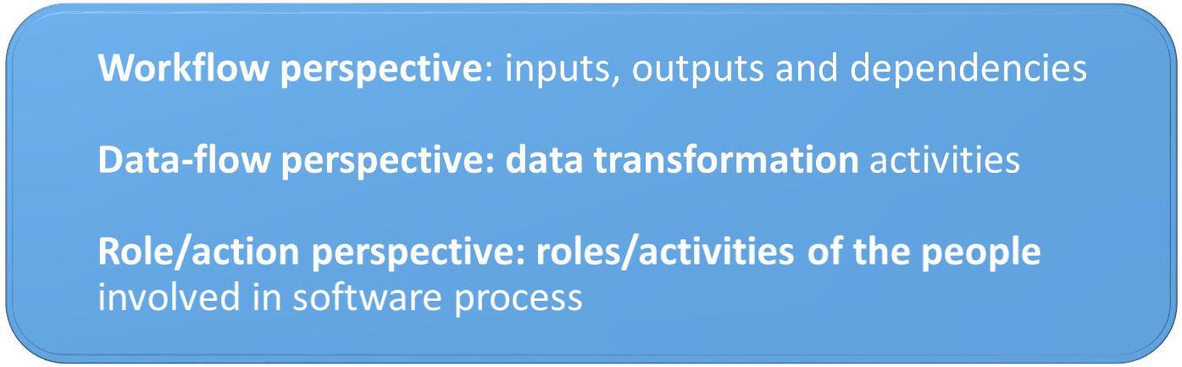
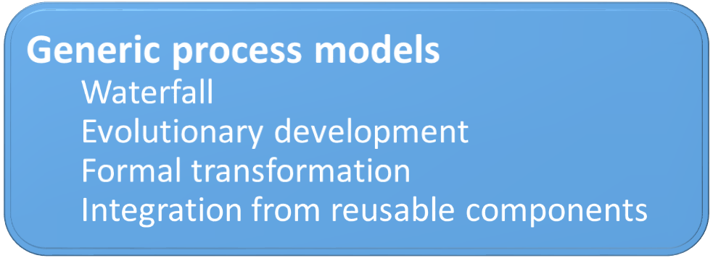
Software Process Model

Slide 14
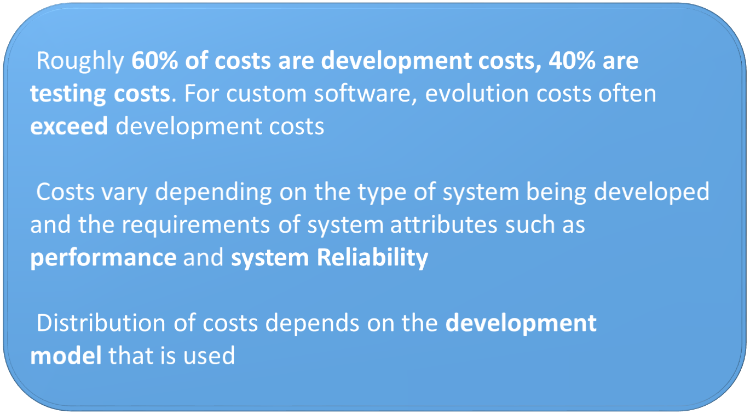
Costs of Software Engineering

Slide 15
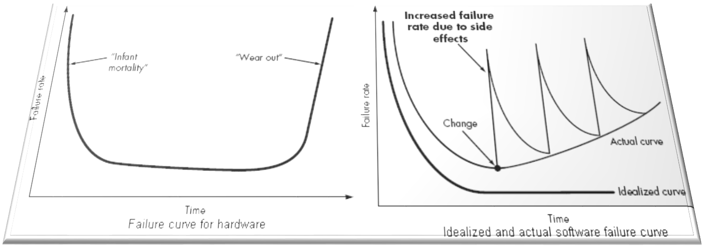
Software Failure Curve

Slide 16

What is CASE
(Computer-Aided Software Engineering)
Software systems which are intended to provide automated support for software process activities.
CASE systems are often used for method support
Upper-CASE
• Tools to support the early process activities of requirements
and Design
Lower-CASE
• Tools to support later activities such as programming,
debugging and testing

Slide 17

What are the attributes of good software?
The software should deliver the required functionality and performance to the user and should be maintainable, dependable and usable
Maintainability
• Software must evolve to meet changing needs
Dependability
• Software must be trustworthy
Efficiency
• Software should not make wasteful use of system resources
Usability
• Software must be usable by the users for which it was designed

Slide 18

What are the key challenges facing software engineering?
Coping with legacy systems, coping with increasing diversity and coping with demands for reduced delivery times
Legacy systems
• Old, valuable systems must be maintained and updated
Heterogeneity
• Systems are distributed and include a mix of hardware and
software
Delivery
• There is increasing pressure for faster delivery of software

Slide 19
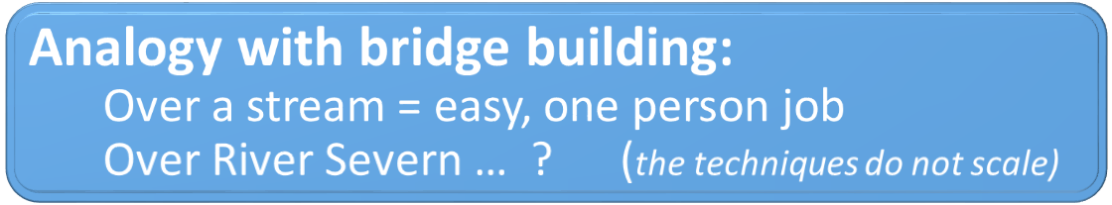
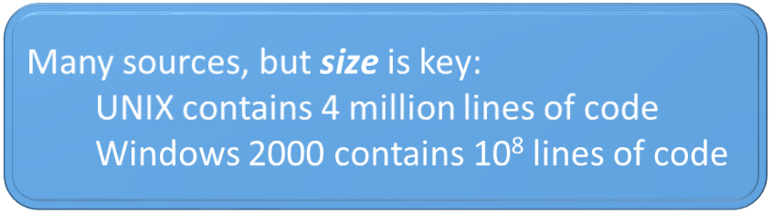
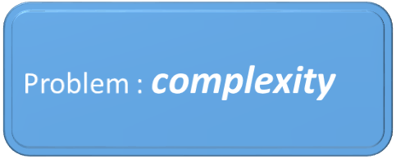
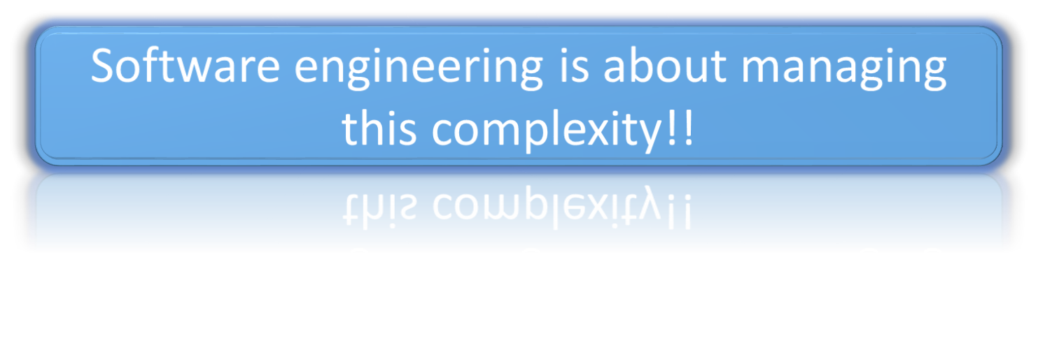
Need of Software Engineering

Slide 20
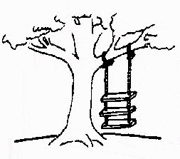
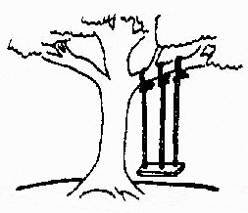


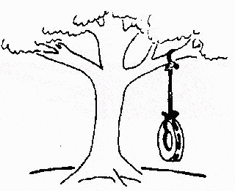
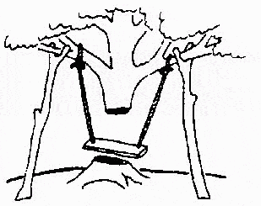
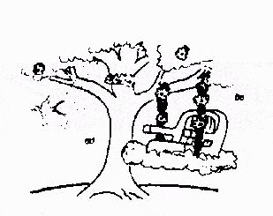
How Programs Are Usually Written …
The developers understood it in that way
This is how problem is solved now
Requirements specification was defined like this
This is how problem was solved before.
This, in fact, is what the customer wanted … ;-)
That is program after debugging
This is how program is described by marketing department

Slide 21
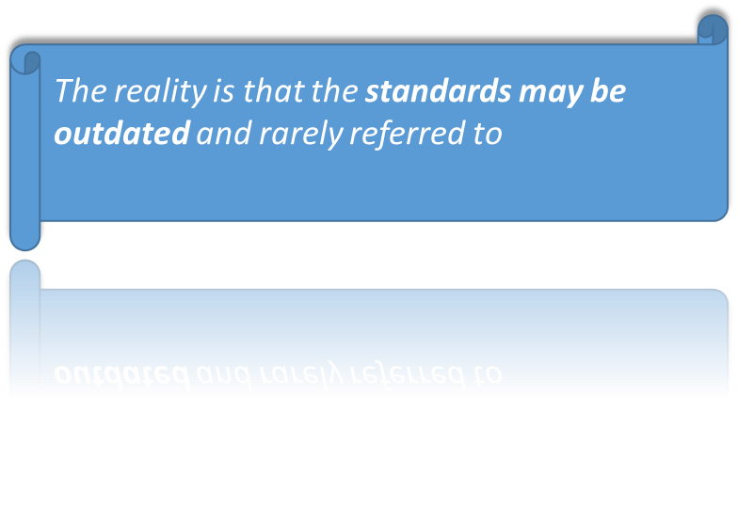
Software Myths
Myth: A traditional story accepted as history; serves to explain the world view of a people
- Software standards provide software engineers with all the guidance
they need.

Slide 22
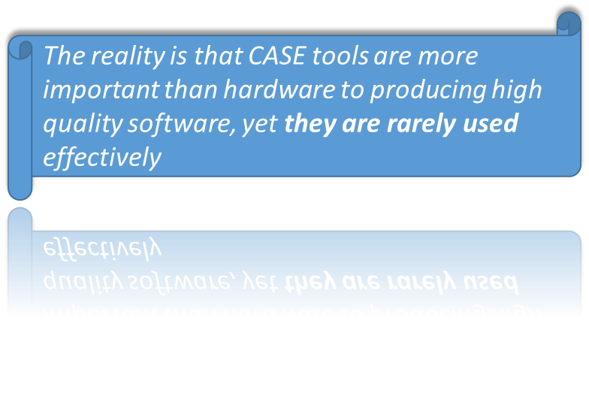
Software myths
- People with modern computers have all the software development tools .

Slide 23
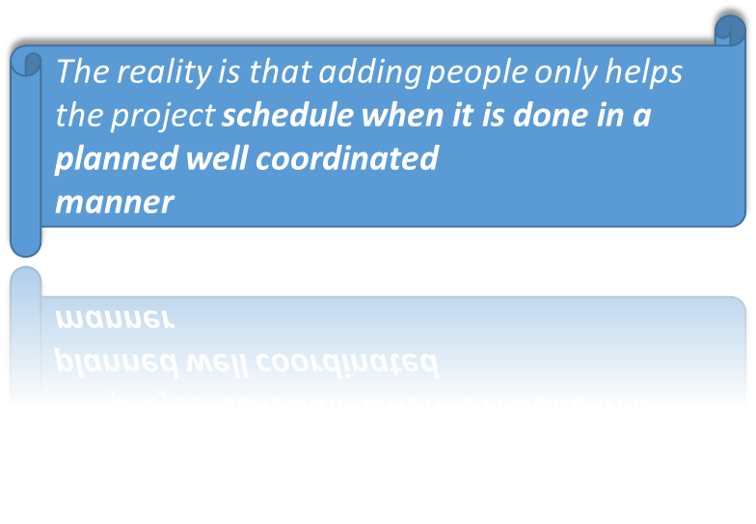
Software Myths
- Adding people is a good way to catch up when a project is behind schedule.

Slide 24
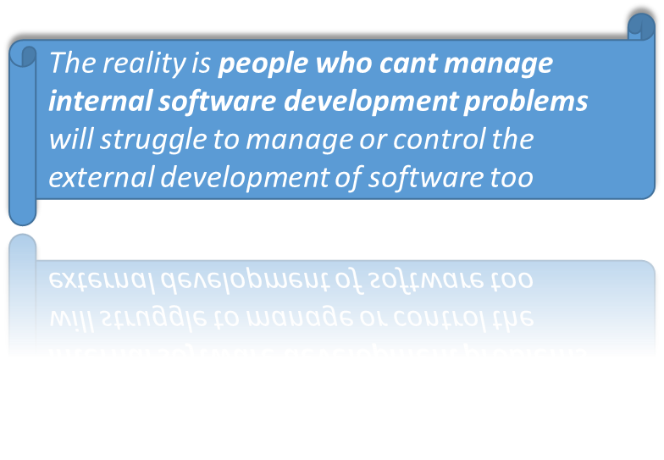
Software Myths:
- Giving software projects to outside parties to develop solves software project management problems.

Slide 25
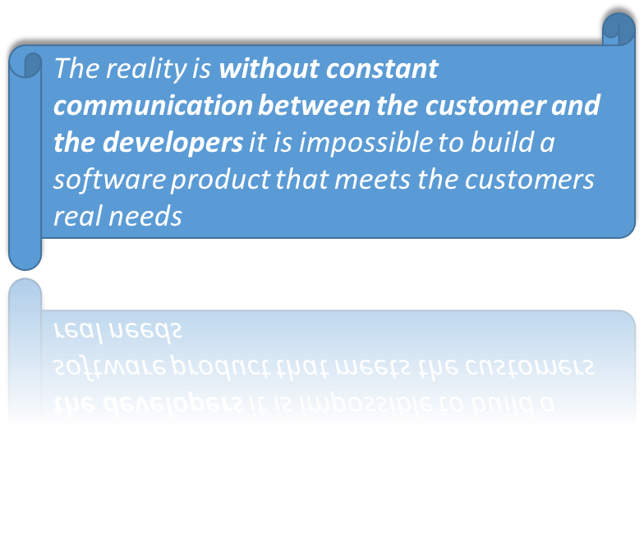
Software Myths:
- A general statement of objectives from the customer is all that is needed to begin a software project.

Slide 26
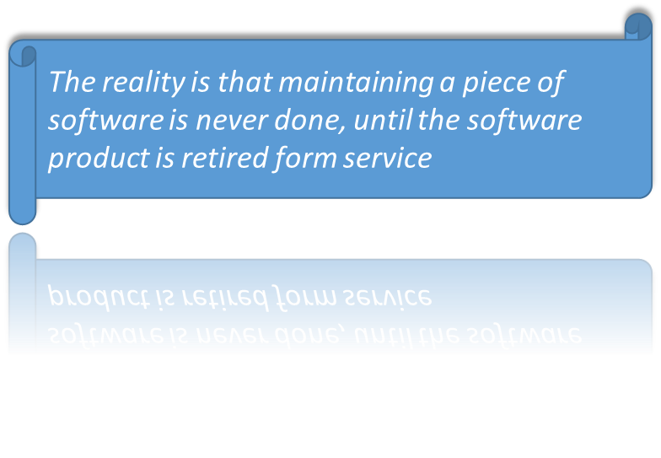
Software Myths:
- Once a program is written , the software engineers work is finished.

Slide 27
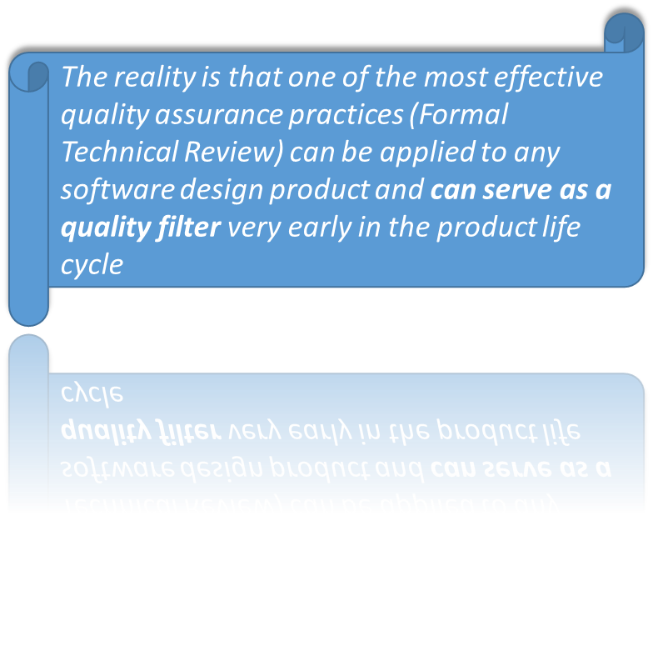
Software Myths:
- There is no way to assess the quality of a piece of software until it is actually running on some machine.

Slide 28

Software Myths:
- The only deliverable from a successful software project is the working program.

Slide 29
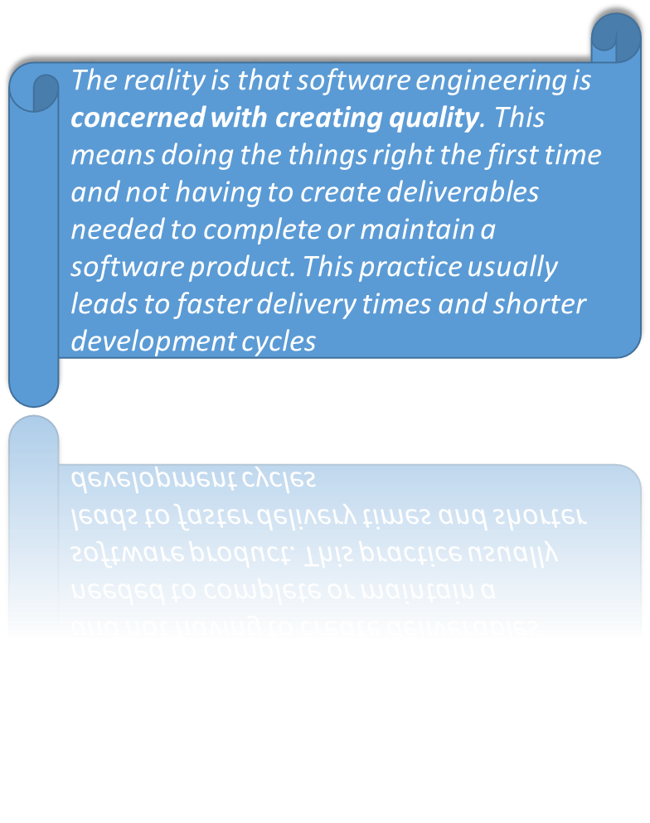
Software Myths:
- Software engineering is all about the creation of large and unnecessary documentation

Slide 30
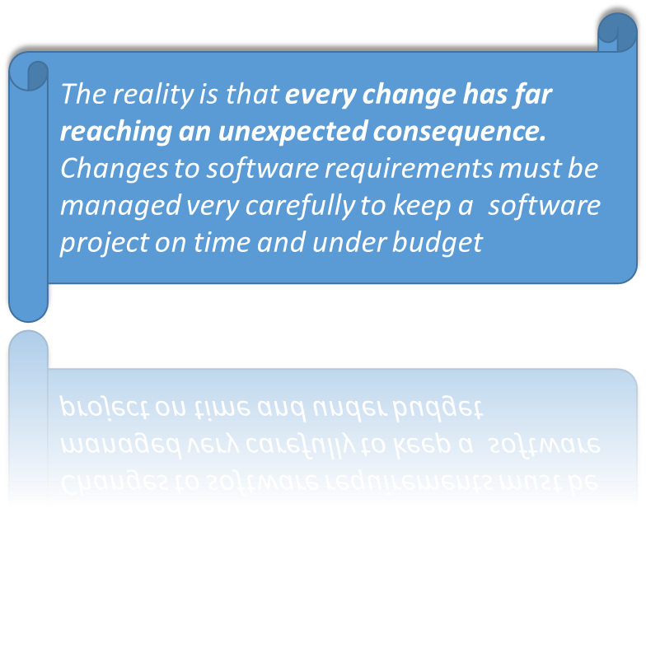
Software Myths:
- Project requirements change continually and change is easy to accommodate in the software design.

