Slide 1
LEGAL CONSULTING MODEL
by
Saurabh Balu Bhosale
21010142
Under the supervision of
Dr. Navanath Saharia

Slide 2
Index
Problem Statement
Solution
Implementation
Web page
Conclusion

Slide 3
Problem Statement
User independency : To equip individuals with the capability to address their legal issues autonomously.
Lack of Legal Literacy : To empower individuals with comprehensive knowledge of their legal and constitutional rights.
Complex Legal Procedures : Indian courts follow specific procedural rules and formalities that individuals representing themselves must adhere to. Without legal training, understanding these procedures can be challenging.
Empowers users with a strategic advantage in legal and constitutional discourse.

Slide 4
Solution
Developing a machine learning (ML) model to comprehend user legal issues and forecast the Indian Penal Code (IPC) sections holds significant promise in enhancing legal assistance services.
This endeavour aims to leverage advanced technology to streamline and optimize the legal consultation process, providing users with tailored and efficient support for their legal predicaments.

Slide 5
Implementation
Developing a legal consulting model leveraging Long Short-Term Memory (LSTM) and Convolutional Neural Network (CNN) architectures signifies a sophisticated approach to legal case analysis and IPC section prediction.
Designed a hybrid neural network architecture combining LSTM and CNN layers to effectively capture both sequential dependencies and spatial patterns within the textual data.
Utilized advanced natural language processing (NLP) techniques to encode textual data into numerical representations, capturing semantic and syntactic features essential for legal case analysis.

Slide 6
Implementation
Procured a comprehensive dataset comprising legal case documents paired with corresponding IPC sections, ensuring representation across diverse legal domains and jurisdictions.
Conducted meticulous data cleaning and pre-processing, including text normalization, punctuation removal, and stop-word elimination, to enhance the quality and consistency of the dataset.
With data cleaning and data augmentation method, it enhanced the dataset and trained a model based on that dataset.

Slide 7
Why LSTM and CNN?
Sequential Data Handling: LSTM is well-suited for handling sequential data, such as text data in legal cases, where the order of words or sentences matters. It can capture long-range dependencies in the data, which is important for understanding legal contexts where certain phrases or clauses may impact the interpretation of laws.
Feature Extraction from Text: CNNs are effective in extracting hierarchical features from input data. In the case of text data, CNNs can be used to identify important patterns or structures within sentences or paragraphs. This is particularly useful in legal texts where specific phrases or terms might indicate the presence of certain legal concepts or sections.

Slide 8
Why LSTM and CNN
Combining Local and Global Information: CNNs are good at capturing local patterns in data, while LSTMs excel at capturing long-range dependencies. By combining both architectures in a model, you can leverage the strengths of each to effectively capture both local and global information from the legal cases, leading to better predictive performance.
Efficient Representation Learning: Both LSTM and CNN layers can automatically learn useful representations of the input data through training. This means that the model can adapt to the characteristics of legal texts without the need for hand-crafted features or extensive preprocessing.

Slide 9
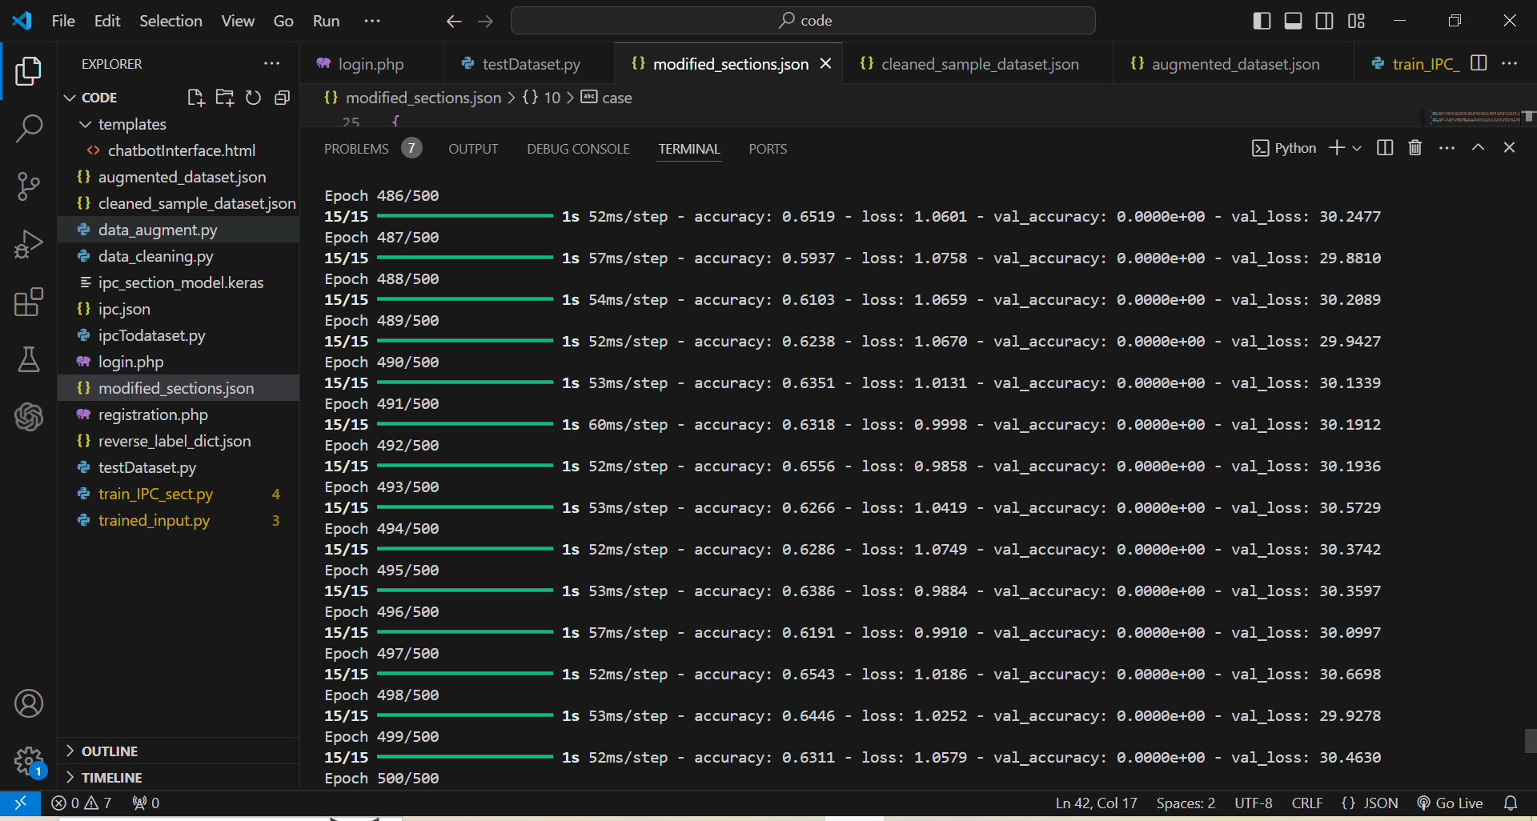
Model Training- Before data cleaning and augmenting, Accuracy- 63

Slide 10
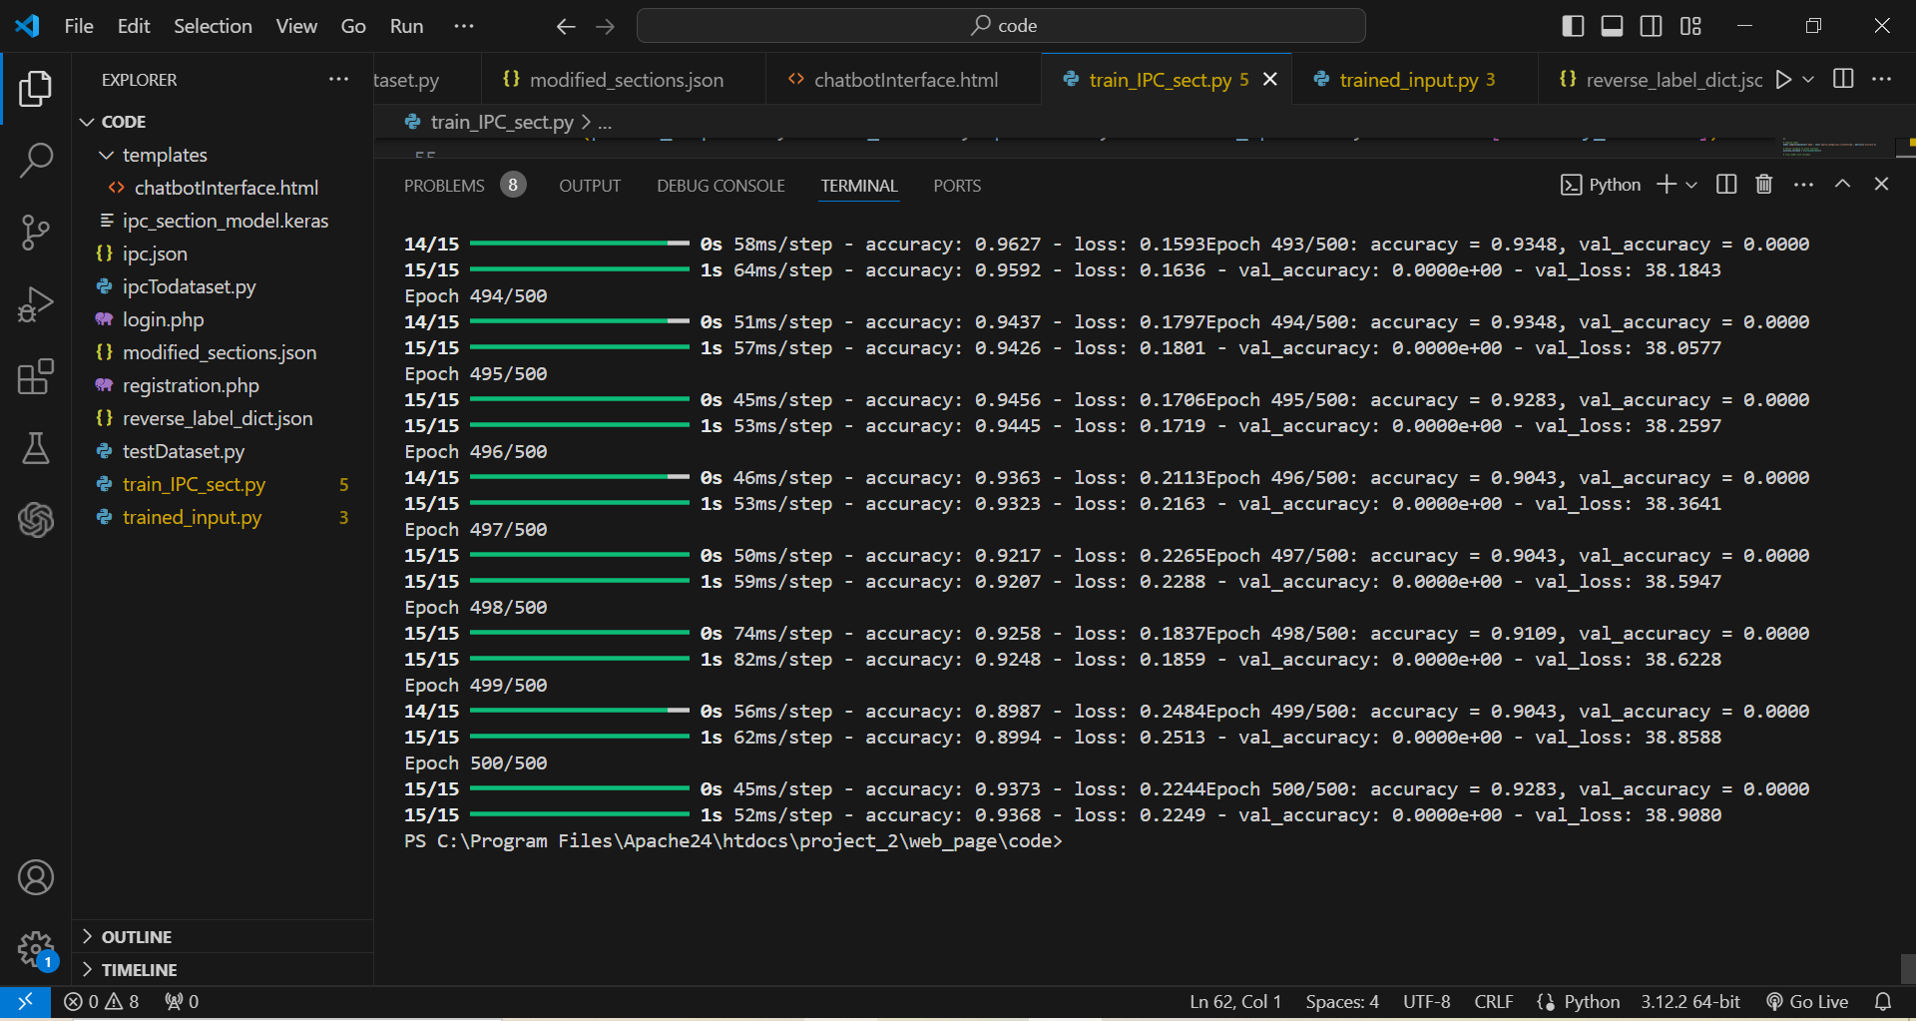
Model Training 2- After data cleaning and augmenting, Accuracy- 93

Slide 11
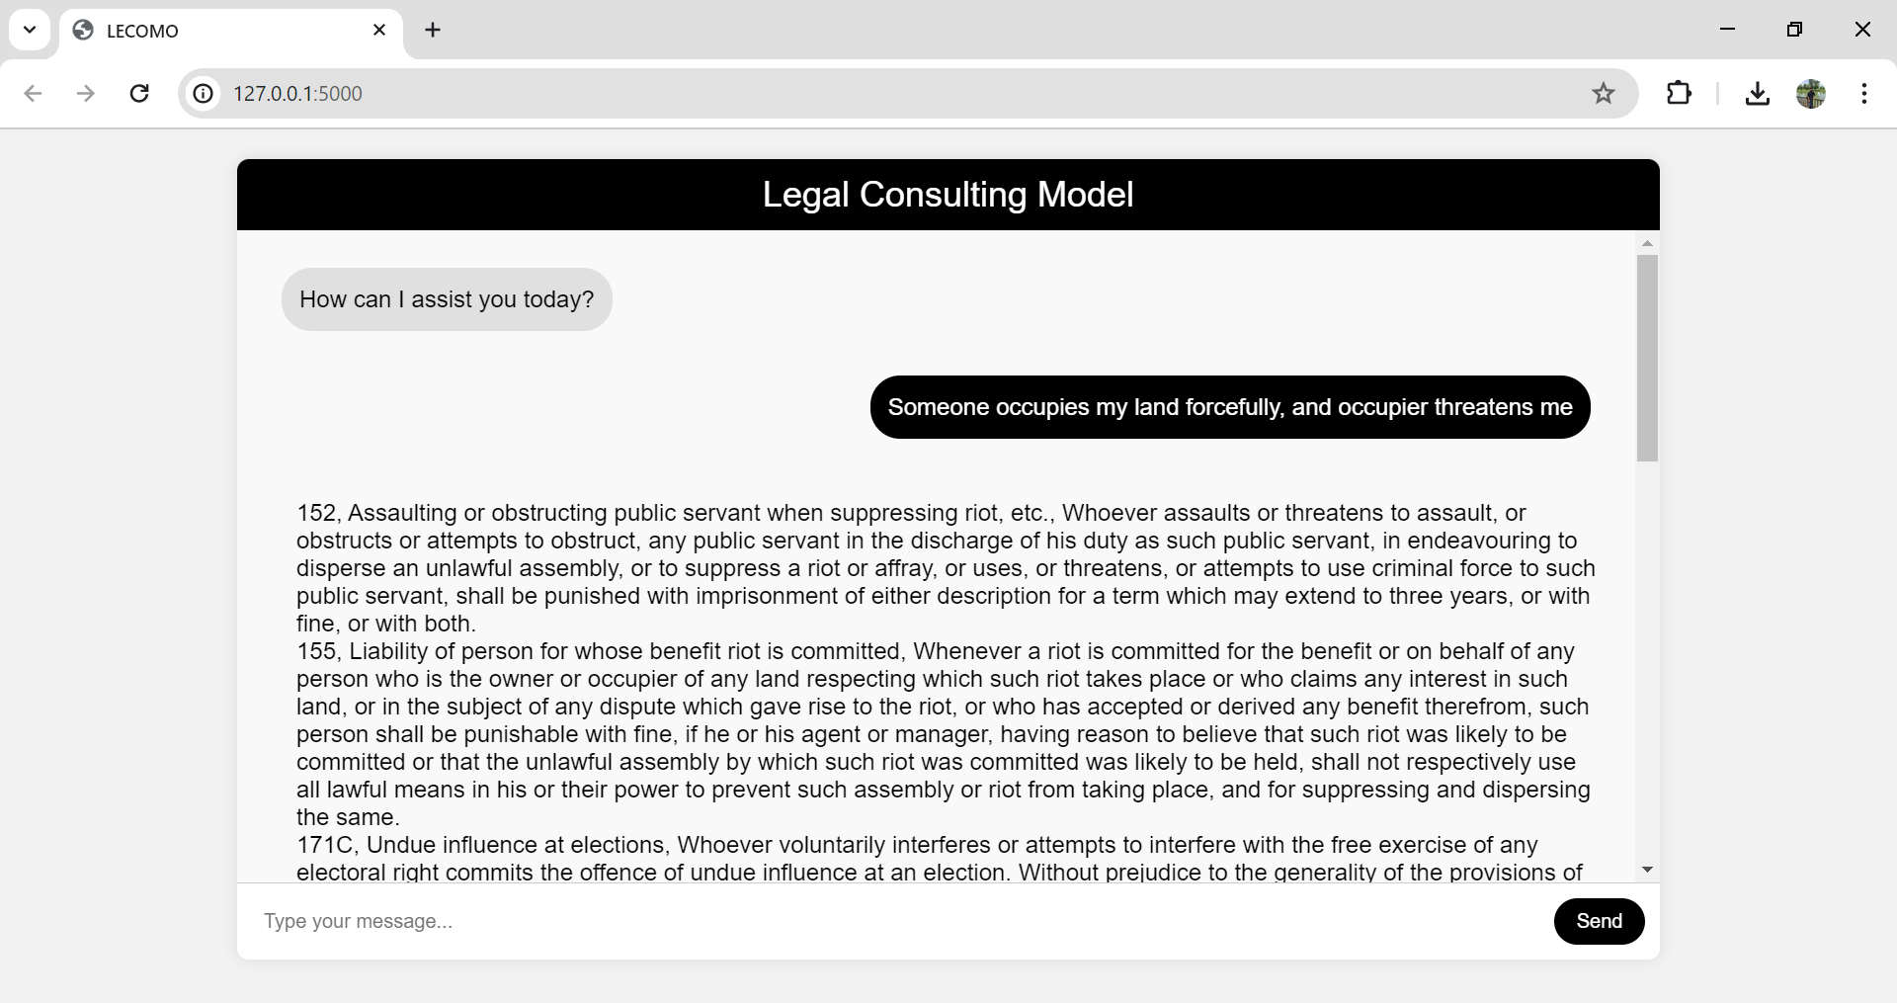

Slide 12
Conclusion
The flaws of the model is that it may show inaccurate and randomized output for non-legal problem/input.
The legal consulting model represents a transformative approach to legal services delivery, empowering individuals and businesses with greater access to legal information, guidance, and support.
By this model aims to revolutionize the legal industry and foster a more equitable and just society. The main use of the project is to provide a platform to users to manage and it suggest their minor legal problems independently.
To literate and aware the user about their own rights and have them a quick suggestion about any legal issue.

