Slide 1
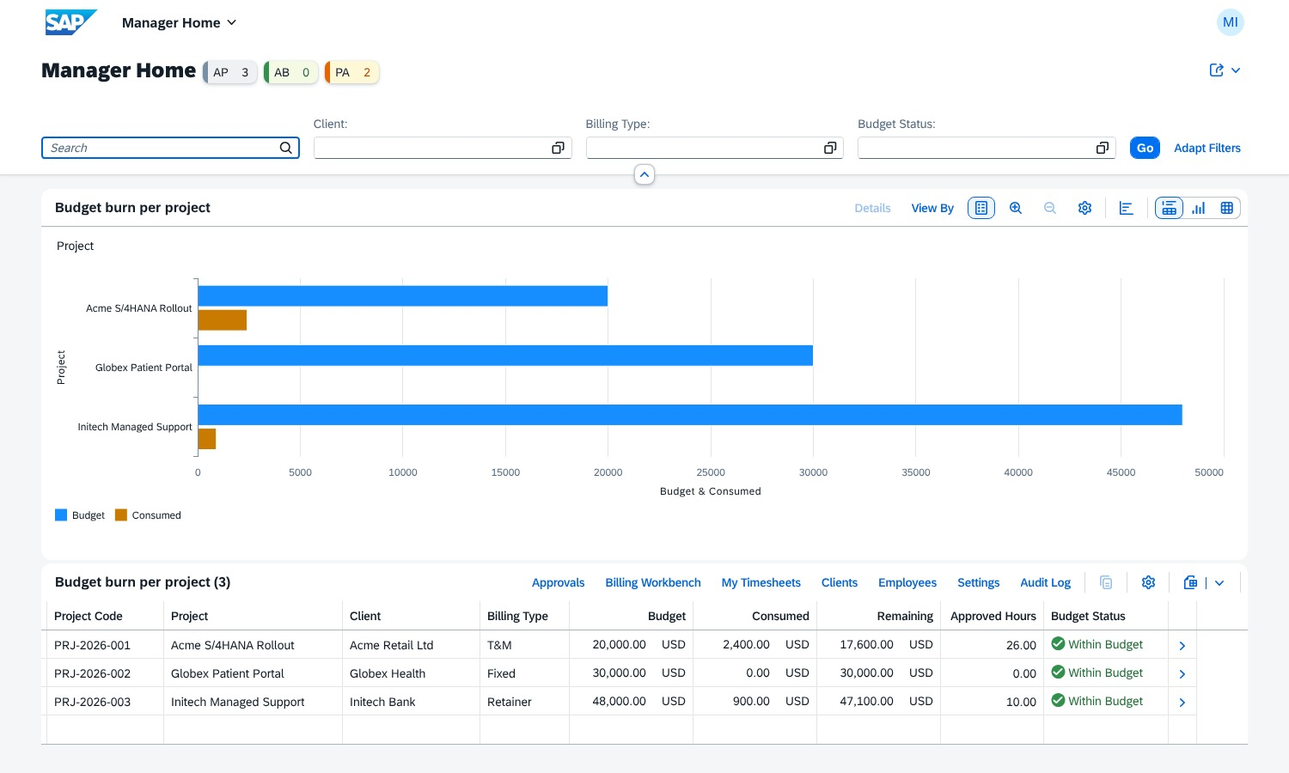
Enterprise PSA
Professional Services Automation on SAP BTP
SAP CAP
HANA Cloud
Fiori Elements
XSUAA
SAP CI/CD
Manager Home – Analytical List Page
Saurabh Pandey · Sprint Evaluation
Notes:
Enterprise PSA: timesheets, budgets and invoices for a services company, built only with SAP technology on the BTP free tier.

Slide 2



Problem → Solution
Scope creep
No real-time tracking
Spreadsheet billing
Tasks burn hours unseen
Budget known at month end
Invoices built by hand
Task burn % and alerts at 75 / 90 / 100 %
Approval rolls up instantly: task → milestone → project → budget
Invoices from approved billable hours: T&M, Fixed, Retainer

Slide 3




Architecture
Fiori Launchpad
Approuter
CAP Node.js
SAP HANA Cloud
9 Fiori Elements apps
XSUAA login · app/
OData V4 · rules · srv/
HDI container · db/
9
41
2
3
Fiori apps
automated tests
roles: Admin, User
languages EN · DE · HI
Only SAP technology · BTP free tier

Slide 4
Data model and project skeleton
Client
Project
Budget (1:1)
Same skeleton as the sample repo
app/
approuter · services.cds · 9 apps
db/
schema.cds · CDSView.cds · i18n
srv/
service.cds · service.js · test.http
root
mta.yaml · xs-security.json · .pipeline
Invoice
Milestone
Alert
Task
Time Entry
master
transaction
Employee
Timesheet

Slide 5
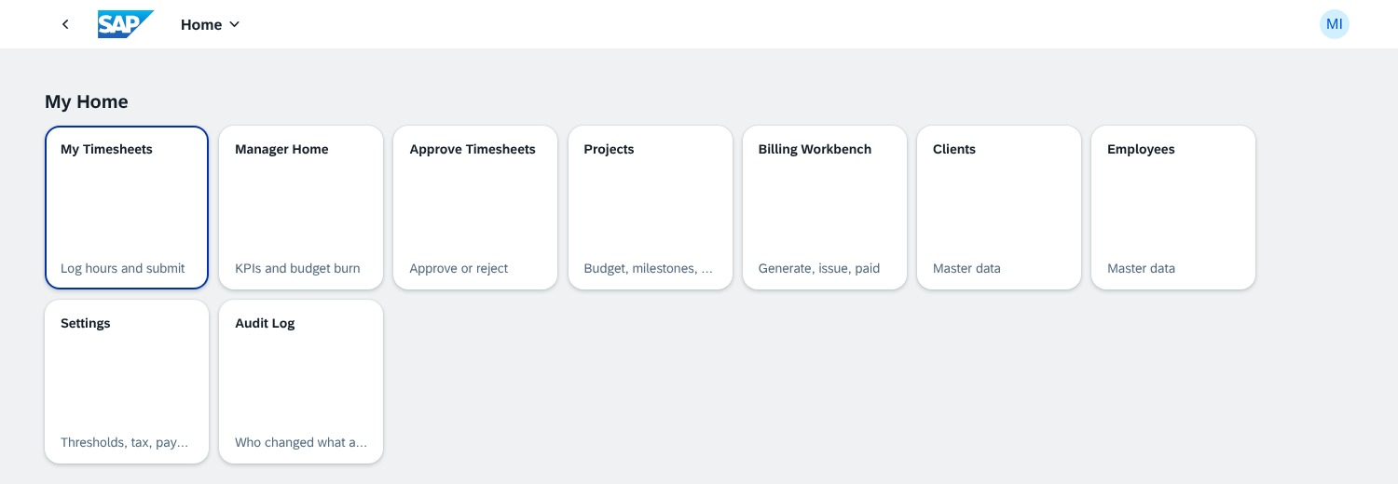
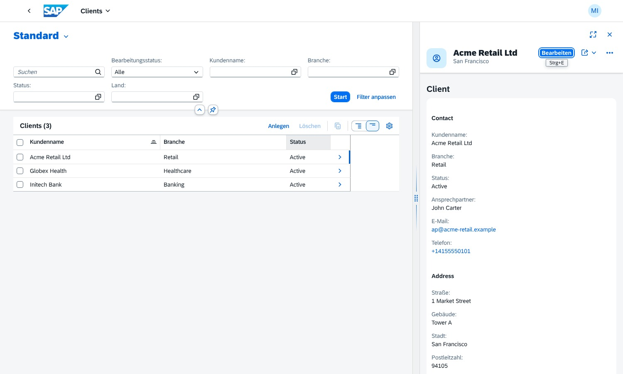
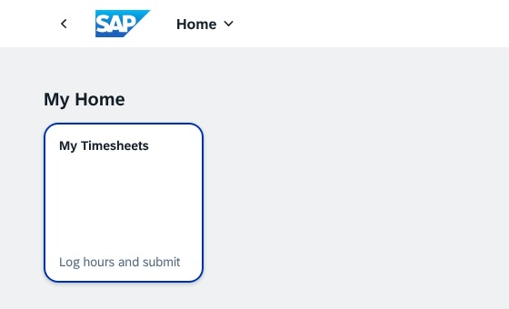
Roles, security and launchpad
XSUAA role collections PSA_Admin / PSA_User
Row-level: own timesheets only ($user)
No self-approval · locked after submit
Admin: 9 apps, starts on Manager Home
User: only My Timesheets
server returns no other data
Labels from db/i18n: EN · DE · HI

Slide 6
Manager Home – Analytical List Page
KPI · Active Projects
KPI · At-Risk Budgets
KPI · Pending Approvals
Chart: budget vs consumed
Filters: client, billing type, status
Row → project details
Buttons to every app

Slide 7
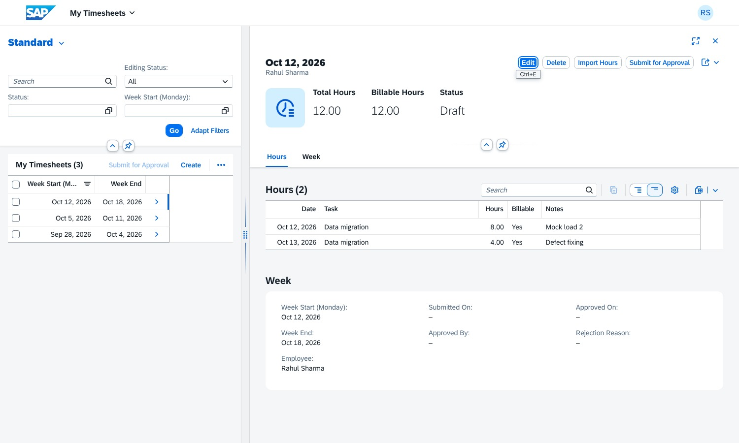
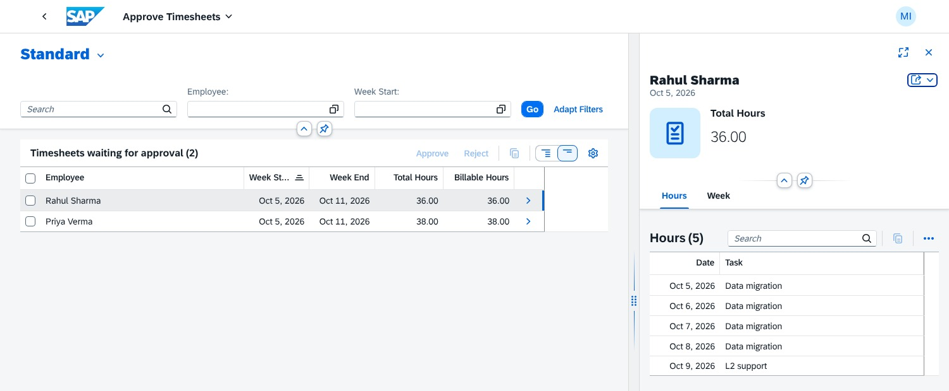
Timesheets → approval → roll-up
Log hours
Submit
Approve
Budget roll-up
Alerts
Admin: bulk Approve · Reject with reason
Hours update task, milestone, project, budget at once
One alert per threshold crossing
User: daily rows, Import Hours, ≤ 24 h/day

Slide 8
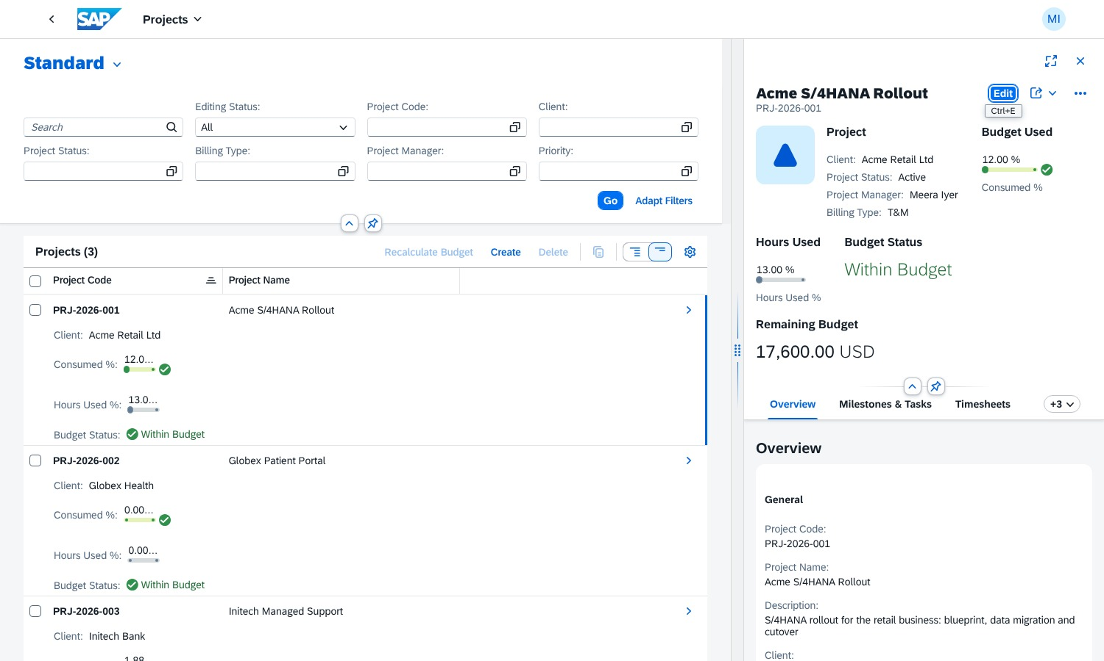
Projects – budget, milestones, tasks
Edit project + budget + milestones + tasks in one draft
Budget used & hours used progress bars
Burn rate and projected completion
Tabs: timesheets, alerts, invoices, change log
Recalculate Budget action
List and details side by side (flexible column layout)

Slide 9
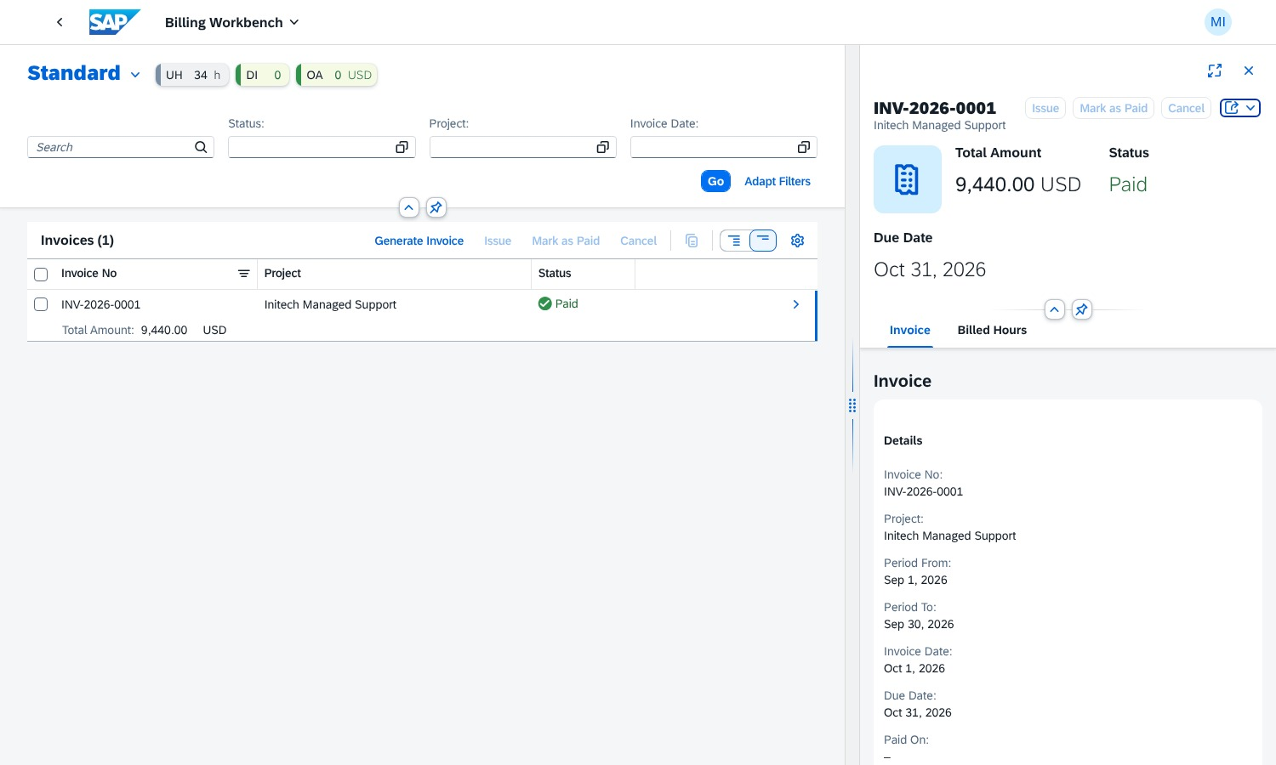
Billing Workbench, settings and audit
Draft
Issued
Paid
Cancel → hours billable again
Overdue = issued and past due
T&M · Fixed (capped) · Retainer
Tax % and payment days in Settings
Every change in the Audit Log
KPIs: Unbilled Hours · Draft Invoices · Overdue Amount

Slide 10





Delivery and CI/CD
Push / merge
SAP CI/CD
mbt build
npm test
cf deploy
to main
webhook job
MTA archive
41 tests
Cloud Foundry
psa-application-ui
psa-application-srv
psa-application-db-deployer
approuter + apps
CAP service · 512 MB
tables + data → HANA
Resources: HANA HDI container · XSUAA (PSA_Admin / PSA_User) · free tier

