Slide 1
CMS Hospital Readmission Prediction
Prepared By: Saurabh Rai

Slide 2
Problem Definition: Fewer Hospital U-turns
Why To Solve:
Use AI methodologies to predict unplanned hospital and Skilled Nursing Facilities admissions and adverse events within 30 days for Medicare beneficiaries
Develop innovative strategies and methodologies to: explain the AI-derived predictions to front-line clinicians and patients to aid in providing appropriate clinical resources to model participants
One in five elderly patients is readmitted to the hospital within 30 days of discharge
CMS penalized over 2,500 hospitals by more than $564 million in 2017 for excessive 30-day hospital readmission rates.

Slide 3
High Level Approach
IDENTIFYING FINAL FEATURES TO KEEP
MODELLING
EXPOSING FINAL MODEL AS FLASK ENDPOINT
OPTIMIZING THRESOLD FOR FINAL MODEL
DATA PREPARATION
DATA PROCESSING PIPELINE

Slide 4
Solution Overview
Selected all the patients that have at least one inpatient claim for ‘Disease of Circulatory System’ category.
Calculated whether the selected patients have been readmitted or not using the inpatient claim dataset.
Calculated the number of outpatient claims for the patients between the discharge date and the next admission date.
Merging the patient demographic details with its inpatient claim details to create final dataframe for modelling.
Creating model & and exposing the endpoints of the best performing one using flask API.

Slide 5
Data Preparation Steps
Inpatient Claims
Disease Selection (Disease of Circulatory System).
Target Generation
Outpatient Claims
Visit Calculation
Beneficiary Summary
Age Calculation
Merging Beneficiary Summary with Inpatient claims
Merging Visits with Inpatient Claims
EDA – Continuous Variables
High Correlation between few variables.
No obvious / visible trend in features w.r.t outcome
EDA – Categorical Variables
ChiSquare Test revels all the features important for prediction
Crammer’s V indicates that strength of association is not much high
Removing columns with more than 60% NaN
Highly skewed distribution
Class imbalance in Target variable (Majority Class : 87% & Minority Class : 13%)
Categorize ICD9 Diagnosis Code and Procedure Code into Groups.

Slide 6
EDA – Summary – Categorical Variables
Features | Categories | IsReadmitted (0) | Not Readmitted (1)
BENE_SEX_IDENT_CD | Female | 0.87 | 0.13
 | Male | 0.87 | 0.13
BENE_RACE_CD | White | 0.87 | 0.13
 | Black | 0.86 | 0.14
 | Others | 0.88 | 0.12
 | Hispanic | 0.87 | 0.13
BENE_ESRD_IND | 0 | 0.89 | 0.11
 | Yes | 0.80 | 0.20
SP_ALZHDMTA | 1 | 0.83 | 0.17
 | 2 | 0.91 | 0.09
SP_CHF | 1 | 0.84 | 0.16
 | 2 | 0.95 | 0.05
SP_CHRNKIDN | 1 | 0.82 | 0.18
 | 2 | 0.94 | 0.06
SP_CNCR | 1 | 0.82 | 0.18
 | 2 | 0.88 | 0.12
SP_COPD | 1 | 0.81 | 0.19
 | 2 | 0.92 | 0.08
SP_DEPRESSN | 1 | 0.84 | 0.16
 | 2 | 0.90 | 0.10
SP_DIABETES | 1 | 0.85 | 0.15
 | 2 | 0.94 | 0.06
No strong association strength between Categorical Variables and the Target.
Cramer’s V plot in the next slide
Detailed EDA available on EDA dashboard

Slide 7
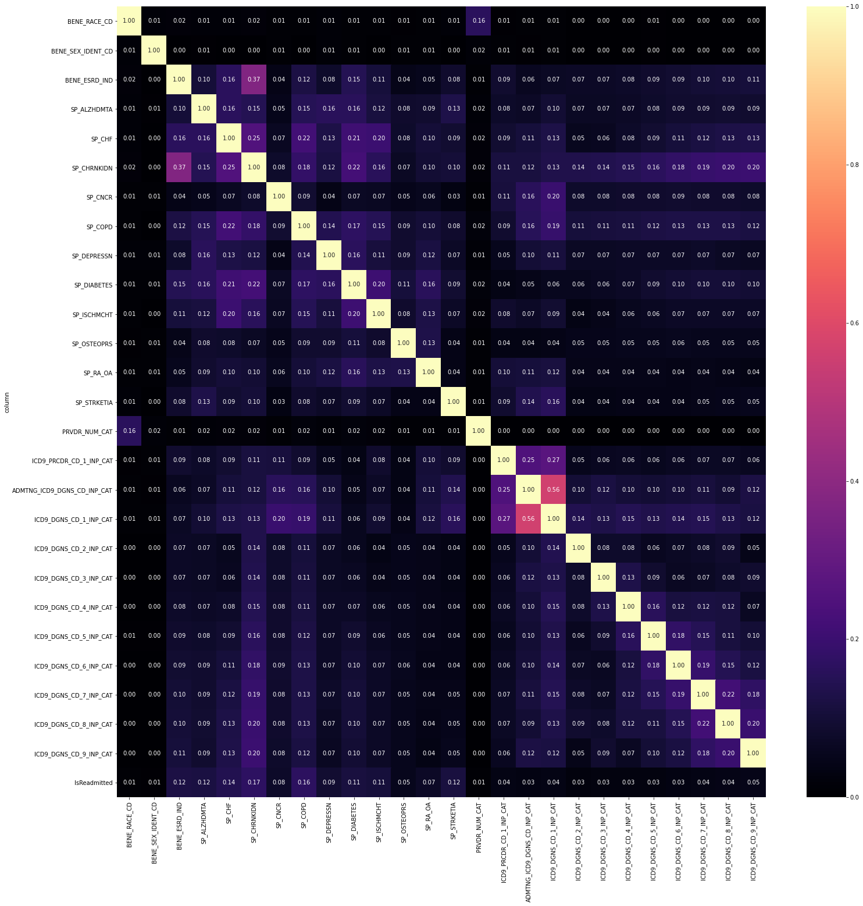

Slide 8
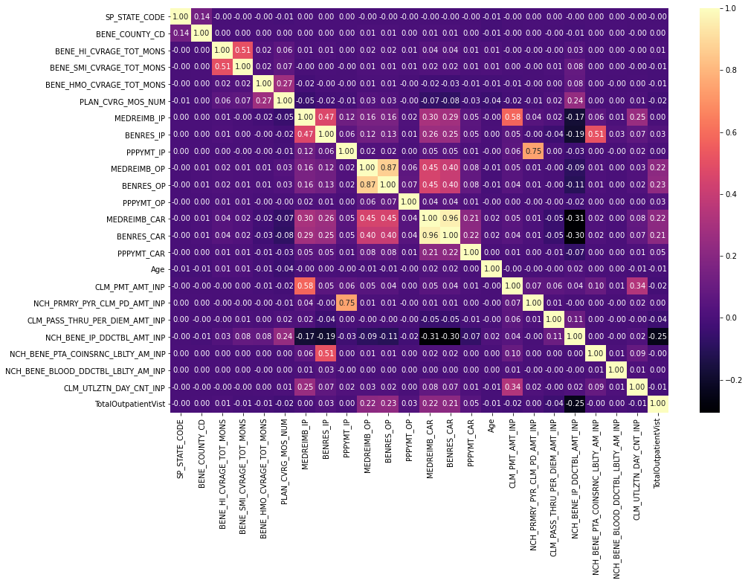
EDA – Summary – Continuous Variables
High correlation between following pairs :-
'BENRES_OP', 'MEDREIMB_OP’
'NCH_PRMRY_PYR_CLM_PD_AMT_INP', PPPYMT_IP
'BENRES_CAR', 'MEDREIMB_CAR’
Detailed EDA available on EDA Dashboard

Slide 9
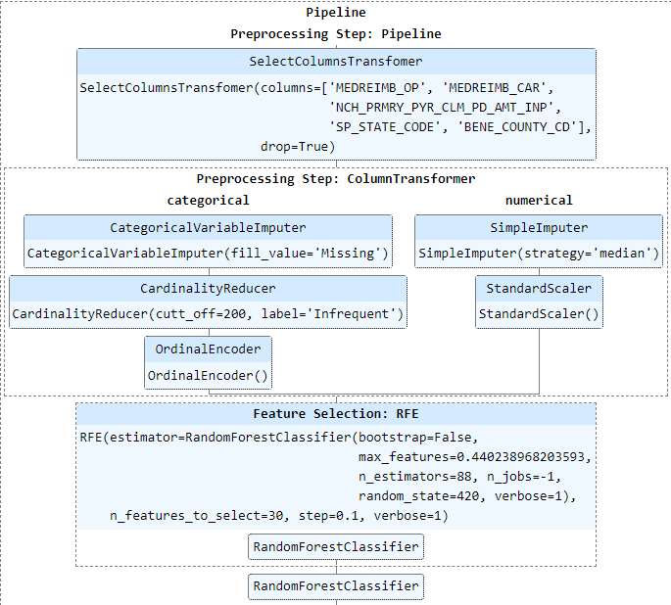
Machine Learning Pipeline :

Slide 10
Machine Learning Pipeline Steps:
Column Selection
Data Cleaning for Numerical Variables
Data Cleaning for Categorical Variables
Class Balancing
Feature Selection
-Select or drop required features
- One feature from the pair of correlated features is dropped in this stage
Impute missing values with median
Scale the numerical features using standard scalar
Impute missing values with a string
Merge categories having less than or equal to specified count.
Perform onehot encoding or ordinal encoding as required
- Use SMOTE or Randomoversampling to balance the class in Target
- RFE to select features based on co-efficient or feature importance from the specified alogirthm

Slide 11




Model & Performance
Model | Feature Selection | Class Balancing | Metrics
Logistic Regression | - | -
Decision Trees | RFE(20) | No
Decision Trees | RFE(20) | RandomOversampling
Random Forest | RFE(30) | No
Random Forest | RFE(30) | RandomOversampling

Slide 12




Model & Performance (continued…)
Model | Feature Selection | Class Balancing | Metrics
Decision Trees | No | No
Decision Trees | No | RandomOversampling
Random Forest | No | No
Random Forest | No | RandomOversampling

Slide 13



Model & Performance (continued…)
Model | Feature Selection | Class Balancing | Metrics
ExtraTrees | RFE(30) | No
ExtraTrees | No | No
ExtraTrees | No | RandomOversampling

Slide 14
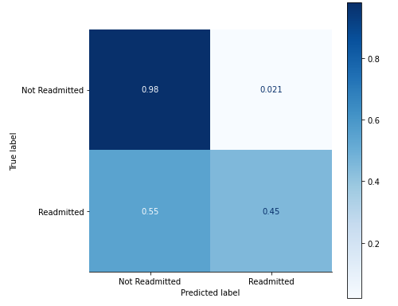
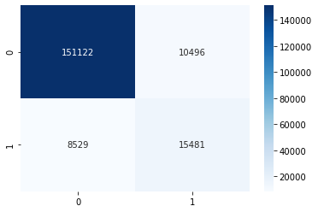
Final Model
Random Forest:
RESULTS:
After selecting Threshold=0.341, we get F1-Score=0.61940, Precision=0.595950263694807, Recall=0.6447730112453145

Slide 15
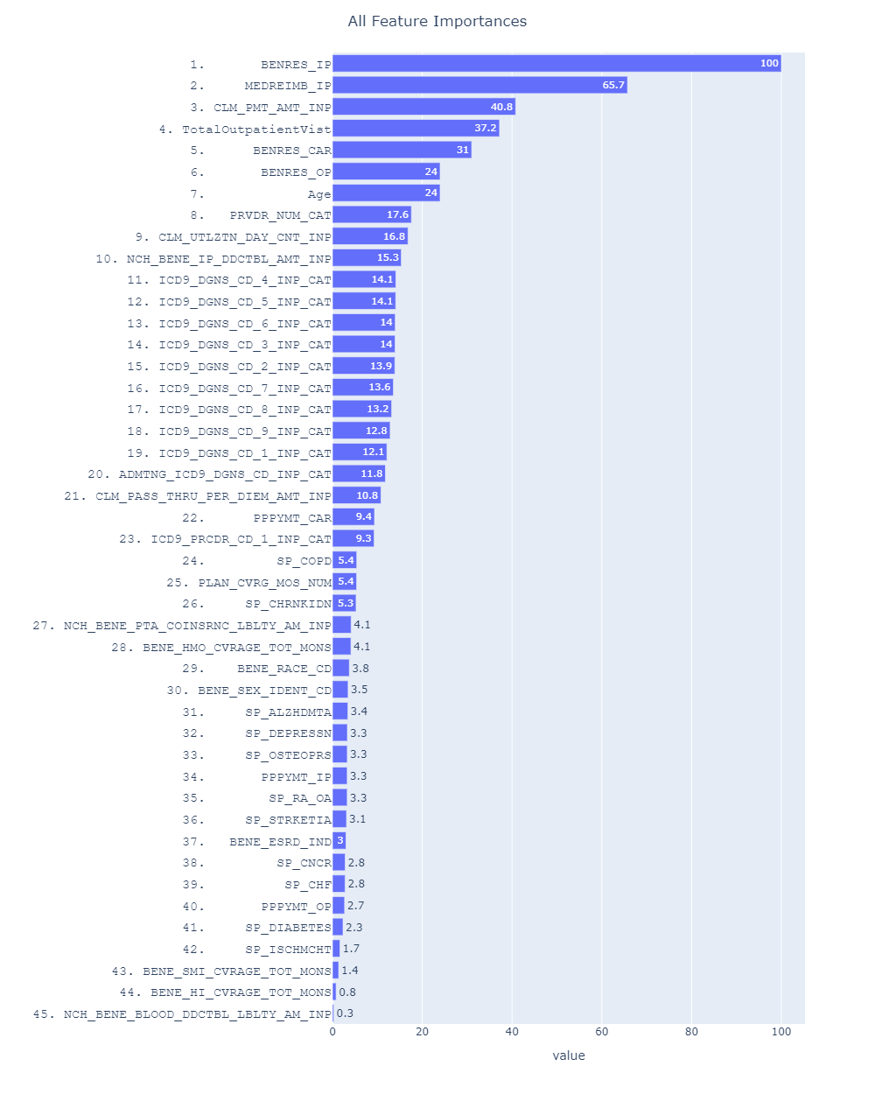
Final Model (Feature Importance)
Random Forest:

Slide 16
What could have been better
Need more realistic data (current data has synthetic elements)
Need data related to patient condition during hospitalization e.g. Oxygen levels, medicines taken, blood pressure, etc.
Infrastructure wise, having more computation power could have helped in implementing advanced oversampling techniques like SMOTE, SMOTEEN and other algorithms like Gradient Boosting, Neural Network, etc.

Slide 17
Thank you

