Slide 1















555G
INVOICE IQ
Team Members:
Saurabh Chauhan (UIN =669573191)
Harsh Khatri (UIN = 657600128)

Slide 2

INTRODUCTION
The aim of the project is to efficiently identify and classify elements within invoice using SpaCy's Named Entity Recognition (NER) approach. Specifically, the objective is to extract information from Invoice PDFs and accurately recognize key details such as invoice numbers, dates, and other relevant aspects.

Slide 3
Doccano is an open source text annotation tool. It can be used to create labeled datasets for: Text classification. Entity extraction.
01.
Doccano
Technologies Used
02.
Docker
Docker is an open-source containerization platform
Spacy
spaCy is a free, open-source Python library that's used for advanced natural language processing (NLP).
03.
TKinter
Tkinter is a Python library that can be used to construct basic graphical user interface (GUI) applications.
04.

Slide 4

Methodology
We explored invoice PDF data on platforms like Hugging Face, Kaggle.
Annotated Invoice pdf entities using Doccano.
Used transformer model for NER to train annotated data.
Created UI using TKinter for user to upload invoice pdf and detect invoice entities.

Slide 5
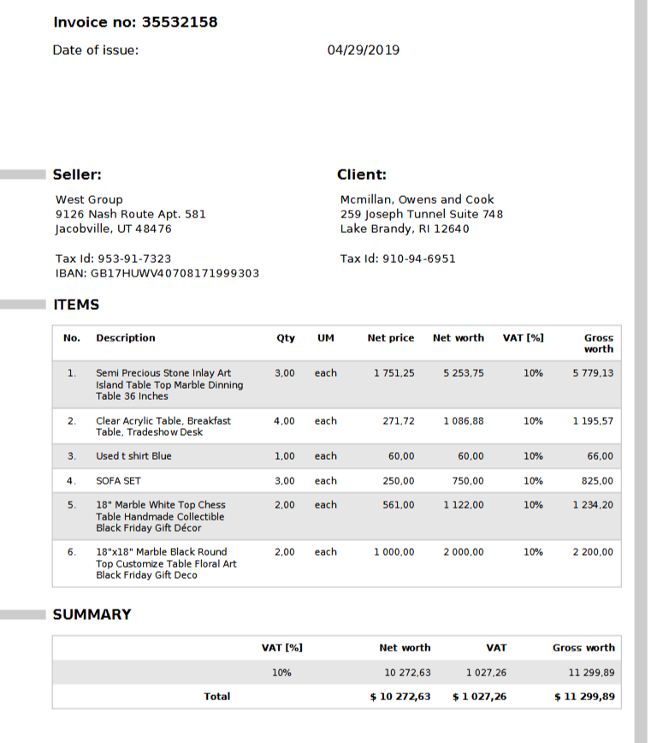
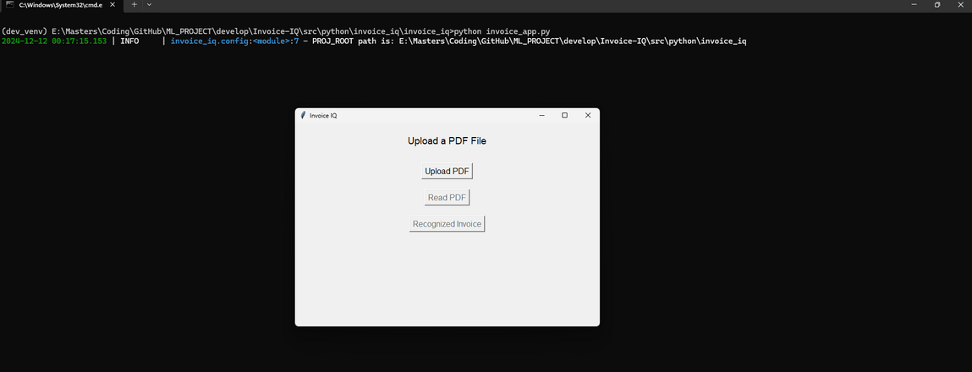
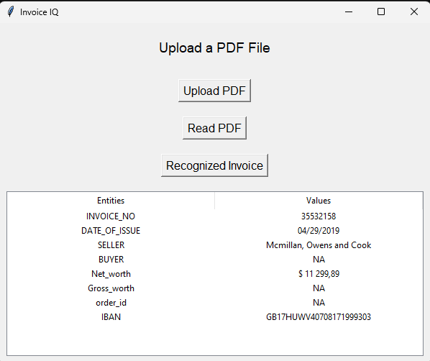
Project Screenshots

Slide 6

Features
Model detects 7 to 8 parameters such as : INVOICE_NO, DATE_OF_ISSUE, SELLER, BUYER, order_id, Net_worth, Gross_worth, and IBAN.
Model Accuracy : 95%
Model has been trained on 3 performance perameter
ents_p
ents_r
ents_f

Slide 7
95%
Accuracy

Slide 8

Conclusion
Implementing AI for tailored use cases, such as invoice processing, significantly enhances user efficiency.
Future advancements in training for broader real-world applications can be achieved using Amazon Sage Maker's automated annotation capabilities.
Leveraging a transformer-based model, the Invoice IQ system successfully boosted invoice data extraction accuracy from 62% to an impressive 95%.
Efficiency was further optimized through GPU acceleration, highlighting the critical role of advanced models and continuous refinement for practical deployment.
This project exemplifies the application of supervised machine learning in solving real-world challenges.

Slide 9
Thank you very much!

