Slide 1
Web Services Term Project
By Saurabh Pathak

Slide 2
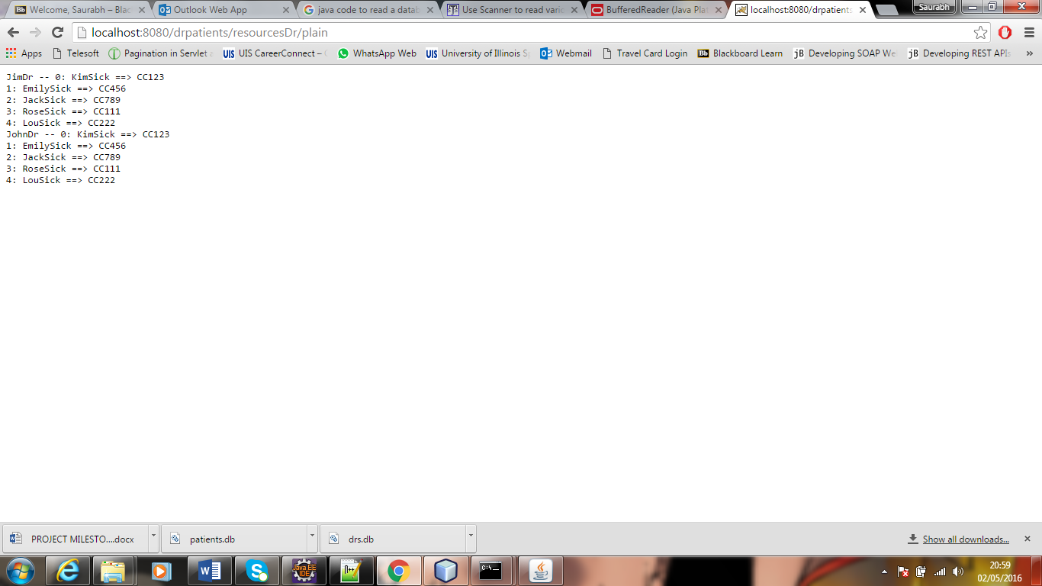
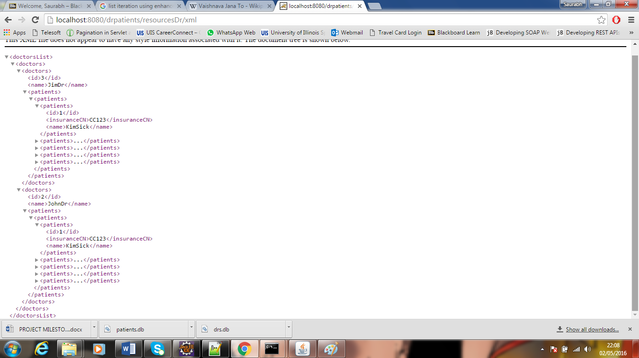
GET List of Doctors in XML & Plain Text

Slide 3
Code Getting Used To Show This
@GET
@Path("/xml/{id: \\d+}")
@Produces({MediaType.APPLICATION_XML}) // could use "application/xml" instead
public Response getXml(@PathParam("id") int id) {
checkContext();
return toRequestedType(id, "application/xml");
}

Slide 4
Code Getting Used To Show This
@GET
@Path("/plain")
@Produces({MediaType.TEXT_PLAIN})
public String getPlain() {
checkContext();
return dlist.toString();
}

Slide 5
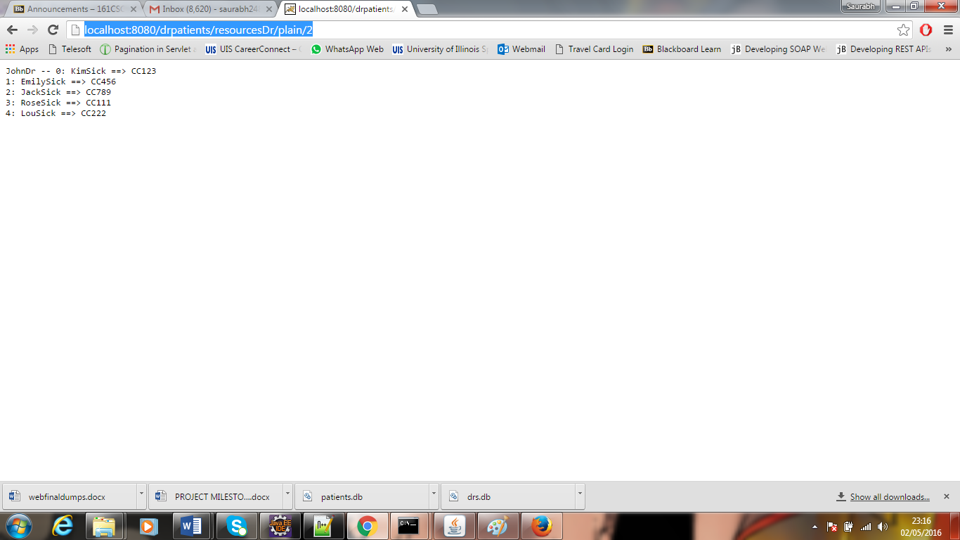
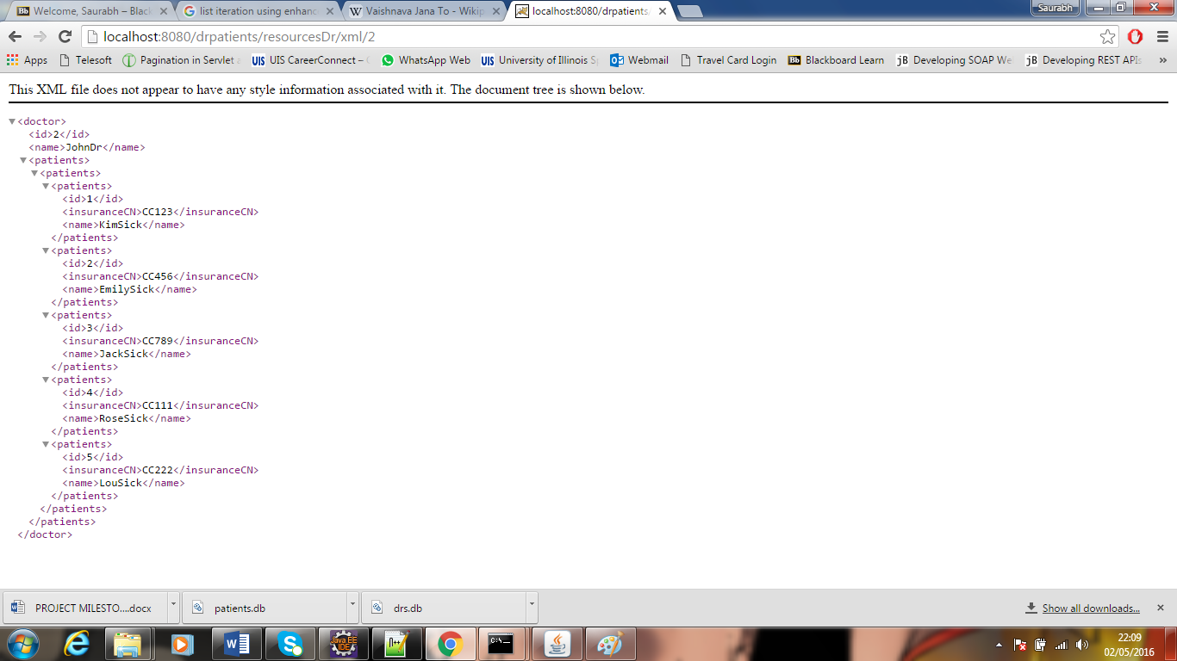
GET an Individual Doctor and Its Patients In XML & Plain

Slide 6
Code Getting Used To Show This
@GET
@Path("/plain/{id: \\d+}")
@Produces({MediaType.TEXT_PLAIN})
public String getPlain(@PathParam("id") int id) {
checkContext();
Doctor doctor = dlist.find(id);
return doctor.toString();
}

Slide 7
Code Getting Used To Show This
@GET
@Path("/xml/{id: \\d+}")
@Produces({MediaType.APPLICATION_XML}) // could use "application/xml" instead
public Response getXml(@PathParam("id") int id) {
checkContext();
return toRequestedType(id, "application/xml");
}

Slide 8
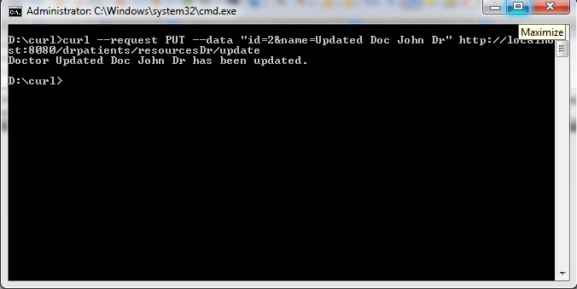
Update Doctor CURL

Slide 9
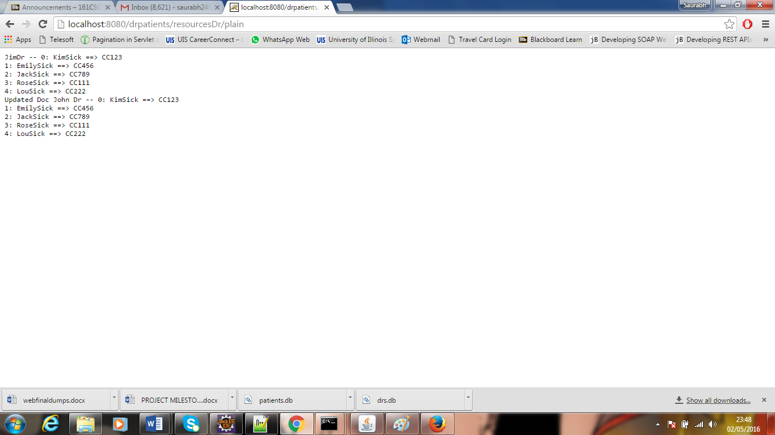
Update Doctor Result

Slide 10
Code To Perform This
@PUT
@Produces({MediaType.TEXT_PLAIN})
@Path("/update")
public Response update(@FormParam("id") int id,
@FormParam("name") String name) {
checkContext();
// not added complete business logic here in slides
return Response.ok(msg, "text/plain").build();
}

Slide 11
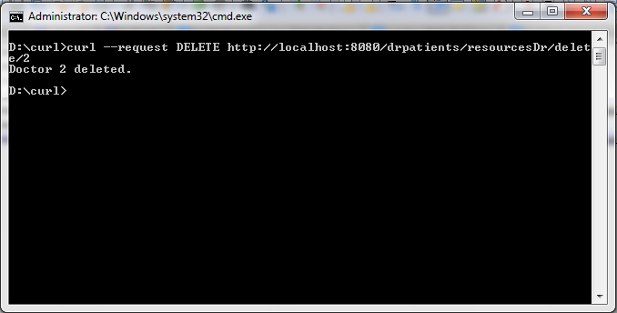
Delete Doctor CURL

Slide 12
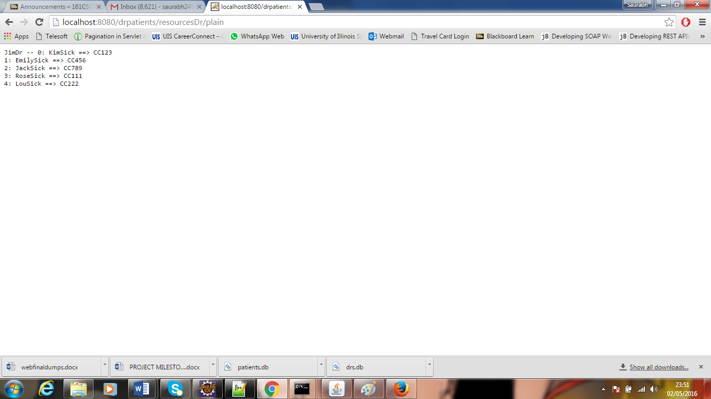
Delete Doctor Result

Slide 13
Code To Perform This
@DELETE
@Produces({MediaType.TEXT_PLAIN})
@Path("/delete/{id: \\d+}")
public Response delete(@PathParam("id") int id) {
checkContext();
String msg = null;
// not added complete business logic here in slides
return Response.ok(msg, "text/plain").build();
}

Slide 14
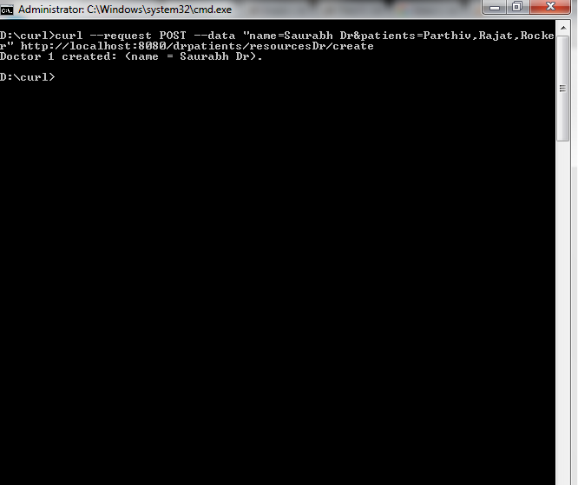
Add a Doctor and Its Patients CURL

Slide 15
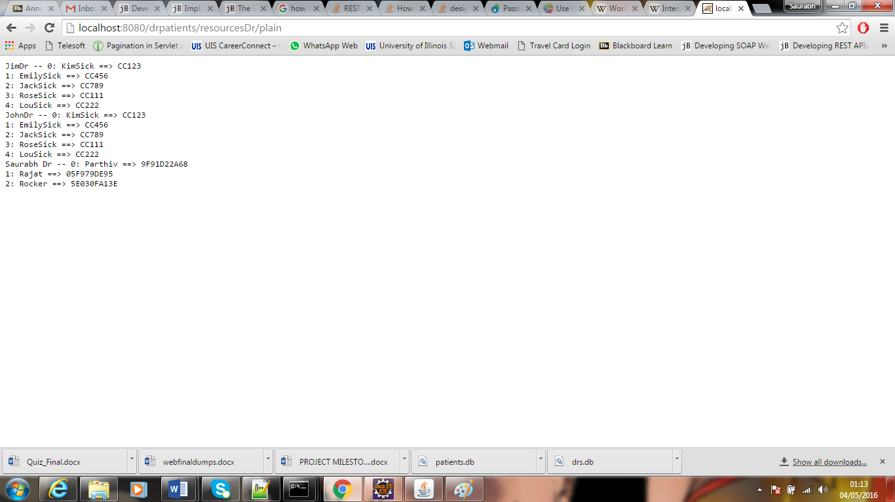
Add a Doctor and Its Patients Result

Slide 16
Code To Perform This
@POST
@Produces({MediaType.TEXT_PLAIN})
@Path("/create")
public Response create(@FormParam("name") String name, @FormParam("patients") String patientNames) {
checkContext();
// not added complete business logic here in slides
}

