Slide 1
CLUSTERING

Slide 2
To Cluster Related Technologies
Algorithm: Hierarchical agglomerative clustering
Similarity Matrix: Carmer's V
Distance Measure: Ward Method

Slide 3
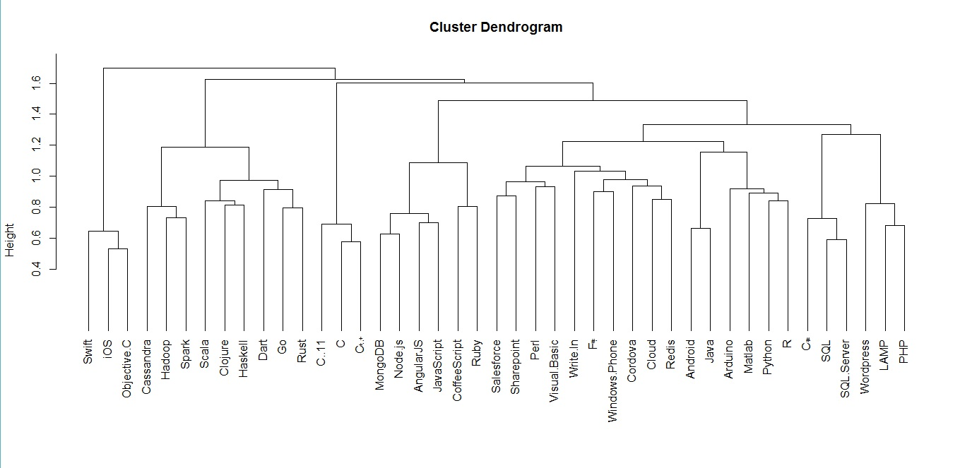

Slide 4
To Form Community of related Users
Country
Age
Technology
Occupation
Experience
Industry
Employement Status

Slide 5
Algorithm: Partitioning Around Medoids
Distance Measure: Gower Distance

Slide 6
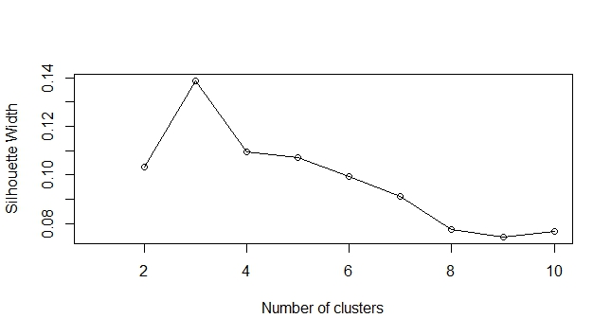
Selecting the number of clusters-silhouette width

Slide 7
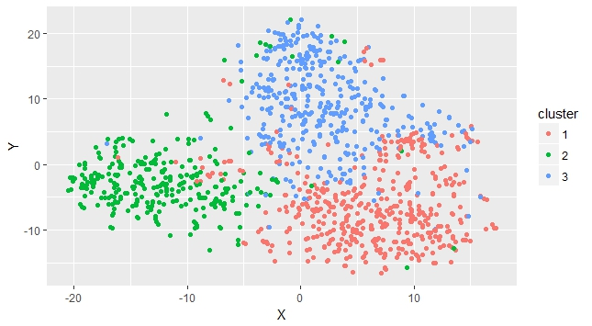

Slide 8
CLASSIFICATION

Slide 9
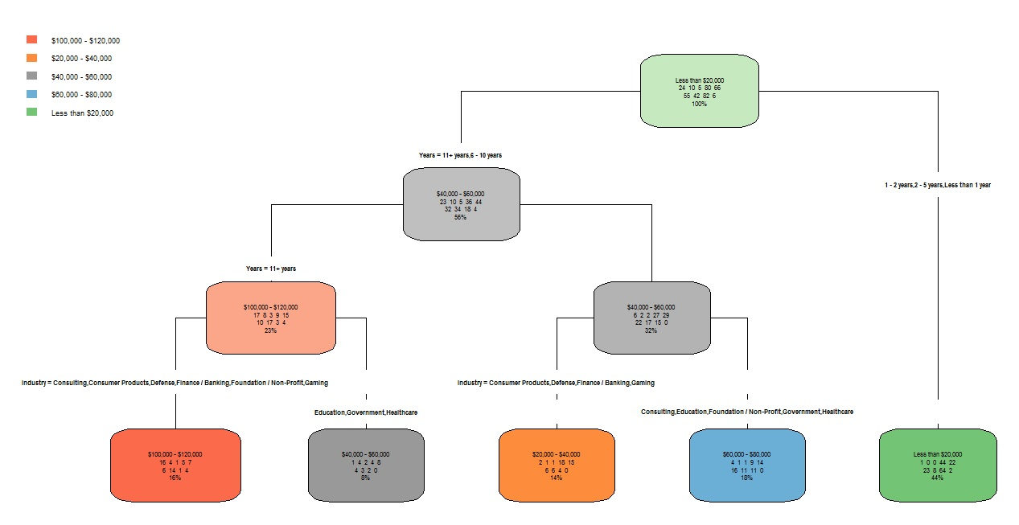

Slide 10
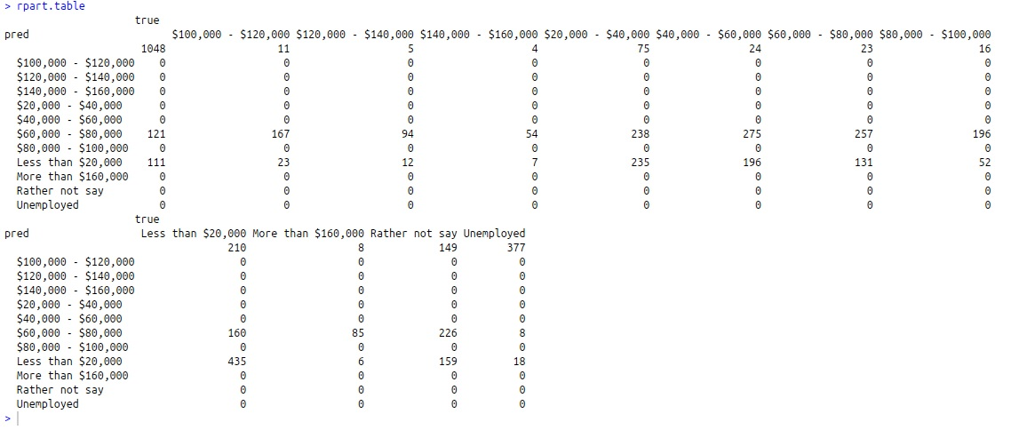

Slide 11
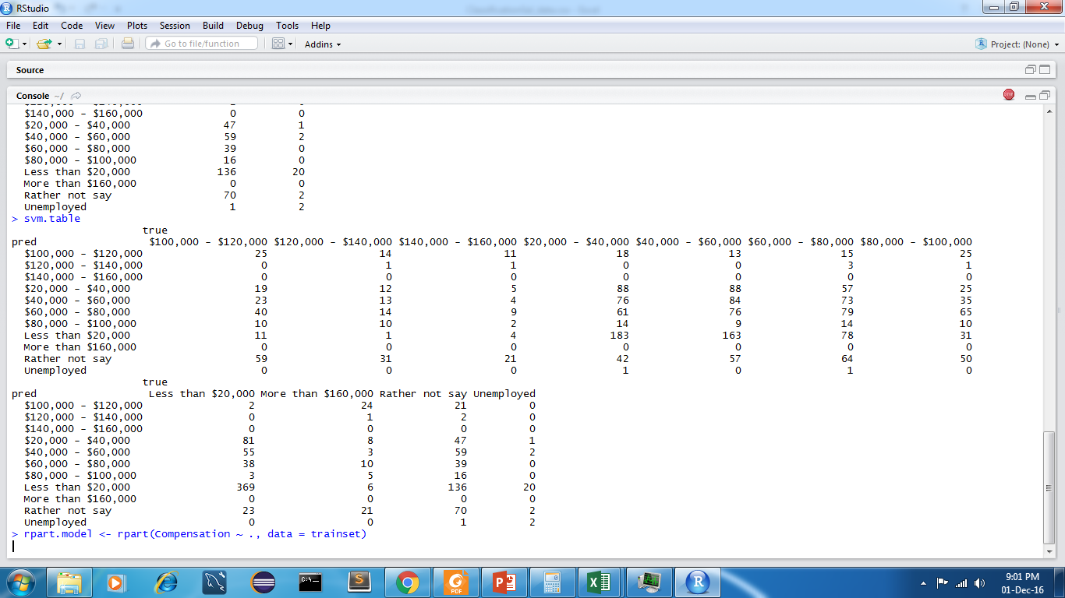

Slide 12
Association Rule Mining
{Country=United States, Age=35-39, Job.Satisfaction=I love my job}=> {Open.to.new.job.opportunities=I am not interested in other job opportunities} 0.008213985 0.6763006 2.146919 -Which kinda people are generally not interested in new job opportunities
{Compensation=More than $160,000, Industry=Finance / Banking} => {Exp=11+ years} 0.005288917 0.8375000 2.835235 -If you earn more than $160,000 in Finance, you better must be quite experienced
{Compensation=More than $160,000, Industry=Consulting, Job.Satisfaction=I love my job} => {Employment.Status=Freelance / Contractor} 0.001301448 0.8000000 7.200000 -Which people tend to get into freelancing

Slide 13
Association Rule Mining
{Exp=Less than 1 year, Country=India, Industry=Software Products} => {Compensation=Less than $20,000} 0.006630881 0.8155340 3.872258 -New Indians in Software products? You earn less than 20K! (I am 81% confident!!)
{Country=Finland, Occupation=Full-stack web developer, Compensation=$40,000 - $60,000} => {Prgm.Hours=1-2 hours per week} 0.001057426 0.6190476 2.954414 -where do I best fit if I don’t like Programming.

Slide 14
Association Rule Mining
{Years=11+ years, Employment.Status=Other} => {Job.Satisfaction=I love my job} 0.003009598 0.7254902 2.120080 -Experienced freelancers tend to love their jobs
{Employment.Status=Freelance / Contractor, Industry=Gaming} => {Prgm.Hours=20+ hours per week} 0.001057426 0.3421053 4.571568 -Code-aholic? Freelancing in Gaming!!

Slide 15
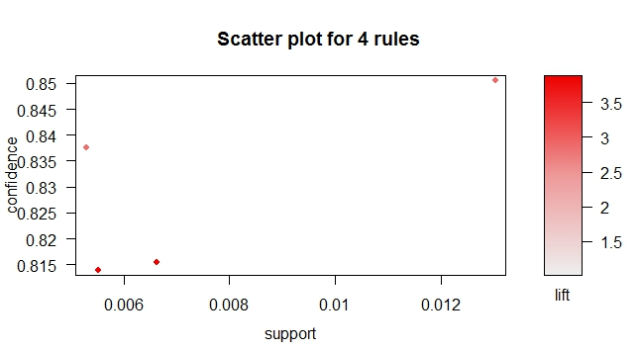
Scatter Plot for Association Rules

Slide 16
Rule Mining- More Ideas
If your current technologies of expertize are specified in LHS, which industry/ occupation will you tend to enter. (Be Confident, you have all the Support to get a Lift in your career!!! ☺)

