Slide 1
A Study On Evaluation Of Browser Performances Of Single Page Application Frameworks
PRESENTED BY – SAURABH B. Devade (10531140)
GUIDE – DR. SHaZIA AFZAL

Slide 2

BACKGROUND HISTORY
worked as a software developer for more than 2 years I know the importance of Frameworks in building software.
I have always been fascinated by the software & in the future, I would like to pursue a software developer as my career.

Slide 3

INTRODUCTION
The importance of the website has increased a lot over the years, due to the availability of the internet and cheaper technologies.
Therefore new websites get created every day for countless reasons.

Slide 4

PRIOR APPROACH FOR BUILDING WBSITES
The older multi-page approach has become inadequate to support the needs of today’s web applications In terms of Speed, Interactivity, User Experience, Latency, etc.
Disadvantages of Multi-page approach
Reload on every click.
Coding each page separately.
Wastage of resources.
Front-end & back-end is tightly coupled.
As the website grows, it keeps getting complex.

Slide 5
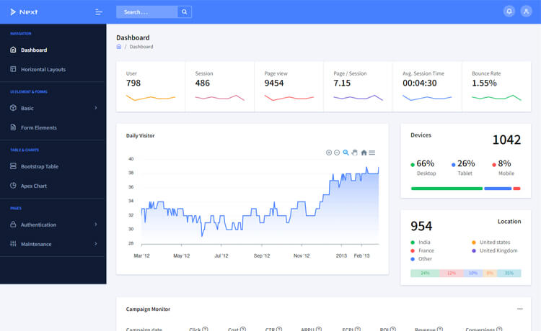
NEW APPROACH
To overcome the issues faced in the old approach, the new approach has evolved called Single-Page Application
A single-page application works inside the client browser and doesn't reload on every interaction.
Only required part gets reloaded.
Back-end & front-end loosely coupled.
Doesn’t waste the resources.
Manageable code: Separation of templates & components

Slide 6
PURPOSE
To support the development of modern-day websites a lot of New frameworks are there.
While choosing the frameworks there is always ambiguity around which framework to choose.
They differ in various aspect like
Scripting Language
Components
Templates
Data-binding
Routing
So this work is made to evaluate the performances of SPAs.

Slide 7

AIM
Aim of the thesis is to compare the different SPA frameworks.
In these frameworks primarily browser performances of the frameworks are computed
Because, If visitors doesn’t find the website interactive & fast, There are high chances of him navigating to another website.

Slide 8
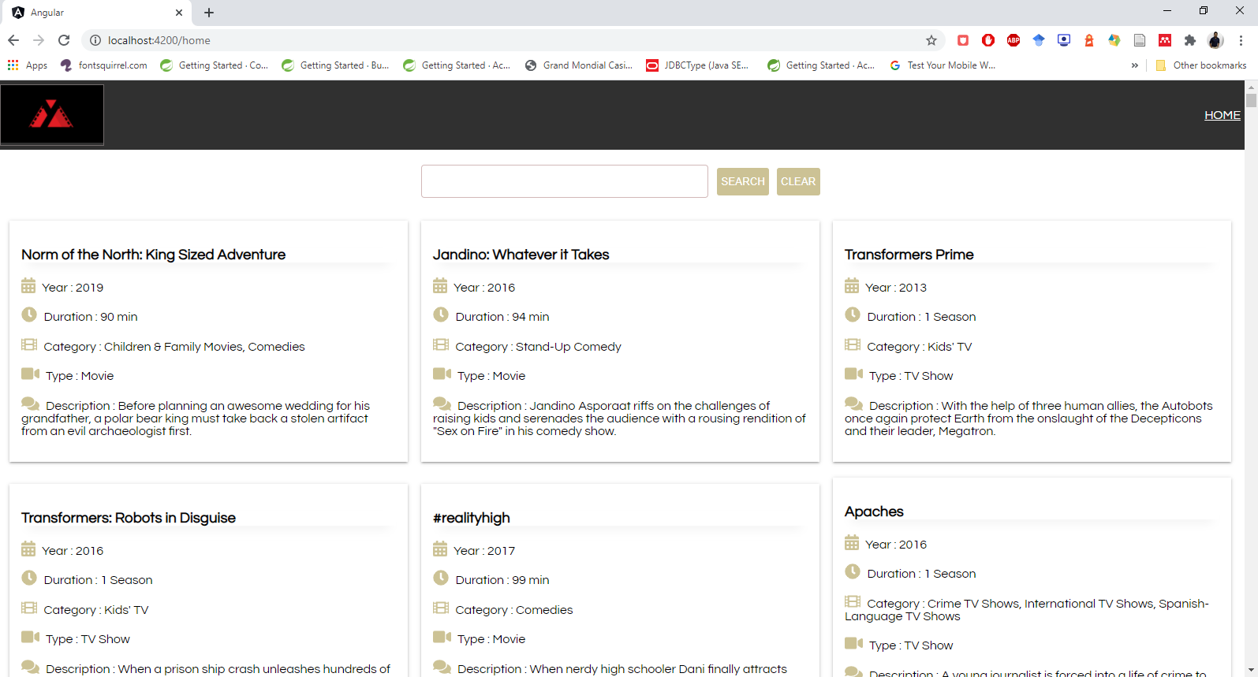
Methodology
To Compare the performance of the frameworks a The Movie app is created.
The Design of the app very simple, Because aim of the thesis is not to build the app but to test the performance of the app in the browser.
The app will display all the movies and shows from the database. The app also has the functionality to search for the movies.

Slide 9
Methodology
Chosen frameworks are Angular 8, Ember.js, Vue.js, React.js.
Important aspects like Routing, Data-Binding, Component, Templates etc are discussed.
The parameters to be tested are:
Lines of Codes
Speed Index,
First Contentful Paint,
Total Blocking Time,
Time to Interactive,
Time Taken To Render Real-Time Data.

Slide 10
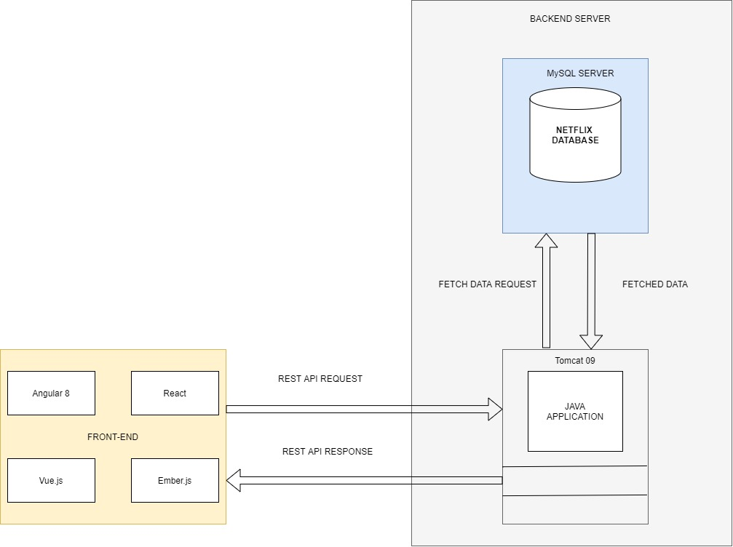
ARCHITECTURE
Architecture is Divided into two major part Back-end & Front-end
Technologies used in backend are:
JAVA (Spring BOOT)
MySQL
Tomcat 09
This Study Doesn't focuse much on the back-end.
Every time front-end wants to communicate with the backend it will send an AJAX request and based on that data will be fetched or sent.

Slide 11
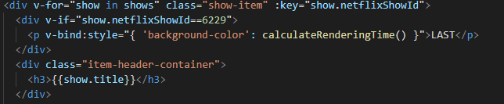
IMPLEMENTATION
To count the Lines of Code two open soured tools are used called cloc & sloc.
For finding the performance metrics such as Speed Index, First Contentful Paint Google's Lighthouse tool is used.
For finding the Time Taken To Load Real-Time Data a custom code is written for every framework.

Slide 12
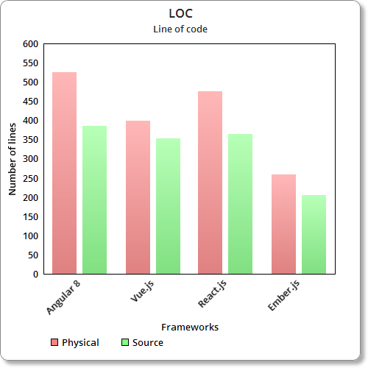
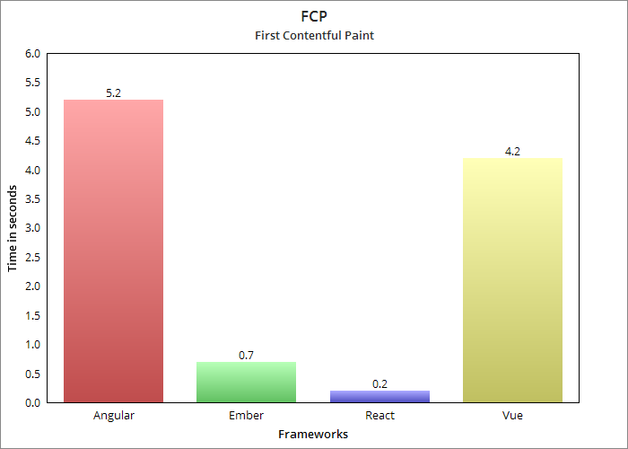
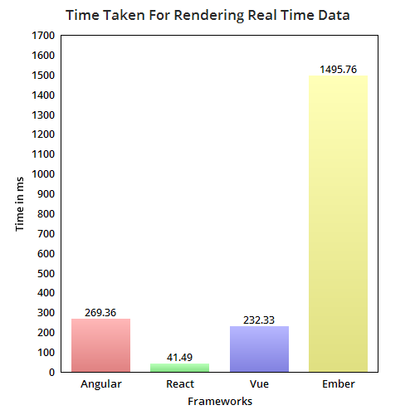
FINDINGS

Slide 13

Difficulties faced
Learning curve
Finding solutions online
Time management
Quantity of literature

Slide 14
Conclusion AND Future Scope
Working on this thesis has helped me a lot in different aspects.
I got very deep insights into the frameworks that how they work, how their routing, data-binding, components differ from each other, etc.
How to read the official documents & their importance.
In future I would like to extend this thesis out of interest and try to add more metrics to it.
I would also like to test these metrics on more JavaScript Frameworks.

Slide 15

QUESTIONS ?

