Slide 1

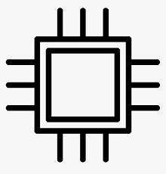





Memory
Processor
Business functionality which brings value
Operating system
Runtime
Disk
IO

