Slide 1

CYBER-PHYSICAL SECURITY · RESEARCH SHOWCASE
The lie the
network can't see.
A digital-twin and physical-watermarking testbed for multi-layer intrusion detection in SCADA systems.
S. Saurabh Krishnan · Hemant Bhupesh · Sanjai S · Nitesh V. M.
Amrita Vishwa Vidyapeetham · Coimbatore, India
Notes:
Title. We built a live, simulated SCADA plant and used it to show that a network-only defender is blind to attacks that lie at the sensor -- and that a digital twin, process physics and an active watermark close that gap.

Slide 2
SCADA / DIGITAL-TWIN SECURITY
02 / 19
THE BLIND SPOT
A compromised sensor sends a
perfect packet with a false value.
falsified value
Sensor
PLC
SCADA · HMI
The network layer sees nothing wrong — the frame is well-formed and on time. Meanwhile the real process diverges.
Operator sees a benign number.
The plant does not.
Detecting this needs reasoning about the physics of the process, not just its packets.
THE PROBLEM
Notes:
The core motivation. A field-device compromise or a sensor-to-PLC MITM presents a plausible-but-false reading; nothing on the wire is anomalous, so a packet-only IDS misses it entirely.

Slide 3
SCADA / DIGITAL-TWIN SECURITY
03 / 19
IT HAS ALREADY HAPPENED
Fifteen years of attacks that reached the physical layer.
2010
2017
Stuxnet
TRITON / TRISIS
Centrifuge sabotage via
falsified PLC logic & readings
Malware targeting the
safety-instrumented system
2015
Now
Ukraine grid
This testbed
Breakers opened remotely;
operators locked out
A place to study and
detect these, reproducibly
Dates and incidents are historical fact; the testbed is a simulation.
CONTEXT
Notes:
Context: Stuxnet (2010), the Ukrainian grid attacks (2015/16) and TRITON (2017) all reached the physical/safety layer. Our testbed is a reproducible place to study and detect such attacks.

Slide 4
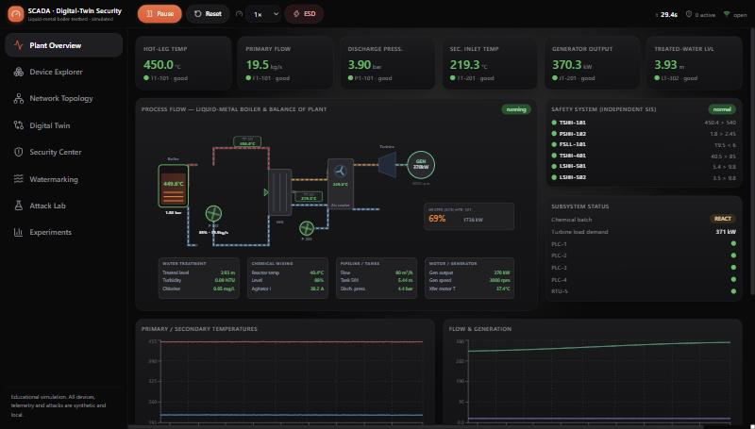
SCADA / DIGITAL-TWIN SECURITY
04 / 19
THE TESTBED
A liquid-metal boiler plant, alive at 10 Hz.
37
17
sensors
actuators
5
72
PLCs / RTU
network nodes
10 Hz
56
live engine
tests passing
WHAT WE BUILT
Operator HMI — animated P&ID, live telemetry, independent safety panel.
Notes:
The platform: a simulated liquid-metal boiler plus four auxiliary subsystems, with 37 sensors, 17 actuators, five controllers and a 72-node network, running live at 10 Hz and covered by 56 automated tests.

Slide 5
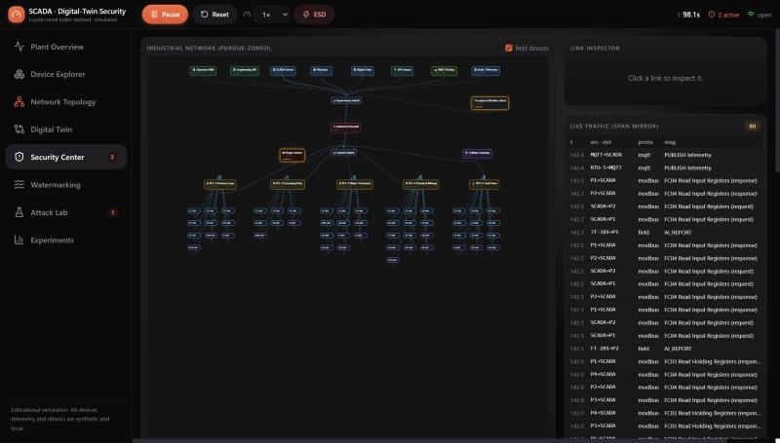
SCADA / DIGITAL-TWIN SECURITY
05 / 19
THE SIMULATED NETWORK
Purdue-zoned, protocol-aware, tapped.
Modbus TCP as spec-conformant ADU bytes; OPC UA and MQTT emulated. A discrete-event bus adds latency, loss and MITM, and mirrors supervisory traffic to the IDS through a SPAN port.
Live SPAN-mirrored Modbus / MQTT traffic feeding the four-layer IDS.
WHAT WE BUILT
Notes:
The network is a Purdue-zoned graph with an industrial firewall and a cellular link to a remote RTU. Modbus TCP uses real ADU bytes; OPC UA and MQTT are honestly labelled as application-level emulation. A SPAN mirror feeds the IDS exactly what a real tap would.

Slide 6

01
THE SYSTEM
How the plant, the twin, the detectors
and the watermark fit together.
Notes:
Section 1: the system -- architecture, the control loop, and the three add-ons that make it a security platform.

Slide 7
SCADA / DIGITAL-TWIN SECURITY
07 / 19
ARCHITECTURE
Five layers, watched by four observers.
Supervisory — SCADA · HMI · historian · auth
OBSERVERS
Digital twin
Network bus — routing · loss · SPAN mirror
independent physics + residuals
Four-layer IDS
PLCs / RTU — PI(D) control · Modbus / MQTT
network · process · twin · watermark
Correlation
Field devices — sensors · actuators
dedup · classify · fuse confidence
Response
Physical plant — ground truth
monitor / approve / automatic
Invariant: the attacker touches only the network and field devices — never the twin, IDS, watermark or safety system.
THE SYSTEM
Notes:
Architecture: a strictly layered stack advanced at 10 Hz, observed by the twin, the four-layer IDS, the correlation engine and the response engine. A key invariant, checked by tests, is that the attacker can only reach the network and field devices.

Slide 8
SCADA / DIGITAL-TWIN SECURITY
08 / 19
THE 10 HZ LOOP
One tick, in a fixed order.
1
Attack lab applies manipulations
What they never see
2
Physical plant integrates (ground truth)
Green steps read the true plant state.
The attacker (step 1) acts only through network and field hooks.
The IDS (steps 5–8) sees only the SPAN mirror — the same bytes a real tap would capture.
3
Hard-wired safety (SIS) may trip
4
Field I/O — sensors sample, PLCs scan
5
Network bus delivers (SPAN mirror)
6
SCADA polling · historian · twin feeds
7
Digital twin + watermark update
8
IDS (4 layers) → correlation
9
Response engine → snapshot
THE SYSTEM
Notes:
The engine runs a fixed per-tick sequence at 10 Hz. The attacker manipulates before the physics step; the safety system and the plant read the real state; the IDS only ever sees the SPAN mirror. Ground-truth labels never reach the detectors.

Slide 9
SCADA / DIGITAL-TWIN SECURITY
09 / 19
THE INDEPENDENT TWIN
A model that won't absorb a lie.
r = observed − predicted
The twin runs its own RK4 physics with datasheet parameters — it never reads the plant's hidden state. Each tick it predicts, then fuses each measurement through a gate.
z = ( r − bias ) / σ
IN THE LIVE FALSE-DATA DEMO
real 459.8 °C
vs falsified 442.3 °C shown to the operator
A reading that jumps outside the gate (|z| < 5) is rejected — so a stealthy lie shows up as a growing residual instead of quietly corrupting the estimate.
twin residual z = −24.9
THE SYSTEM · ADD-ON 01
Notes:
Add-on 1: the independent twin. The gate is the crucial idea -- continuously correcting toward measurements would let a slow lie pass; gating keeps the twin anchored to physics, so the lie becomes a large residual (z = -24.9 in the live demo).

Slide 10
SCADA / DIGITAL-TWIN SECURITY
10 / 19
FOUR LAYERS, ONE VERDICT
Each layer covers another's blind spot.
NETWORK
PROCESS
rogue devices · spoofing · floods · replay · unauthorised writes
limits · frozen signals · rate-of-change · setpoint deviation · energy balance
TWIN
WATERMARK
persistent & sudden residuals · correlated multi-sensor anomalies
missing or abnormal response to the injected excitation
Correlation engine: deduplicates findings into one incident, fuses confidence C = 1 − Π(1 − c_{i}), raises severity per corroborating layer, and classifies.
THE SYSTEM · ADD-ON 02
Notes:
Add-on 2: four independent detectors feed one correlation engine, which deduplicates evidence into a single classified incident and fuses confidence probabilistically -- so a coordinated attack no single layer sees in full still surfaces as one high-confidence incident.

Slide 11
SCADA / DIGITAL-TWIN SECURITY
11 / 19
PHYSICAL WATERMARKING
Probe the process, then listen for the echo.
1
INJECT
2
PREDICT
3
COMPARE
A bounded PRBS excitation is added to the pump command inside the PLC's secured block. The exported register still reports the base value.
Two shadow copies of the twin's hydraulics compute the expected response to the excitation.
Observed flow & pressure are matched to the expected response by correlation ρ, gain and SNR.
Decision: consistent / suspicious / inconclusive Self-suspends on a safety trip, saturation or poor measurement quality — never forces an unsafe perturbation.
THE SYSTEM · ADD-ON 03
Notes:
Add-on 3: active defence. We inject a secret, bounded signal and check the process actually responds to it. A replay or smoothing attack that erases the signature is flagged. Baseline correlation is ~0.80 (flow) and ~0.95 (pressure).

Slide 12
02
THE EVIDENCE
Ten attacks, one honest question:
which layers actually catch them?
Notes:
Section 2: the evidence -- the attack laboratory, a live demonstration, and the quantitative results.

Slide 13
SCADA / DIGITAL-TWIN SECURITY
13 / 19
THE ATTACK LABORATORY
Ten reproducible scenarios.
False sensor-data injection
Frozen sensor readings
1
2
Actuator-response manipulation
Unauthorised setpoint write
3
4
Command replay
Supervisory-link DoS
5
6
Insider / out-of-policy write
Digital-twin model tamper
7
8
Watermark interference
Coordinated process + network
9
10
Each records its seed, makes real changes, exposes a ground-truth label, and supports stop/recover. Detection must come from evidence — starting a scenario raises no alert by itself.
THE EVIDENCE
Notes:
Ten reproducible attacks. The key property: during telemetry falsification the real plant keeps running on real actuator action while only the observed values are faked -- and ground-truth labels never reach the detectors.

Slide 14
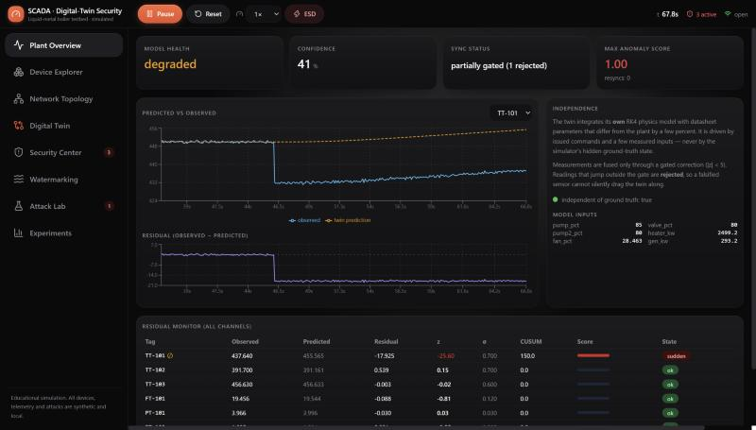
SCADA / DIGITAL-TWIN SECURITY
14 / 19
LIVE — FALSE DATA INJECTION
The twin tells the truth the sensor hides.
459.8 °C
real hot-leg temperature
442.3 °C
shown to the operator
z = −24.9
twin residual, CUSUM saturated
96 %
incident confidence
THE EVIDENCE · LIVE
Observed (blue) is pulled to the fake value; the twin prediction (orange) keeps tracking reality.
Notes:
The money shot. A -18C bias is injected on the hot-leg sensor. The real temperature rises while the operator sees the fake value; the independent twin flags it at z = -24.9 and the engine raises a critical incident at 96% confidence.

Slide 15
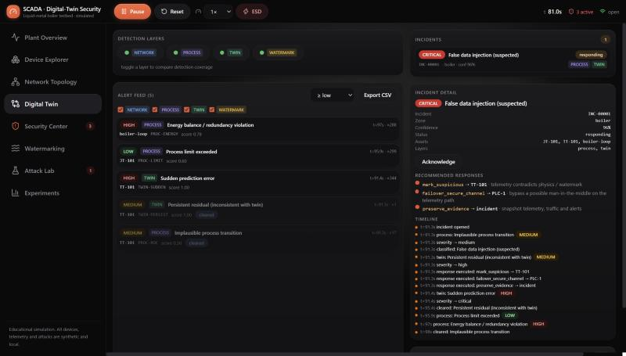
SCADA / DIGITAL-TWIN SECURITY
15 / 19
CORRELATED, THEN CONTAINED
Two layers fire. One incident. An automatic response.
PROCESS + TWIN fire
energy-balance + sudden-residual evidence — the network stays silent
Correlated incident
“False data injection” · critical · 96% confidence
Automatic response
mark suspicious · secure-channel failover · preserve evidence
THE EVIDENCE · LIVE
Alert feed, the correlated critical incident, and the executed responses.
Notes:
Detection to containment. The process and twin layers fire -- not the network -- and the correlation engine raises one critical incident; in automatic mode the response engine marks the sensor suspicious, fails over to a secure channel and preserves evidence.

Slide 16
SCADA / DIGITAL-TWIN SECURITY
16 / 19
RESULTS
Detection F1 by configuration.
Scenario | Net only | Net+Proc | +Twin | Full+WM | Latency
A. Normal operation | — | — | — | — | —
B. False data injection | miss | 0.94 | 0.94 | 0.94 | 0.2 s
C. Watermark interference | miss | miss | 0.71 | 0.96 | 1.1 s
D. Unauthorised setpoint | 0.91 | 0.91 | 0.91 | 0.91 | 0.0 s
E. Command replay | 0.93 | 0.93 | 0.93 | 0.93 | 0.5 s
F. Coordinated | 0.91 | 0.91 | 0.91 | 0.91 | 0.5 s
Network-only is blind to B and C — field-bus lies leave no network evidence. Process + twin recover B in 0.2 s; the watermark lifts C from 0.71 to 0.96.
THE EVIDENCE
Notes:
The headline table. Read left to right: adding layers recovers the attacks the network cannot see, while command-path attacks (D, E, F) are caught by the network alone. The watermark specifically rescues scenario C.

Slide 17
SCADA / DIGITAL-TWIN SECURITY
17 / 19
THE KEY FINDING
Zero, or ninety-four.
For telemetry-falsification attacks, a packet-only IDS scores nothing. The extra layers do all the work.
THE WHOLE ARGUMENT
Command-path attacks
caught by the network layer.
Telemetry falsification
invisible there — caught by process + twin.
Erased signatures
caught by the active watermark.
THE EVIDENCE
Notes:
The single most important result. Each layer covers a blind spot of the others, and only the full stack fused by correlation covers all four attack families.

Slide 18
SCADA / DIGITAL-TWIN SECURITY
18 / 19
WHO BUILT WHAT
Author contributions.
S. Saurabh Krishnan
Hemant Bhupesh
Digital twin — model, gated correction, residual/CUSUM analysis — and the experiment & evaluation framework and 56-test suite.
Plant & network simulation — boiler and subsystems, device abstractions, PLC/RTU control, the safety system and the protocol layer.
Sanjai S
Nitesh V. M.
Multi-layer IDS and correlation, the ten attack scenarios, and the automated defensive-response engine.
Physical watermarking, the React operator HMI, the FastAPI/WebSocket backend and persistence, and documentation.
CREDITS
Notes:
Author contributions across the four team members.

Slide 19

DEFENCE IN THE PHYSICS
A network-only defender is blind.
A twin, the physics and a watermark can see.
Full multi-layer stack: sensor falsification detected in 0.2 s (F1 0.94) where network-only scores 0.00. Live at 10 Hz, reproducible, 56 tests.
Thank you.
S. Saurabh Krishnan · Hemant Bhupesh · Sanjai S · Nitesh V. M.
Amrita Vishwa Vidyapeetham, Coimbatore · educational research simulation
Refs: Stuxnet (Symantec, 2011) · Mo & Sinopoli (Allerton 2009) · Mo et al. (IEEE CSM 2015) · Cárdenas et al. (ASIACCS 2011) · Urbina et al. (CCS 2016) · Goh et al. (CRITIS 2016) · Lee et al. (E-ISAC/SANS 2016).
Notes:
Close. The thesis in one line: defence must live in the physics, not just the packets. Headline numbers and references. Thank the audience and invite questions.

