Slide 1
Java environment setup and java basics

Slide 2
Java Features
Simple & robust
Secure
Portable
Platform independent, Hardware independent and Architecture neutral
WORA ( Write Once and Run Anywhere)
Full OOP support
Exclusive threading support
Interpreted
Automatic memory management ( garbage collection)
Functional programming support

Slide 3
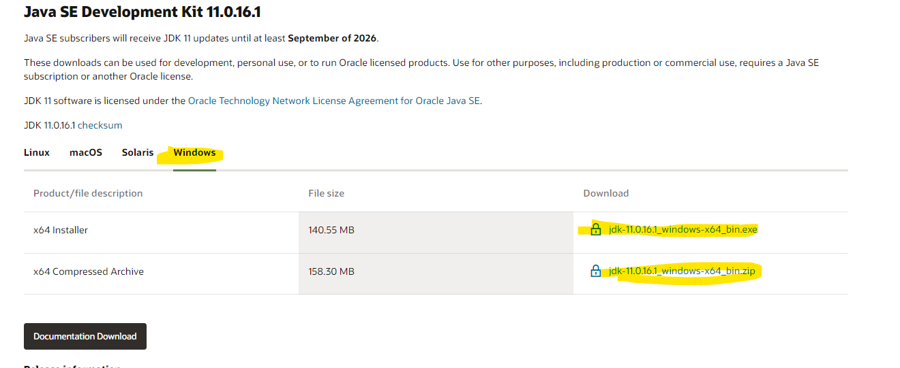
Java installation steps
Download JDK 11 from Oracle official site
https://www.oracle.com/java/technologies/downloads/#java11

Slide 4
Java installation steps
Install Java using installer if exe is downloaded or extract if zip is downloaded
Setting up path on windows
Add jdk installation directory path in path variable
Check java version post installation with below command
Command: java –version
java is command/executable name, –version is option
Download Java Docs
Direct : https://docs.oracle.com/en/java/javase/11/docs/api/index.html
Downloadable : https://www.oracle.com/java/technologies/javase-jdk11-doc-downloads.html

Slide 5
JRE, JVM and JDK
JRE :
Java API Libraries for running the application + JVM (Java Virtual Machine)
ex. rt.jar
Contains packaged class like java.lang, java.util
JRE has a major responsibility for creating an environment for the execution of code.
JVM :
Loads classes using class loaders
Helps in executing the Java bytecode.
It has interpreter to interpret byte code
I comes with Just-in-Time (JIT) compiler for converting the Java source code into a low-level machine language.

Slide 6
JRE, JVM and JDK
JDK :
The JDK enables developers to create Java programs that can be executed and run by the JRE and JVM
JRE + dev tools for developing, debugging, and monitoring java code. Ex javac, javap, javah, jar, keytool etc.

Slide 7
Java compilation and execution
Java Source Code
Test.java
Java complier
( javac Part of JDK)
Java Bytecode
Test.class
JVM
( interpreter)
Java Runtime ( JRE)

Slide 8
Java keywords
abstract Specifies that a class or method will be implemented later, in a subclass
assert Assert describes a predicate placed in a java program to indicate that the developer thinks that the predicate is always true at that place.
boolean A data type that can hold True and False values only
break A control statement for breaking out of loops.
byte A data type that can hold 8-bit data values
case Used in switch statements to mark blocks of text
catch Catches exceptions generated by try statements
char A data type that can hold unsigned 16-bit Unicode characters
class Declares a new class
continue Sends control back outside a loop
default Specifies the default block of code in a switch statement
do Starts a do-while loop

Slide 9
Java keywords
double A data type that can hold 64-bit floating-point numbers
else Indicates alternative branches in an if statement
enum A Java keyword is used to declare an enumerated type. Enumerations extend the base class.
extends Indicates that a class is derived from another class or interface
final Indicates that a variable holds a constant value or that a method will not be overridden
finally Indicates a block of code in a try-catch structure that will always be executed
float A data type that holds a 32-bit floating-point number
for Used to start a for loop
if Tests a true/false expression and branches accordingly
Implements Specifies that a class implements an interface
import References other classes
instanceof Indicates whether an object is an instance of a specific class or implements an interface

Slide 10
Java keywords
int A data type that can hold a 32-bit signed integer
interface Declares an interface
long A data type that holds a 64-bit integer
native Specifies that a method is implemented with native (platform-specific) code
new Creates new objects
null This indicates that a reference does not refer to anything
package Declares a Java package
private An access specifier indicating that a method or variable may be accessed only in the class it’s declared in
protected An access specifier indicating that a method or variable may only be accessed in the class it’s declared in and its sub-classes
public An access specifier used for classes, interfaces, methods, and variables indicating that an item is accessible throughout the application/anywhere
return Sends control and possibly a return value back from a called method
short A data type that can hold a 16-bit integer

Slide 11
Java keywords
static Indicates that a variable or method is a class method
strictfp A Java keyword is used to restrict the precision and rounding of floating-point calculations to ensure portability.
super Refers to a class’s base class (used in a method or class constructor)
switch A statement that executes code based on a test value
synchronized Specifies critical sections or methods in multithreaded code
this Refers to the current object in a method or constructor
throw Creates an exception
throws Indicates what exceptions may be thrown by a method
transient Specifies that a variable is not part of an object’s persistent state
try Starts a block of code that will be tested for exceptions
void Specifies that a method does not have a return value
volatile This indicates that a variable may change asynchronously
while Starts a while loop

Slide 12
Hello java program
public class HelloJava {
public static void main(String[] args) {
System.out.println("Hello Java");
}
}
//Below takes value form command line arguments
public class HelloJava {
public static void main(String[] args) {
System.out.println("Hello " + args[0]);
}
}

Slide 13
Java statements and block of statements
Statements
A statement is a java code terminated by a semi-colon which can execute.
Ex. System.out.println("hello");
Block of statements
It contains more than one statements enclosed in curly brackets.
Blocks can be nested: block within block
Ex.
{
System.out.println(“Hello");
System.out.println(“Java");
}

Slide 14
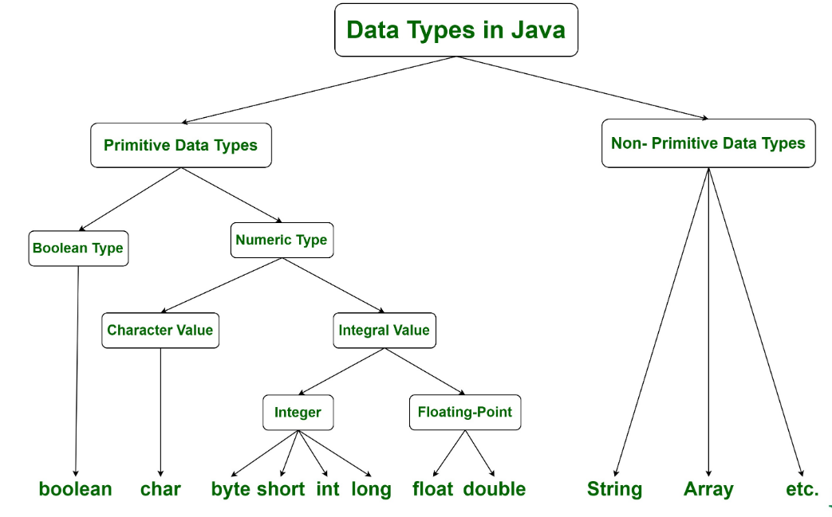
Data types in Java

Slide 15
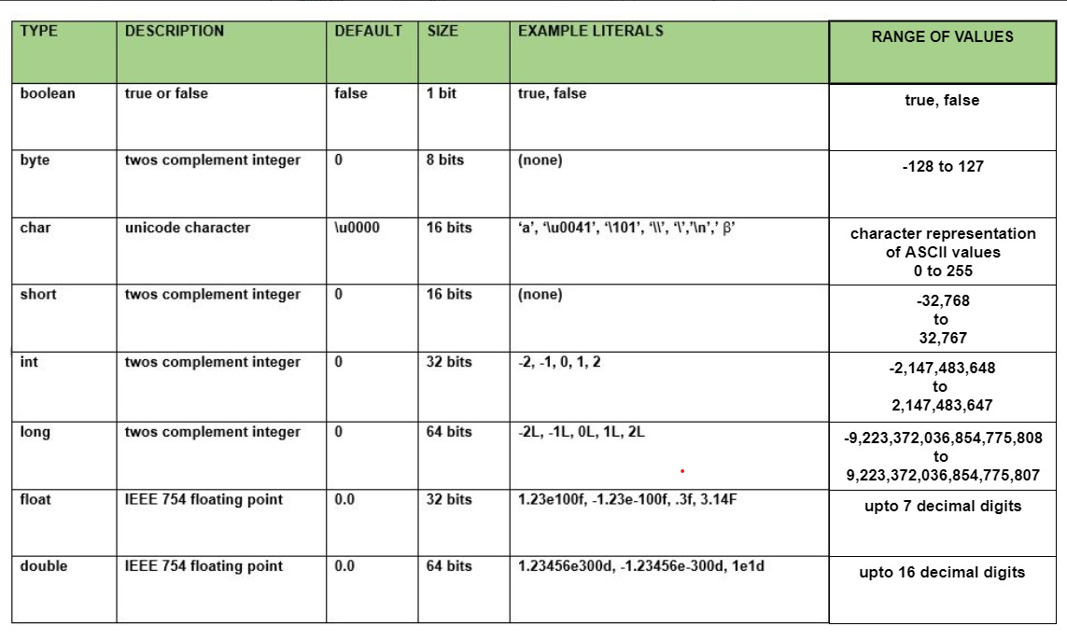
Data types in Java

Slide 16
2’s Compliment
Java stores integer types in 2’s compliment format
2’s Compliment = 1’s Compliment + 1
Ex. Decimal 40
40 to binary -> 0010 1000
1’s Compliment -> 1101 0111
+ 1
1101 1000
Size of byte is 8 and 1 digit is signed so range will be 2^7 to ((2^7)-1) = -128 to 127

Slide 17
Format specifiers for datatypes
Format Specifier | Conversion Applied
%% | Inserts a % sign
%x %X | Integer hexadecimal
%t %T | Time and Date
%s %S | String
%n | Inserts a newline character
%o | Octal integer
%f | Decimal floating-point
%e %E | Scientific notation
%g | Causes Formatter to use either %f or %e, whichever is shorter
%h %H | Hash code of the argument
%d | Decimal integer
%c | Character
%b %B | Boolean
%a %A | Floating-point hexadecimal

Slide 18
Variable declaration and initialization
Variable is saved In memory which value varies withing the rage of values.
Range of value depends upon the datatype of variable
Syntax
<datatype> variableName;
Variable declaration/definition | Variable initialization and assignment
int number; double balance; float percentage; char c; | int number = 100; // Init int number1 = 50; // Init number1 = number; //Assignment double balance = 100.50; char ch= ‘A’; float percentage = 10.50F;

Slide 19
Rules for Identifier names
Allowed characters for identifiers are all alphanumeric characters([A-Z],[a-z],[0-9]), ‘$‘(dollar sign) and ‘_‘ (underscore).
Identifiers should not start with digits([0-9]).
Java identifiers are case-sensitive.
Reserved Words/Keywords can’t be used as an identifier.
Valid Identifiers | Invalid identifies
number, $balance, empName, dept_name, PI, EMPTY, str, out etc. | #number, no@, 123number, final, null etc.

Slide 20
Naming convention
For classes and interfaces:
Names should begin with a capital letter. And if there are multiple words in the class name then each word must also begin with a capital letter.
It follows UpperCamelCase notations.
Ex. String, HelloJava, Scanner, GregorianCalendar, HashMap, Comparable, Comparator etc.
For packages:
Also package names always start with lowercase characters And if there are multiple words in the package name, then you need to use uppercase for all words except for the starting word.
Ex. util, lang, io, nio etc.
For data members
Instances and other variables names must start with lowercase and if there are multiple words in the name, then you need to use Uppercase for starting letters for the words except for the starting word.
It follows as lowerCamelCase.
Ex. empName, index, calculatePerimeter, balcance, assetsValue etc.
For constants
Constants/finals shold have all letters capital/ uppercase.
Ex. PI, EMPTY, HEX, APP_NAME etc

Slide 21
Few more Java rules
Variables must be initialized before use. Un-initialized data members and local variables gives error in compilation
A .java file can have more than one non public classes but only one public per file
If there is a public class in a file, the name of the file must match the name of the public class.
Ex. a class declared as
public class Test {
//some code goes here
}
must be in a source code file named Test.java.
Ex : int number;
number++; // Un-initialized variable usage is error

Slide 22
Programs demo
Print integer, float, double and char using System.out.printf methods
Program to add 2 numbers using command line arguments
Program to add 2 numbers by getting inputs from user
Print size of data types
Demonstrate local variable, class/static variable and instance variables

Slide 23
Widening and narrowing for primitive data types
Widening (Automatic promotion)− Converting a lower datatype to a higher datatype is known as widening.
Ex. int to long
Narrowing (type-casting) − Converting a higher datatype to a lower datatype is known as narrowing.
Ex. float to int
byte
short
int
long
float
double
char

Slide 24
Programs Demo
Print ASCII values of char
Test widening and narrowing of primitive data types
Binary Literals

Slide 25
Operators
Arithmetic Operators
Unary Operators
Assignment Operator
Relational Operators
Logical Operators
Ternary Operator
Bitwise Operators
Shift Operators
instance of Operator

Slide 26
Arithmetic Operators
Arithmetic Operators: Used to perform simple arithmetic operations on primitive data types.
* : Multiplication
/ : Division
% : Modulo
+ : Addition
– : Subtraction

Slide 27
Unary Operators
Unary Operators: Unary operators need only one operand. They are used to increment, decrement or negate a value.
– : Unary minus, used for negating the values.
+ : Unary plus indicates the positive value
++, -- : Increments and Decrement operator. They cab be prefix and postfix
! : Logical not operator, used for inverting a boolean value.

Slide 28
Assignment Operator
‘=’ : Assignment operator is used to assigning a value to any variable. It has a right to left associativity
Ex. i = 10; i = i +10;
Compound Statement/Shorthand. For example, instead of i = i+10, we can write i += 10;
+=, for adding left operand with right operand and then assigning it to the variable on the left.
-=, for subtracting right operand from left operand and then assigning it to the variable on the left.
*=, for multiplying left operand with right operand and then assigning it to the variable on the left.
/=, for dividing left operand by right operand and then assigning it to the variable on the left.
%=, for assigning modulo of left operand by right operand and then assigning it to the variable on the left.
Ex. value += 10;

Slide 29
Relational Operators
Relational Operators: These operators are used to check for relations like equality, greater than, and less than. They return boolean results after the comparison
==, Equal to returns true if the LHS is equal to the RHS.
!=, Not Equal to returns true if the LHS is not equal to the RHS.
<, less than: returns true if the LHS is less than the RHS.
<=, less than or equal to returns true if the LHS is less than or equal to the RHS.
>, Greater than: returns true if the LHS is greater than the RHS.
>=, Greater than or equal to returns true if the LHS is greater than or equal to the RHS.

Slide 30
Logical Operators and Ternary
Logical Operators: These operators are used to perform “logical AND” and “logical OR” operations,
&&, Logical AND: returns true when both conditions are true.
||, Logical OR: returns true if at least one condition is true.
!, Logical NOT: returns true when a condition is false and vice-versa
Ternary operator: Ternary operator is a shorthand version of the if-else statement.
Syntax
condition ? if true : if false

Slide 31
Bitwise, Shift and instance of Operators
Bitwise Operators: These operators are used to perform the manipulation of individual bits of a number.
&, Bitwise AND operator: returns bit by bit AND of input values.
|, Bitwise OR operator: returns bit by bit OR of input values.
^, Bitwise XOR operator: returns bit-by-bit XOR of input values.
~, Bitwise Complement Operator: This is a unary operator which returns the one’s complement representation of the input value.
Shift Operators: These operators are used to shift the bits of a number left or right, thereby multiplying or dividing the number by two, respectively.
<<, Left shift operator: shifts the bits of the number to the left and fills 0 on voids left as a result. Similar effect as multiplying the number with some power of two.
>>, Signed Right shift operator: shifts the bits of the number to the right and fills 0 on voids left as a result. The leftmost bit depends on the sign of the initial number. Similar effect as dividing the number with some power of two.
>>>, Unsigned Right shift operator: shifts the bits of the number to the right and fills 0 on voids left as a result. The leftmost bit is set to 0.

Slide 32
instance of Operators
instanceof operator: The instance of the operator is used for type checking. It can be used to test if an object is an instance of a class, a subclass, or an interface.

