Slide 1
Collection Framework

Slide 2
Array limitation
Array size is fixed and array does not grow if its full
Inserting and deleting elements need reorganization of array
Array elements are not automatically sorted

Slide 3
Collection framework
Collection is group of data elements/objects referred as single unit.
Collection framework has
1. Interfaces
2. Implementations
3. Algorithms

Slide 4
Why Collections?
Collections are auto growable and shrinkable. It avoid shortage or wastage of memory.
Collection are generic which can store any object types. Generic -> Parametrized types and are applicable for : classes , interfaces, enums , methods , constructors.
Collection framework has data structures, Tuned algorithms with quality
Reduced Programming effort
Reusability

Slide 5
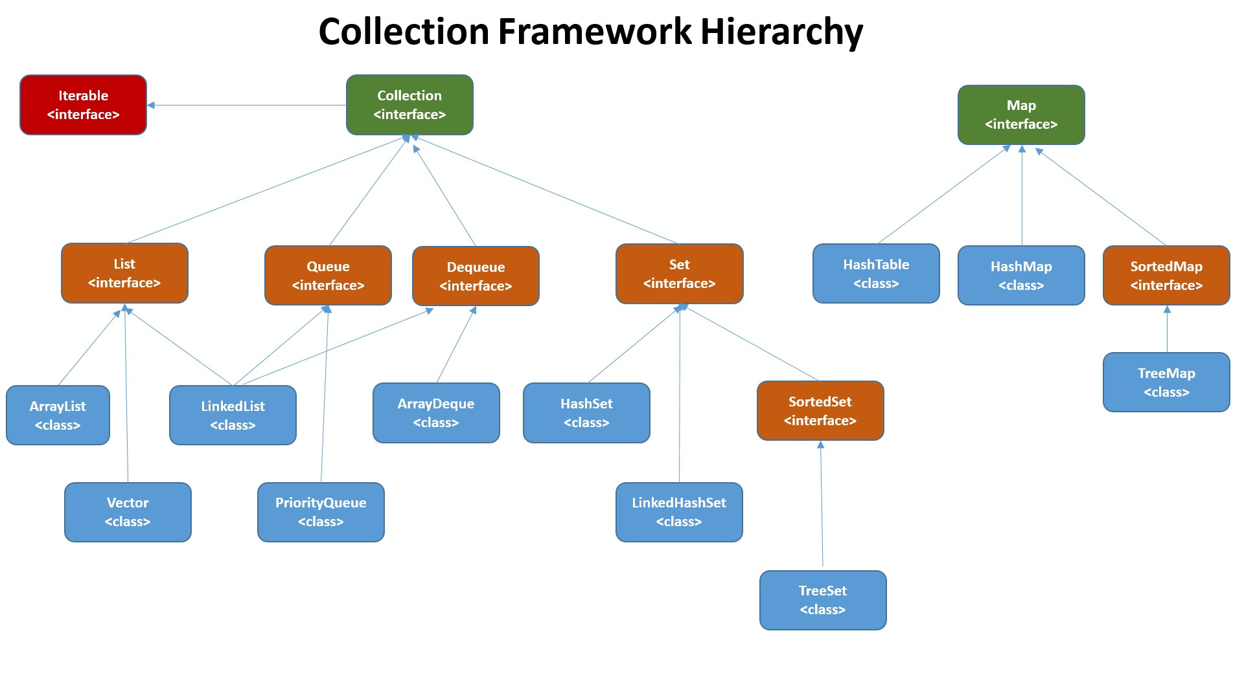

Slide 6
Collections Utility classes
Arrays: Utility class for common Array operations
Searching, Sorting, comparison, toString operations etc
Collections: Utility class for common Collection operations
Searching, Sorting, reverse, synchronization, unmodifiable operations etc
Object
Arrays
Collections

Slide 7
Collection<E> interface
Its sub-interface of Iterable<T>
Has behaviours for general purpose operation on collection
No concrete implementation classes
Ex. add, addAll, clear, contains, containsAll, remove, removeAll, removeIf, iterataor, isEmpty, stream, toArray etc.

Slide 8
Abstract classes in Collection
AbstractList
AbstractCollection
AbstractQueue
AbstractSequentialList
AbstractSet
AbstractMap
These classes can be extended to implement our own collection extensions

Slide 9
List<E> interface
Its sub-interface of Collection<E>
It represents Ordered Collection.
Maintains insertion order
Supports index based operations
Allow duplicates values
Allow null values
Concrete implementations of List<E>
ArrayList<E>, LinkedList<E> (Thread unsafe)
Vector<E> (Thread safe)

Slide 10
ListInterator<E> interface
Its Sub-interface of Iterator<T>
Its used for traversal of Lists
Can be used only with List implementations
We can get ListIterator using below List methods
ListIterator<E> | listIterator() | Returns a list iterator over the elements in this list (in proper sequence).
ListIterator<E> | listIterator​(int index) | Returns a list iterator over the elements in this list (in proper sequence), starting at the specified position in the list.

Slide 11
Exceptions related to List or Iterator
java.util.NoSuchElementException : thrown whenever trying to access the element beyond the size of list via Iterator/ListIterator
java.lang.IllegalStateException : thrown whenever trying to remove element before calling next().
java.util.ConcurrentModificationException :thrown when trying to use same iterator/list iterator after modification. This is fail-fast behavior of the Iterator/ListIterator
java.lang.IndexOutOfBoundsException -- thrown while trying to access elements beyond size

Slide 12
Sorting
Collections can be sorted using Collections sort method
Sorting criteria can be passed to Collections.Sort(..)
If sorting criteria is not passed externally the it will do implicit or natural sorting
Important Interfaces for defining sorting criteria
Comparable
Comparator

Slide 13
Sorting
Natural Sorting ( Implicit/ internal ordering) | Custom Sorting ( Explicit)
Sorting Criteria will be within the UDT or the objects to be sorted | Sorting Criteria will be outside the
UDT implements java.lang.Comparable<T> Must override method public int compareTo(T o); | Separate class implements java.util.Comparator<T> Must override method public int compare(T o1,T o2);
Use java.util.Collections class API Method public static void sort(List<T> l1) | Use java.util.Collections class API Method public static void sort(List<T> l1,Comparator<T> c)

Slide 14
Wild cards in Generics
<?> wild card char ? Denotes any type
<? Extends T> : It defines upper bound i.e any type extending or sub class of T and T itself is allowed
<? super T> : It defined lower bound i.e any super type of T and T itself is allowed
List<? extends Employee> empList1 = new ArrayList<PermEmployee>();
List<? extends Employee > empList2 = new ArrayList<Employee>();
List<? super PermEmployee> list1 = new ArrayList<PermEmployee>();
List<? super PermEmployee > list2 = new LinkedList<Employee>();

Slide 15
Set<E> interface
Its sub-interface of Collection<E>
Does not supports index based operations
Does not allow duplicates values
Allow single null values
Concrete implementations of Set<E>
Hashset<E> (un ordered),
LinkedHashSet<E> (ordered),
TreeSet<E>(sorted but unordered) though SortedSet<E> interface

Slide 16
Map<K,V> interface
A map cannot contain duplicate keys; each key can map to at most one value.
The Map interface provides three collection views, which allow a map's contents to be viewed as a set of keys, collection of values, or set of key-value mappings.
Map implementation, TreeMap<K,V> is ordered and HashMap<K,V> is un-ordered.
Map has initial capacity & load factor.
Allows only one null key reference
Map implantations are thread unsafe.

Slide 17
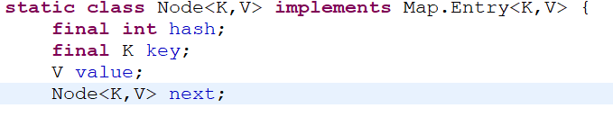
HashMap<K,V>
HashMap has default capacity 16 and load factor 0.75f.
HashMap works on hashing principle
HashMap contains an array of Nodes and Node can represent as below

Slide 18
HashMap<K,V>
Hashing is a process of converting an object into integer form by using the method hashCode(). It’s necessary to write the hashCode() method properly for better performance of HashMap
Buckets: Bucket is one element of the HashMap array. It is used to store nodes. Two or more nodes can have the same bucket. In that case, a link list structure is used to connect the nodes. Buckets are different in capacity.

Slide 19
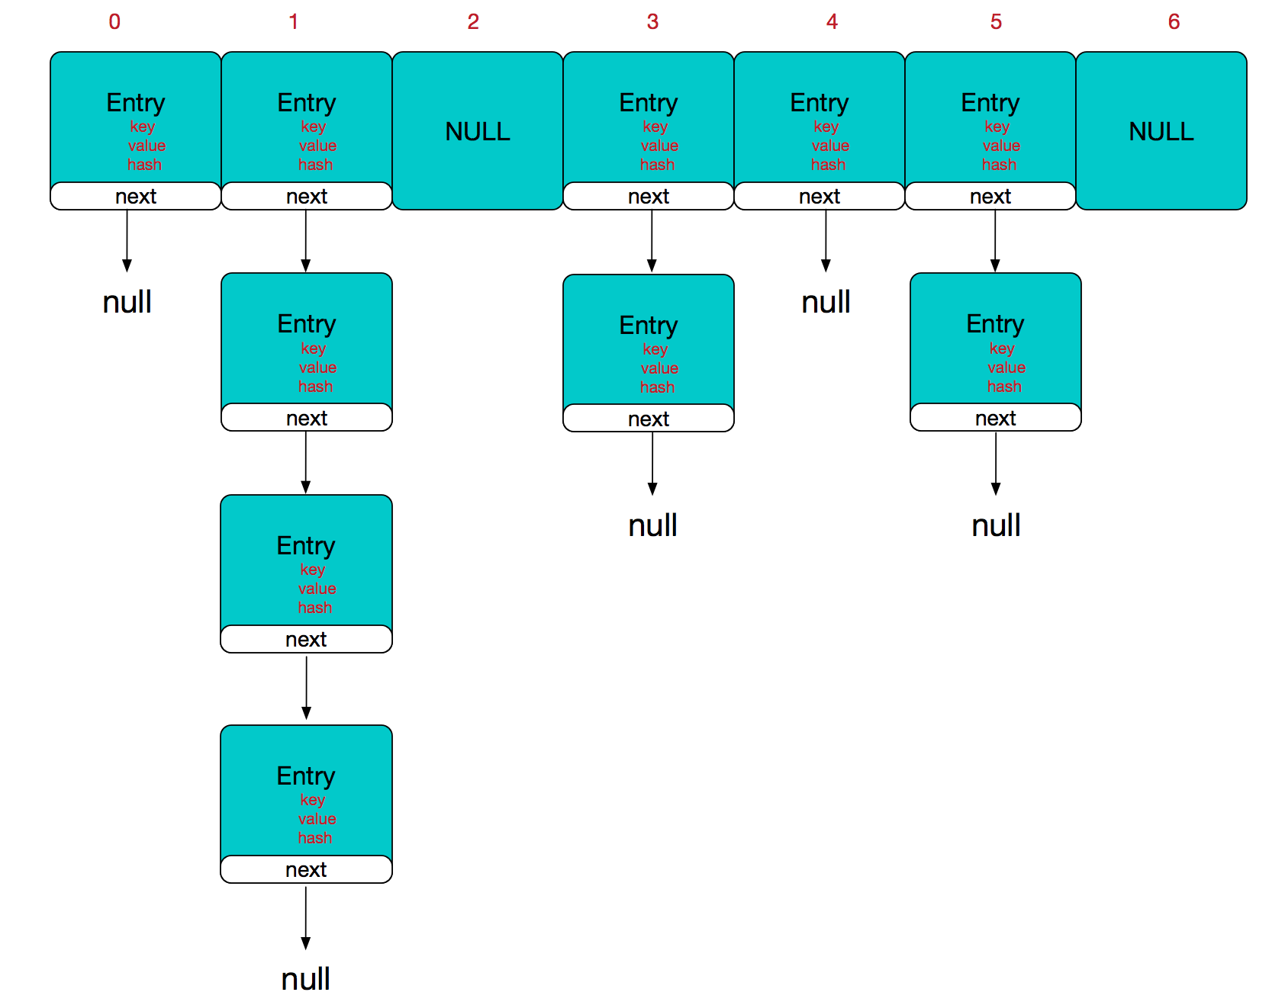
Internal Structure of HashMap

Slide 20
HashMap<K,V>
Hash collision degrades the performance of HashMap significantly.
Java 8 hash elements use balanced trees instead of linked lists after a certain threshold is reached. Which means HashMap starts with storing Entry objects in linked list but after the number of items in a bucket becomes larger than a certain threshold, the bucket will change from using a linked list to a balanced tree, this will improve the worst case

Slide 21
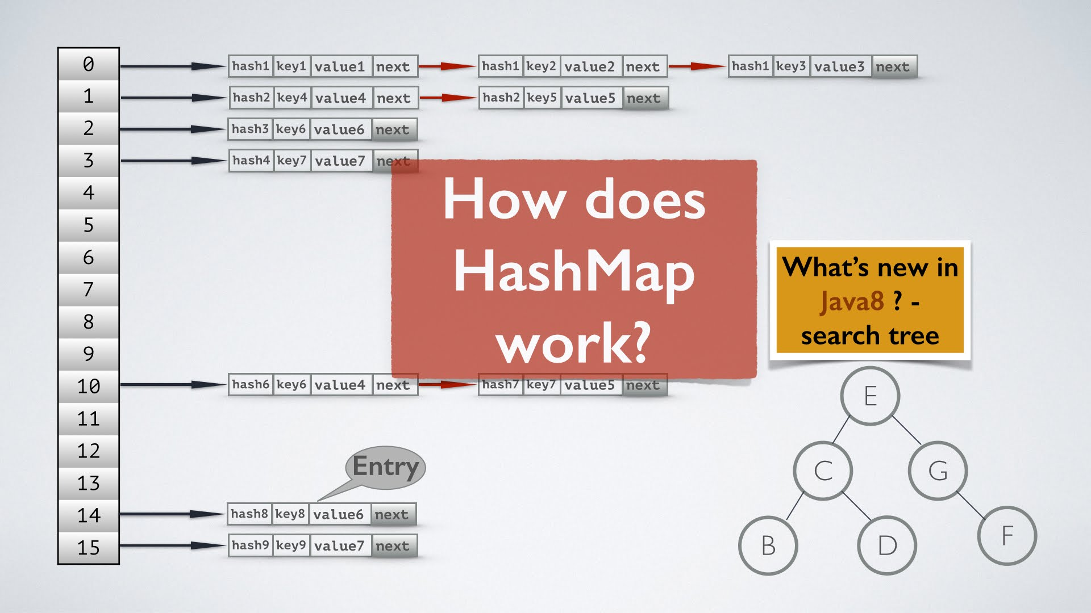
Internal Structure of HashMap

