Slide 1
Java I/O

Slide 2
Java I/O
The basic units of Input/Output in Java are IO Streams
A stream can be thought of as a flow of data from a source to a destination i.e from InputStream to OutputStream

Slide 3
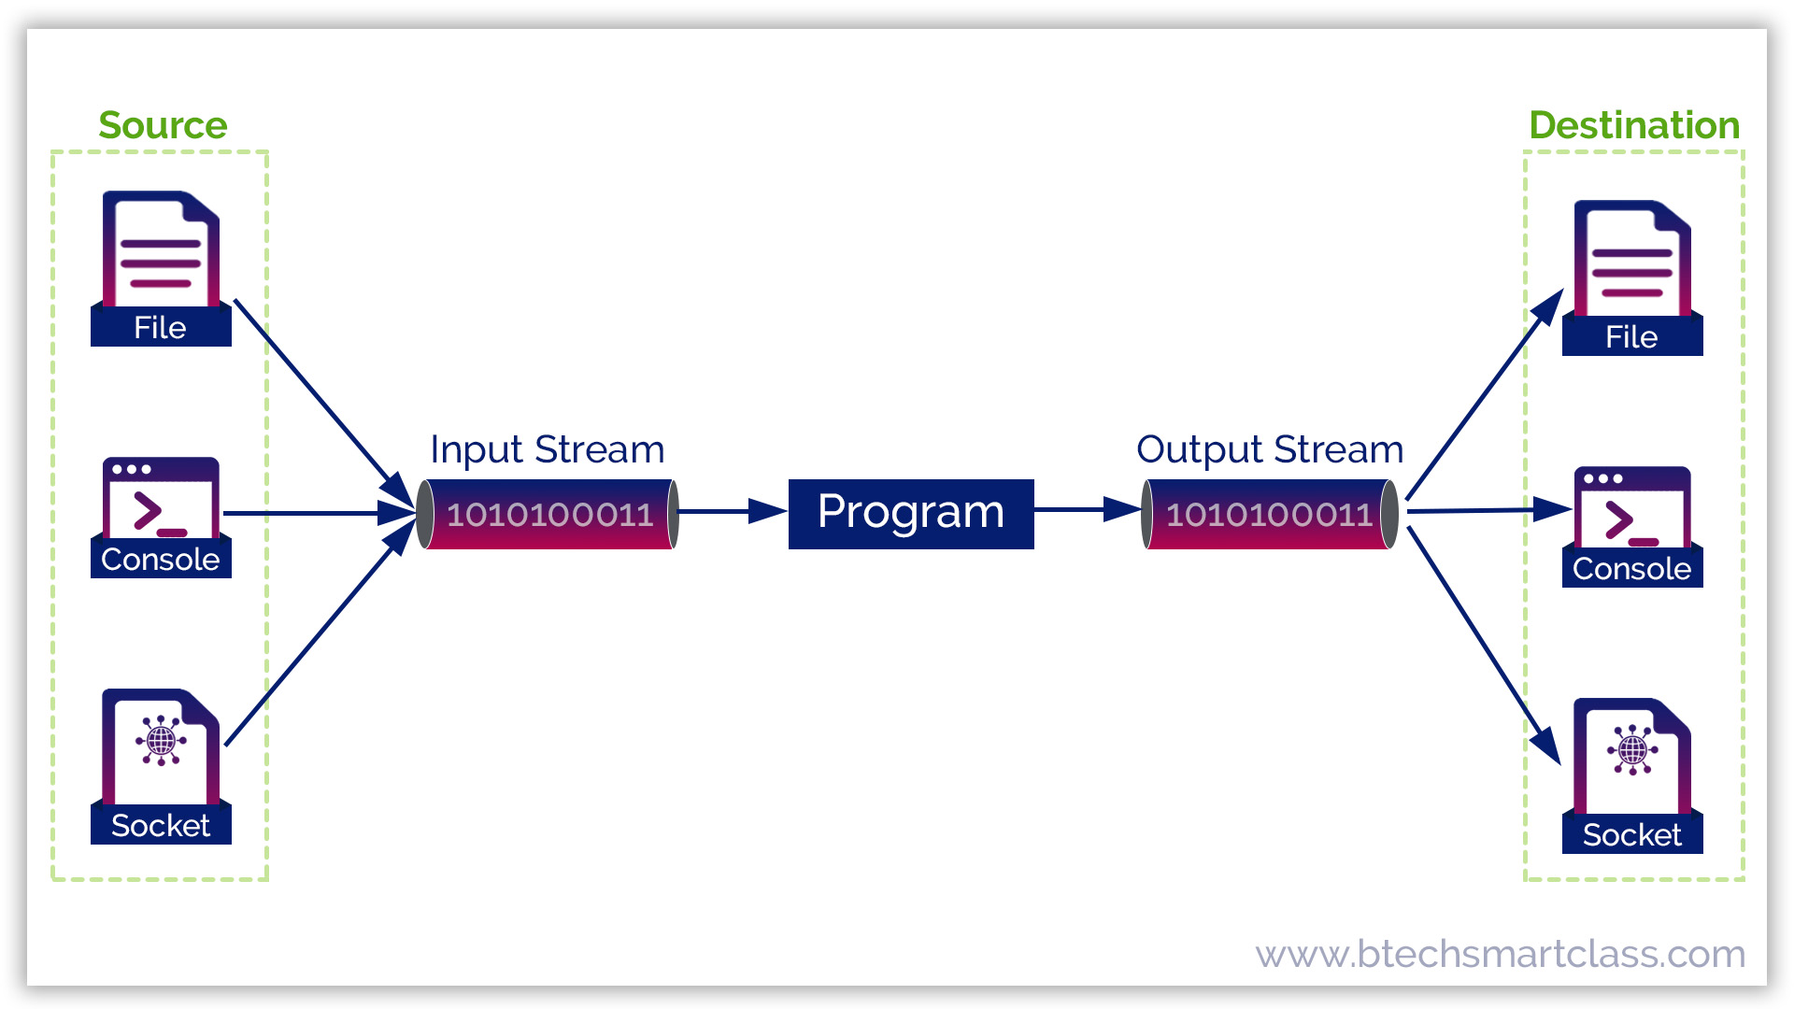
Java I/O

Slide 4
Java I/O
Java supports two types of streams
Character streams ( use Unicode)
Byte streams ( use byte)
Input and output of character data are handled by readers and writers
Input and output of byte data are handled by input streams and output streams

Slide 5
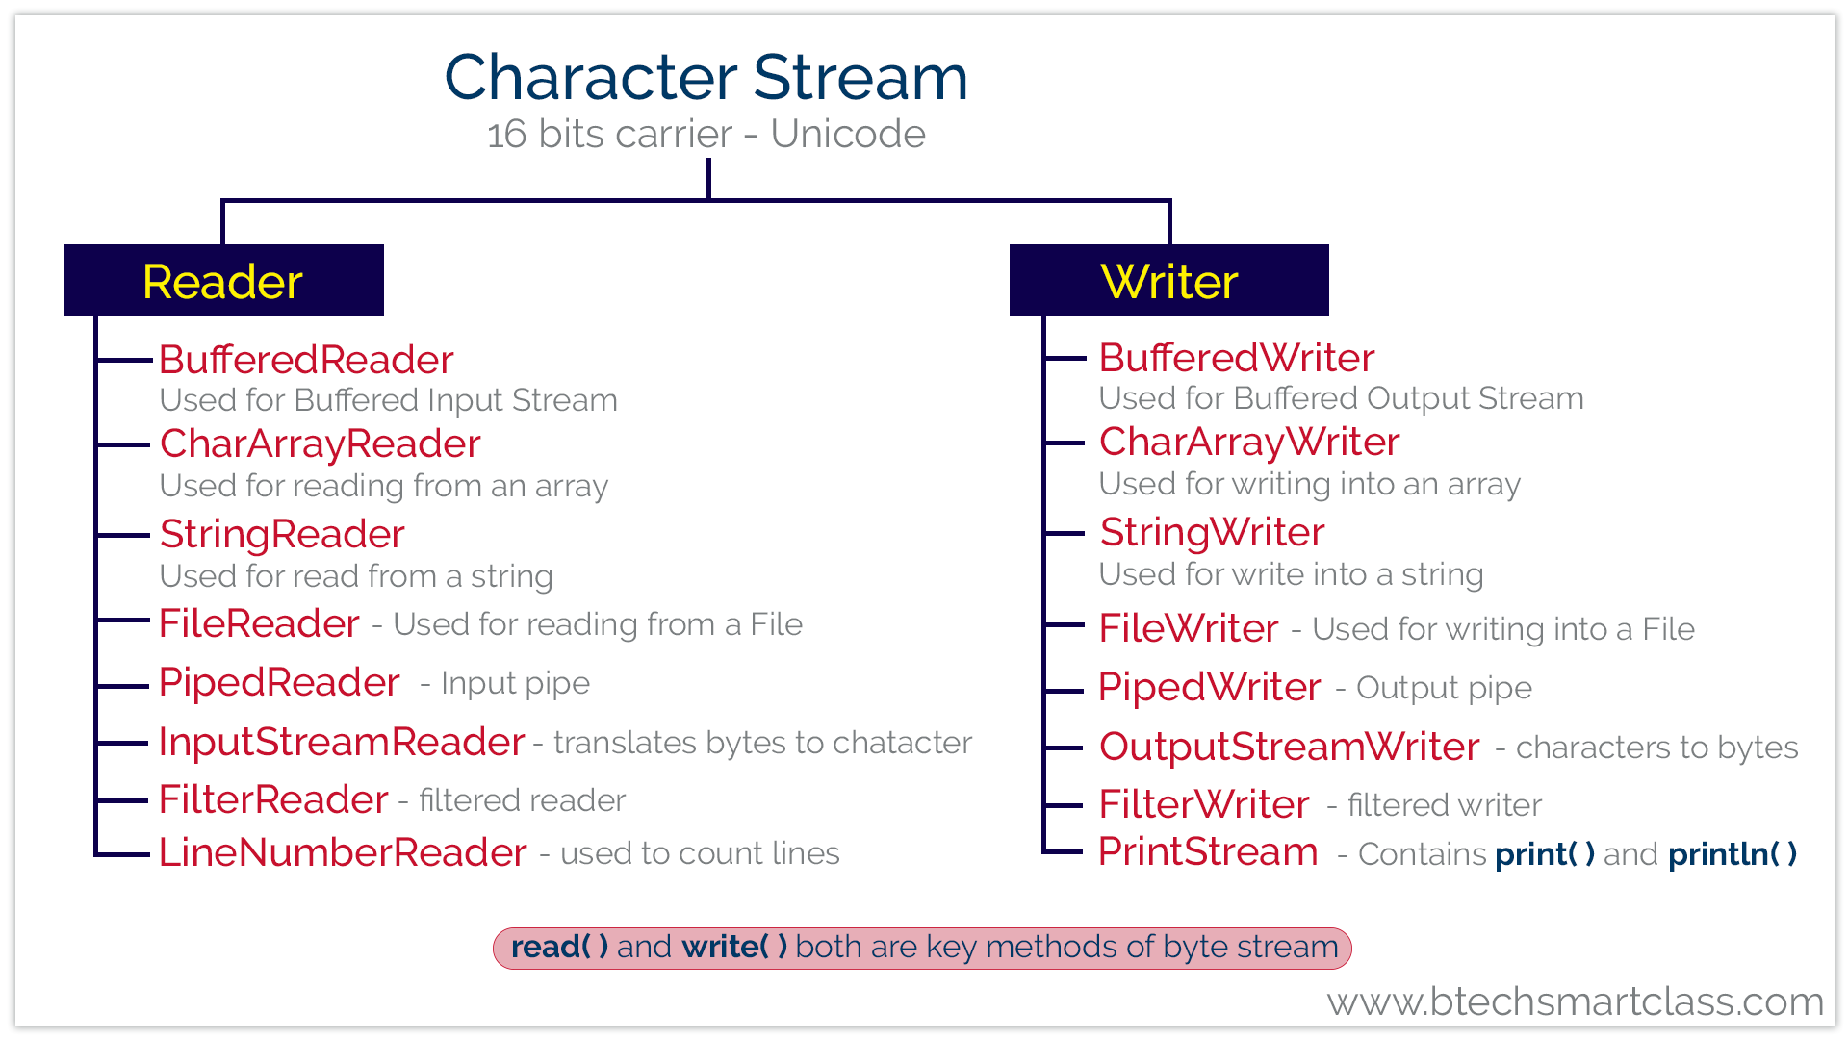
Character Stream

Slide 6
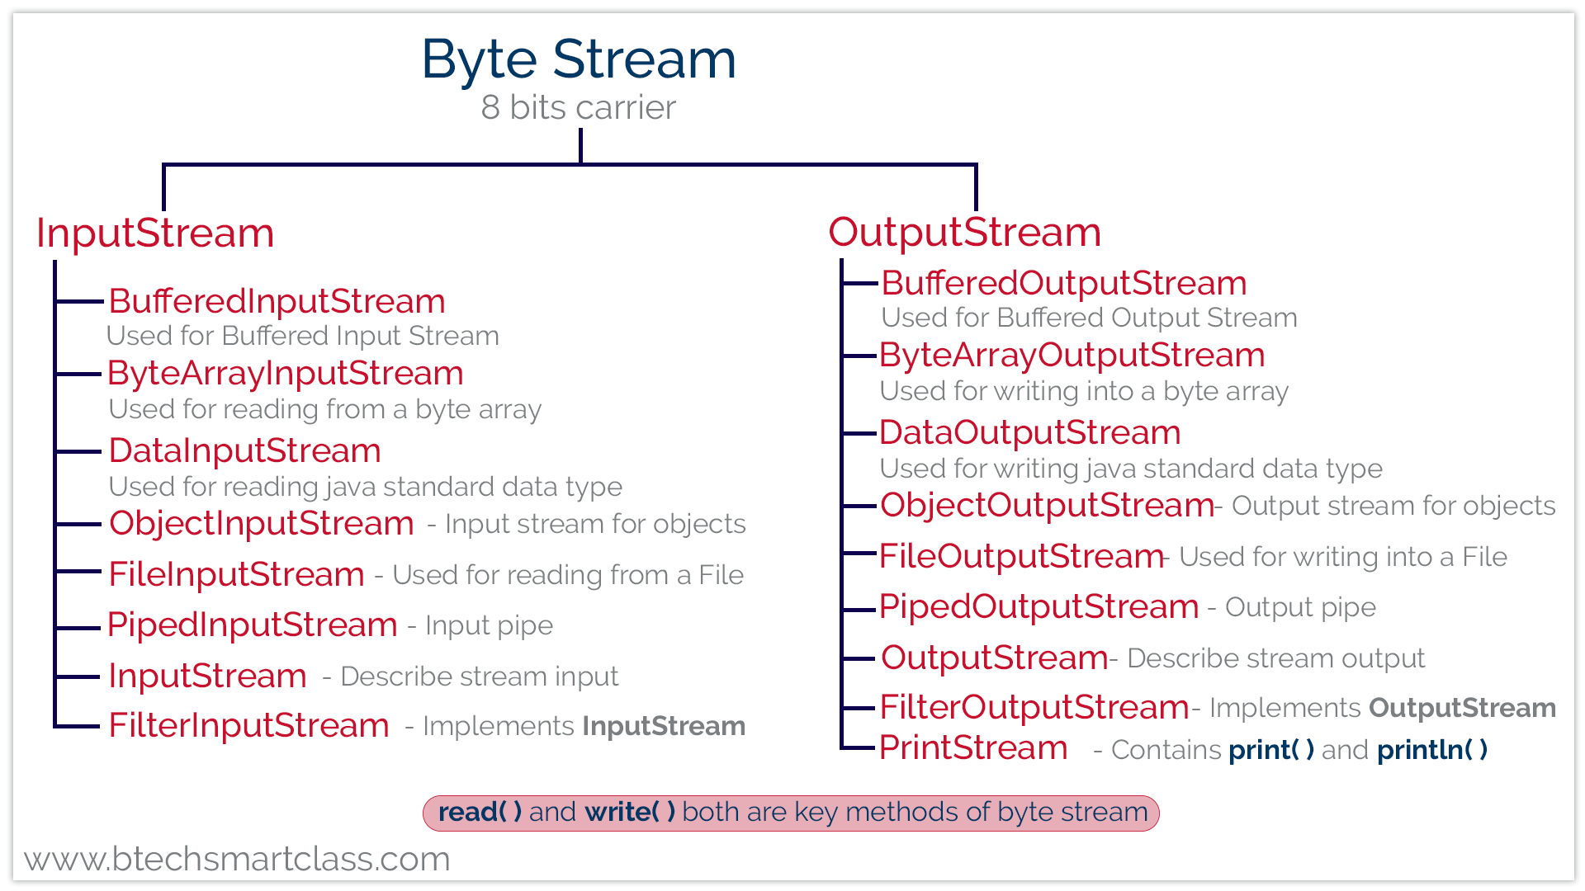
Byte Stream

Slide 7
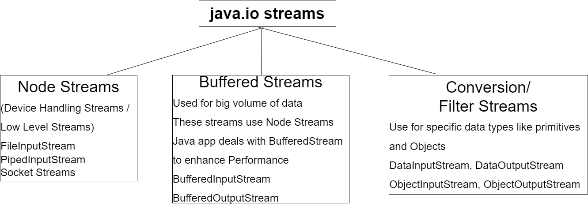
Stream Types

Slide 8
BufferedWriter vs PrintWriter
BufferedWriter | PrintWriter
BufferedWriter can specify size of buffer | PrintWriter can not specify size of buffer
BufferedWriter has write methods | PrintWriter has Write and Print methods
Can not wrap character oriented streams only | Can wrap character oriented and byte oriented streams only
Does not support flushing | Supports Auto flushing

Slide 9
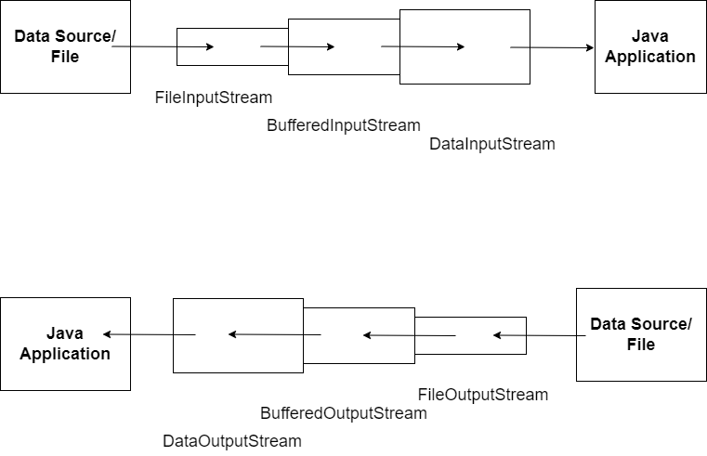
Stream Chaining

Slide 10
Java Serialization
Read or write a Java object to a stream
Saving an object to persistent storage is called persistence
Java provides a Serializable interface
Serializable Interface has no methods and is a marker interface
When an object is serialized, only data of the object are preserved

Slide 11
Java Serialization
If a data variable is an object, data members of the object are also serialized if that object’s class is serializable
If a serializable object contains reference to non-serializable element, the entire serialization fails
“transient” fields does not get serialized
ObjectInputStream and ObjectOutputStream are used for serialization

Slide 12
Java Serialization
What is serialVersionUID?
Each time an object is serialized, the object is Stamped with serialVersionUlD, and it’s calculated based on information about the class and fields.
When object is being deserialized, if the class has changed since the object was serialized, the class could have a different serialVersionUID, and deserialization will fail.(java.lang.InvalidClassException).
Serialization format overview
Magic Number.
Serialization format version number.
Class description -> class name, serialVersionUID, description of data members(class signature)
State of the object.(non static & non transient data members)

Slide 13
File class
The File class has methods to perform below operation on a file
Create File objects
Check a File object can be read and written to.
Check if File object exists.
Get file (and path) names.
Get a list of file names inside a directory.
Create a Directory.
Rename a file.
Last modification date.
Delete the File object.

