Slide 1
Control structures and loops

Slide 2
Control structures for decision making
Decision Making in java is done using if, if-else, switch-case
Selection statements:
if
if-else
nested-if
if-else-if ladder
switch-case
Jump Statements
break
continue
Return

Slide 3
if statement
if syntax: if (condition) {
// Statements to execute if condition is true
}
if-else syntax: if (condition) {
// Executes this block if condition is true
} else {
// Executes this block if condition is false
}
Nested if syntax: if (condition1) {
// Executes when condition1 is true
if (condition2) {
// Executes when condition2 is true
}
}

Slide 4
if-else-if ladder
If-else-if syntax :
if (condition1) {
statements;
} else if (condition2) {
statement;
} else if (condition3) {
statement;
} else {
statement;
}

Slide 5
Switch- case
switch-case: The switch statement is a multiway branch statement. It provides an easy way to dispatch execution to different parts of code based on the value of the expression.
switch (expression) {
case value1:
statements;
break;
case value2:
statements;
break;
case valueN:
statements;
break;
default:
statements;
}
The expression can be of type byte, short, int char, or an enumeration. Beginning with JDK7, expression can also be of type String.
Duplicate case values are not allowed.
The default statement is optional.
The break statement is used inside the switch to terminate a statement sequence.
The break statement is optional. If omitted, execution will continue on into the next case.

Slide 6
Jump statements
Java supports three jump statements: break, continue and return. These three statements transfer control to another part of the program.
break: In Java, a break is majorly used for:
Terminate a sequence in a switch statement
To exit/break a loop.
continue: It is useful to continue the loop skipping statements below continue statement.
return : It is used to return value or control to calling function.

Slide 7
Demo programs/ assignments
Program to find maximum number of three numbers
Print if number is odd or even
Print passing class for Student based on marks entered
40 to < 50 - Pass class
50 to < 60 - Second class
60 to < 75 - First class
75+ - Distinction
Print each number in words from 1 to 10 using switch case.

Slide 8
Loops
Loops are used to perform repetitive tasks by executing statement written inside loop
while loop:
Its entry controlled loop
A while loop is a control flow statement that allows code to be executed repeatedly based on a given boolean condition.
Syntax:
while (condition) {
loop statements...
}

Slide 9
Loops
for loop:
Its entry controlled loop
for loop provides a concise way of writing the loop structure.
Unlike a while loop, a for statement consumes the initialization, condition and increment/decrement in one line thereby providing a shorter, easy to debug structure of looping.
Syntax:
for (initialization; testing condition; increment/decrement) {
statement(s)
}

Slide 10
Loops
do while:
Exit controlled Loop
do while loop is similar to while loop with only difference that it checks for condition after executing the statements
Syntax:
do {
statements..
} while (condition);

Slide 11
Recusion
Calling a method within itself
Recursive methods can replace loops
Recursive function should have halting condition otherwise the methods will be called infinite time.
Ex.
//calling a method within itself
public static int factorial(int no) {
if(no == 1) {
return 1;
}
return no * factorial(no - 1);
}

Slide 12
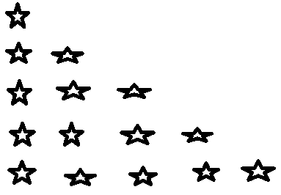
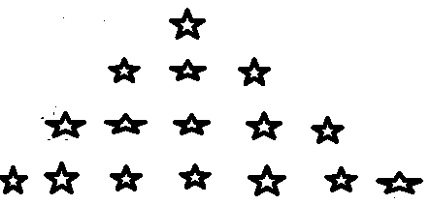

Demo programs/ assignments
Print n numbers using loops
Print Fibonacci series up to n numbers.
Print factorial of input number with loop and recursion
Print below patterns

