Slide 1
Objects and Reference

Slide 2
Object and Class
2
What is Object?
Any real life entity which has properties and behaviours
Instance of class / variable of class
What is class?
Blueprint for Object
template that describes the data/ properties/attributes and behaviors/methods associated with its instance.
It defines data access policy using public, private and protected keywords.

Slide 3
Object life cycle
3
Garbage collection of Object
Object creation
Object Initialization
(using constructor)
Perform behaviours
(using instance methods)

Slide 4
Access specifiers for data members and methods
4
Access specifiers:
private members can be accessed within class only
protected members can be accessed within class and inside child classes
default members can be accessed within package
public members can be accessed anywhere
protected and default behaves same within packages but protected can be accessed inside child class

Slide 5
Access specifiers for data members and methods
5
Access specifiers/Access Control:
Access Specifier | Same Class | Same Package | Sub-class or child class outside package | Outside class, package and sub-class
public | Yes | Yes | Yes | Yes
protected | Yes | Yes | Yes | No
default | Yes | Yes | No | No
private | Yes | No | No | No

Slide 6
Constructors
6
Constructor is special method with same name as class and with or without arguments but no return type.
Constructor is used to initialize object
If programmer do not write constructor for class, default no argument constructor will be used for object initialization
Types of Constructors
Default constructor ( 0 or no arguments)
Parameterized constructor (with arguments)

Slide 7
Example of class and Constructors
7
package com.cdac.acts;
public class Student {
private int rollNo;
private String name;
private String course;
public Student() {
}
public Student(int rollNo, String name, String course) {
this.rollNo = rollNo;
this.name = name;
this.course = course;
}
public void printStudent() {
System.out.println("\n*****Student Data starts******");
System.out.println("Student Roll No : "+ rollNo);
System.out.println("Student Name : "+ name);
System.out.println("Student course : "+ course);
System.out.println("*****Student Data ends******");
}
public static void main(String[] args) {
Student s1 = new Student();
s1.printStudent();
Student s2 = new Student(123, "Ram", "DAC");
s2.printStudent();
}
}

Slide 8
Reference variable
8
When we create an object (instance) of class then space is reserved in heap memory.
We create a reference pointing to object is called Reference variable
Classes, interfaces, arrays, enumerations, and, annotations are reference types in Java.
Reference variables hold the objects/values of reference types in Java.
Reference variable can also store null value. Default value is null
Student s1 = new Student(123, "Ram", "DAC");
S1 -> Reference variable( located on stack)
Student Object : located on Heap
Heap memory
Object of Student class with properties and behaviours
s1

Slide 9
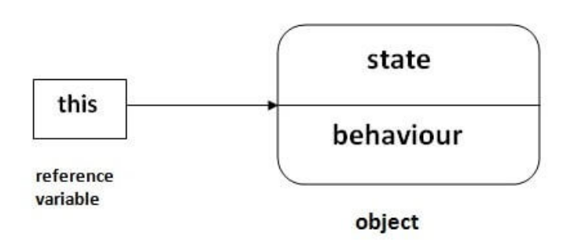
Reference variable
9
Reference can be passed to methods for pass by reference.
this is reference variable which points/refers to invoking objects in instance methods and constructors.
To be precise this is final reference which can not ne changed or modified
Ex. this = null; //invalid statement

