Slide 1
Arrays

Slide 2
Arrays in Java
An array in Java is a group of like-typed or homogeneous elements /variables stored in contagious memory.
Arrays are dynamically allocated in Java unlike C++.
Arrays are Arrays are objects in Java, we can find their length using the object property length.
Java Arrays are ordered, and each has an index beginning from 0.
Java array can also be used as a static field, a local variable, or a method parameter.

Slide 3
Arrays in Java
The direct superclass of an array type is Object
Every array type implements the interfaces Cloneable and Serializable
This storage of arrays helps us in randomly accessing the elements of an array [Support Random Access].
The size of the array cannot be changed once initialized.

Slide 4
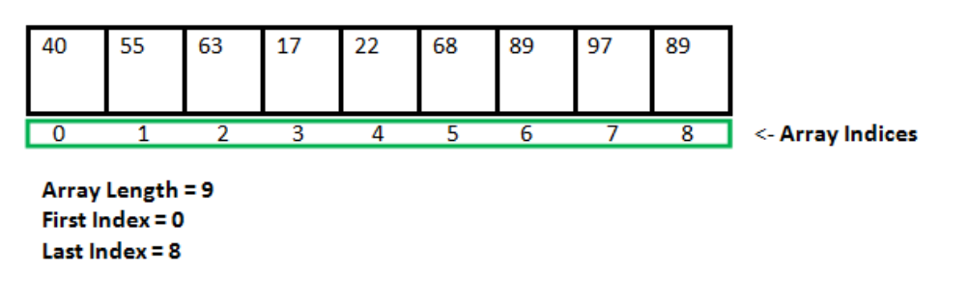
Arrays in Java
An array of primitives (int, char, etc.) and object (or non-primitive) references of a class depending on the definition of the array.
In the case of primitive data types, the actual values are stored in contiguous memory locations.
In the case of class objects, the actual objects are stored in a heap segment.
1D Array Representation

Slide 5
Arrays Declaration
int arr[]; or int[] arr; // 1D array of int
double[] arr1; // 1D array of double
String[] args; // 1D array of double
Object[] objectArr; // 1D array of Objects
Employee[] empArr; // 1D array of Employees
int arr[][]; // 2D array of int
String[][] strArray; // 2D array of Strings

Slide 6
Array Literal & Array Initialization
If size of the array and variables of the array are already known, array literals can be used
1D Array Literal
int arr[] = new int[]{40,55,63,17,22,68,89,97,89};
new int[] can be omitted if values are provided while creating array
int arr1[] = {40,55,63,17,22,68,89,97,89}; // Array Literal
String[] strArr = {"Hi","Hello","Namste"}; // Array literal
2D Array Literal
int[][] array2D = {{1,2,3},{4,5,6}}; // Array of two 1D array i.2D array
String[][] strArray2D = {{"Hi","Hello","Namste"},
{"Bye","Tata","Chalta hu"}}; // 2D string array

Slide 7
Instantiating and accessing an Array in Java
int intArray[]; //declaring array
intArray = new int[20]; // allocating memory to array
or
int[] intArray = new int [20]; // Array creation in one step
// Setting values to array element
for (int i = 0; i < arr.length; i++) {
arr[i] = 0;
}
// Accessing the elements of array
for (int i = 0; i < arr.length; i++) {
System.out.println("At index " + i + " : "+ arr[i]);
}

Slide 8
Arrays utility class
An Array can be converted to String for printing using Arrays.toString()
int arr1[] = {40,55,63,17,22,68,89,97,89};
// no need of loop for printing
System.out.println(Arrays.toString(arr1));

Slide 9
Program demo
Create any array, get values from user, print values, modify array elements etc.
Search in the array
Binary search in the array
Print class is array using getClass() method
Print super class of Array using getClass().getSuper()

Slide 10
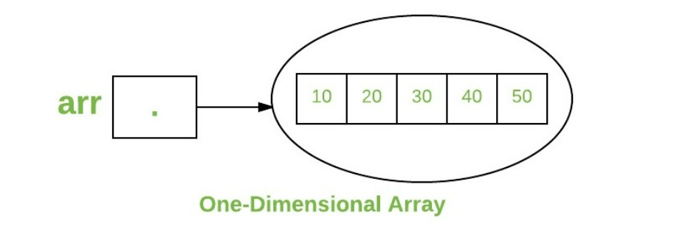
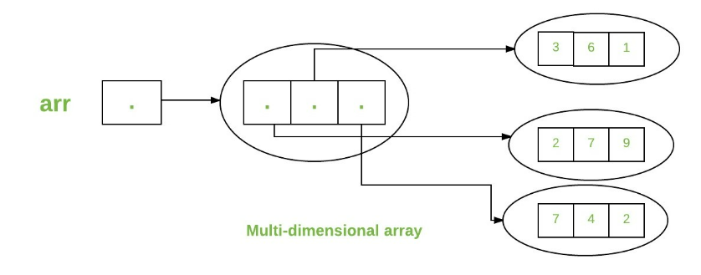
1D and 2D array representation

Slide 11
Multidimensional arrays
Multidimensional arrays are arrays of arrays with each element of the array holding the reference of other arrays.
These are also known as Jagged Arrays.
int arr[][] = { { 2, 7, 9 }, { 3, 6, 1 }, { 7, 4, 2 } };
// printing 2D array
for (int i = 0; i < 3; i++) {
for (int j = 0; j < 3; j++) {
System.out.print(arr[i][j] + " ");
}
System.out.println();
}

Slide 12
Passing arrays to methods
package com.cdac.acts;
public class ArrayPrinter {
public static void printArray(int[] arr) {
//Print Array Elements
for (int i = 0; i < arr.length; i++) {
System.out.println("\nElement="+ arr[i]);
}
}
public static void printArray(String[] strArr){
//Print Array Elements
for (int i = 0; i < strArr.length; i++) {
System.out.println("\nElement="+ strArr[i]);
}
}
public static void main(String args[]) {
int arr[] = { 10, 60, 90, 50, 40};
// passing array to method
printArray(arr);
String strArr[] = { "C", "C++", "Java", "C Sharp"};
// passing array to method
printArray(strArr);
}
}

