Slide 1
Object Oriented Paradigm

Slide 2
Object Oriented Paradigm
2
Object oriented Paradigm has Object Oriented Principles
Object Oriented Principles
Encapsulation
Inheritance
Polymorphism
Cohesion
Coupling
Programming practices
Data abstraction
Data Handling

Slide 3
Object Oriented Principles
3
Encapsulation:
binding data members with member functions of object.
binding properties with behaviours of object.
Inheritance:
Creation of new object by acquiring common properties and behaviours and extending behaviour of parent object if required.
Generalization to Specialization

Slide 4
Object Oriented Principles
4
Polymorphism:
many forms of same thing
different behaviour for different caller
Coupling:
Interaction between different objects( Message passing)
Coupling should be low ideally
Cohesion:
Interaction within object
Cohesion should be high( Self sufficient object)

Slide 5
Programming practices
5
Data Abstraction:
Knowing required details about Object
Never details about how the object performs behaviors
Data Hiding:
Controlling the accessibility of objects data( Properties and behaviors)
Hiding details from outside world.

Slide 6
Code re-use techniques in Java
Association (has-a relationship)
Using existing objects/functionality
Inheritance (is-a relation)
Code reuse and extension

Slide 7
Association
One class contains one or more references/objects of other classes. (class has an object from another class as a data member)
Association is also called containment
Through Association we can use existing functionality AS-IS.
Association is specialized to Aggregation and Aggregation specialized to Composition
Examples
Person has Addresses
Student has Certificates
Person has AdharCard
Notes:
Example: Pen -> initializing Ball
Example: implementation of Stack2 using containment

Slide 8
Association, Aggregation and Composition
Aggregation
Composition
Association

Slide 9
Association
It defines has- relationship between objects
Define Multiplicity between objects
Association can be used for implementing one-to –one, one-to-many and many-to-many kinds of relationship between objects.
Example. Car and Driver relationship
Notes:
Example: Pen -> initializing Ball
Example: implementation of Stack2 using containment

Slide 10
Aggregation
It is also has-a relationship
It is special case of Association
Define directional has-a relationship between objects
Direction has to be specified that which object contains which object
Example: Car has Engine, Course has Students
Notes:
Example: Pen -> initializing Ball
Example: implementation of Stack2 using containment

Slide 11
Composition
It is also has-a relationship
Restricted Aggregation is called Composition
Directional has-a relationship between objects
If one object contains another object, if the contained objects does not exists without existence of container object.
Example : Car has price
Notes:
Example: Pen -> initializing Ball
Example: implementation of Stack2 using containment

Slide 12
Steps to implement Association
Create Address class with fields like houseNo, laneNo, area , pinCode etc.
Create Student class with fields like rollNo, name and Create reference/object of Address class( has-relationship)
Student class object can be represented as
houseNo
laneNo
area
pinCode
Address Object
rollNo
name
address
Student Object
Notes:
Example: Pen -> initializing Ball
Example: implementation of Stack2 using containment

Slide 13
Inheritance (is-a relationship)
Inheritance allows one class to acquire properties and behaviors of another class.
Inheritance establishes is-a relationship between objects.
The class whose properties & behaviors are inherited in another class is called as Base or Parent or Super class.
The class which inherits properties & behaviors another class is called as Derived or Child or Sub class.
Runtime Polymorphism can not be done without Inheritance.
Notes:
Example: Pen -> initializing Ball
Example: implementation of Stack2 using containment

Slide 14
Types of Inheritance
There are 5 major types of inheritance
Single Inheritance
Multilevel Inheritance
Hierarchical Inheritance
Multiple Inheritance
Hybrid Inheritance
Notes:
Example: Pen -> initializing Ball
Example: implementation of Stack2 using containment

Slide 15
Single Inheritance
Person
Student
Notes:
Example: Pen -> initializing Ball
Example: implementation of Stack2 using containment

Slide 16
Multilevel Inheritance
Player
CricketPlayer
Baller
Notes:
Example: Pen -> initializing Ball
Example: implementation of Stack2 using containment

Slide 17
Hierarchical Inheritance
Player
CricketPlayer
FootballPlayer
Notes:
Example: Pen -> initializing Ball
Example: implementation of Stack2 using containment

Slide 18
Multiple Inheritance
Lion
Tiger
Liger
Notes:
Example: Pen -> initializing Ball
Example: implementation of Stack2 using containment

Slide 19
Hybrid Inheritance( Diamond)
Animal
Lion
Tiger
Liger
Notes:
Example: Pen -> initializing Ball
Example: implementation of Stack2 using containment

Slide 20
Inheritance Syntax
Inheritance syntax
public class <Derived class Name> extends <Base class Name> {
// Instance variables/methods
}};
Example:
public class CricketPlayer extends public Player {
// Instance variables/methods
}
Extends keyword denote inheritance
Notes:
Example: Pen -> initializing Ball
Example: implementation of Stack2 using containment

Slide 21
Implementing Inheritance Example
Steps to be followed
Create class Player with name and age .
Create class CricketPlayer by extending/inheriting Player class. Add runs as extra instance data member
Create object of Player and CricketPlayer class and call methods
Object of CricketPlayer can be represented as
name
age
runs
Notes:
Example: Pen -> initializing Ball
Example: implementation of Stack2 using containment

Slide 22
22
Access specifiers for data members and methods
Access Specifier | Same Class | Same Package | Sub-class or child class outside package | Outside class, package and sub-class
public | Yes | Yes | Yes | Yes
protected | Yes | Yes | Yes | No
default | Yes | Yes | No | No
private | Yes | No | No | No

Slide 23
Constructor Calls in Inheritance (chaining)
If Derived class object is created, first Base class constructor and then Derived class constructor gets called
If base class has only parameterized constructor, it can not be called automatically hence programmer needs to call it explicitly ( To avoid this situation, we can implement parameterized as well as default constructor in base class)
Notes:
Example: Pen -> initializing Ball
Example: implementation of Stack2 using containment

Slide 24
Constructor Calls in Inheritance
Why Base class constructor gets called in inheritance?
Constructor is object specific and to initialize base class object within Derived class object constructor call is required.
Notes:
Example: Pen -> initializing Ball
Example: implementation of Stack2 using containment

Slide 25
Up casting
Up casting is using the Super class reference to refer the sub-class object
Conversion of sub-class reference into its super class reference is called Up casting.
Player
CricketPlayer
Notes:
Example: Pen -> initializing Ball
Example: implementation of Stack2 using containment

Slide 26
Polymorphism
Polymorphism means many forms of same thing
There are two type of Polymorphism
Static Polymorphism ( Early binding)
Achieved through Method Overloading
Runtime Polymorphism ( Late or runtime binding )
Achieved through Method Overriding & late binding
Methods are called using Dynamic Method dispatch
Notes:
Example: Pen -> initializing Ball
Example: implementation of Stack2 using containment

Slide 27
Method Overriding
When both super class and sub-class have instance method with same signature but different implementation is called as Method Overriding
Extends behavior of parent class method in child class
Requirements for Method Overriding
Inheritance is must for method overriding
Same signature means same return type, parameter list and name of method
Static and final methods can not be overridden as they are not inherited in child class
Notes:
Example: Pen -> initializing Ball
Example: implementation of Stack2 using containment

Slide 28
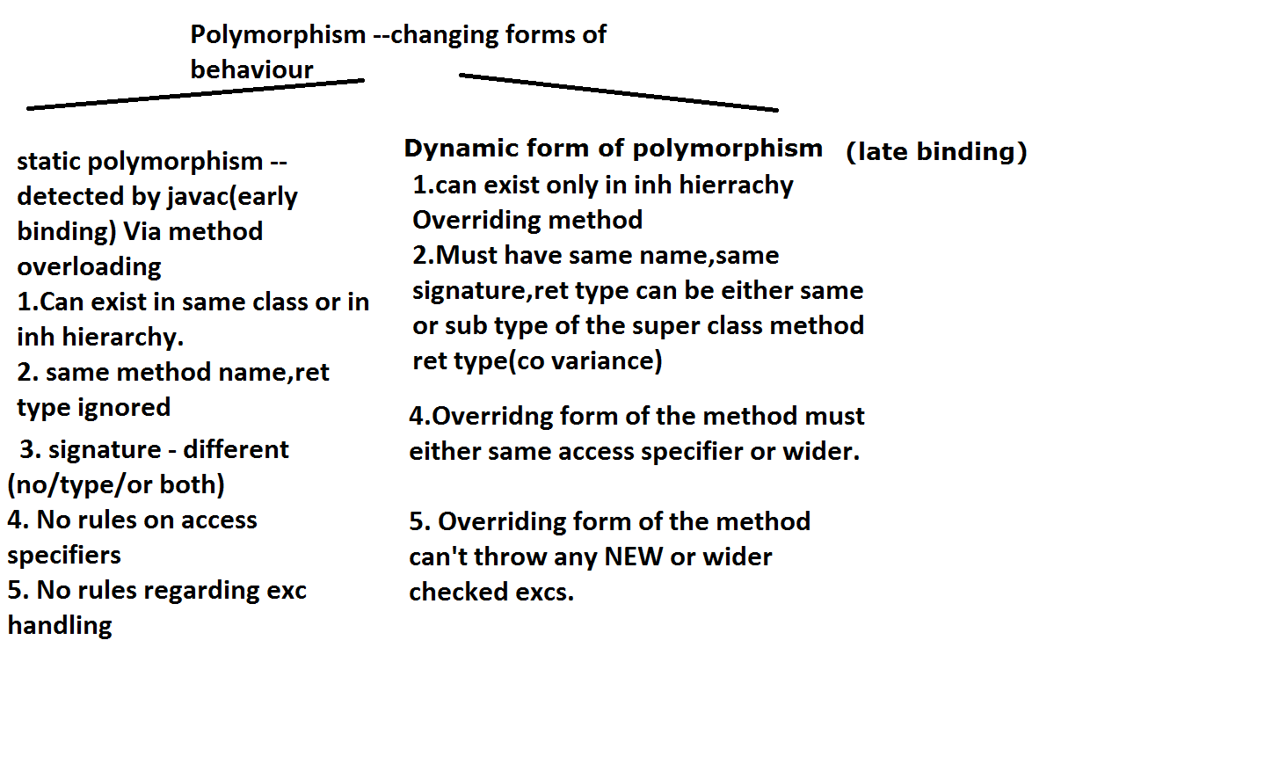
Method Overloading vs Method Overriding

Slide 29
Virtual Methods and dynamic method dispatch
Dynamic method dispatch is achieved through virtual methods
All instance methods are by default virtual in Java
Method calls are resolved at runtime based on type of object but not considering type of reference
Notes:
Example: Pen -> initializing Ball
Example: implementation of Stack2 using containment

Slide 30
Abstract class and Interface
Abstract class is class which has at least one abstract method or class declared as abstract
abstract keyword can be applied to methods and classes
Abstract class is incomplete which has common functionality implemented and some functionality is unimplemented (incomplete type)
Interface has all methods are public and abstract
Object of Abstract class & Interface can not be created.
Notes:
Example: Pen -> initializing Ball
Example: implementation of Stack2 using containment

