Slide 1
CLOUD COMPUTING / RESEARCH PROJECT
Fragmentation-Aware
Scheduling for Multi-Tenant
MIG-Based GPU Clouds
A100 profile abstraction
Discrete placement positions
COMPUTE · 7 POSITIONS
Auditing Minimum Fragmentation Increment (MFI) and evaluating bounded lookahead under synthetic workloads
0 1 2 3 4 5 6
MEMORY · 8 POSITIONS
Saurabh Kumar
0 1 2 3 4 5 6 7
IIT (BHU), Varanasi | October 2026
A legal profile must satisfy BOTH footprints and the permitted start-index set.
SIMULATION-BASED STUDY
Published MFI is the foundation; this project audits assumptions and evaluates whether lookahead is worth its cost.
No physical GPU benchmark or cloud deployment is claimed.
Notes:
Open by describing the work as a simulation-based research extension. The published MFI method is the foundation; this project audits implementation assumptions and evaluates whether fixed/adaptive lookahead is worthwhile.
Sources: [1] MFI paper; [2] NVIDIA MIG documentation.

Slide 2
OVERVIEW
Project in One Minute
01
02
03
04
MIG constraints
MFI baseline
Bounded lookahead
Paired experiments
Compute + memory + legal index positions
Minimize immediate fragmentation increase
Simulate limited future admissions
Acceptance, uncertainty and decision cost
Current conclusion
Score semantics materially change placement choices. The current small study has not established a consistent, reliable acceptance gain from lookahead.
Contribution here = implementation audit + controlled evaluation, not a claim that lookahead is already superior.
[1]
02
Notes:
Set expectations early: MFI is prior work, while the project contribution is the implementation audit and evaluation of the proposed extension. “No reliable gain established” is a meaningful research outcome, not a failure.
Source: [1]

Slide 3
PROBLEM
Why GPU Scheduling Is Difficult in Multi-Tenant Clouds
Heterogeneous requests
One GPU, discrete placement options
3g.40gb
large profile
Compute positions
1g.20gb
small memory-heavy
Memory positions
2g.20gb
medium profile
MIG uses isolated GPU Instances with dedicated compute and memory resources.
Profiles are discrete; only supported size combinations and legal starts are allowed.
1g.10gb
small profile
A placement can be feasible now yet reduce how many later jobs can be admitted.
HARDWARE-LEVEL ISOLATION · DISCRETE PROFILES
[1, Section III; 2]
03
Notes:
Explain that the scheduling problem is online: future workload types and durations are not known exactly when the current request arrives. MIG reduces interference but also constrains placement flexibility.
Source: [1, Section III; 2]

Slide 4
SYSTEM MODEL
MIG Profile Model Used by the Simulator
Profile
Compute
Memory
Legal starts
A profile has TWO independent footprints
7g.80gb
7
8
0
Example: 3g.40gb
4g.40gb
4
4
0
Compute (3 positions)
3g.40gb
3
4
0, 4
Memory (4 positions)
2g.20gb
2
2
0, 2, 4
1g.20gb
1
2
0, 2, 4, 6
3 compute slices ≠ 3 memory slices
1g.10gb
1
1
0, 1, 2, 3, 4, 5, 6
Model boundary
Key example: 1g.20gb = 1 compute + 2 memory slices.
A100-80GB table from the paper; not a live driver query or validated hardware emulation.
[1, Table I; 2]
04
Notes:
This detail matters because some profiles have different compute and memory footprints. The simulator validates both dimensions and the legal placement-start set.
Source: [1, Table I; 2]

Slide 5
CORE CONSTRAINT
Fragmentation: Enough Free Slices, but No Legal Placement
Requested profile: 3g.40gb | Legal starts: 0 and 4
GPU A — fragmented
GPU B — legal placement exists
Compute positions (7)
Compute positions (7)
0
1
2
3
4
5
6
0
1
2
3
4
5
6
Memory positions (8)
Memory positions (8)
0
1
2
3
4
5
6
7
0
1
2
3
4
5
6
7
START 0 BLOCKED · START 4 BLOCKED
LEGAL START 4 AVAILABLE
Aggregate free slices are sufficient, but no legal pair fits.
Both complete footprints are clear.
Blue = occupied | Teal/cyan = candidate footprint
Blue = occupied | Teal/cyan = candidate footprint
Illustrative schematic, not measured output. Existing allocations do not migrate in this model.
[1, Figure 3 and Section V-A]
05
Notes:
Use the diagram to explain why first-fit or a simple best-fit resource count can fail even when aggregate free resources appear sufficient. The key constraint is legal index/footprint feasibility.
Source: [1, Figure 3 and Section V-A]

Slide 6
RESEARCH DESIGN
Research Question and Evaluation Objectives
CORE QUESTION
Can bounded lookahead improve future job acceptance enough to justify its extra decision latency?
MODEL
CONFORMANCE
COMPARISON
EVIDENCE
Separate compute, memory, legal starts and job lifetimes.
Audit score semantics against the paper’s numeric example.
Keep paper-path baselines separate from global-feasible alternatives.
Use paired traces; report acceptance, latency and uncertainty.
Hypothesis to test — not a claim
Selective lookahead may help when greedy MFI candidates are near-tied, while using less computation than fixed search.
Current scope: acceptance as a primary proxy; fairness, SLOs, energy and priorities are not optimized.
Project research protocol; [1]
06
Notes:
Emphasize that the engineering objective is more jobs accepted, but this project currently uses acceptance as a primary proxy and must also measure decision cost. Fairness, SLOs and energy are outside the current objective.
Source: Project research protocol; [1]

Slide 7
FOUNDATION
Published Foundation: Minimum Fragmentation Increment (MFI)
PUBLISHED METHOD
MFI DECISION LOOP
Zambianco, Fasol & Doriguzzi-Corin
1
Enumerate
feasible GPU/start pairs
“An Online Fragmentation-Aware GPU Scheduler for Multi-Tenant MIG-based Clouds”
2
Dry-run
hypothetical placement
arXiv:2511.18906 (2025)
Counts blocked legal profile placements.
3
Measure
ΔF = Fafter − Fbefore
Weights each profile by its memory-slice count.
Chooses a feasible placement minimizing ΔF.
4
Select
argmin ΔF
Paper study: 100 simulated A100 GPUs, 4 profile distributions, 500 runs per distribution.
Published MFI ≠ this project’s lookahead extension
[1]
07
Notes:
Do not attribute the project’s lookahead algorithm to the original authors. The source paper establishes MFI and its baseline comparisons; our lookahead evaluation is an extension/hypothesis implemented in this repository.
Source: [1]

Slide 8
IMPLEMENTATION
System Model and Simulator Architecture
LOOKAHEAD CONTEXT — past profile counts + completed-duration history only
Synthetic trace
Event simulator
Scheduler policy
GPU state update
Metrics + CSVs
arrival time
profile · duration
arrival + completion
handlers
FF / RR / MFI
fixed / adaptive
allocate legal pair
or reject
acceptance, utilization
latency, diagnostics
Arrival event
Completion event
Call policy → accept and allocate, or reject. Each decision uses only the current state and permitted history.
Release occupied positions; record completed duration for future history-based estimates.
No true future trace or true active-job completion times are revealed to the policy.
Repository: src/mig_scheduler/simulator.py, context.py, state.py
08
Notes:
Explain the information boundary. If the scheduler could see the actual next job or the exact completion time of a running job, it would be evaluating an oracle rather than an online scheduler.
Source: Repository: src/mig_scheduler/simulator.py, context.py, state.py

Slide 9
EXPERIMENTAL INPUTS
Synthetic Workload Distributions
Each arriving job requests one of six profiles. Four categorical distributions create different placement pressures.
Profile
Uniform
Skew-small
Skew-big
Bimodal
7g.80gb
16.7%
5%
30%
30%
4g.40gb
16.7%
10%
25%
15%
3g.40gb
16.7%
10%
20%
5%
2g.20gb
16.7%
20%
10%
5%
1g.20gb
16.7%
25%
10%
15%
1g.10gb
16.7%
30%
5%
30%
Uniform
Skew-small
Skew-big
Bimodal
All profiles equally likely.
Many small requests; can block larger profiles.
Large requests have fewer placement options.
Large and small requests dominate together.
[1, Table II; src/mig_scheduler/workloads.py]
09
Notes:
These distributions originate in the MFI paper’s experimental protocol. Workload traces are synthetically generated and then paired: every policy sees the same trace for a given replicate.
Source: [1, Table II; src/mig_scheduler/workloads.py]

Slide 10
COMPARISON SETUP
Policies Compared: From Simple Placement to MFI
Policy family
Decision logic
Role in this project
First Fit (FF)
First available GPU/start under its order
Simple placement baseline
Round Robin (RR)
Rotate GPU choice to spread requests
Load-balancing baseline
Paper-path BF-BI / WF-BI
Choose one GPU by residual capacity, then use Best Index
MIG-aware paper baselines
MFI all-starts
Minimize ΔF under the all-legal-starts score
Prior score interpretation
MFI free-anchor
Minimize ΔF under anchor-filtered score
Figure-3-conformance candidate
Global-feasible BF/WF
Rank every feasible GPU/start pair globally
Separate alternative heuristics; not paper-path
Score mode and baseline-selection semantics are explicit experimental factors—not hidden implementation details.
Repository: src/mig_scheduler/paper_baselines.py, mfi_score_variants.py; [1]
10
Notes:
This slide prepares the audience for the M12 audit: a global search that always scans all feasible placements can be stronger than a GPU-first algorithm and therefore must not be labeled as the same baseline.
Source: Repository: src/mig_scheduler/paper_baselines.py, mfi_score_variants.py; [1]

Slide 11
ALGORITHM
How MFI Selects a Placement
MFI selects the feasible pair (g*, i*) with the smallest ΔF.
Fragmentation score
F(g) = Σ mₚ × Nblockedₚ(g)
1
Check aggregate resources
free compute ≥ profile compute AND free memory ≥ profile memory
Sum over profiles p with enough aggregate free compute AND memory.
2
Check legal footprint
full compute and memory ranges at start i do not overlap
mₚ
profile memory-slice count
3
Evaluate a hypothetical state
Nblockedₚ(g)
blocked legal starts counted by selected score mode
recompute score under the selected interpretation
4
Take argmin ΔF
ΔF(g,i) = F(after placement) − F(before)
tie-break deterministically by GPU ID, then start index
Score is a flexibility heuristic, not a percentage of wasted GPU capacity.
[1, Algorithm 1 and Algorithm 2; src/mig_scheduler/fragmentation.py]
11
Notes:
MFI is greedy because it considers the immediate change in fragmentation score, not a full future trace. For every candidate the simulator dry-runs a placement, scores the resulting state, and compares ΔF values.
Source: [1, Algorithm 1 and Algorithm 2; src/mig_scheduler/fragmentation.py]

Slide 12
METHOD CONFORMANCE
M12 Audit: Reconstructing the Paper’s Figure 3 Scores
Reported in the paper: F(GPU 1) = 8 and F(GPU 2) = 16
Reconstructed state
Compute occupancy
Paper score
free_anchor_starts
all_legal_starts
GPU 1: 1g.10gb @ 2, @ 3
2 / 7 = 28.6% ≈ 30%
8
8
14
GPU 2: 2g.20gb @ 2; 1g.10gb @ 5
3 / 7 = 42.9% ≈ 43%
16
16
23
all_legal_starts
free_anchor_starts
Counts every blocked legal start when aggregate compute and memory are sufficient.
Skips starts whose anchor index is already occupied in either resource dimension, then checks the full footprint.
Conformance clue, not proof: anchor filtering is not explicit in the paper pseudocode; its executable source was unavailable.
[1, Figure 3 and Algorithm 1; M12_FIGURE3_CONFORMANCE.md]
12
Notes:
Explain that the diagram does not print every occupied index in machine-readable form, so the states are reconstructed consistently with the figure and utilization labels. This is an implementation audit, not a claim to have recovered the authors’ source code.
Source: [1, Figure 3 and Algorithm 1; M12_FIGURE3_CONFORMANCE.md]

Slide 13
BASELINE AUDIT
M12 Audit: Correct Baseline Semantics
Paper-path BF-BI / WF-BI: choose a GPU first, then try Best Index starts on that GPU.
1
Rank GPUs
2
Select one GPU
3
Try Best Index
4
Accept or reject
Only GPUs with sufficient aggregate compute AND memory enter the ranking.
BF minimizes the documented residual score; WF maximizes it.
Inspect legal starts on the selected GPU in profile-specific order.
If no legal start exists there, reject—even if another GPU could fit.
Project residual score assumption
Why this audit matters
R(g,p) = (Cfree − Cₚ)/7 + (Mfree − Mₚ)/8
Global-feasible BF/WF search all feasible GPU/start pairs and are kept as separate alternative heuristics—not mislabeled as paper-path baselines.
BF minimizes R; WF maximizes R.
M12_BASELINE_SEMANTICS.md; [1]
13
Notes:
This fixes a methodological confound. Earlier global feasible search could rescue a request by looking at another GPU after the selected GPU fails. The Figure 3 failure mechanism is precisely that selection of one GPU can result in rejection.
Source: M12_BASELINE_SEMANTICS.md; [1]

Slide 14
EXTENSION
Fixed Lookahead: Evaluate Future Admission, Not Only Immediate Fragmentation
01
02
03
04
Enumerate
Roll out
Count
Choose
All feasible current placements a
Same sampled future job plans per candidate
Future jobs admitted within horizon H
Candidate with highest mean future acceptance
Estimated future admission value
M13 SETTINGS
V̂H(a) = (1 / R) Σᵣ Yᵣ(a)
H = 2
3 rollouts per feasible current placement candidate
Yᵣ(a) = number of later jobs admitted in rollout r; the current job is excluded.
Tie-break: lower immediate ΔF → GPU ID → start index.
Future workload and residual lifetimes are sampled/predicted from available history; true future ground truth is not exposed.
LOOKAHEAD_METHOD.md; src/mig_scheduler/schedulers.py
14
Notes:
This policy is a finite-horizon Monte Carlo lookahead. Because the candidate count can vary and each candidate gets multiple rollouts, total search work scales with candidates × rollouts × horizon.
Source: LOOKAHEAD_METHOD.md; src/mig_scheduler/schedulers.py

Slide 15
EXTENSION
Adaptive Lookahead: Spend Search Only When It Might Matter
Profile estimate from past arrivals
Decision gates
q̂ₚ = (nₚ + η) / (N + Kη)
Insufficient history?
Use greedy MFI
Compare older vs. newer halves of recent profile history:
Recent mix unstable?
Use greedy MFI
TV(q̂old, q̂new) = ½ Σₚ |q̂old,ₚ − q̂new,ₚ|
Rt = max(0, 1 − TV / θTV)
Top ΔF candidates not close?
Use greedy MFI
Stability score and Student-t stopping interval are heuristics—not calibrated probabilities or formal error guarantees.
Otherwise
Shortlist ≤5 and run rollouts
M13: H = 2 · batch size 2 · 2–4 rollouts · ≤5 candidates
ADAPTIVE_LOOKAHEAD_METHOD.md; M13_SCORE_MODE_DESIGN.md
15
Notes:
The adaptive policy attempts to trade off search effort and decision quality. Its nominal interval should not be treated as a rigorous confidence guarantee: repeated interim checks, selecting the observed best candidate, discrete rollout outcomes, and multiple comparisons affect coverage.
Source: ADAPTIVE_LOOKAHEAD_METHOD.md; M13_SCORE_MODE_DESIGN.md

Slide 16
IMPLEMENTATION AUDIT
Implementation: Explicit Score Mode Through the Entire Decision Path
Repository modules
One contract, end to end
score_mode
all_legal_starts | free_anchor_starts
profiles.py / state.py
Profile geometry, legal starts, occupancy
current ranking
ΔF for feasible current placements
fragmentation.py / mfi_score_variants.py
Score functions + greedy MFI
future rollouts
same score mode for later placements
schedulers.py / context.py / simulator.py
Fixed/adaptive search + online boundary
tie-breaking
(ΔF, GPU ID, start index)
adaptive fallback
greedy MFI uses declared mode too
workloads.py / scripts
Trace generation, paired runs, CSVs, manifests
M13 fix: consistent score_mode end-to-end.
Deterministic candidate ordering makes paired comparisons reproducible.
src/mig_scheduler/mfi_score_variants.py; src/mig_scheduler/schedulers.py; CHANGELOG_M13.md
16
Notes:
M13 preserves all-starts for backward compatibility at the Python constructor level while exposing the CLI option. The CLI defaults to the free-anchor Figure-3-conformance candidate; tests guard against mismatched score modes between current placement and hypothetical rollout.
Source: src/mig_scheduler/mfi_score_variants.py; src/mig_scheduler/schedulers.py; CHANGELOG_M13.md

Slide 17
PROJECT DEVELOPMENT
How the Research Evolved: Milestones 1–13
1
M1–M3
Core model
Simulator, profile/placement state, greedy MFI and fixed-lookahead prototype.
2
M4–M6
Algorithm checks
Adaptive budget hypothesis, tiny-trace offline oracle, matched budget frontier.
3
M7–M10
Protocol audits
Horizon, workload dynamics, arrival spacing and load-basis sensitivity.
4
M11–M12
Conformance
Resource gates, BF/WF semantics, Figure 3 score and baseline audits.
5
M13
Controlled test
Score-aware fixed/adaptive lookahead under paired progressive and burst loads.
The repository includes source, tests, manifests, per-job decisions, aggregate CSVs, plots and decision memos.
Repository changelogs M6–M13
17
Notes:
This is a research engineering progression. Some milestones added auditability and experiment validity rather than a new algorithm, and that work is important because MFI has ambiguous details in the paper.
Source: Repository changelogs M6–M13

Slide 18
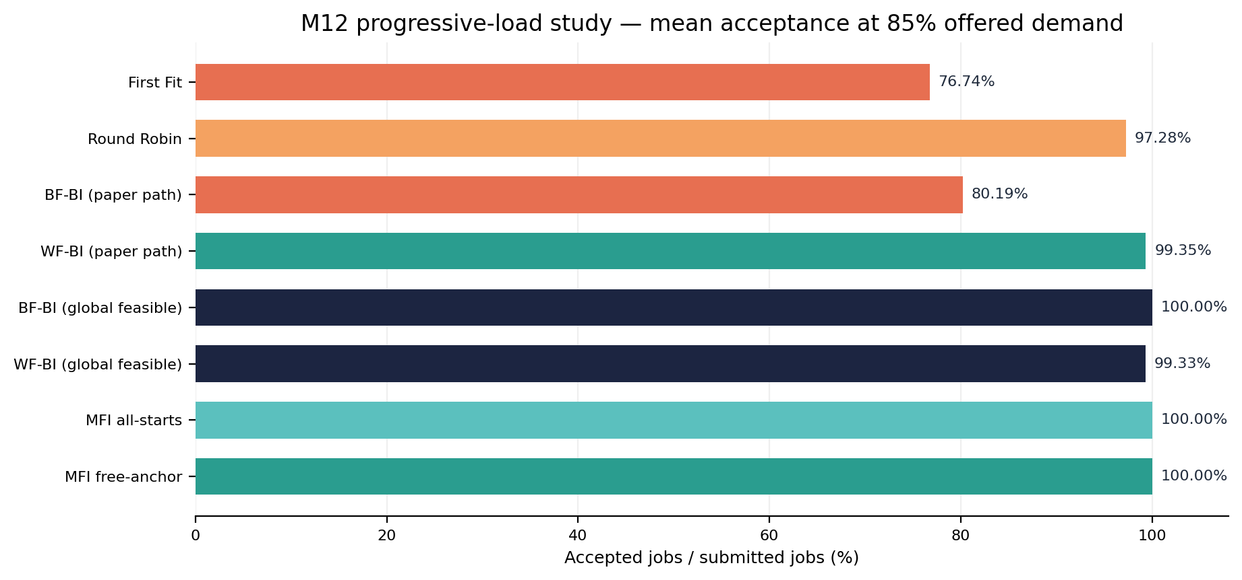
RESULTS · M12
M12 Result 1: Progressive Load on 100 Simulated GPUs
100 GPUs · 4 distributions · 5 reps/distribution · 8 policies (160 runs); mean acceptance at 85% requested-demand checkpoint.
results/m12_figure3_baseline_study_100gpu_5rep/M12_EXPERIMENT_REPORT.md; [1]
18
Notes:
At this point, the MFI score-mode choice changed many placement decisions but did not change acceptance in the progressive sample at the tested checkpoint. Avoid using the result to claim MFI is universally optimal; the sample is small and synthetic.
Source: results/m12_figure3_baseline_study_100gpu_5rep/M12_EXPERIMENT_REPORT.md; [1]

Slide 19
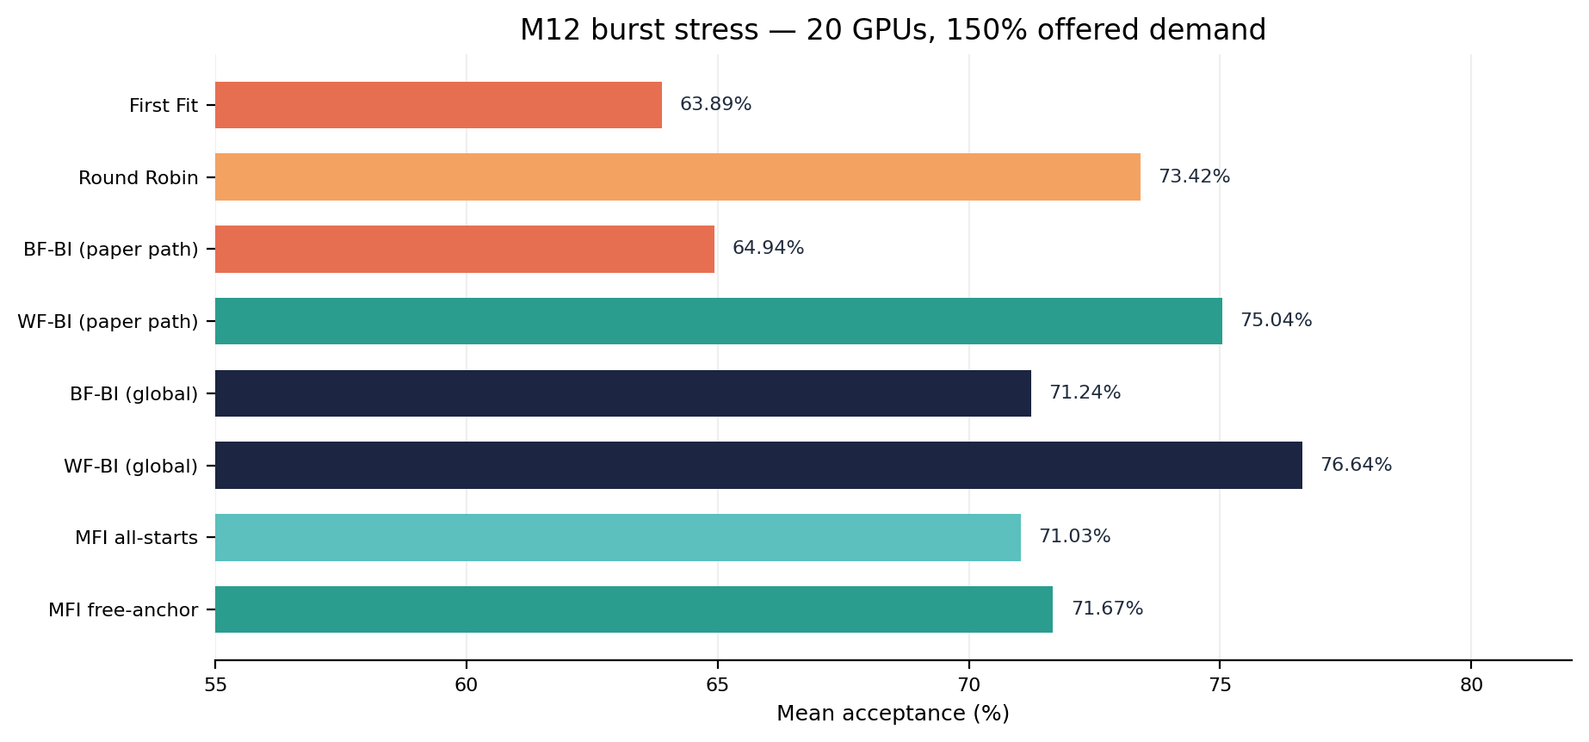
RESULTS · M12
M12 Result 2: Burst / High-Demand Stress Test
20 GPUs · 150% offered demand · gap 0.0 · 5 reps/distribution · 160 runs. Free-anchor − all-starts = +0.64 pp; paired interval −0.80 to +1.86 pp includes zero.
results/m12_burst_150pct_20gpu_5rep/M12_EXPERIMENT_REPORT.md
19
Notes:
The burst experiment creates more pressure to pack jobs because capacity cannot be reused through completions during the arrival sequence. The score modes may select different placements, but the uncertainty interval is too broad to establish a meaningful advantage.
Source: results/m12_burst_150pct_20gpu_5rep/M12_EXPERIMENT_REPORT.md

Slide 20
RESULTS · M13
M13 Experiment: Paired Evaluation of Score-Aware Lookahead
Cluster
Two arrival regimes
4 A100-profile GPUs (abstract model)
Progressive
100% offered-demand target · inter-arrival gap 0.25
Workloads
Burst / stress
150% offered demand · gap 0.0 (all arrivals before completion)
Uniform, skew-small, skew-big, bimodal
Replications
3 per distribution × 2 regimes = 24 shared traces
Search settings
Fixed: H = 2; 3 rollouts per feasible current candidate.
Policies
Adaptive: H = 2; 2–4 rollouts, batch size 2, at most 5 candidates.
10 variants × 24 traces = 240 simulations
Matched traces isolate policy differences; sample size remains exploratory.
M13_EXPERIMENT_REPORT.md; m13_run_manifest.json
20
Notes:
The experiment is much smaller than a full scale-up study. The purpose is to see whether score mode and lookahead policies behave differently and whether the results justify a larger held-out experiment.
Source: M13_EXPERIMENT_REPORT.md; m13_run_manifest.json

Slide 21
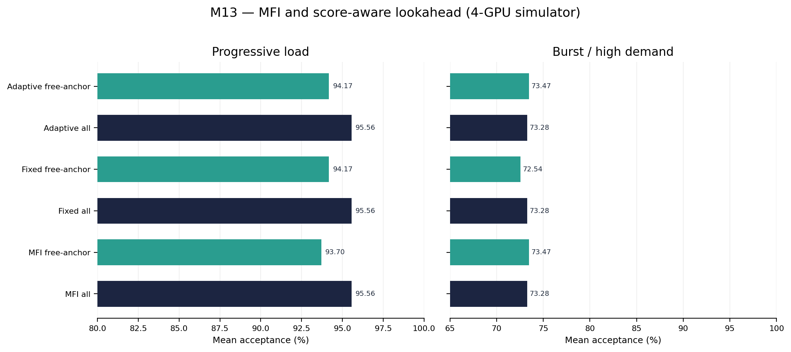
RESULTS · M13
M13 Results: Acceptance Does Not Show a Consistent Lookahead Win
Only 12 paired traces per regime: differences are exploratory, not evidence of a robust gain.
results/m13_score_aware_lookahead_4gpu_3rep/M13_EXPERIMENT_REPORT.md
21
Notes:
The positive progressive free-anchor differences are small and their paired intervals touch zero. The burst result changes direction for fixed free-anchor lookahead. The correct conclusion is inconclusive—not that lookahead never helps, and not that it has been proven to help.
Source: results/m13_score_aware_lookahead_4gpu_3rep/M13_EXPERIMENT_REPORT.md

Slide 22
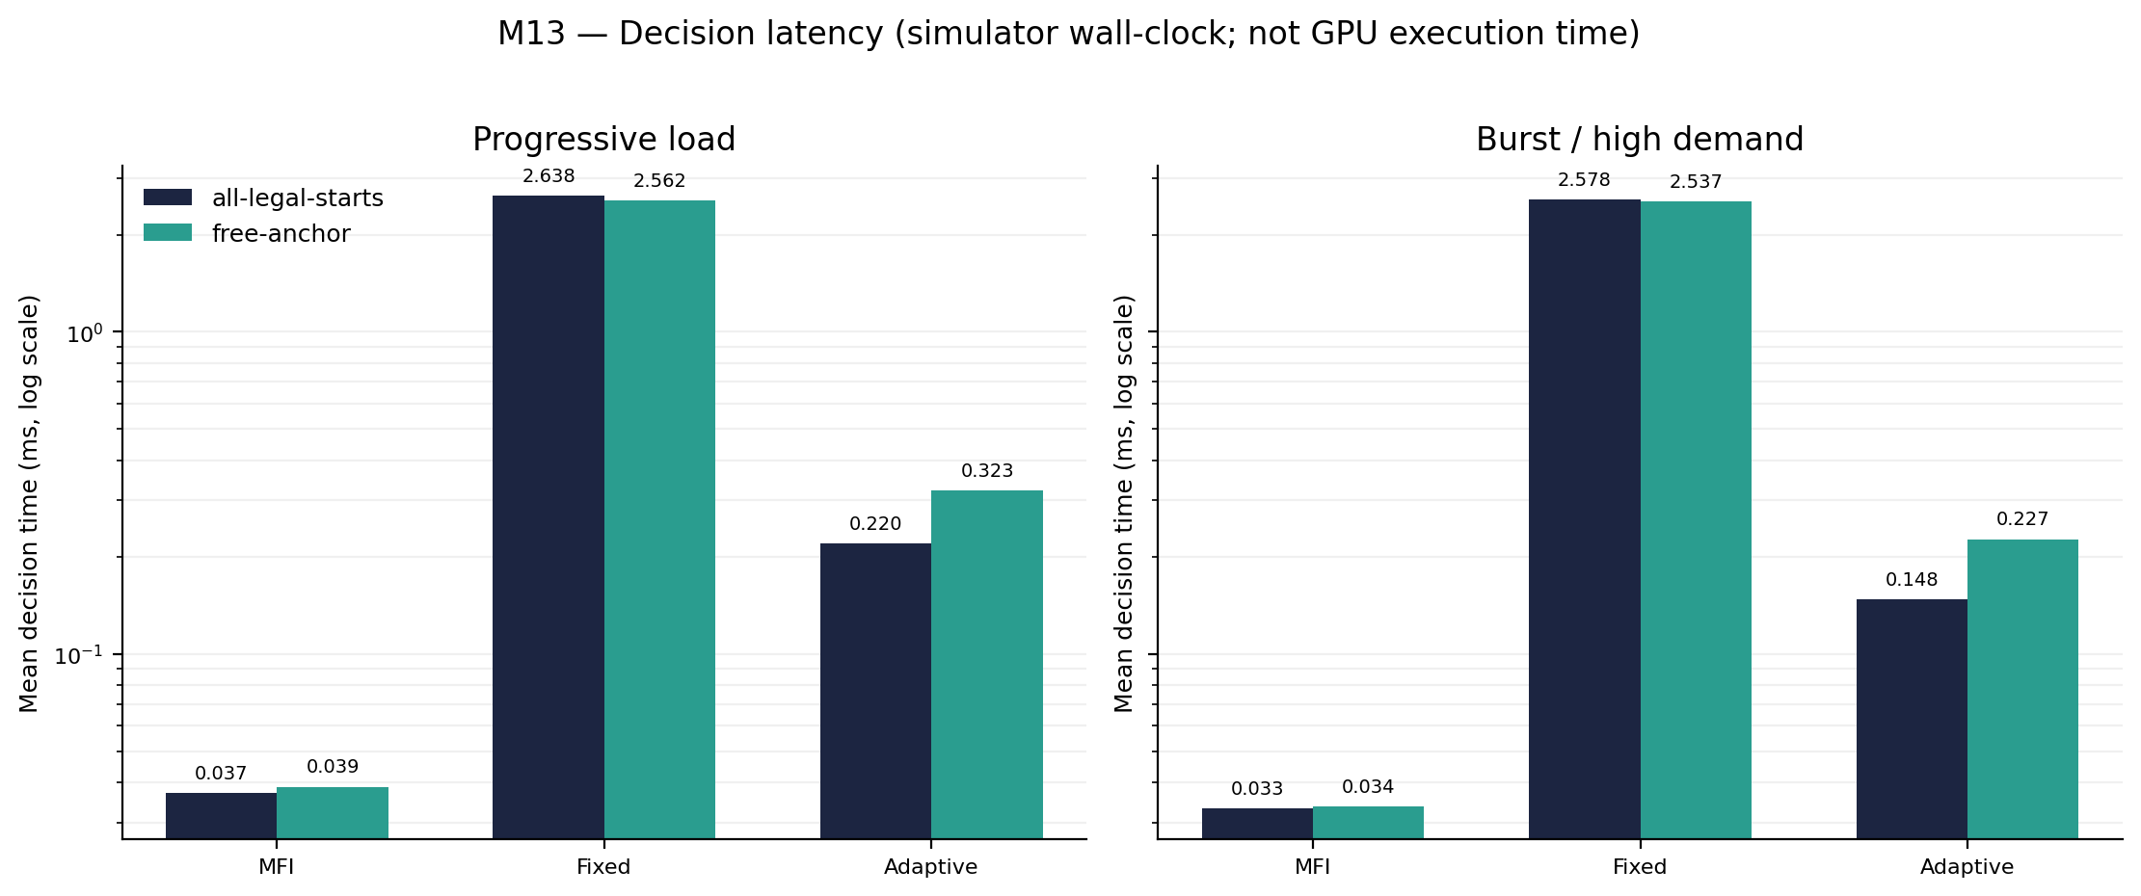
RESULTS · M13
M13 Results: Decision Latency and Search Frequency
Simulator wall-clock time (ms), logarithmic axis; machine/process dependent—not GPU kernel time.
M13_EXPERIMENT_REPORT.md; m13_policy_summary.csv
22
Notes:
The cost-benefit question is central: fixed lookahead is tens of times slower than MFI for no consistent admission improvement in this sample. Adaptive reduces the search budget but the gates often prevent lookahead from running; their thresholds require further calibration.
Source: M13_EXPERIMENT_REPORT.md; m13_policy_summary.csv

Slide 23
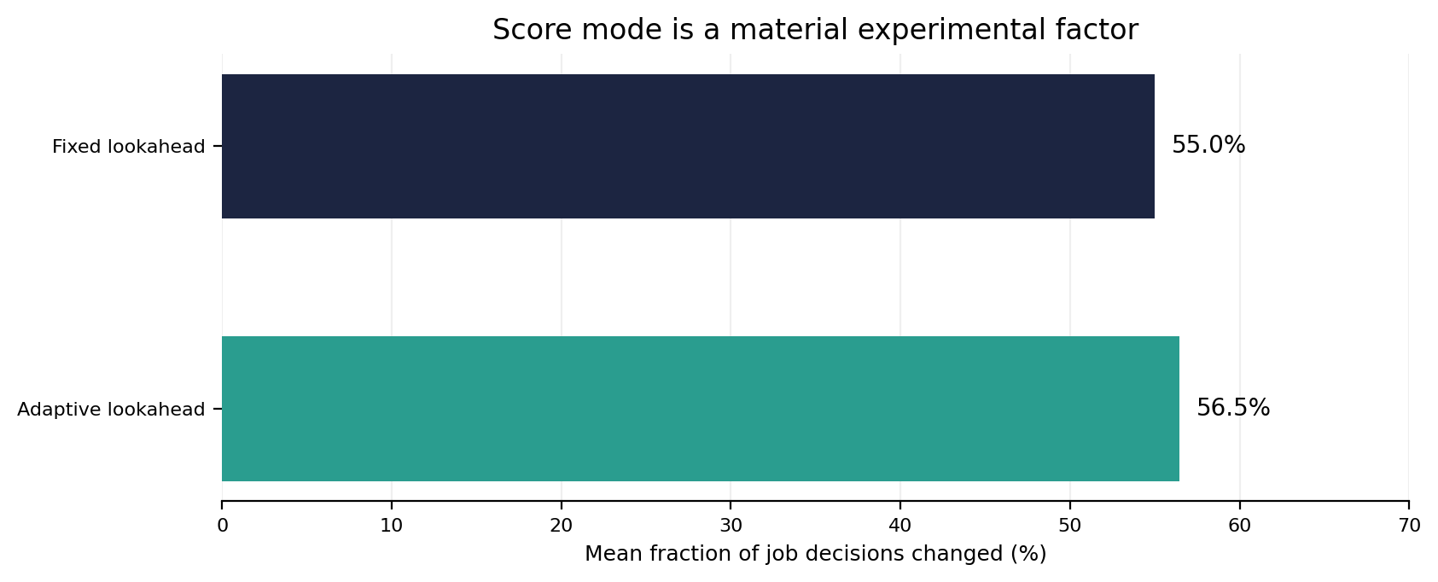
RESULTS · M13
M13 Audit: Score Semantics Change Many Decisions
Fixed lookahead: 55.0% of per-job decisions changed
Adaptive lookahead: 56.5% changed
A changed tuple = (status, GPU ID, start index); it may not change job acceptance.
m13_score_mode_decision_sensitivity.csv; M12_FIGURE3_CONFORMANCE.md
23
Notes:
The score-mode ambiguity is not cosmetic. Different fragmentation scores reorder candidates and future rollout placements. The Figure 3 conformance candidate is better constrained by the reported numerical values, but the paper does not make the exact anchor filtering explicit.
Source: m13_score_mode_decision_sensitivity.csv; M12_FIGURE3_CONFORMANCE.md

Slide 24
RELIABILITY
Validation and Reproducibility
TESTS
BASELINE CHECKS
EXPERIMENT ARTIFACTS
107 automated tests passed
Profile-model validation
Raw runs + per-job decisions
python -m pytest -q
Memory-overlap regression
Aggregate summaries + paired deltas
Regression tests cover score-aware lookahead and placement constraints.
MFI argmin consistency over 250 deterministic randomized states.
Bootstrap intervals + JSON run manifest.
What tests do not establish
Implementation consistency is not proof of exact performance replication or live NVIDIA driver behavior.
Python 3.11+ recommended · python -m pip install -e ".[test,analysis]"
M13_RUN_ME_FIRST.md; scripts/validate_baseline.py
24
Notes:
Mention that deterministic regression tests protect the implementation against regressions, while stochastic scheduling results need statistical replication and external validation. Correct code does not imply that every modeled behavior matches live driver behavior.
Source: M13_RUN_ME_FIRST.md; scripts/validate_baseline.py

Slide 25
INTERPRETATION
Limitations, Threats to Validity, and Next Experiments
Limit
Implication
Concrete next action
Simulation fidelity
Abstract profile/placement model; not driver-validated MIG emulation or hardware benchmark.
Validate model assumptions against supported configurations before hardware claims.
Synthetic workloads
No real tenant arrival/profile/duration dataset.
Use trace-driven or calibrated workload distributions.
Small M13 sample
3 repetitions per distribution/regime; 12 paired traces per regime.
Expand to ≥20–30 held-out seeds after calibration.
Score ambiguity
Free-anchor matches two Figure 3 values; original executable behavior remains unconfirmed.
Keep both score modes in all sensitivity studies.
Policy heuristics
BF/WF residual scalarization and adaptive stop thresholds are assumptions.
Preregister alternatives and calibrate only on separate tuning seeds.
Objective scope
Acceptance only; fairness, SLOs, energy, migration and priorities are not optimized.
Add operational constraints only after admission/latency behavior is stable.
Next experiment: preregister a larger paired study with held-out seeds; report acceptance, latency, fallback rate and variability together.
M13_FINDINGS_AND_NEXT_DECISION.md; ADAPTIVE_LOOKAHEAD_METHOD.md
25
Notes:
A larger study should separate tuning/calibration seeds from test seeds. If the acceptance gain remains negligible and latency cost remains high, the defensible decision may be to simplify or drop lookahead rather than force a novelty claim.
Source: M13_FINDINGS_AND_NEXT_DECISION.md; ADAPTIVE_LOOKAHEAD_METHOD.md

Slide 26
TAKEAWAYS
Conclusion: What We Know Today
01
MFI is a useful baseline
It explicitly minimizes immediate increase in profile-specific fragmentation.
02
Score semantics matter
free_anchor_starts matches reported Figure 3 scores 8 and 16 on reconstructed states.
03
Baseline labels need precision
Paper-path GPU-first BF/WF are distinct from global-feasible alternatives.
04
M13 made the comparison consistent
Score mode now reaches current placement, rollout placement, tie-breaking and fallback.
05
No stable lookahead win established
Fixed search adds substantial decision latency in the current small sample.
Research decision
Do not claim superiority yet. Expand the paired held-out study and keep both score modes explicit.
Repository M12–M13 reports
26
Notes:
Close with the key lesson: accurate method semantics and experimental controls matter as much as algorithm design. The next milestone should test whether any observed gains survive more seeds and a wider set of workload dynamics.
Source: Repository M12–M13 reports

Slide 27
SOURCES
References
[1]
Marco Zambianco, Lorenzo Fasol, and Roberto Doriguzzi-Corin.
“An Online Fragmentation-Aware GPU Scheduler for Multi-Tenant MIG-based Clouds.” arXiv:2511.18906, 2025.
https://arxiv.org/abs/2511.18906
[2]
NVIDIA.
“Multi-Instance GPU User Guide” — concepts, supported MIG profiles and MIG device names.
https://docs.nvidia.com/datacenter/tesla/mig-user-guide/
[3]
Bekir Turkkan, Pavankumar Murali, Pavithra Harsha, Rohan Arora, Gerard Vanloo, and Chandra Narayanaswami.
“Optimal Workload Placement on Multi-Instance GPUs.” arXiv:2409.06646, 2024.
https://arxiv.org/abs/2409.06646
Project artifacts
M12_FIGURE3_CONFORMANCE.md · M12_BASELINE_SEMANTICS.md · M13_SCORE_MODE_DESIGN.md · M13_EXPERIMENT_REPORT.md · M13_FINDINGS_AND_NEXT_DECISION.md
External sources [1]–[3]; project files listed above.
27
Notes:
The primary source is the MFI paper. NVIDIA documentation supports the MIG terminology and profile model; Turkkan et al. is the source cited in the project for profile-specific Best Index ordering.
Source: External sources [1]–[3]; project files listed above.

Slide 28
TECHNICAL APPENDIX
Appendix A — MFI Pseudocode and Feasibility Checks
PRESENTATION PSEUDOCODE
Two independent gates
INPUT state S; arriving profile p; score_mode
Aggregate free compute must be enough.
CANDIDATES ← ∅
for each GPU g:
Aggregate free memory must be enough.
if free_compute(g) < compute(p): continue
if free_memory(g) < memory(p): continue
F_before ← F(g, score_mode)
for each legal start i:
REJECT if no legal pair
if compute OR memory footprint overlaps: continue
S′ ← hypothetical placement (g, i)
Free totals alone do not establish a legal start.
ΔF ← F(S′, score_mode) − F_before
append (ΔF, GPU_ID, i) to CANDIDATES
if CANDIDATES = ∅: reject
Complexity note
else: allocate argmin (ΔF, GPU_ID, start index)
The paper describes main decision cost as scaling with GPU count; profile/start enumeration is bounded by the fixed hardware profile table.
Derived presentation pseudocode, not a byte-for-byte quotation. Source: [1, Algorithm 2] + project implementation.
[1, Algorithm 2]; src/mig_scheduler/mfi_score_variants.py
28
Notes:
This is presentation pseudocode derived from the implementation and source algorithm—not a byte-for-byte quote. The tie-break by GPU/start ID makes results deterministic in the implementation.
Source: [1, Algorithm 2]; src/mig_scheduler/mfi_score_variants.py

Slide 29
TECHNICAL APPENDIX
Appendix B — Reproduce the M13 Experiment
FROM THE REPOSITORY ROOT · PYTHON 3.11+ RECOMMENDED
python -m venv .venv
# Windows PowerShell: .venv\Scripts\Activate.ps1
# Linux/macOS: source .venv/bin/activate
python -m pip install -e ".[test,analysis]"
python -m pytest -q
python scripts/validate_baseline.py
python scripts/run_m13_score_aware_lookahead.py --gpus 4 --repetitions 3 --seed 20261026 --out results/m13_score_aware_lookahead_4gpu_3rep
KEY OUTPUTS
m13_raw_runs.csv
Run-level outcomes
m13_paired_acceptance_vs_free_anchor_mfi.csv
Paired deltas + bootstrap intervals
m13_per_job_decisions.csv
Job choices + search diagnostics
m13_score_mode_decision_sensitivity.csv
Changed-decision fraction by policy
m13_policy_summary.csv
Acceptance, utilization and runtime
m13_run_manifest.json
Exact configuration and seed
Matched traces are the key control; wall-clock timing may vary by machine/process.
M13_RUN_ME_FIRST.md
29
Notes:
The committed current experiment output corresponds to these parameters. Re-running on a different machine may produce slightly different wall-clock timings; the policy logic, workload seed and configuration are the key reproducibility items.
Source: M13_RUN_ME_FIRST.md

