Slide 1

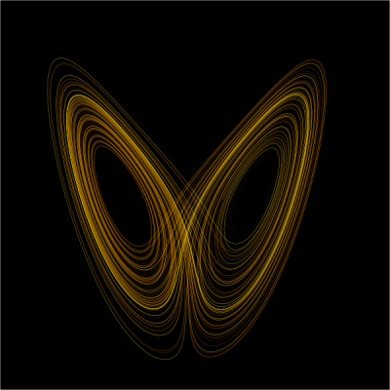
College Net Wi-Fi Enabled Data Acquisition Network Using Openmoko
Dated: 26th Mar, 2009
Mentored By:
Mr. Dhananjay V. Gadre
By:
Saurabh Gupta (81/EC/05)
Vijay Majumdar (97/EC/05)

Slide 2
Overview
Data Acquisition System (DAS)
Data Acquiring Device
Openmoko Framework
Implementation
Communication Engine and Protocols
Graphical User Interface Development
Central Database Storage Server
Applications of DAS
Future Scope
References

Slide 3
Data Acquisition System (DAS)
Describes the behavior of certain dynamical systems – that is, systems whose states evolve with time.
Explain system dynamics that are highly sensitive to initial conditions.
Chaotic Systems appear to be random although they are fully deterministic.
Chaotic systems are always non-linear.

Slide 4
Different Modules of DAS
Discovered by Edward Lorenz,1963 and is based on chaos theory
“The notion of a butterfly flapping it's wings in one area of the world, causing a tornado or some such weather event to occur in another remote area of the world”
Small variations of the initial condition of a dynamical system may produce large variations in the long term behavior of the system.
System is not random, not steady and not even periodic. It is completely deterministic and yet appear to be random.
The belief of unimportance of digits after 3rd or 4th decimal place is proved wrong (0.506 instead of 0.506127 had entirely different result)

Slide 5
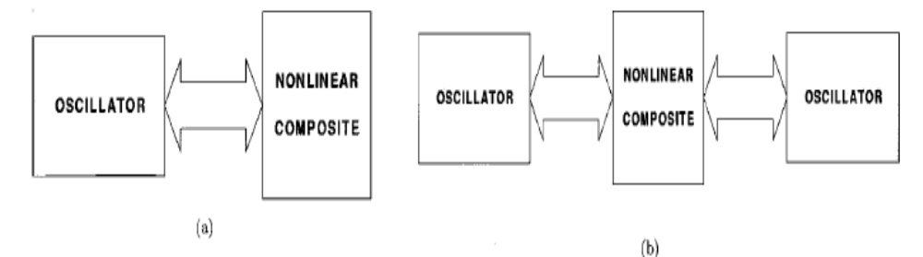
Data Acquisition Device
Oscillators showing chaotic behavior and sensitive to initial conditions.
Structure is based on generic second order sinusoidal oscillator.
Chaos is generated by linking these sinusoidal oscillator engines to simple passive first-order or second-order nonlinear composites.
Non linear composite can be passive also (e.g. diode or FET)

Slide 6
Openmoko Framework (Hardware)
At least three energy storage elements must exist.
Chaotic oscillator can be clearly described using differential equation of appropriate order.
Accordingly, at least one chaotic oscillator can be derived from any sinusoidal oscillator. The derivation process requires a nonlinearity which is not necessarily active.
Two different classes of chaotic oscillators are constructed.
Conjecture: In any analog continuous-time chaotic oscillator which is capable of exhibiting simple limit cycle behavior, there exists a core oscillator providing an unstable pair of complex conjugate eigen values and a control parameter which can move this pair.

Slide 7
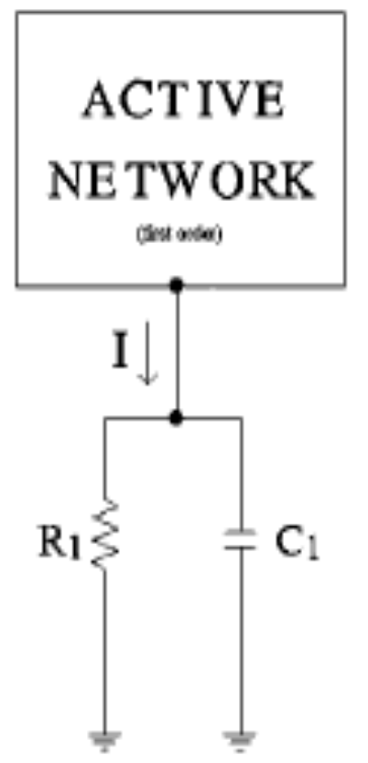
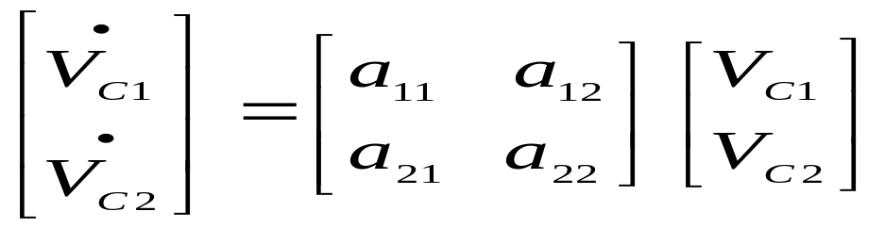

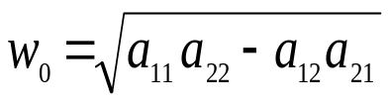

Openmoko Framework (Software)
Characterized by a parallel RC branch and a second order sinusoidal oscillator.
Represented by following state space equations:
……..(1)
The condition and frequency of oscillation is:
Current I depends on V_{C1} and V_{C2} as :

Slide 8
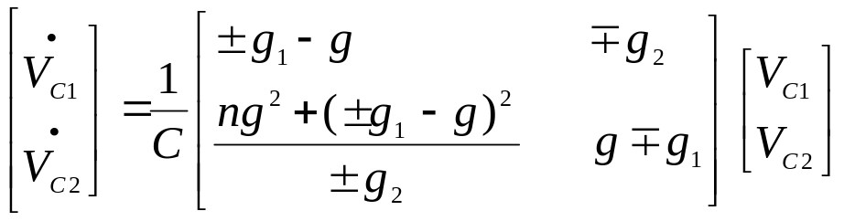
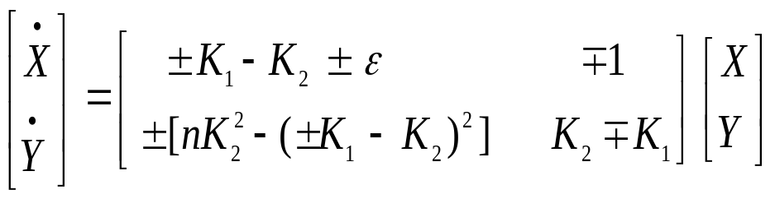
Implementation
Eq 1. can be written as:
……..(2)
Introducing the variables for normalization, eq (2) can be rewritten,
τ = tg₂/C, X = V_{C1}/V_{ref}, Y = V_{C2}/V_{ref}, K₁ = g₁/g₂ and K₂ = g/g₂
……..(3)

Slide 9
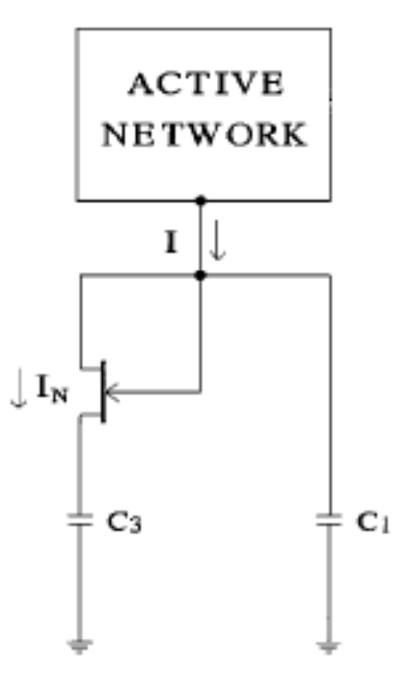
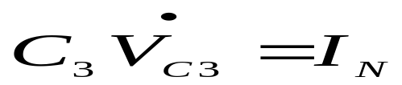
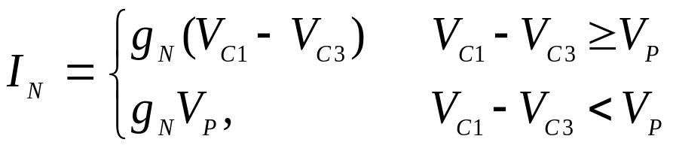
Communication Engine and Protocols
Non linearity added is FET-C composite and R₁ is removed.
FET-C composite is described by first order equations as:
Action of FET is for switching similar to diode in D-L composite chaotic oscillator.

Slide 10
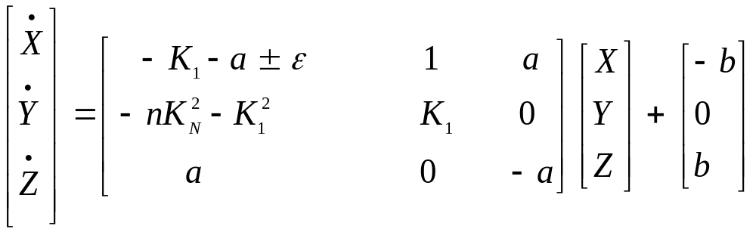
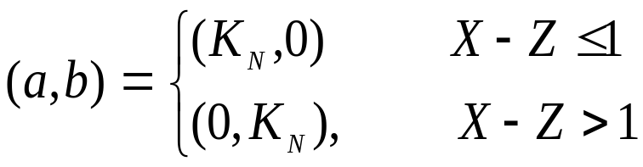
Graphical User Interface
In addition to variables in (3), using new variables: Z = V_{C3}/V_{ref} and K_{N} = g_{N}/g₂ , the state space representation becomes:
……..(5)
FET performs the switching action and energy across capacitor C₃, is continuously stored (a = K_{N}) and dissipated (a = 0) by this switching action.

Slide 11
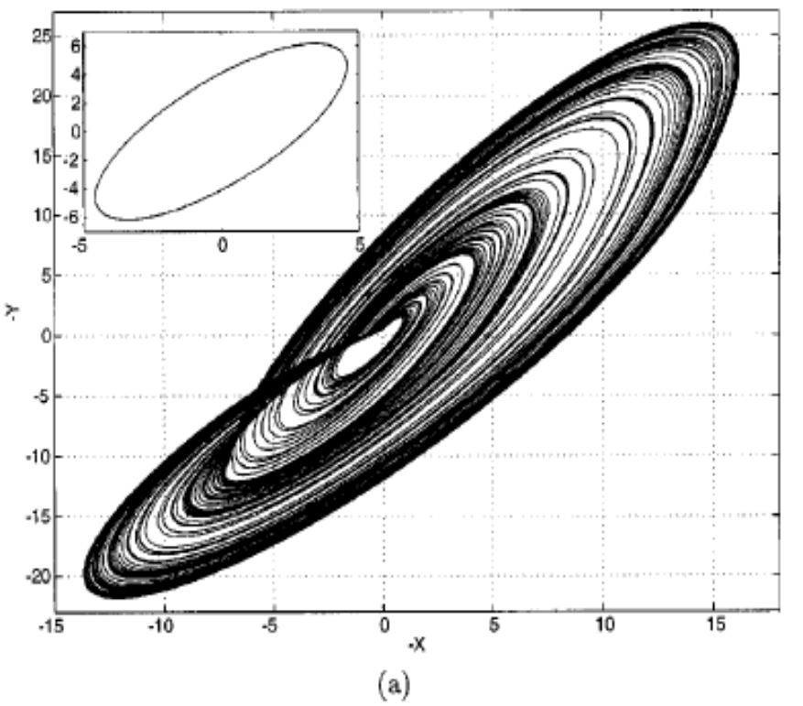
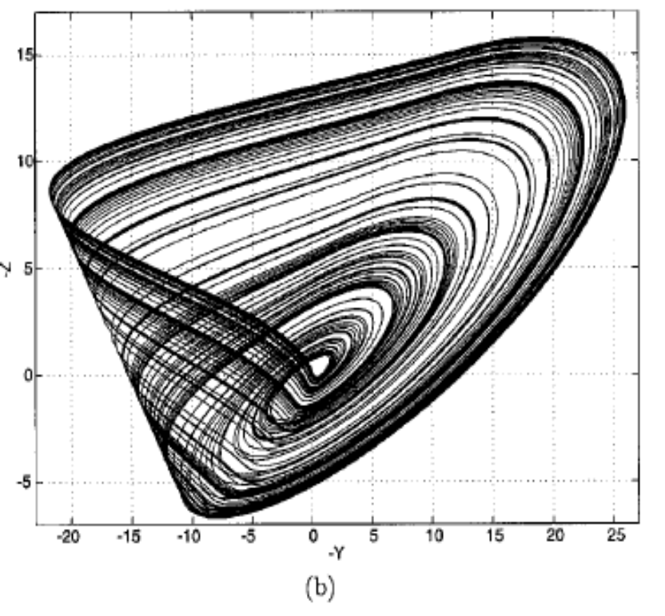
Central Database Storage Server
Simulation Result ( K₁ = 1, K_{N} = 2, ɛ = -0.3, n = 0.2 )
  X – Y projection
  Y – Z projection

Slide 12
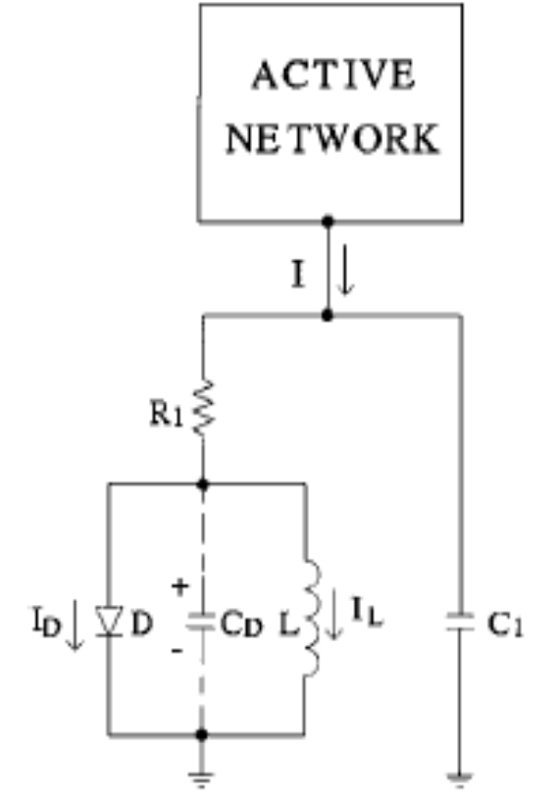
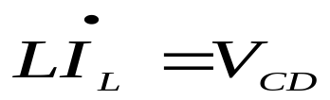
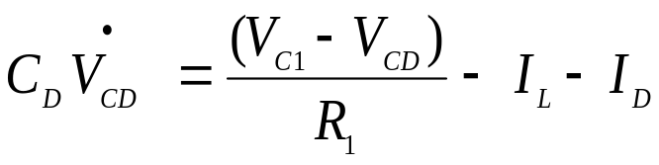
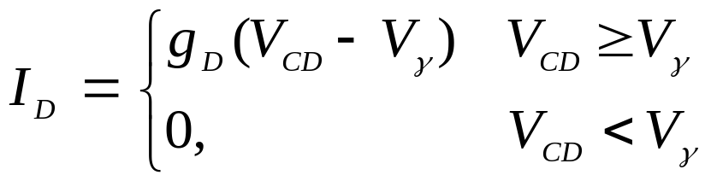
Application of DAS
Non linearity added is diode-inductor composite in series with R₁
D-L composite is described by:

Slide 13
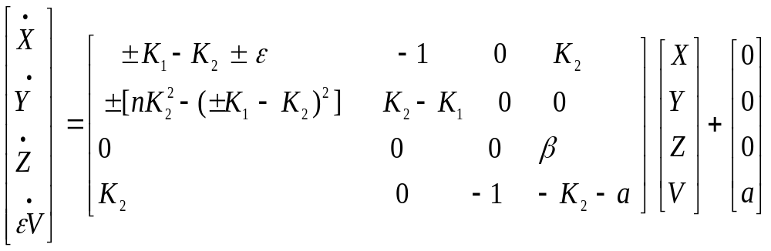
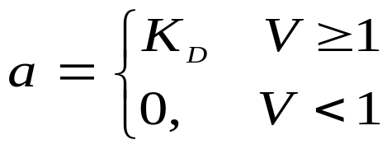
Deployment of DAS in NSIT
In addition to variables in (3), using new variables: Z = I_{L}/(g₂V_{ref}), V = V_{CD}/V_{refs} , β = C/g₂²L , ɛ_{C} = C_{D}/C, K_{D} = g_{D}/g₂, the state space representation becomes:
……..(4)
Diode performs the switching action and energy across inductor is continuously stored ( V < 1) and dissipated (V > 1) by this switching action.

Slide 14
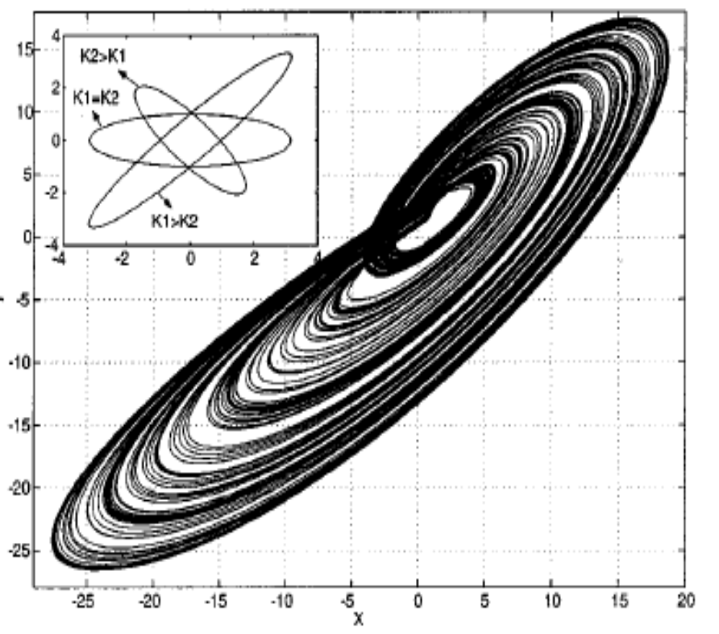
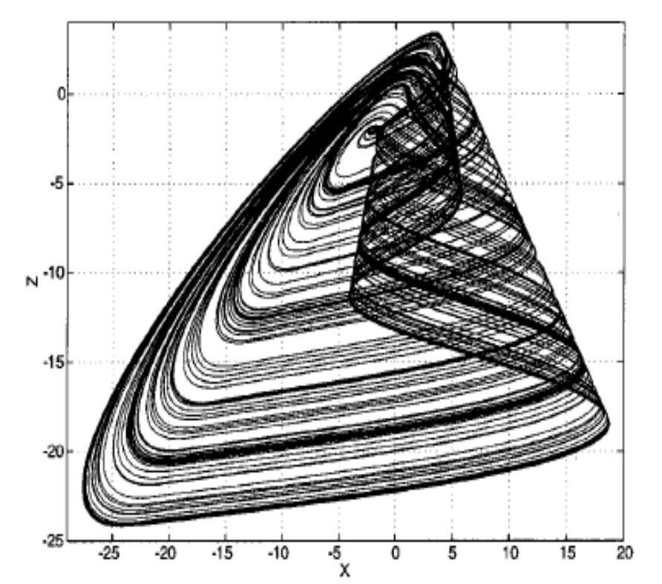
Future Scope
Simulation Result (K₁ = 2, K₂ = 1, K_{D} = 50, ɛ = -0.35, ɛ_{C} = 0.01, n = 0.1, β = 1)
  X – Y projection
  X – Z projection

Slide 15
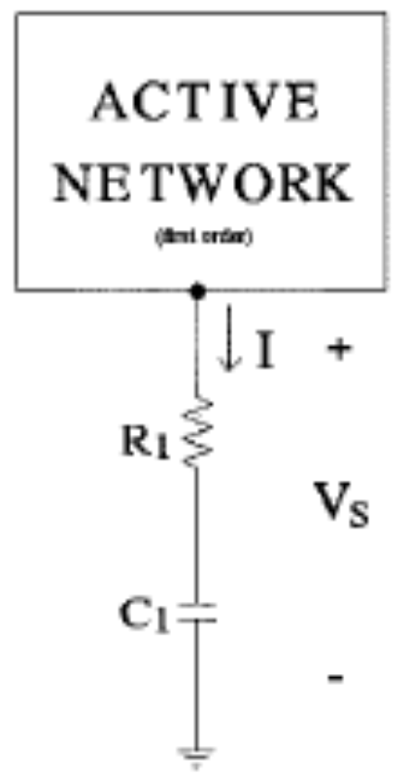

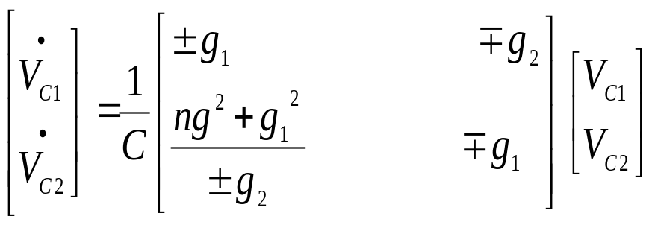
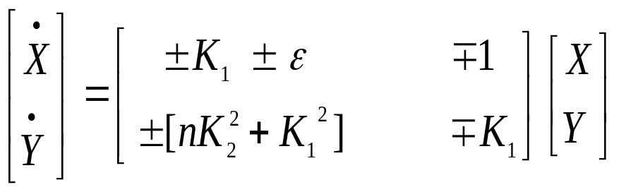
Characterized by a series R-C branch.
……..(6)
Similar to class I oscillator, state space equations
are:
……..(7)
……..(8)

Slide 16
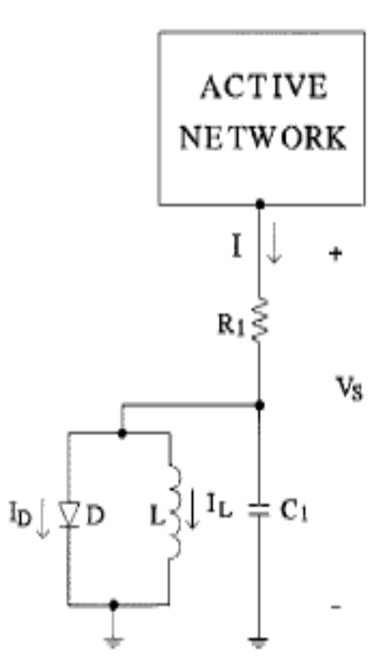
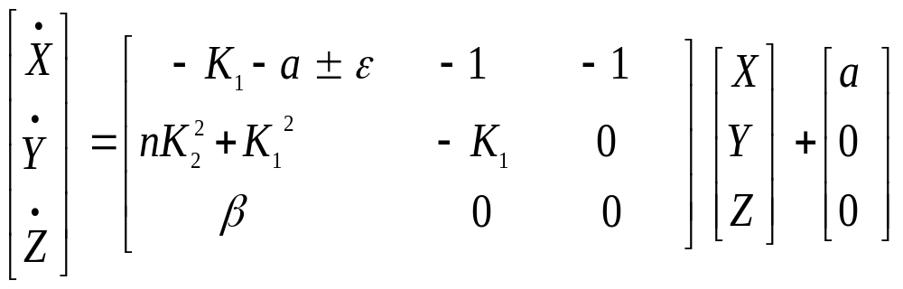

Class II D-L composite chaotic Oscillator
Same analysis as of class I
……..(9a)
……..(9b)

Slide 17
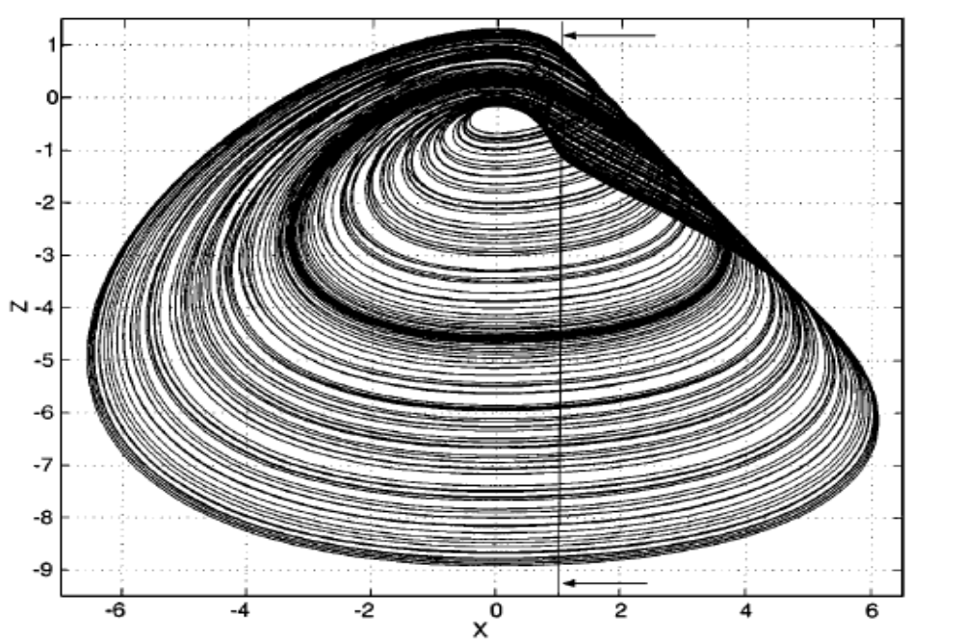
Class II D-L composite chaotic Oscillator (cont.)
Simulation Result (K₁ = 2, K₂ = 0.1, K_{D} = 3, ɛ = 0.32, n = 1, β = 1 )
  X – Z projection

Slide 18
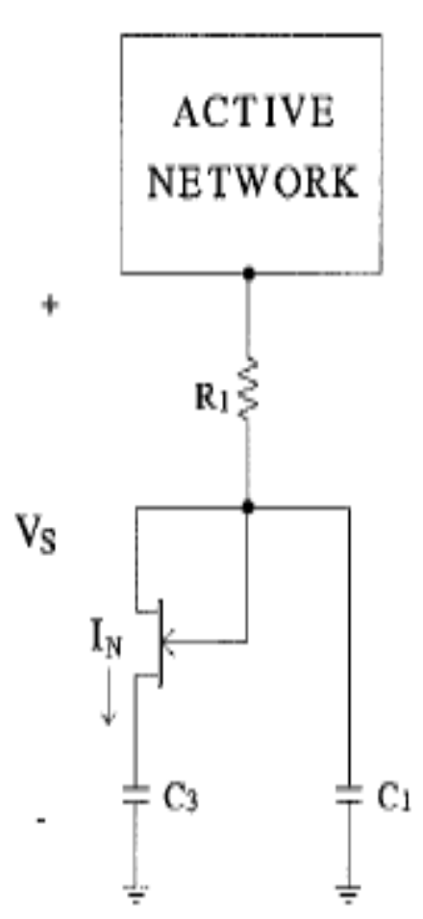
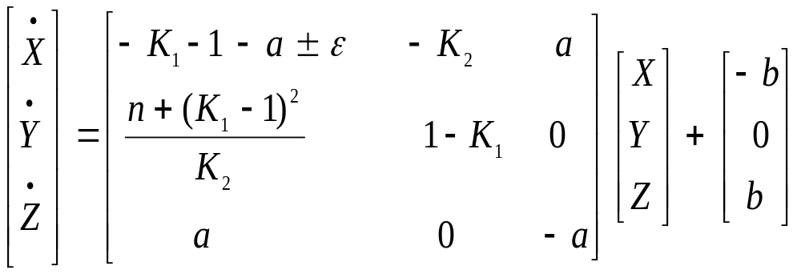
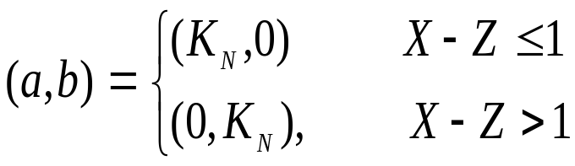
Class II FET-C composite chaotic Oscillator
Same analysis as of class I
……..(14)

Slide 19
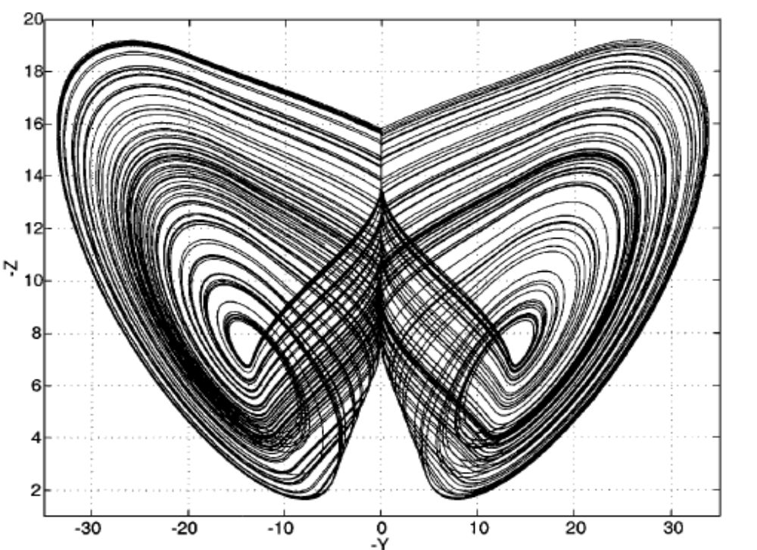
Class II FET-C composite chaotic Oscillator (cont.)
Simulation Result (K₁ = 0, K_{N} = 2, ɛ = -0.2, n = 0.9 )
  X – Y projection

Slide 20
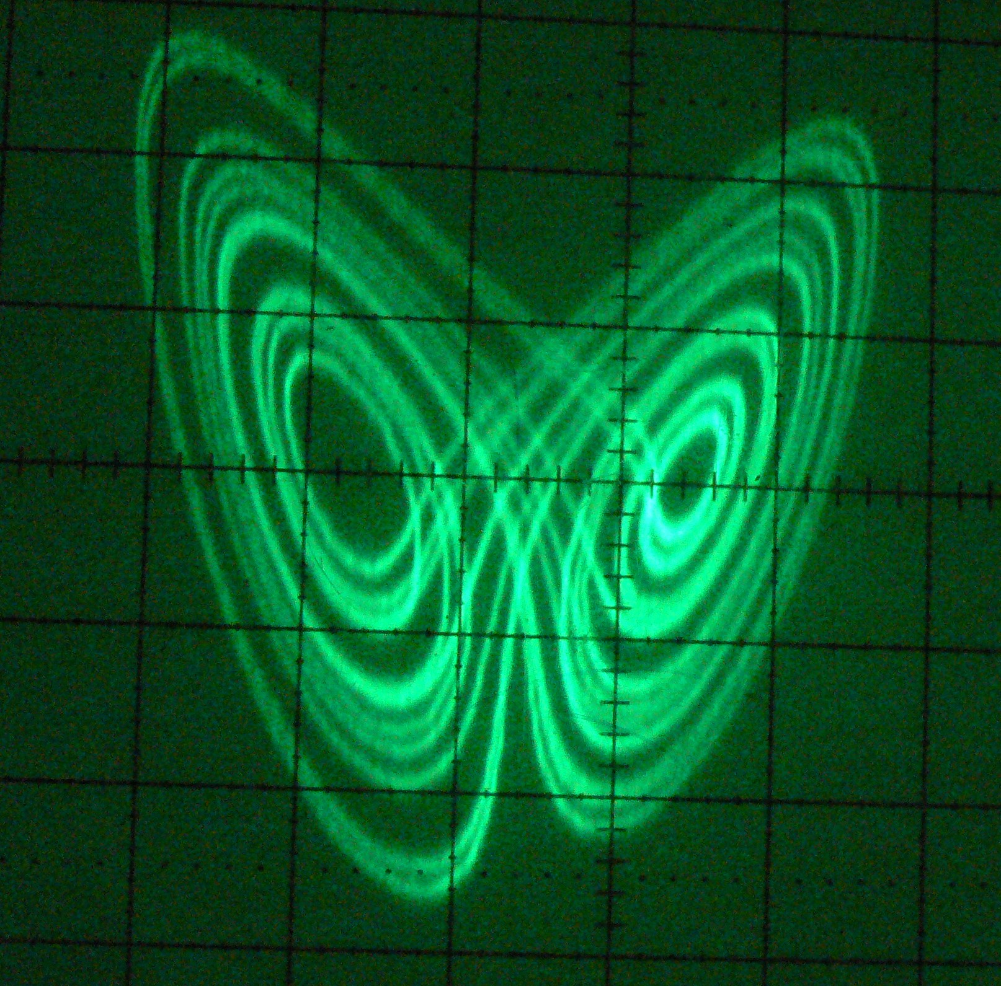
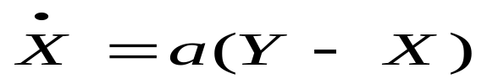
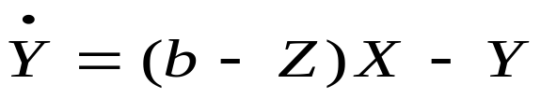
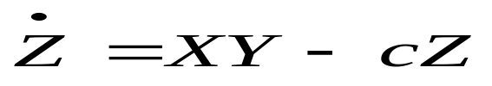
Lorenz Attractor
(a -> Prandtl number, b -> Rayleigh number, c -> damping constant)
A double spiral non periodic curve
Neither steady state nor periodic motion. System always stayed on a curve and never settled down to a point
Sensitive to initial conditions
  X – Z projection

Slide 21
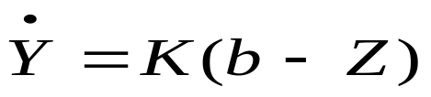
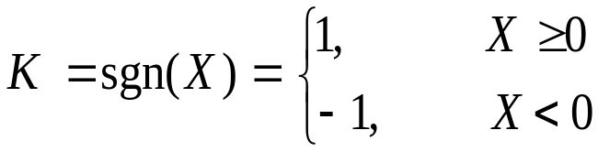
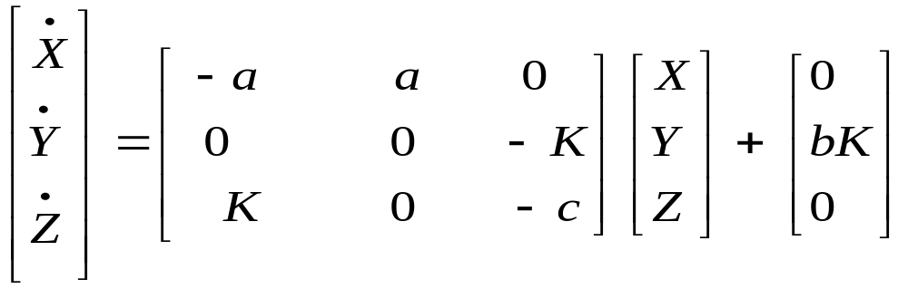
Modified Lorenz Attractor
Z always remain positive, so XY can be replaced by KX to ensure this.
Modified equations:
……..(15)
……..(16)

Slide 22
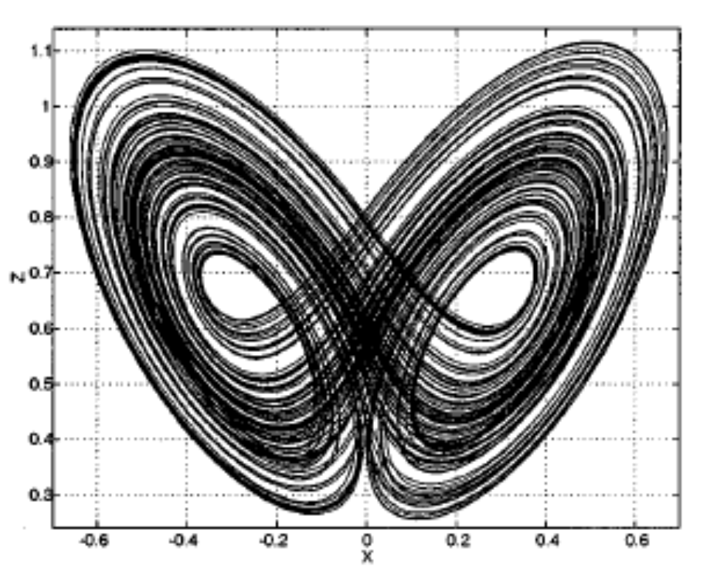
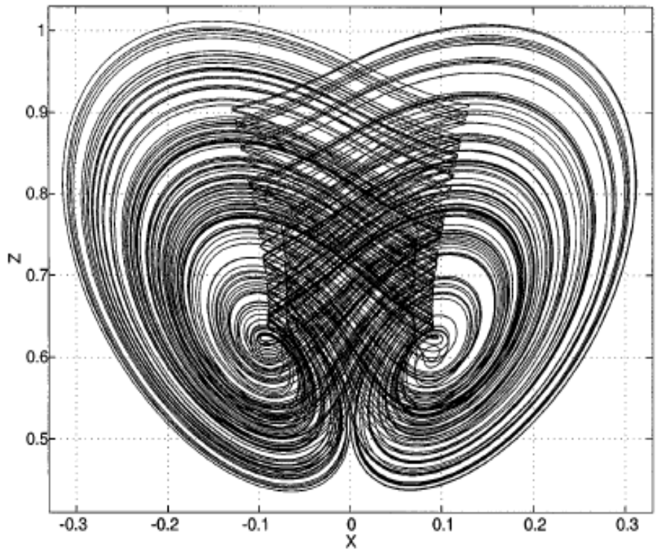
Simulation Result
  V_{C2} - V_{C3} trajectory (a = b = 0.6, c = 0.45, m = 0 )
  V_{C2} - V_{C3} trajectory (a = b = 0.6, c = 0.15, m = 0 )

Slide 23
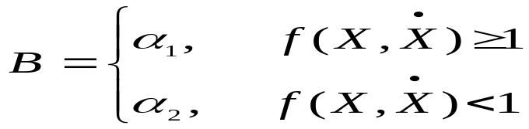
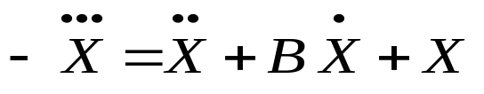
General Dynamics of Chaotic Oscillators
Simplest possible dynamics of continuous chaotic oscillator can be observed by:
1) The oscillator is described by a third-order system of differential equations
2) The ON–OFF switching action of a single passive device is the only nonlinearity
3) The describing equations of second-order subsystem, which admits a pair of unstable complex conjugate eigen values in at least one of the regions of operation of the switching device, can be identified.
Simple example of above dynamics is :

Slide 24
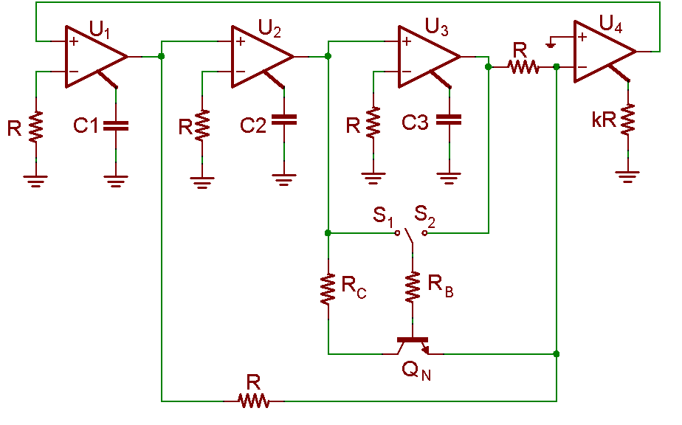
Practical Realization using CFOA
  R = 1k, C₁ = C₂ = C₃ = 1nF, R_{B} = 1k, R_{C} = 100E, f(X,Ẋ) = Ẋ

Slide 25
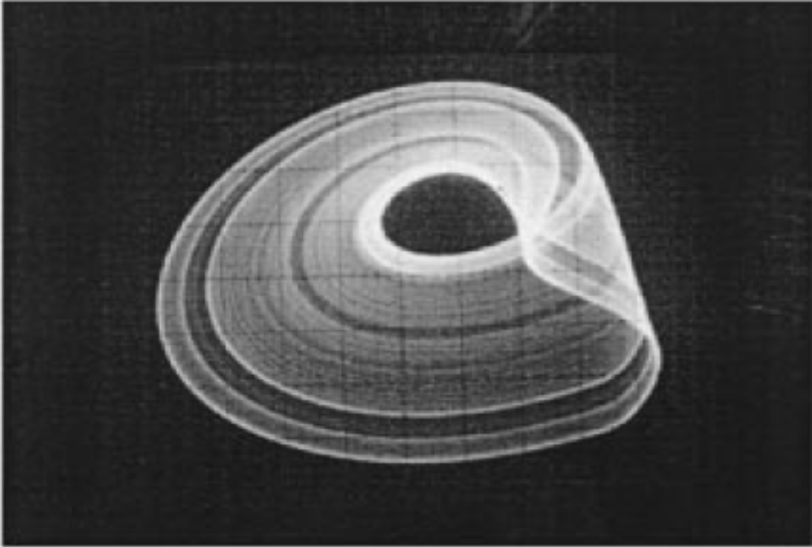
Simulation Result
  Ẋ - X trajectory

Slide 26
Applications of chaos theory
Used in ecology where population growth follow chaotic dynamics.
Other areas are weather prediction, gaming, encryption technology, robotics, economics, biology etc.
Human heart is also a chaotic pattern.
Music can also be created using fractals.

Slide 27
References
http://en.wikipedia.org/wiki/Data_acquisition
http://wiki.openmoko.org/wiki/Main_Page
http://en.wikipedia.org/wiki/WiFi
http://code.google.com/p/attendance-on-openmoko/
http://attendance-on-openmoko.googlecode.com/svn/trunk/ .

Slide 28
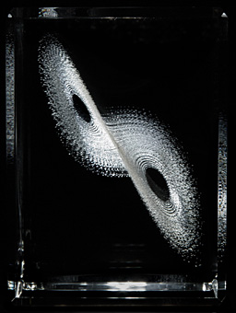
Thank you

