Slide 1

College Net Wi-Fi Enabled Data Acquisition Network Using Openmoko
Mentored By:
Mr. Dhananjay V. Gadre
By:
Saurabh Gupta (81/EC/05)‏
Vijay Majumdar (97/EC/05)‏
Dated: 29th May, 2009

Slide 2
Overview
Data Acquisition System (DAS)‏
Data Acquiring Device
Openmoko Framework
Implementation
Communication Engine and Protocols
Graphical User Interface Development
Central Database Storage Server
Applications of DAS
Future Scope
References

Slide 3
Introduction
Design of a secured, automated and user friendly remote data acquisition system.
This project aims at developing a Data acquisition system which can be deployed in NSIT.
Currently the testing and target device for data acquisition is a portable hand held embedded device which is touch sensitive.
Data can be related to anything like student's record, attendance or output of some sensors.
Data handling and processing is done in a robust manner and output display is made using custom made software and graphical user interface

Slide 4
Data Acquisition System (DAS)‏
A device to measure and log some data or parameters.
Sampling of real world signals which can be manipulated by a computer.
Signals can be digital (called logical signals) or analog signals.
Data is acquired by using sensors which works automatically or with some human involvement.
DAS is normally electronic based and made up of hardware and software.
Hardware part is sensors, cables and electronic components like memory etc.
Software part is data acquisition logic and the analysis software.

Slide 5
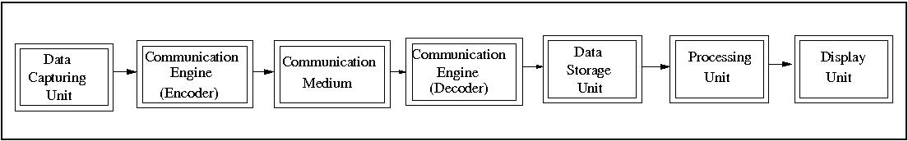
Different Modules of DAS
Main parts are data acquiring unit, communication engine and data processing unit
Data Capturing Unit is Openmoko in this project.
Communication engine is a program written in C++ and PHP which communicates through TCP/IP protocol.

Slide 6
Different Modules of DAS (cont.)‏
Communication medium is wireless through Wi-Fi protocol.
Data storage unit is a remote server with enough memory to store data digitally in form of database.
Processing Unit is a computer with sufficient processing power.
Display unit contains the output either on a computer monitor or in the form of printed results.

Slide 7
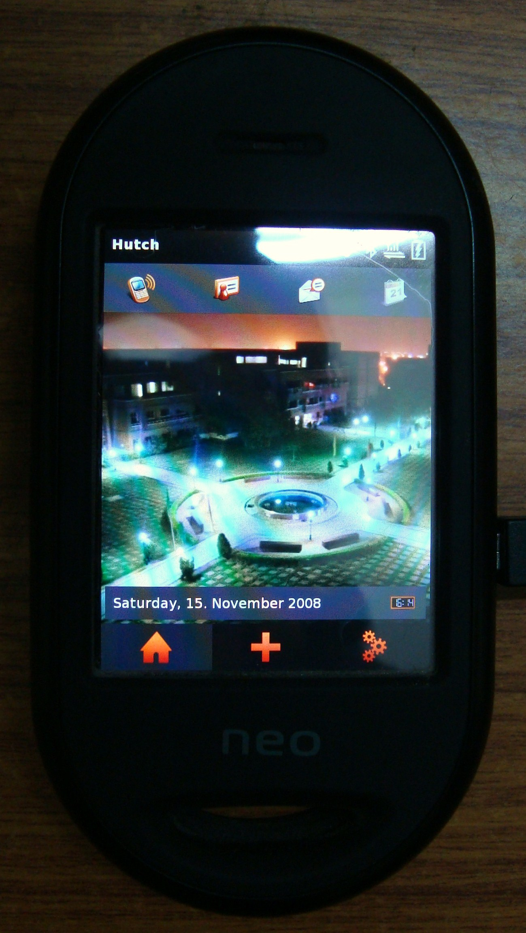
Data Acquisition Device
Device used in this project is called Openmoko.
Portable, hand held and touch sensitive.
Runs Linux as operating system on it.
Completely open source device.
Can work as a mobile phone also.

Slide 8
Openmoko Framework (Hardware)‏
The hardware specifications are:
Hardware Electrical
400/500 MHz Samsung 2442B Processor/SOC (400 minimum, ARM920T core, ARMv4T)
128 MB SDRAM total, 64 MB CPU internal, 64 MB external
Display (LCD screen)‏
resolution: 480 x 640 pixels
size: 43mm x 58mm (1.7” x 2.27”)
Wi-fi transceiver.
Bluetooth Module
GPS/AGPS module support
GSM/GPRS modules and driver

Slide 9
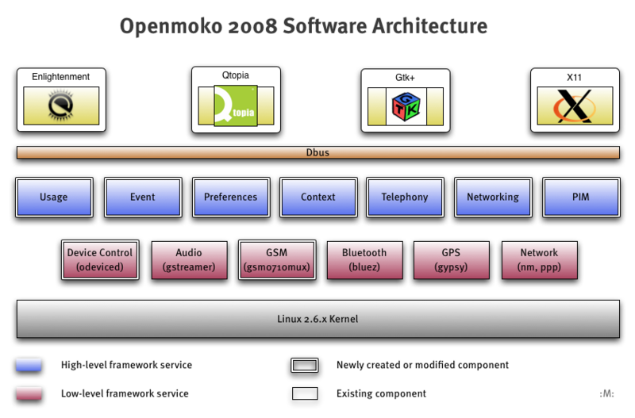
Openmoko Framework (Software)‏

Slide 10
Implementation
Developing application for communication between the data capturing unit and storage unit.
Developing graphical user interface to facilitate the user acquire and record the data in a comfortable and easy way.
Developing protocols and database structure to be used in the system.
Porting all applications on the embedded device along with full customization support.
Set up of a central data server to communicate with data capturing unit.
Developing an intra college website with many configurable options and graphical user interface using LAMP technology.
Deployment of whole system in NSIT

Slide 11
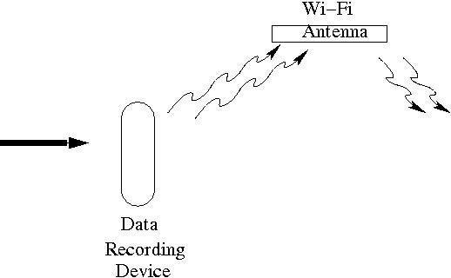


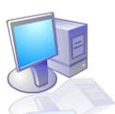
Project Overview
U
Remote
Server
User

Slide 12
Communication Engine and Protocols
Responsible for transfer of data from data capturing device (openmoko here) and data processing unit (remote server).
Communication medium is wireless through Wi-Fi protocol.
Network uses the IPv4 TCP/IP protocol. Data is sent in form of packets through a socket connection between remote server and Openmoko.
Error detection and Error removal methods are used in the software implementation.
Communication part is implemented using C++ and PHP programming languages at the network layer.
Handles data in a robust way. Unsent data is stored locally and sent next time.

Slide 13
Steps in Communication Setup
Creation of socket for a particular IP address and port number on both sides.
Allocation of resource to this socket.
Sending of data across this socket from sender to receiver.
Confirmation of receipt of data from the receiver.
Genuinity of the data is checked via software APIs.

Slide 14
Graphical User Interface Development
Data Capturing Device has LCD screen for user interface.
A user friendly graphical user interface is developed for openmoko.
Language used in developing GUI is C/C++ using gtk+ library.
Data can be recorded on the device by touching only using a stylus.

Slide 15
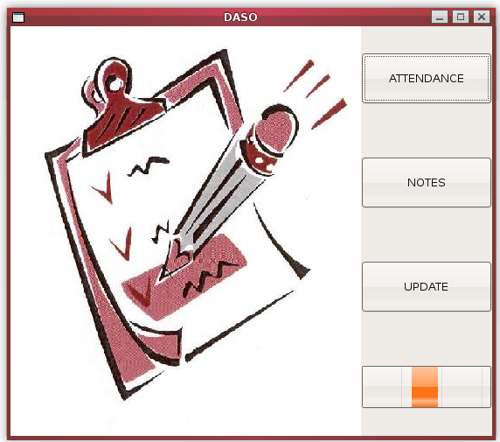
Graphical User Interface
  Window for selection of action

Slide 16
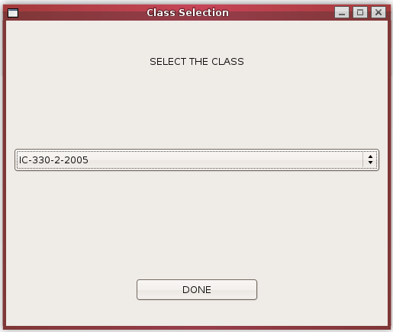
Graphical User Interface
  Selection of class

Slide 17
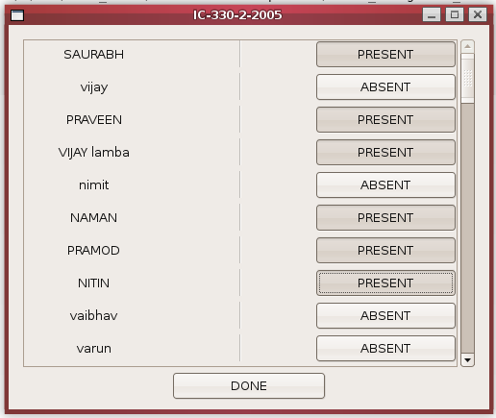
Graphical User Interface
  Marking the attendance

Slide 18
Central Database Storage Server
Remote storage Device with enough memory to store the data.
Communicates via Communication Engine with the data capturing unit.
Server operates all the time and always remain in a listening mode to receive any data from the remote data acquiring device.
Server also serves as a web server for which supports an intra college website.
Server uses operating system Linux having a static IP.
LAMP (Linux-Apache-MySQL-PHP) technology is used for running website.

Slide 19
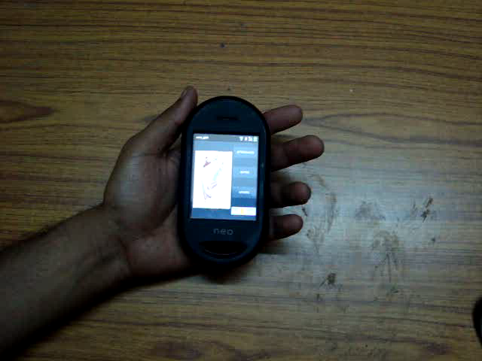
Demo Video

Slide 20
Deployment of DAS in NSIT
Currently, the project aims to support automatic attendance and notes writing feature.
An intra college website will operate where all the statistics can be seen.
Each teacher will have a data capturing device (Openmoko) and an account is provided so that they can access the data website.
Proper Wi-Fi access is needed across the campus to facilitate data communication.
Compete provision for feeding the data to server through PC in case Wi-Fi medium fails.
All data will be stored centrally and can be seen in form of plots, bar graph etc.

Slide 21
Deployment of DAS in NSIT (cont.)‏
There will not be any need for manually maintaining the statistics of attendance for any month.
The data can be printed out.
Attendance data can be merged with the administration’s data which contains the marks and other information about the student.
Data stored is totally secure and no manipulation is allowed by any means.

Slide 22
Advantages
Extensible and support plug-ins.
Independent Modules, can be used in other projects
No dependencies.
Can be integrated with other applications.
Can be used with any data acquisition device.
Openmoko can be interfaced with any sensors.
Data stored will have proper back up in case of any data loss or failure.

Slide 23
Application of DAS
Telemetry
Surveillance
Experimentation and Calibration
Disaster Management System, Monitoring and Tracking
Weather monitoring at Remote Locations

Slide 24
Future Scope
It can be integrated with speech recognition module which will allow to record the data merely by speaking the words. e.g. attendance can be marked simple by speaking the roll number.
It can be integrated with Face recognition application. Attendance can be taken by capturing a picture of the class and faces of the present students are recognized.
Can be interfaced with analog sensors and transducers and data can be stored and plotted on the display unit.

Slide 25
References
http://en.wikipedia.org/wiki/Data_acquisition
http://wiki.openmoko.org/wiki/Main_Page
http://en.wikipedia.org/wiki/WiFi
http://code.google.com/p/attendance-on-openmoko/
http://attendance-on-openmoko.googlecode.com/svn/trunk/
http://wiki.openmoko.org/wiki/Neo_FreeRunner_GTA02_Hardware

Slide 26
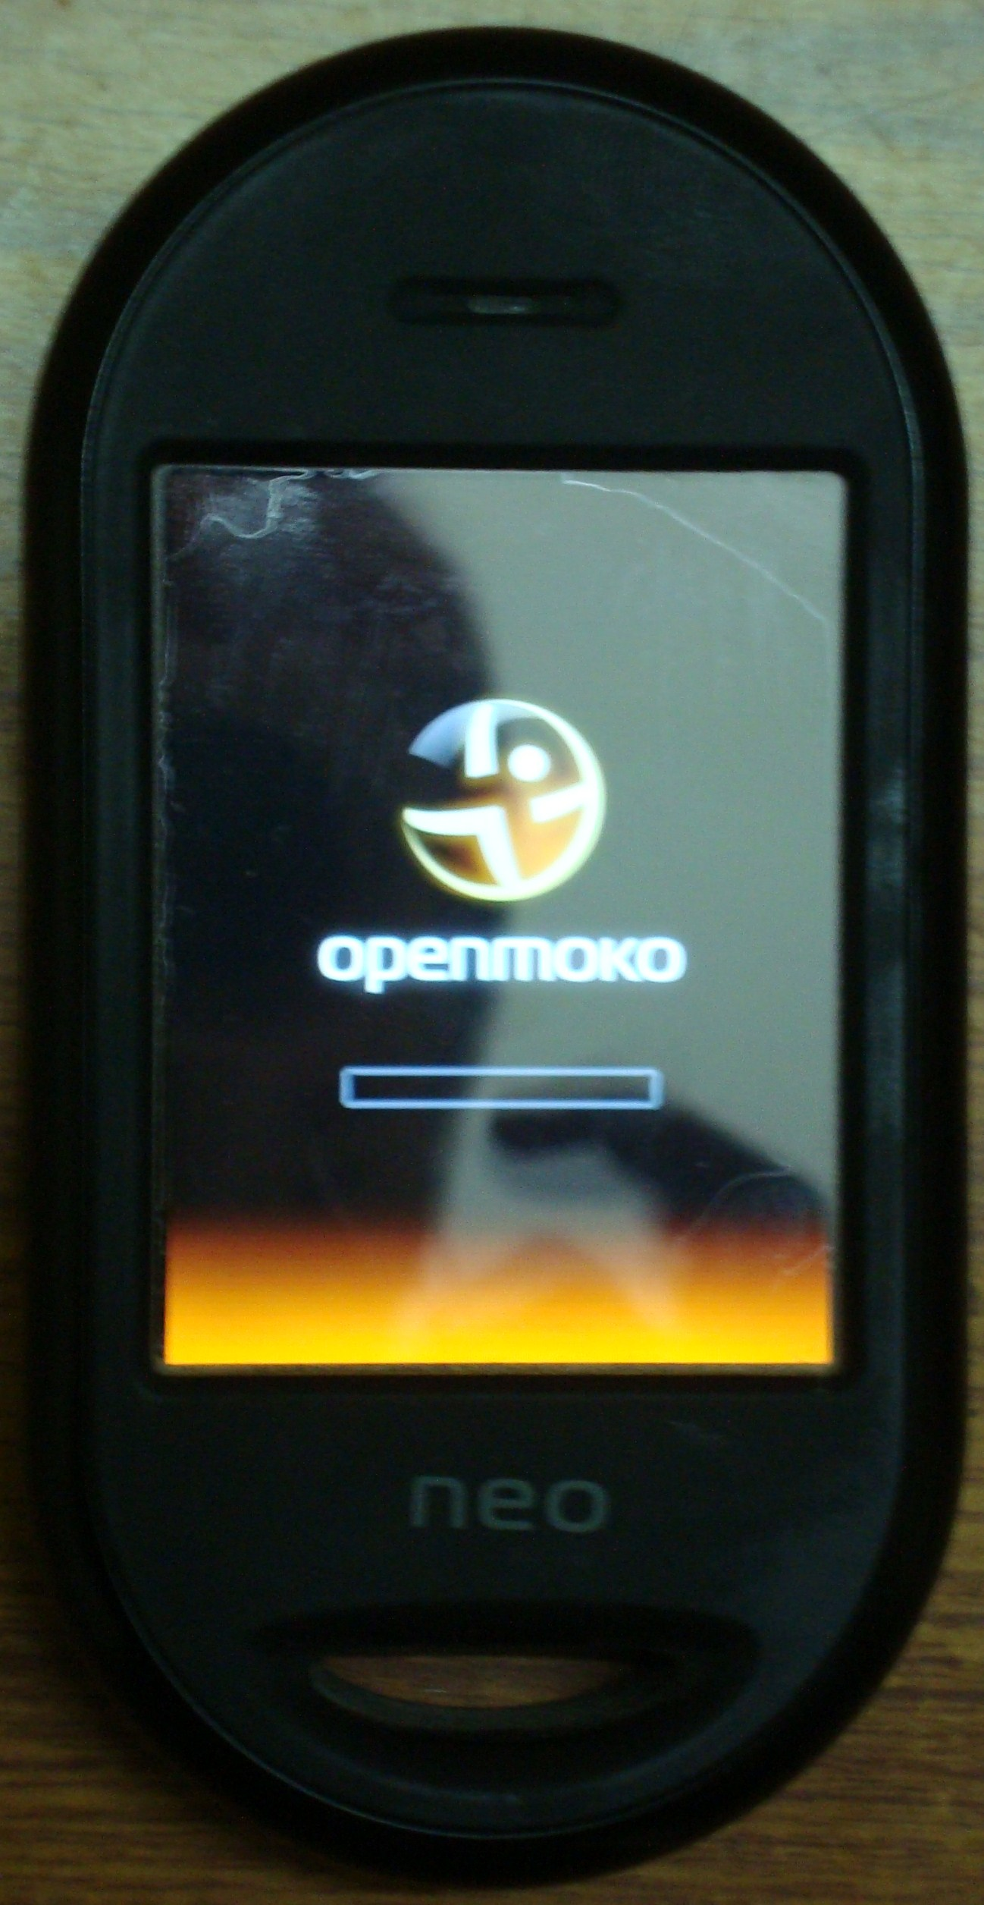
Thank you

