Slide 1
Intro to Parallel & Distributed Computing-
Saurabh Singh (ss2716)
Final Course Project- Converting a Colored Image to Greyscale

Slide 2
Problem Statement- Color to Grayscale conversion of an Image
Convert a Color jpg image to a Grayscale one. Initially take the RGB channels of the image and compute the new luma component by averaging out the values i.e. Y=(R+G+B)/3 for each pixel. Inspect the outcome and figure out what may be a potential problem. Does this relate to how our eyes perceive the colors? Our eyes are most sensitive to green and least sensitive to Blue. Hence, experiment with different weighting of color channels and report your findings. Also check the following formula from the wiki page of Grayscale to compute the luma component:
Y' = 0.299 * R +0.587 * G + 0.114 * B.
​What are your parallelization and optimization techniques used in order to speed up the process?

Slide 3
Why bother parallelizing?
Involves manipulation in the pixel values.
Usually pixels internally stored as matrices.
Each pixel calculation independent of the other pixel calculations.
Y' = 0.299*R + 0.587*G + 0.114*B.
A high definition image can have up-to 25000000 pixels (even more)
Do you see now why the problem lends itself quite naturally to parallel a solution?

Slide 4
But does parallelization always help?
Not really.
What if we have a small image of 10x10 (100 pixels)
Suppose we use threads- (one thread per pixel)
The overhead of creating and context switching threads takes over here
Take a look at the following plot of Serial VS Parallel implementations.

Slide 5
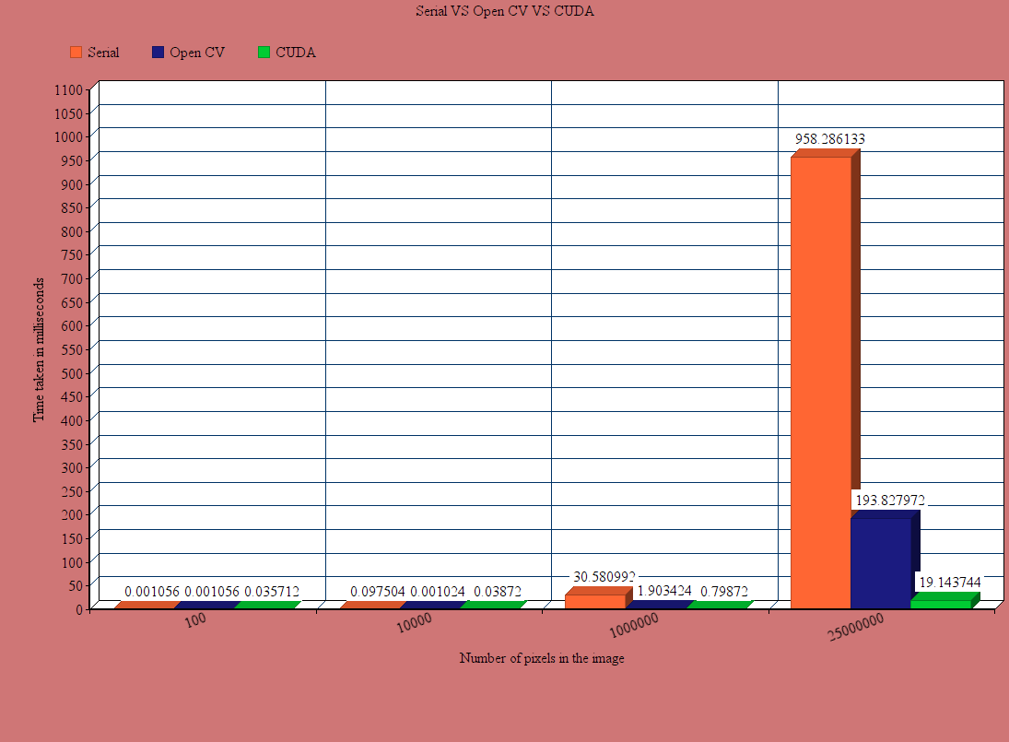

Slide 6
But how we do it?
First approach, Threads?
Ok! But regular CPU will have only eight cores at max.
If #threads > #CPU, some will have to wait!
We have 25000000 elements to process
GPU? Yes, we can create thousands of threads and they can be executed in batches.
Less wait, because more processing units.
Less overhead for creating and context switching threads since GPU threads are extremely lightweight.

Slide 7
Is there anything else we can use? Apart from CUDA?
Yes, there is a graphic library. OpenCV
Does everything automatically.
Can’t we use it directly?
Where is the fun in that?
Besides, can we do better than OpenCV?
Lets find out.

Slide 8
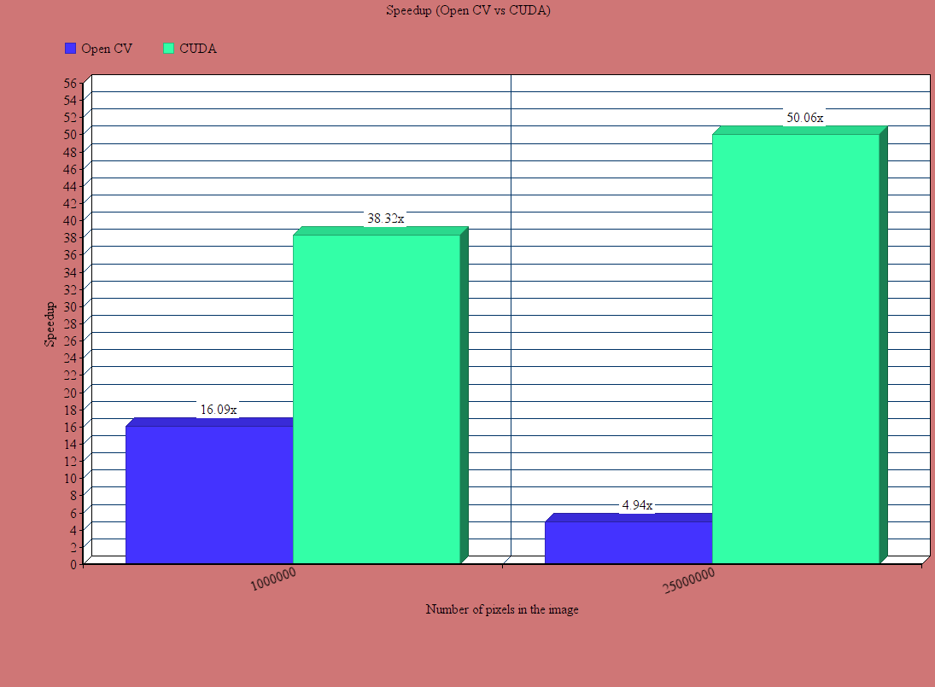
How did we do against OpenCV?

Slide 9
Highlights
What's the optimum number of threads per blocks in CUDA?
We try to find that sweet spot by increasing the number of threads per block.
By increasing it in a multiple of 32 (wrap size).
512 is the number!
See the plot below

Slide 10
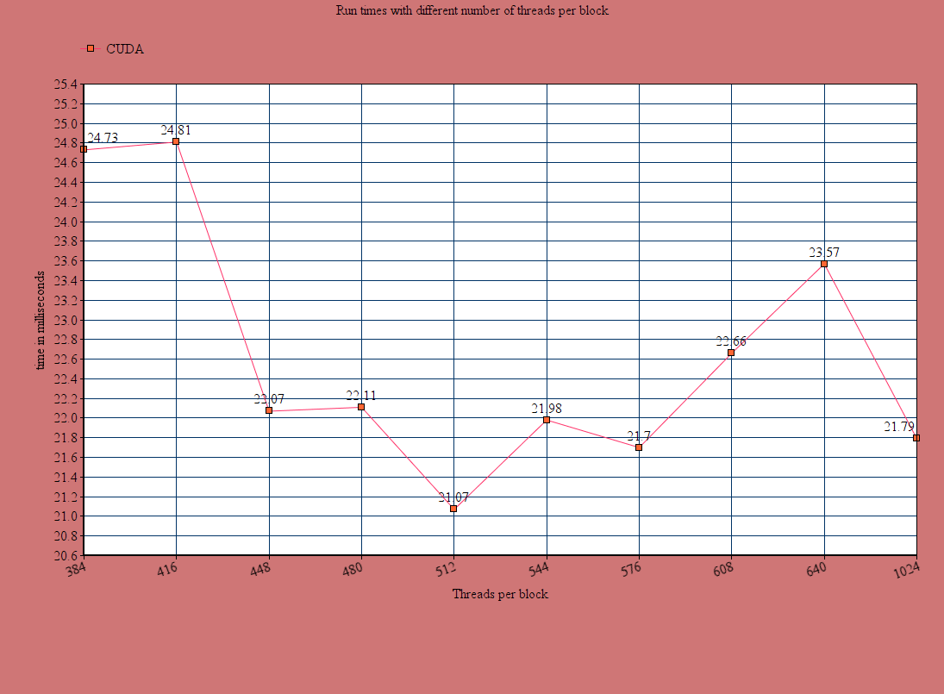

Slide 11
Challenges?
The main challenge was to set up CUDA environment.
Figuring out the OpenCV image format.
THE END

