Slide 1
Parkme
Parking spots just for you……….

Slide 2
CONTENT :
Need of car parking.
About app.
Features.
Business.
Open source.
Github Id
Future amendment.

Slide 3
Need of car parking
Parking spaces are very important to cities. A city must have enough parking spaces to provide their residents and their visitors a place to park their car. Since cars are a main factor in transportation.
In today’s people parks their cars in the road , this reduces the width of the road.
Many problems arises if we park cars in the road :-
Traffic jams.
Accidents.
Unordered car parking.
Lack of sufficient parking space.

Slide 4
ABOUT APP
Parkme is an application which generally tells us how many parking spots are available for parking and it tells to the user all parking details . All information is gathered through this app about when the car comes in the parking area and when it comes out from the parking area , and through this app the user will retrieve the information about the car and the driver in case of the emergency.

Slide 5
Attributes used:
Name
In this user will enter his/her name.
Contact no.
User will enter his/her contact number.
Vehicle no.
In this user will enter the vehicle number.

Slide 6
Spot
In this user will fill the empty spots .
In this user will enter the time of arriving of the vehicle in the parking.
Time

Slide 7
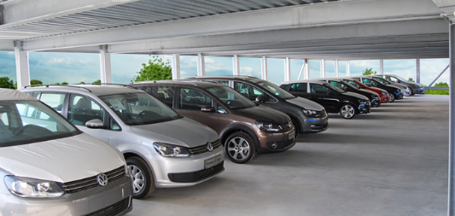
Features
Quick check in and check out.
Print vouchers and reports.
Real time vehicle counting.
Every vehicle is systematically arranged.
Chances of blockage of road reduces.
Security.
Accommodates maximum cars in minimum space.
Attractive modular design.
Vehicle identification.

Slide 8
Data flow diagram

Slide 9
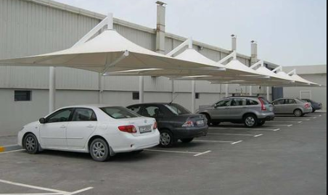
Public purpose
This application helps the students and faculty and others for parking their vehicles.
It will make the parking work easier for the user and the customer to park their car and if the organization wants detail about the vehicles ,how many vehicles come in this month and how much time they stay their vehicle and in which time they enter and in which time they comes out .And it also makes the vehicle secure . This application also helps the user to tell how many spots are vacant for car parking . This application also helps in proper management of car parking in case of any event occurs in the organization.

Slide 10
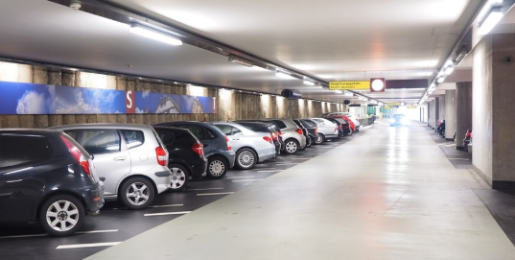
Open source

Slide 11
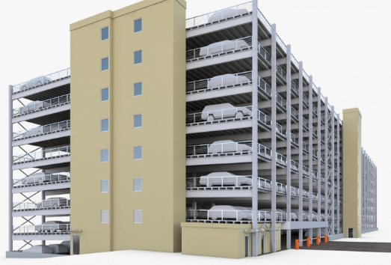
Future amendment
We are making this project for the ground level parking.
In future , if there is multi-storey parking then we will create the slots for the multi-storey parking . Then it reduces the workload of the user for parking the vehicle in the multi-storey parking.
We will create this application for the customer for pre -booking . Through this ,customers can book their vehicles parking in the advance , so that they will not waste their time for parking .

Slide 12

Thank you

