Slide 1
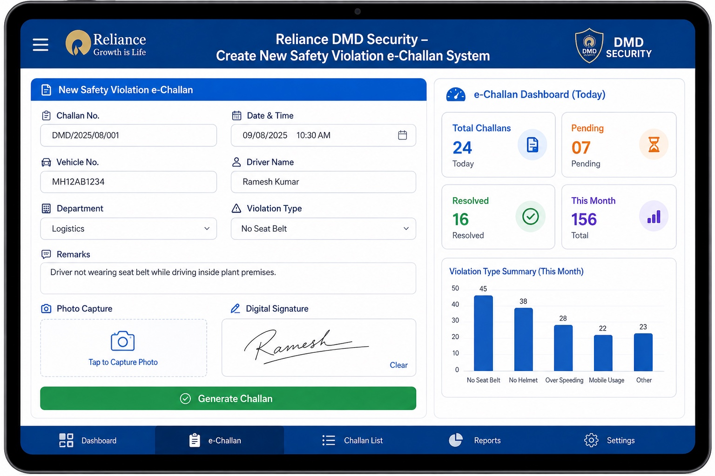
Safety Violation
e-Challan System
Concept Proposal
From Paper Challans to Smart Digital Compliance
Tablet-based entry • Digital signature • Photo evidence • Central reporting
Prepared for discussion | Security Department
Concept Proposal • Reliance DMD Security • Slide 1

Slide 2
1. Current Process – Paper Challan
Existing approach and practical challenges
• Manual paper challan preparation at the gate / traffic point
• Driver signature and supporting details handled physically
• Records require manual compilation and filing
• Finding old challans or preparing periodic reports takes time
• Limited visibility of violation trends and repeat violations
Paper entry
Manual
Signature
Physical
Evidence
Separate
Reporting
Manual
Tracking
Limited
Concept Proposal • Reliance DMD Security • Slide 2

Slide 3
2. Proposed Solution – Tablet e-Challan
Traffic Marshal completes the challan directly on a tablet
• Auto-generated challan number and date/time
• Vehicle, driver and department details
• Standardized safety violation selection
• Remarks and photo capture for evidence
• Driver signs directly on the tablet
• One-touch Generate Challan
Concept Proposal • Reliance DMD Security • Slide 3

Slide 4
3. Simple Workflow
A complete digital flow from violation to report
1
Identify
2
Enter
3
Capture
Traffic Marshal observes violation
Vehicle + driver + violation details
Photo evidence + remarks
4
Sign
5
Generate
6
Report
Driver signs on tablet
e-Challan created instantly
Record available for dashboard / Excel
Concept Proposal • Reliance DMD Security • Slide 4

Slide 5
4. Admin Dashboard & Excel Reporting
Simple management view for Security / authorized users
Total Challans
Today's
Resolved
Pending
156
24
16
07
Challan No. | Date | Vehicle | Driver | Violation | Status
DMD/2025/08/001 | 09/08/25 | MH12AB1234 | Ramesh Kumar | No Seat Belt | Resolved
DMD/2025/08/002 | 09/08/25 | MH14CD5678 | Amit Singh | No Helmet | Pending
DMD/2025/08/003 | 09/08/25 | MH12EF9012 | S. Patil | Over Speeding | Resolved
DMD/2025/08/004 | 09/08/25 | MH12GH3456 | R. Sharma | Mobile Usage | Pending
Download Excel Report
Concept Proposal • Reliance DMD Security • Slide 5

Slide 6
5. Key Benefits & Next Step
Simple, practical and scalable concept
Paperless
Reduce manual challan paperwork and filing
Faster
Complete challan creation at the point of violation
Traceable
Each challan gets a unique digital record
Evidence
Photo + remarks + driver signature together
Reports
Filter records and download Excel reports
Visibility
Understand violation trends and recurring issues
Next Step: Review the concept → approve the basic workflow → develop a pilot web application.
Concept Proposal • Reliance DMD Security • Slide 6

