Slide 1

K.Srivatsan - vatsank@gmail.com
IT Trainer Since 1991
Conducting Java Training Since 2004
About 50+ Corporate Clients

Slide 2

HTTP://BIT.LY/ANG4_VATSAN
GITHUB.COM/VATSANK

Slide 3
Topics
Angular Introduction
Angular Branding
Single Page and Multi Page Application
MVC Pattern

Slide 4
Angular
A platform that makes it easy to build applications with the web.
It combines declarative templates, dependency injection, end to end tooling
Integrated best practices to solve development challenges.
Empowers developers to build applications that live on the web, mobile, or the desktop
_x000b_

Slide 5
AngularJs -1.x
A JavaScript-based front-end web application framework
  maintained by Google
Helps developing single-page applications.
Simplifies both the development and the testing of applications
  by providing a framework for client-side
  model–view–controller (MVC)
  model–view–viewmodel (MVVM) architectures
  Also components commonly used in rich Internet applications.

Slide 6
AngularJS 1.x
Works by first reading the HTML page, which has embedded into it additional custom tag attributes.
Interprets those attributes as directives to bind input or output parts of the page to a model that is represented by standard JavaScript variables.
The values of those JavaScript variables can be manually set within the code, or retrieved from static or dynamic JSON resources.
Its is the frontend part of the MEAN stack
  MongoDB database,
  Express.js web application server framework,
  Angular.js itself,
  Node.js server runtime environment.

Slide 7
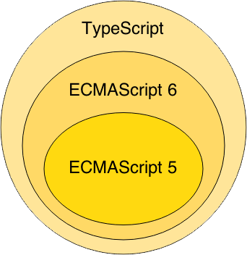
Angular 2
Angular 2 successor to Angular 1 than a “update.”
  The final version was released on September 14, 2016
Component based without any controllers or scopes.
  Much Cleaner and has removed most of the directives found in Angular1
Uses strongly typed language
  Extended version of TypeScript annotations decorators

Slide 8
Angular1.X vs Angular 2
Angular 2 shares some concepts with its predecessor
  the special HTML templating syntax,
  directives/components to modify the DOM
Has Introduced better strategies and concepts to improve the performance
  By updating data binding concept.
Angular 1 may not be deprecated or will not lack support
  It will be there to stay
Angular 2 is Well designed and its is mobile oriented.
  Need for Iconic framework is minimized

Slide 9
Version History
Angular 2 | 14th Sep 2016
Angular 4 | 23rd March 2017
Angular 5 | 11th Nov 2017
Angular 6 | 03rd May 2018

Slide 10
Angular 2
Dropped controllers - uses component-based UI
  Instead of binding to properties in the scope they are directly bound to the components
  Uses the ES6 modules.
  Similar to ReactJS.
Routers
  Enhanced Routing
  Feature rich than the old ngRoute

Slide 11
Angular 4
Released on March 23, 2017.
  Skipping 3 to avoid a confusion due to the misalignment of the router package's version which was already distributed as v3.3.0
  Angular 4 is backward compatible with Angular 2.
Smaller & Faster
  Angular applications becomes smaller and faster.
View Engine
  AOT generated code reduce the size of the generated code by around 60%
  More complex the templates the higher the savings.
  Migrating to 4 reduced production bundles by hundreds of kilobytes.

Slide 12
What is New angular 4
Animation Package
  Animations is removed from @angular/core and into their own package.
  Added by importing @angular/platform-browser/animations.
Improved *ngIf
  Can now use an if/else style syntax
TypeScript 2.1 and 2.2 compatibility
  Updated to a more recent version of TypeScript.
  Improve the speed of ngc
  Better type checking in application.
Source Maps for Templates
  When there is an error caused by something in templates
  A Source Map is generated that give a meaningful context in terms of the original template.

Slide 13
Angular 5
Angular 5 was released on November 1, 2017.
Key improvements in Angular 5
  Support for progressive Web apps,
  A build optimizer that makes the application smaller by eliminating unnecessary code.
  Pipes for internationalized number, date, and currency.
  Run validation and value updates on blur and submit rather than on every input event.

Slide 14
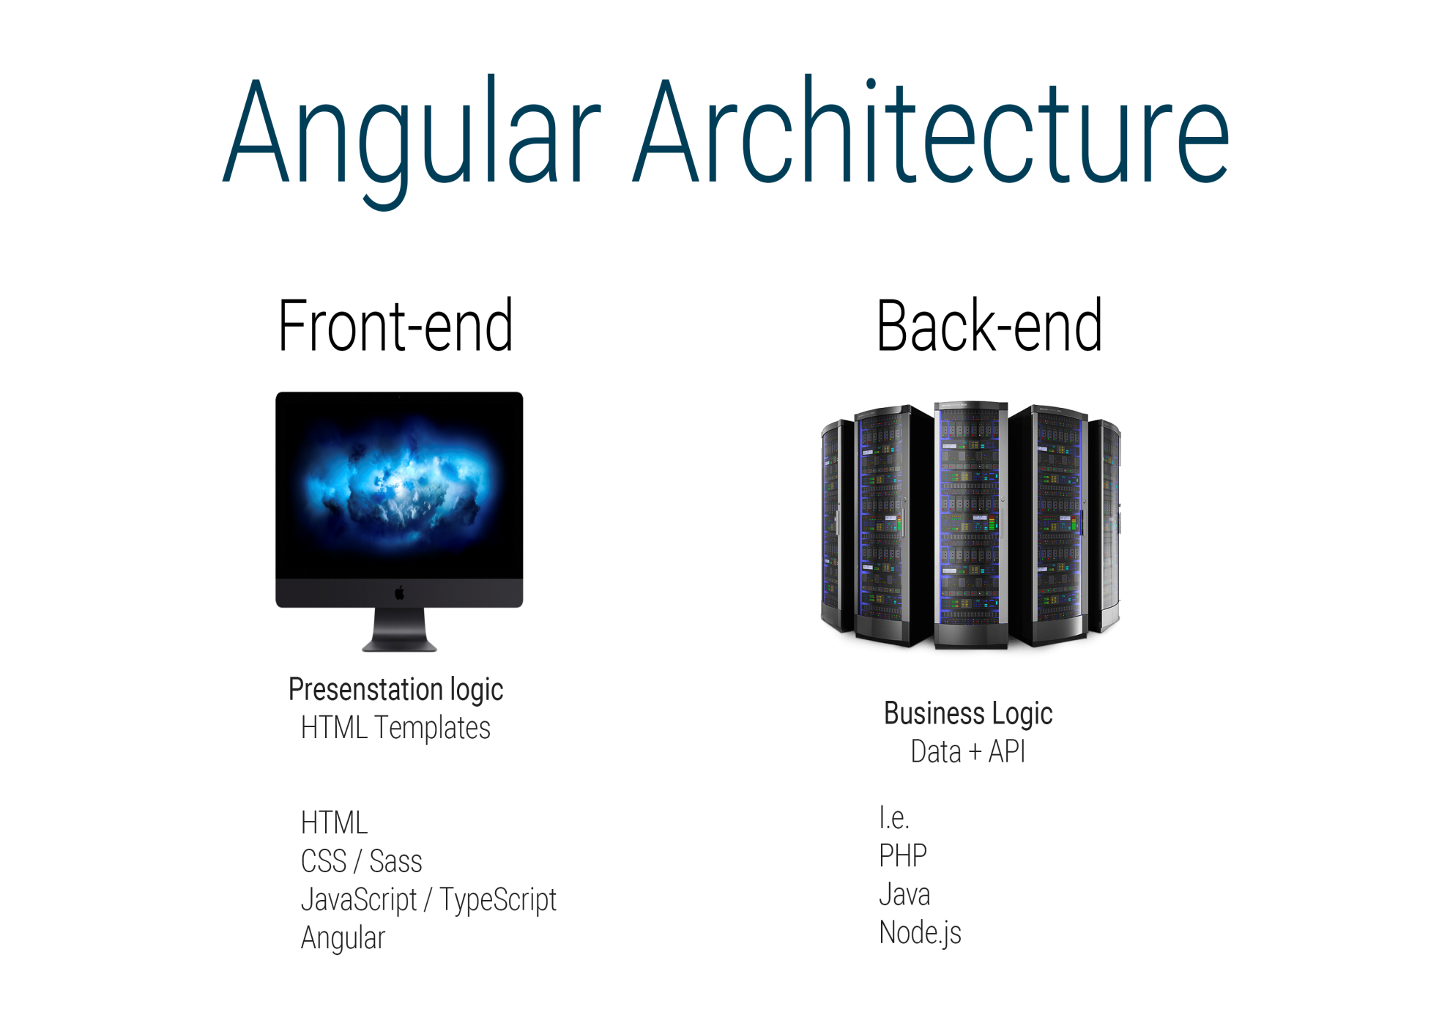

Slide 15
Angular - Architecture
The architecture of Angular 2 contains following modules:
  Module
  Component
  Template
  Metadata
  Data Binding
  Service
  Directive
  Dependency Injection

Slide 16
Single Page Applications
Writing large-scale, maintainable single-page-applications are big challenge.
  fixing bugs, writing unit tests and creating reusable chunks of code…
Single-page-applications with older frameworks gies different ways to design an application.
  There wasn’t any structure, encapsulation and everything was tightly coupled to each other.
SPA-technologies like Angular make use components.
  With a predefined structure and encapsulation

Slide 17
Single Page Application
HTML is a great declarative language for static documents.
  It does not contain much in the way of creating applications,
One "real" HTML page whose content can be changed in Javascript without having to download a new page.
  The new content is created programmatically using templates.
  Server sends an application engine along with the HTML page
The engine controls the entire application including processing, input, output, painting, and loading of the HTML pages.
Server is used when there is a need for new data or must perform secured operations such as authentication.

Slide 18
Characteristics Single Page Application:
Chunking
  Pages are constructed by loading chunks of HTML fragments and JSON data instead of receiving full HTML from server on every request.
Controllers
  JavaScript code that handles complex DOM and data manipulations, application logic and AJAX calls is replaced by controllers that separate views and models using MVC or MVVM patterns.
Templating
  coding of UI and DOM manipulations are replaced by declarative binding of data to HTML templates.
Routing
  selection of views and navigation (without page reloads) that preserves page state, elements and data

Slide 19
MVC on Client Side
Client side MVC
  MVC framework is built entirely on the client side.
  Server only delivers data to the application.
  The binding of the data to the models happens client side.
Need for client-side MVC
  operations are not only with HTML but with data on the page.
  when data is collection of JSON
  Process data, perform all required calculations, render HTML and put that into page.
  CRUD actions , over REST API.
  adding or deleting should not make page to reload
  can update page according to current data state.

Slide 20
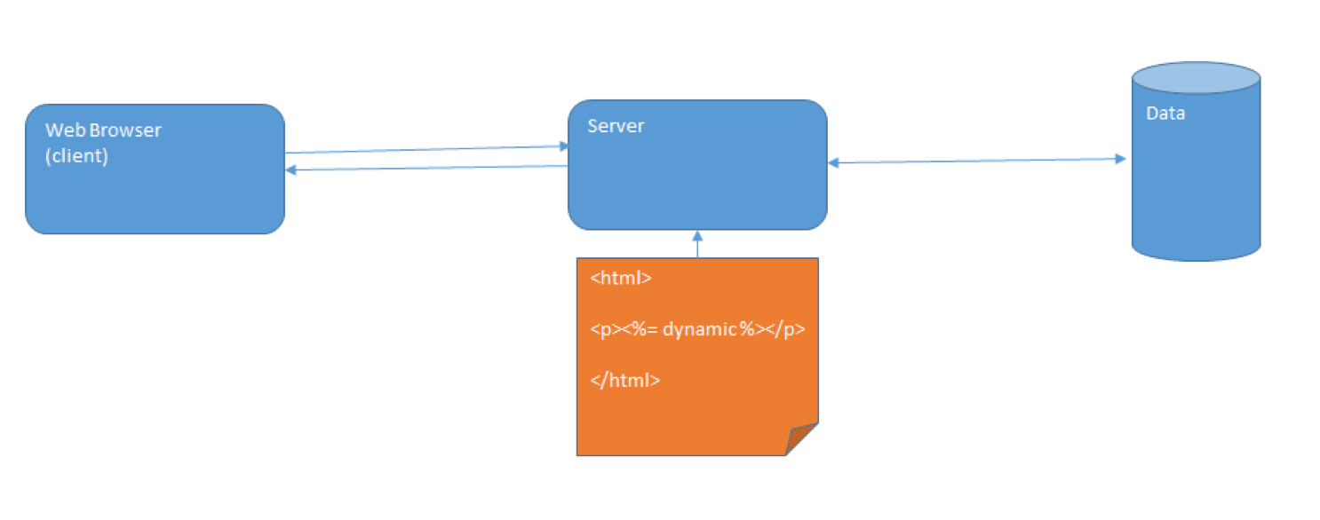
MVC on Server Side

Slide 21
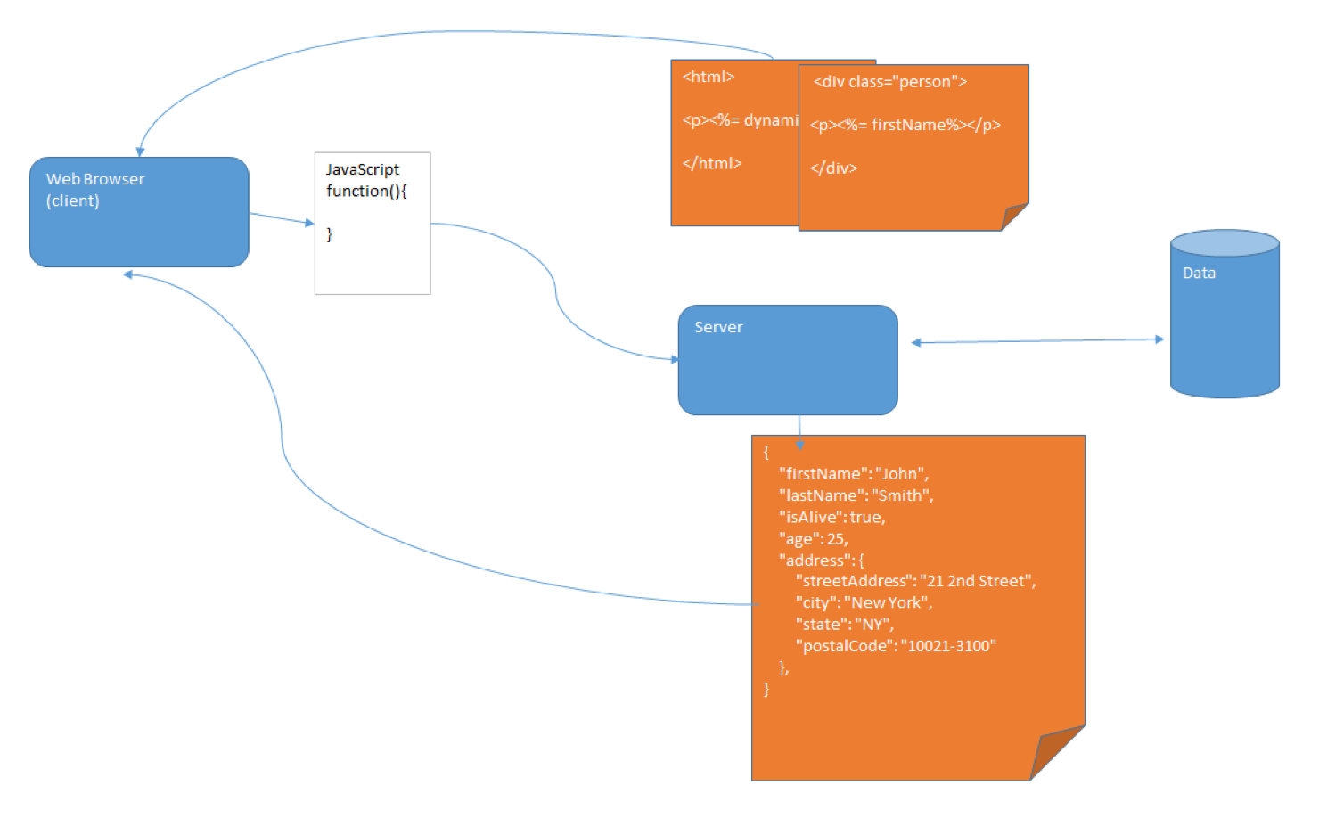
MVC on Client Side

Slide 22
MVC in Angular
Angular is more of component based architecture.
  A well defined component consist of individual set of MVC architecture.
Model will mostly uses services, which is accessed through Components
  A Simple class file can also be called Model.
component.html
  These are the view
  The HTML, is what is presented to the user (along with some CSS for layout). It is easy to see how this represents the view.
component.ts
  Is the controller .
  It can choose which data to push to view
  Has difference forms of binding

Slide 23
Single Page Application in Angular
Single Page application have many MVC relationships
MVC’S be side by side
A user can navigate from one page to another
MVC can be nested
Example : In a Hotel Application
  We can components for
  Reservation
  front desk
  room service
  catering
Each one of them MVC on its own

Slide 24
Angular 4 Dependency
Introduction to NodeJs
Introduction to Es6
Introduction to Type Script

Slide 25
Choosing a Module Loader
Module bundling.
  Module loader takes a group of modules with their dependencies and merges them into a single file in the correct order.
Having <script> tag loads files is inefficient as it reduces the page speed as the browser requests each file separately.
Can bundle several files together into one big file.
The entire file can be downloaded in one single request reducing the number of requests.
Can also minify the file (remove the extra spaces,comments, unnecessary characters etc) and make files smaller

Slide 26
Choosing a Module Loader
The two popular Module loaders are Webpack and SystemJS
Webpack is a more flexible module bundler than SystemJS.
It can not only bundle modules but also minifies our modules.
It also comes with a development server with hot module replacement option.
The Angular CLI project has moved to Webpack from the SystemJS.

Slide 27
Webpack
Webpack is a powerful module loader.
It takes modules with dependencies and generates static assets representing those modules.
Webpack has the ability to bundles any kind of file: JavaScript, TypeScript, CSS, SASS, LESS, images, HTML, fonts etc.
The clever parser that can process nearly every 3rd party library.

Slide 28
Webpack Dev Server
The Webpack also comes with a development server.
Can be used run application as we are developing the application.
The Development server uses the Webpack’s watch mode.
Any changes made to our application are instantly updated.
Configured by using the webpack.config.js. Configuration file

Slide 29
Angular Development Environment
Installing Angular CLI
Done by using the following command.
    npm install -g @angular/cli
Creating the Project
  Created by executing the following command from the Prompt
  ng new “gettingstarted”
  Creates a folder gettingstarted and copies all the required files and configuration settings.

Slide 30
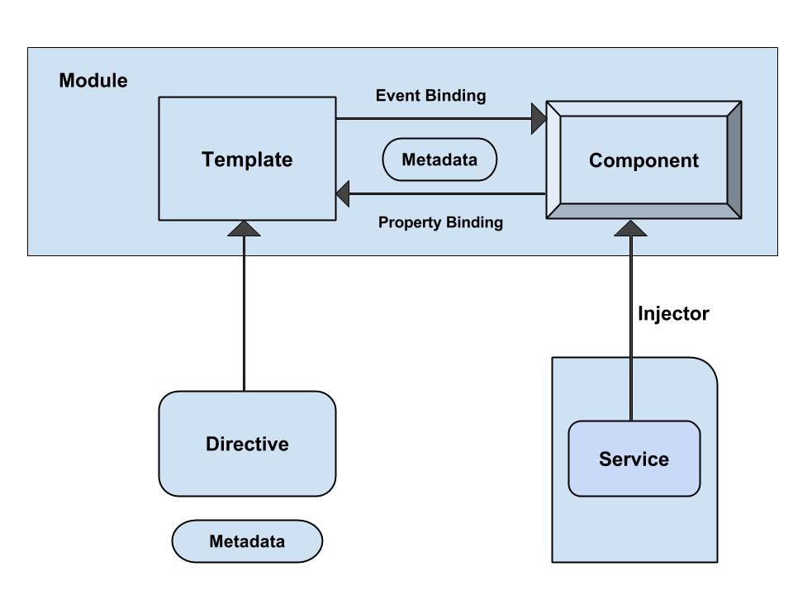
Angular - Architecture

Slide 31
Angular Application Folder structure
Creates a Sample Angular Application
It contains the subfolders e2e, node_modules and src.
It also contains the few configuration files
Angular.json
  This is the configuration file for Angular CLI
karma.conf.json
  The Configuration file karma test runner. Angular uses the Jasmine as the testing framework
protractor.conf.js
  The Configuration file for protractor end to end test runner.
tslint.json
  tslint is a static code analysis tool used in software development for checking Typescript code quality.

Slide 32
Packages.json
It also creates a packages.json which contains dependencies
  {
  "name": "quickstart",
  "version": "0.0.0",
  "scripts": {
  },
  "dependencies": {
  },
  "devDependencies": {
  }
  }

Slide 33
Packages.json
Script Section
  This Script section contains many of the most useful commands
  Ng,start,test etc
devDependencies Section
  This section contains the entries required for application development
  Typescript,karma,jasmine,protractor etc.,

Slide 34
dependencies section
  This section contains the framework and utility capabilities
@angular/core
  Critical runtime parts for every application.
  metadata decorators, Component, Directive, dependency injection, and the component lifecycle hooks.
@angular/common
  The commonly needed services, pipes, and directives provided by the Angular team.
@angular/compiler
  Template Compiler
  Can convert to code
  Used indirectly via platform-browser-dynamic or the offline template compiler.
@angular/platform-browser
  For bootstrapping applications for production

Slide 35
Updating Package.json
Can also add in Project’s package.json and run update
  "dependencies": {
  "bootstrap": "^3.3.7”
  },
Import the Bootstrap.min.css to style.css
  @import "../node_modules/bootstrap/dist/css/bootstrap.min.css";

Slide 36
Sample Application
app/app.component.ts
  where root component is defined
app/app.component.css
  where Css Styles are defined
app/app.component.html
  where HTML templates are defined
app/app.component.spec.ts
  where Test Specification are defined
app/app.module.ts
  - the entry Angular Module to be bootstrapped
index.html
  this is the page the component will be rendered in
app/main.ts
  - is the glue that combines the component and page together

Slide 37
@Component decorator
Components are decorated with @Component decorator.
Provides Metadata about component
It consists of three main parts
  @Component({
  selector: 'app-root',
  templateUrl: './app.component.html',
  styleUrls: ['./app.component.css']
  })

Slide 38
@Component
Selector
  Denotes the location to display the template.
  The tag in the HTML file is replaced with the the template
templateUrl
  Contains the path to the HTML template file.
  This HTML file is used to render the view.
  The file is in the same folder as the AppComponent.
styleUrls
  An array of Style Sheets that uses to style our HTML file.
  It points towards to app.component.css style sheet.

Slide 39
Export and Import Component
  import { Component } from '@angular/core';
  @Component({
  selector: 'app-root',
  templateUrl: './app.component.html',
  styleUrls: ['./app.component.css']
  })
  export class AppComponent {
  title = 'app';
  }

Slide 40
app/app.component.html
  <div style="text-align:center">
  <h1>
  Welcome to {{title}}!!
  </h1>
  </div>

Slide 41
app/app.module.ts
The Angular applications are organized as modules.
  application must have at least one module.
  root Module is loaded first
  Reference of root component type is passed as argument
  Its called as root module
Application routes declarations should be done here

Slide 42
NgModule
Modules are class decorated with the @NgModule
Decorator function which has one argument
  A metadata object with properties describing the module.
Some of its important properties are:
Bootstrap Array
Export Array
Import Array
Provider Array.

Slide 43
Modules
Bootstrap array
  Used to inform which components need to be loaded, so that its functionality can be accessed in the application.
Export array
  Used to export components, directives, and pipes which can then be used in other modules.
Import array
  Used to import the functionality from other modules.
Providers array
  Used to provide the services by the module

Slide 44
Modules
  import { NgModule } from '@angular/core';
  import { BrowserModule } from '@angular/platform-browser';
  import { CreditCardModule } from '../credit-card/credit-card.module';
  import { AppComponent } from './app.component';
  @NgModule({
  imports: [ BrowserModule, CreditCardModule ],
  declarations: [AppComponent],
  bootstrap: [AppComponent] })
  export class AppModule { }

Slide 45
app/main.ts
Makes angular to load the AppModule and controls the start up of the application
bootstrapModule method of platformBrowserDynamic library
  to bootstrap AppModule
  import { enableProdMode } from '@angular/core';
  import { platformBrowserDynamic } from '@angular/platform-browser-dynamic';
  import { environment } from './environments/environment';
  import { AppModule } from './app/app.module';
  if (environment.production) {
  enableProdMode();
  }
  platformBrowserDynamic().bootstrapModule(AppModule);

Slide 46
app.main.ts
platformBrowserDynamic library.
  Contains the functions required to bootstrap the angular application.
enableProdMode from @angular/core library.
  The Angular’s code by default runs in development mode.
  The development mode runs few assertions and checks
  helps in debugging the application.

Slide 47
index.html
  <html>
  <head>
  <link rel="icon" type="image/x-icon" href="favicon.ico">
  </head>
  <body>
  <app-root></app-root>
  </body>
  </html>
The selector “app-root”, defined in component metadata is used as HTML tag.
Angular scans the HTML page for <app-root>
  replaces the entire content with content of app.component.html

Slide 48
Running Angular Application
  npm start
  will run definitions of the start command of the scripts object in package.json file.
  Compiles the Angular application and invokes the Webpack development server.
  Watches project folder and if any changes are made it compiles the project again.
  Server listens on HTTP Port 4200.
  http://localhost:4200/
Can Change the Default Port using angular-cli.json
  "defaults": {
  "styleExt": "css",
  "component": {},
  "serve": {
  "port": 5200
  }
  }

Slide 49
Ng-serve
ng serve
  command launches the server,
  Watches files, and rebuilds the app
  serves an Angular project via a development server
Using the --open or -o option
  will automatically open browser on http://localhost:4200/.

Slide 50
The Component
Angular migrated from directives to components
  Directives that are always associated with a direct template.
They represent the view of the application.
Can have methods and properties, which supply logic to view.
Smart / Container components
  application-specific, higher-level, container components, with access to the application's domain model.
Dumb / Presentational components
  components responsible for UI rendering and/or behavior of specific entities passed in via component properties and events

Slide 51
Generating Components
ng generate or ng g
Ng generate component footer
ng g component my-new-component
ng g component feature/new-cmp
Creating a new component, generates the following files
  component.html (View)
  component.ts (Controller)
ng generate --help
  To View all available options Angular CLI.

Slide 52
Angular CLI commands
Directive
  ng g directive my-new-directive
  ng g d my-new-directive
Pipe
  ng g pipe my-new-pipe
  ng g p my-new-pipe
Service
  ng g service my-new-service
  ng g s my-new-service
Class
  ng g class my-new-class
  ng g cl my-new-class
Interface
  ng g interface my-new-interface

Slide 53
Angular CLI commands
To skip npm install
  --skip-install: boolean
  default false
To Add Routing Information and import in main app
  --routing: boolean,
  default false,

Slide 54
Assets
Static Files like images and styles are served from assets folder
src/assets/css and copy the styles.css to it.
src/assets/images and copy the images to it

Slide 55
Component Class
The basic building block of an UI
  An application is a tree of components.
Component decorator marks a class as an Angular component
A component must belong to an NgModule in order for it to be usable by another component or application.
Component Class has a constructor() to setup Dependency Injection
Components can control their runtime behavior by implementing various Life-Cycle hooks.

Slide 56
Configuring More than One Component
  Done in the app.module.ts
  import { AppComponent } from './app.component';
  import { HeaderComponent } from './app.headercomponent';
  @NgModule({
  declarations: [
  AppComponent,
  HeaderComponent,
  ],
  imports: [
  BrowserModule
  ],
  providers: [],
  bootstrap: [AppComponent,HeaderComponent]
  })
  export class AppModule { }

Slide 57
Header Component
  import { Component, OnInit } from '@angular/core';
  @Component({
  selector: 'app-header',
  templateUrl: './header.component.html',
  styleUrls: ['./header.component.css']
  })
  export class HeaderComponent implements OnInit {
  banner: string;
  constructor() {
  this.banner = 'assets/images/Banner.jpg';
  }
  ngOnInit() { }
  }

Slide 58
Data Binding - Interpolation
communication between a component and it’s Template
  {{ expression }} to render the bound value to the component’s template.
  To weave calculated strings into the text between
    HTML element tags and within attribute assignments.
  Replaces the name with the string value of the corresponding component property
  <img src={{banner}} class='banner' />

Slide 59
Index.html
  <!doctype html>
  <html lang="en">
  <head>
    <base href="/">
    <meta name="viewport" content="width=device-width, initial-scale=1">
    <link rel="icon" type="image/x-icon" href="favicon.ico">
  </head>
  <body>
      <app-header> </app-header>
      <app-root> </app-root>
  </body>
  </html>

Slide 60
TEMPLATES

Slide 61
Angular Templates
Templates mix native HTML with custom elements.
Inline Templates
  Specified directly in the component decorator
  Template literals with back-ticks allow multi-line strings.
  @Component({
  selector: 'inline-template',
  template: ` <h2>Inline Template</h2>
  <p> Multi-line inline template using back-ticks </p>`
  })
  export class InlineComponent {}

Slide 62
Angular Templates
External Templates
  Defined in a separate HTML file
  Referenced with templateUrl.
  Recommended to use if the template contains more than 3 lines.
  @Component({
  selector: 'external-template',
  templateUrl: 'app/templates/external-template.html'
  })
  export class ExternalComponent {}

Slide 63
Built-in Directives -ngFor
Part of core directive to build data presentation lists and tables
Takes an iteration expression
A loop variable defined using the keyword let
  <tr *ngFor="let medicine of medicineList">
    <td>{{medicine.medicineName}}</td>
    <td>{{medicine.price}}</td>
    <td>{{medicine.unit}}</td>
  </tr>
  <tr *ngFor="let medicine of medicineList let i=index">
  <td>{{i+1}}</td>
  </tr>

Slide 64
DEPENDENCY INJECTION

Slide 65
Dependency Injection
The ability to add functionality to components at runtime.
  Simplify dependency management in software components.
Done by reducing the amount of information a component needs to know about its dependencies,
  unit testing can be made easier and code is more likely to be flexible.

Slide 66
Without DI
  class Travel{
    private localTransport: Car;
    private hotel: Hotel;
  constructor() {
    this.localTransport = new Car(‘BMW');
    this.hotel = new Hotel(‘ThreeStar');
  }

Slide 67
Passing Dependencies
  class Travel{
    private localTransport: Car;
    private hotel: Hotel;
  constructor(vechType:string,hotelCategory:string) {
    this.localTransport = new Car(vechType);
    this.hotel = new Hotel(hotelCategory);
  }

Slide 68
DI – Next Step
  class Travel{
    private localTransport: Car;
    private hotel: Hotel;
  constructor(localTransport:Car,hotel:Hotel) {
    this.localTransport =localTransport;
    this.hotel =hotel;
  }
  }
  travelPlan = new Travel(new Car(), new Hotel(‘Three Star‘));
  When Travel is instantiated it does not need to know anything about its Hotel or Local Transport
  The construction of these elements has been moved out of the class
  Angular provides a dependency injection system.

Slide 69
DI Framework
DI Frameworks have the concept of an Injector object.
An Injector is a like the factory function for a collection of objects.
Injectors return singletons.
  There is not just one injector per application, there is at least one injector per application.
Injectors are organized in a tree that parallels Angular 2's component tree.

Slide 70
DI with Angular
A separate class with injectable decorator.
  Allows the functionality of the class to be injected
The Component in which it has to be used ,
  Defined as a provider in the @Component decorator.
A provider is a resource that Angular uses to provide
A class provider generates/provides an instance of the class.
  @Component ( {
  providers : [classname]
  })

Slide 71
SERVICES

Slide 72
Services
A service is used when a common functionality needs to be provided to various modules.
  Eg: A database functionality that could be reused among various modules.
A separate class which has the injectable decorator
  ng g service my-new-service
Added to the module to use the service as a provider in the @Component decorator.
Services are singleton objects.
Services are capable of returning the data in the form promises or observables.

Slide 73
@Injectable
@Injectable()
  Let know a class can be used with the dependency injector.
  Not strictly required if the class has other Angular decorators on it.
  Best practice is to decorate injectables with @Injectable(), as it is makes more sense to the reader.
providedIn: 'root‘
  Indicates that the root injector is responsible for creating an instance
  These are automatically made available to the entire application
  Don't need to be listed in any module.

Slide 74
Model Class
  import { Injectable } from '@angular/core';
  @Injectable()
  export class WeatherData {
  minTemp:number;
  maxTemp:number;
  forecast:string;
  constructor(){
  this.minTemp=29;
  this.maxTemp=30;
  this.forecast='thundstrom and rains';
  }
  getWeatherData(){
  return this;
  }
  }

Slide 75
Service
  import { Injectable } from '@angular/core';
  import {WeatherData} from "./weather-data";
  @Injectable()
  export class WeatherService {
  data:WeatherData;
  constructor(data:WeatherData) {
  this.data=data;
  }
  getWeather(): any {
  return this.data.getWeatherData();
  }
  }

Slide 76
Component
    import { Component } from '@angular/core';
    import {WeatherService} from "./weather.service";
    import {WeatherData} from "./weather-data";
    @Component({
    providers:[WeatherService,WeatherData]
    })
    export class AppComponent {
    weatherReport:WeatherData;
    constructor(private ws :WeatherService){
    this.weatherReport=ws.getWeather();
    }

Slide 77
*R*eactive E*x*tensions for *J*ava*S*cript
A library for composing asynchronous and event-based programs by using observable sequences.
Observable:
  Invokable collection of future values or events.
  Observable is used to manage async data.
  An Observable can have multiple subscribers and all the subscribers are notified when the state of the Observable changes.
Observer:
  Callbacks to listen to values delivered by the Observable.
Subscription:
  Execution of an Observable
  Used for cancelling the execution by unsubscribing.
Operators:
  Functions dealing with collections
  map, filter, concat ,etc.

Slide 78
RxJS
  var button = document.querySelector('button');
  button.addEventListener('click', () => console.log('Clicked!'));
Using RxJS
var button = document.querySelector('button');
  Rx.Observable.fromEvent(button, 'click') .
  subscribe(
  () => console.log('Clicked!')
  );

Slide 79
HttpClient
Introduced in the Angular 4.3.
Available in package @angular/common/http
  To replace the older HttpModule.
The Response returned from the HttpClient is an observable
  Needs to be Subscribed.
  The response can be converted to desired object

Slide 80
HttpClient
get() :
  parses the JSON server response into the anonymous Object type.
  Can specify the type of response to make consuming the output easier and more obvious.

Slide 81
HttpResponse
Can also configure to get the full response
getConfigResponse(): Observable<HttpResponse<Config>> {
return this.http.get<Config>( this.configUrl, { observe: 'response' }); }
Now HttpClient.get() returns an Observable of typed HttpResponse rather than just the JSON data.
.subscribe(resp => {
const keys = resp.headers.keys();
this.headers = keys.map(key => `${key}: ${resp.headers.get(key)}`); this.config = { ... resp.body }; }); }

Slide 82
Using Promise
findAllWithPromise(): Promise<BloodDonar[]> {
return this.http.get<BloodDonar[]>('http://localhost:3000/bloodDonars').toPromise();
}
this.service.findAllWithPromise();
.then(
res => this.bloodDonars = res ).catch(err => console.log(err.error));

Slide 83
Http Client Module
  import {HttpClientModule, HttpClient} from '@angular/common/http';
  @NgModule({
  declarations: [
  AppComponent,
  ],
  imports: [
  BrowserModule ,HttpClientModule],
  providers: [HttpClient],
  bootstrap: [AppComponent]
  })
  export class AppModule { }

Slide 84
Get Method
  @Injectable(
  {
  providedIn: 'root'
  }
  )
  export class MedicineApiService {
  constructor(private http: HttpClient) { }
  baseURL = 'http://localhost:3000/medicines';
  findAll(): Observable<Medicine[]> {
  return this.http.get<Medicine[]>(this.baseURL);
  }
  }

Slide 85
Post and Delete Method
  add(medicine): Observable<Medicine> {
  const headers =
  new HttpHeaders().set('content-type', 'application/json');
  return this.http.post<Medicine>(this.baseURL, medicine, {headers});
  }
  remove(codeNumber): Observable<Medicine> {
  return this.http.delete<Medicine>(this.baseURL + '/' + codeNumber);
  }

Slide 86
Subscribing
  @Component({
  selector: 'app-crud',
  templateUrl: './crud.component.html',
  styleUrls: ['./crud.component.css']
  })
  export class CrudComponent implements OnInit {
  medList: Medicine[]
  constructor(private service: MedicineApiService) { }
  ngOnInit() {
  this.service.findAll()
  .subscribe(data => this.medList = data, err => console.log(err));
  }
  }

Slide 87
Subscribe()
.subscribe(success, failure, completed);
Success:
  Whenever observable returns a value.
  (response) => { this.repos=response; }
Failure:
  When observable is failed to generate the expected data or has encountered some other error.
  (error) => {this.errorMessage=error; this.loading=false; },
Completed:
  When the observables complete its task.
  () => {this.loading=false;})

Slide 88
PROPERTY BINDING

Slide 89
Types of Property Binding
Element property binding
  works within HTML element
  binds a component property to a DOM property.
Component property binding
  works within component element to bind parent component property into child component property.
Directive property binding
  Works within HTML element with angular directives such as NgClass and NgStyle.
  Component property or any angular expression is bound to angular directive.

Slide 90
ELEMENT PROPERTY BINDING

Slide 91
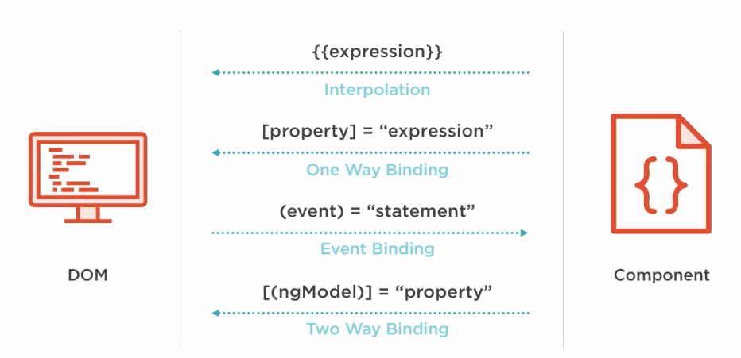
Element Property Binding

Slide 92
Property Binding
  Property binding A One way Binding that allows to send
    from the component class, to the component’s template.
Sets an element property to a component property value.
Can be Used for non-string data value.
Done by wrapping brackets around an element
  Done to a component property.
  <img [src]=" imageUrl ">
  <button [disabled]='isDisabled'>Try Me</button> // in the template
  isDisabled: boolean = true; // in the component class

Slide 93
Property Binding – Element Property
  export class FoodComponent {
  idly :Food={
  favTime:’Any time”,
  name:'idly',
  imageUrl:'assets/images/idly.jpg'
  }
  }
  export class Food{
  favTime:string;
  name:string;
  imageUrl:string
  }
  <img [src]="idly.imageUrl">
  <h1 [innerHTML]=“idly.name"></h1>

Slide 94
Event Binding
Event handler are is specified inside the template using ()
  Event handler is then coded in the class to process the event.
Can take the same property that is on the HTML element wrap it in parenthesis.
  template: `
  <h1>My First Angular App</h1>
  <img [src]="imageUrl" (click)='myMethod()'> `
      imageUrl =‘’assets/images/idly.jpg'
  myMethod() {
  console.log('Hello);
  }

Slide 95
Event Binding
Can also pass information about the event to the component class:
  ` <img src=“{{imageUrl}}" (click)='myMethod($event)'> `
  myMethod(event:any) {
  console.log(event);
  }

Slide 96
Two Way Binding
Combines the input and output binding into a single notation
Done by using a special directive called ngModel.
<input [(ngModel)]="name" >
  <input [ngModel]="name" (ngModelChange)="name=$event">
square braces [..] refers property binding.
circle braces (..) refers to the event binding.
  Together as [(..)] refers two way binding
This syntax is called Banana in a Box ([()]).

Slide 97
Two Way Binding- App Module
  import { FormsModule } from '@angular/forms';
  @NgModule({
  declarations: [
  AppComponent,
  ],
  imports: [
  BrowserModule,FormsModule
  ],
  providers: [],
  bootstrap: [AppComponent,ShowplacesComponent]
  })

Slide 98
Two Way Binding
  <div> <label>Name:</label>
  <input type="text" [(ngModel)]="name">
  <h1>Hello {{name}}!</h1> </div>
  export class AppModule {
  private name:string='World';
  }

Slide 99
Two way Binding
  <div> {{student.studentNumber}}</div>
  <div> {{student.studentName}} </div>
  <div>{{student.mark}}</div>
  <input [value]="student.studentNumber“ [(ngModel)]="student.studentNumber">
  <input [value]="student.studentName" [(ngModel)]="student.studentName">
  <input [(ngModel)]="student.mark">
  <p> <button (click)="reset()">Reset</button> </p>

Slide 100
Two Way Binding
  export class AppComponent {
  private name:string='World';
  private student:Student={
  studentNumber :101,
  studentName :'Ramesh',
  mark :78
  }
  reset(){
  this.student.studentNumber=0;
  this.student.studentName='';
  this.student.mark=0;
  }
  }

Slide 101
DIRECTIVES

Slide 102
Directives
Used to attach behavior to DOM elements.
Built-in directives to the framework
  NgFor, NgIf, NgModel, NgClass
There are three kinds of directives:
Components
  @Component(): Is also a directive with a template.
Structural Directives
  Can change the DOM layout by adding and removing DOM elements
Attribute Directives
  doesn’t change the DOM but can change the appearance or behavior of an element such as NgStyle.

Slide 103
Attribute Directives
These directives change the appearance or behavior of a component.
They work in a way that is component agnostic and not bound to implementation details.
Example:
  ngClass and ngStyle work on any component or element.

Slide 104
NgStyle Directive
To modify a component or element's style attribute.
  @Component({
  selector: 'style-example',
  template: `
  <p [ngStyle]="{'background-color':messageStyle}">
  `
  })
  export class StyleExampleComponent {
  messageStyle:string='yellow';
  }

Slide 105
NgClass Directive
Directive changes the class attribute that is bound to the component or element it's attached
Binding a string
  Can bind a string directly to the attribute.
  @Component({
  selector: 'class-as-string',
  template: `
  <p ngClass='centerText'>Page Designed by Ramesh</p>
  `,
  Binding an Array : A list of applicable class names defined in css
  <p [ngClass]="['centerText','highLight']">Page Designed by Ramesh</p>

Slide 106
Binding an object
Object can be bound to the directive.
Each property name of that object to the component if that property is true.
  @Component({
  selector: 'class-as-object',
  template: `
  <p [ngClass]="{ card: true, dark: false, flat: flat }">
  <button type="button" (click)="flat=!flat">Toggle Flat</button>
  </p>
  `,
  export class ClassAsObjectComponent {
  flat: boolean = true;
Object's card and flat properties are true
  those classes are applied
  Since dark is false, it's not applied.

Slide 107
Structural Directives
It’s a "syntactic sugar" for tasks that’s done Internally,
Its translated into a <ng-template> element
And then wrapped around the host element Prefixed with an asterisk.
ngIf , ngFor , and ngSwitch .
  @Component({
  selector: 'directive-example',
  template: `
  <p *structuralDirective="expression">
  Under a structural directive.
  </p>
  `})

Slide 108
Built-in Directives -ngFor
Part of core directive to build data presentation lists and tables
Takes an iteration expression
A loop variable defined using the keyword let
  <tr *ngFor="let medicine of medicineList">
    <td>{{medicine.medicineName}}</td>
    <td>{{medicine.price}}</td>
    <td>{{medicine.unit}}</td>
  </tr>
  <tr *ngFor="let medicine of medicineList let i=index">
  <td>{{i+1}}</td>
  </tr>

Slide 109
ng-template directive
Represents an Angular template
Used for rendering HTML.
  It is never displayed directly.
  It gets loaded as part of parent view content.
  Build in Structural directives use this.
The content of this tag will contain part of a template
  Which can be composed together with other templates
  Resulting in a final component template.

Slide 110
ngFor
ngFor also provides some other values that can be bound to:
  index - position of the current item in the iterable starting at 0
  first - true if the current item is the first item in the iterable
  last - true if the current item is the last item in the iterable
  even - true if the current index is an even number
  odd - true if the current index is an odd number
  *ngFor="let emp of employees;
  let even = even; let odd = odd"
  [ngClass]="{ odd: odd, even: even }"> {{emp.name}}

Slide 111
Built-in Directives –ngIf
*ngif="condition“
  <div>
  <button (click) =“clicked()”>Toggle</button>
    <div *ngIf=“show”>
    <p> see Image</p>
    </div>
  </div>
  export class AppComponent{
  show:boolean =true;
  Clicked (){
  this.show=!this.show;
  }
  }

Slide 112
ngIf
<h2 *ngIf="condition">Hello {{name}}</h2>
<button (click)="condition = !condition">Click</button>
// When the above code is Rendered
  <ng-template [ngIf]=“condition">
  <h2 >Hello {{name}}</div>
  </ng-template>
  <!--bindings={
  "ng-reflect-ng-if": "true"
  }-->
  <h2 _ngcontent-c0="">Hello Angular5</h2>

Slide 113
*ngIf and Else
Components has a defined template in the component class.
  Can display a template if an expression matches some condition.
  <li *ngIf="myArr“>Hello World</li>
If object myArr is defined, it evaluates to true and displays the HTML element
<li *ngIf="myArr == 'something'“>Hello India.</li>
Can also specify the ! not operator and it won't display the given HTML element

Slide 114
*ngIf and Else
Can also declare else as conditions:
  template: `
  <h1>Greeting !</h1>
  <ul> <li *ngIf="myArr; else otherTmpl“>Hello World.</li> </ul>
  <ng-template #otherTmpl>Hello India</ng-template> `
Can also use then inside of expression
  template: `
  <h1>Greeting</h1>
  <div *ngIf="myArr; then tmpl1 else tmpl2"></div>
  <ng-template #tmpl1>Here</ng-template>
  <ng-template #tmpl2>Not here</ng-template> `,

Slide 115
NESTING COMPONENTS

Slide 116
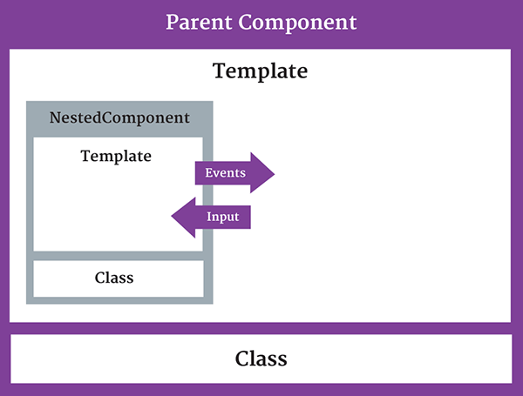
Nested Component
The component being used inside another component is known as the child component
  and the enclosing component is known as the parent component.

Slide 117
Nested Component -Child
  import { Component } from '@angular/core';
  @Component({
  selector: 'appchild',
  template: `<h2>Hi {{greetMessage}}</h2>` })
  export class AppChildComponent {
  greetMessage: string = "I am Child";
  }

Slide 118
Nested Component- Parent
  import {Component } from '@angular/core';
  import {AppChildComponent} from './appchild.component';
  @Component({
  selector: 'my-app',
  template: `<h1>Hello {{message}}</h1>
  <appchild></appchild> `,
  })
  export class AppComponent {
  message : string = "I am Parent";
  }

Slide 119
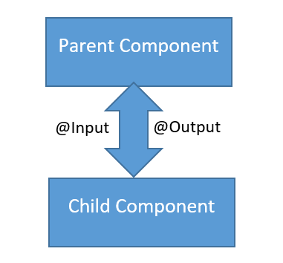
Communication Between Components
Can share data and information with another component by passing data or events.
Components can communicate to each other in different ways:
  Using @Input()
  Using @Output()
  Using Services
  Parent component calling ViewChild

Slide 120
PASSING DATA USING @INPUT
  To pass data into components from template and to dynamically configure them.
  Supports change tracking.
  Can NOT pass @Input() to a bootstraped component.
Binds a property within one component (child component) to receive a value from another component (parent component).
  One way communication from parent to child.
Component property should be annotated to act as input property.

Slide 121
Child Component
  import { Component,Input,Output,EventEmitter, OnInit } from '@angular/core';
  @Component({
  selector: 'review-food',
  templateUrl:'reviews.component.html',
  styleUrls: ['../food-items/food/food.component.css']
  })
  export class ReviewsComponent {
  @Input() reviewedby:string;
  details='Reviewed by 200 peoples';
  }

Slide 122
Parent Component-One Way Component Property Binding
  import { ReviewsComponent } from '../../reviews/reviews.component';
  @Component({
  selector: 'app-food',
  templateUrl: './food.component.html',
  styleUrls: ['./food.component.css'],
  })
  export class FoodComponent {
  reviewer:string = 'Zomoto';
  }
Reviwed by <review-food [reviewedby]='reviewer'></review-food>
Parent component sets the value of the child component’s property
Input Property as defined in Child
Bound property in Parent

Slide 123
Detecting the Input changes
Child Component can know the when the input changes
Input changes can be detected in the child component by using
  OnChanges LifeCycle Hook
  Using Input Setter

Slide 124
OnChanges
Import the OnChanges and SimpleChanges
Whenever parent component changes the value of Input properties
  ngOnChanges() in child component runs automatically.
Method takes SimpleChanges as an argument
  It gives new and previous value of input values after changes.
Can find out the details about
  Which input properties have changed
  How they have changed.

Slide 125
Input Change Detection
Change Detection
  Done by using property getter and setter
Get and Set Method is Decorated with @Input
  @Input()
  set count(count: number) {
  this._count = count;
  console.log(count);
  }
  get count(): number { return this._count; }

Slide 126
@output
One way communication from child to parent component
Uses events
  binds a property of a component to send data from one component (child component) to calling component (parent component).
The child component exposes an EventEmitter property
  It emits events when something happens.
  The parent binds to that event property and reacts to those events.
The child's EventEmitter property is an output property,
  Its adorned with an @Output decoration
  @Output()
  sendMsgEvent = new EventEmitter<string>();
  sendMsgEvent will be custom event name.

Slide 127
Child Component
  import { Component,Input, Output,EventEmitter,OnInit } from '@angular/core';
  export class ChildComponent implements OnInit {
  @Input() childName: string;
  @Output() result: EventEmitter<String> = new EventEmitter<string>();
  constructor() { }
  ngOnInit() { }
  addData(){
  this.result.emit(this.childName + 'Added');
  }
  }
Property placeholder to receive from parent
Property To Parent

Slide 128
Emit
emit()
  emit a change to (change) listener in the parent
  Which will invoke the onchange($event) callback
  The data associated with the event will be given via the $event property.
Child-Component.html
  <p>
  <button (click)="addData()">Add Medicine</button>
  </p>

Slide 129
Parent-component.html
  <input type="text" name='user' [(ngModel)]='name'>
  <p>
  <app-child childName ={{name}} (result)="onChange($event)"></app-child>
  {{msg}}
  </p>
  childName : refers to @Input Property in to Child Component
  name : refers to property in the Parent Component
  Result : refers to @output Property in Child Component

Slide 130
Parent Compnent
  import { Component, OnInit, SimpleChanges } from '@angular/core';
  @Component({
  })
  export class ParentComponent implements OnInit {
  msg: string;
  name: string;
  constructor() { }
  ngOnInit() {
  }
  onChange(val) {
  this.msg = val;
  }
  }

Slide 131
@ViewChild()
Used to get the first element or the directive matching the selector from the view DOM.
  If the view DOM changes, and a new child matches the selector, the property will be updated.
@ViewChildren()
To get the QueryList of elements or directives from the view DOM.
  Any time a child element is added, removed, or moved, the query list will be updated, and the changes observable of the query list will emit a new value.

Slide 132
Child to Parent Sharing Data
Child to Parent Sharing Data
  If an instance of the parent component class must read or write child component values or must call child component methods.
One component is injected into another
  The parent has access to the child attributes and functions.
  Child won’t be available until after the view has been initialized.
  Need to implement AfterContentInit lifecycle hook
    Can receive the data from the child in this method.

Slide 133
Child Components
  export class GuestPhotosComponent implements OnInit {
  guestPhoto: string;
  constructor() {
  this.guestPhoto = 'assets/images/frntView.jpg';
  }
  }
  export class HotelPhotosComponent implements OnInit {
  hotelPhoto: string;
  constructor() {
  this.hotelPhoto = 'assets/images/rearView2.jpg';
  }
  }

Slide 134
Parent Component
  export class GalleryComponent implements OnInit, AfterContentInit
  {
  hp: string;
  gp: string;
  @ViewChild(GuestPhotosComponent) guestPhotos: GuestPhotosComponent;
  @ViewChild(HotelPhotosComponent) hotelPhotos: HotelPhotosComponent;
  ngAfterContentInit(): void {
  this.gp = this.guestPhotos.guestPhoto;
  this.hp = this.hotelPhotos.hotelPhoto;
  }
  }

Slide 135
Parent Template
  <app-guest-photos></app-guest-photos>
  <app-hotel-photos></app-hotel-photos>
    <img src={{gp}} alt='hello'>
    <img src={{hp}} alt='style'>

Slide 136
Passing Data Between Siblings
Data between siblings, grandchildren passed by a shared service.
RxJS BehaviorSubject
  Will return the current value on subscription
getValue()
  - To extract the last value as raw data.
  Ensures that the component always receives the most recent data.
  A Service is injected into the constructor of one Component
  It then subscribe to the currentMessage observable
  Set its value equal to the message variable.

Slide 137
Behavior Subject
A special type of observable
  Needs an initial value
  It must always return a value on subscription
On subscription
  Can Returns the last value of the subject.
  Can also send values to a subject in addition to subscribing to it.
Returns an Observable using the asObservable()

Slide 138
BehaviorSubject
  let bSubject = new BehaviorSubject("a");
  bSubject.next("b");
  bSubject.subscribe(value => { console.log(“Got", value);
  // Got b,
  bSubject.next("c"); // Got c
  bSubject.next("d"); // Got d

Slide 139
Service
  export class DataService {
  private messageSource =
  new BehaviorSubject<string>('My Desktop Suggestion');
  currentMessage = this.messageSource.asObservable();
  constructor() { }
  changeMessage(message: string) {
  console.log('change method in service fired');
  this.messageSource.next(message);
  }
  }

Slide 140
Component - 1
  export class ComputerComponent implements OnInit {
  suggestion: string;
  constructor(private service: DataService) { }
  ngOnInit() {
      this.service.currentMessage.subscribe(
      message => {
      console.log('Msg in Computer' + message);
      this.suggestion = message;
      });
  }
  }

Slide 141
Component 2 - Template
  {{response}}
  <button (click)="newMessage()">suggest </button>

Slide 142
Component -2
  export class PrinterComponent implements OnInit {
  response: string;
  constructor(private service: DataService) { }
  ngOnInit() {
    this.service.currentMessage.subscribe(message => {
    console.log('Msg in Printer' + message);
    this.response = message;
    });
  }
  newMessage() {
  console.log('Printer is changing message ');
  this.service.changeMessage(' Dell Desktop');
  } }

Slide 143
Component Interactions
Parent to Child
  Sharing Data via Input()
Child to Parent
  Sharing Data via ViewChild()
Child to Parent
  Sharing Data via Output() and EventEmitter
Unrelated Components
  Sharing Data with a Service

Slide 144
CUSTOM DIRECTIVES

Slide 145
Custom Directives
Custom Attributes Directive are created as a class.
  ng generate directive [name]
The class is decorated with the Directive decorator
  specifies a selector which will be looked up in views.
The Class has a constructor which takes two arguments
  ElementRef and Renderer
<p> <span myUnderline>Hover to underline</span> </p>

Slide 146
Element Reference
  constructor(private el: ElementRef, private renderer: Renderer2) {}
ElementRef
  A wrapper for the actual DOM element
  Can Uses its property nativeElement to access DOM Elements
  el.nativeElement.style.backgroundColor = "gray";

Slide 147
Renderer
Angular application can be run on environment
  browser, server side via node and on a native mobile device.
Renderer2
  A platform independent way of setting properties on elements
  Can create element, provide a text and then it can be appended with any existing element at run time on any event of an element.
  Can add and remove CSS classes, styles, HTML attributes

Slide 148
Renderer
Methods of Renderer2 service.
createElement(): Creates element such as <div>, <ul>, <li> etc. These elements need to be appended with any existing element.createElement(name: string, namespace?: string|null): any
createText(): Creates text that needs to be appended with any existing element.createText(value: string): any
appendChild(): Appends new element to any existing element.appendChild(parent: any, newChild: any): void

Slide 149
Simple Directive
  <p> appHightlight prefBg="orange" fntSize="20px">{{eachEmployee.employeeName}}</p>
  @Directive({
  selector: '[appHightlight]'
  })
  export class HightlightDirective implements OnInit {
  @Input() prefBg: string;
  @Input() fntSize: string;
  constructor(private element: ElementRef, private renderer: Renderer2) { }
  ngOnInit() {
  this.renderer.setElementStyle(this.element.nativeElement, 'fontSize', this.fntSize);
  this.renderer.setElementStyle(this.element.nativeElement, 'backgroundColor', this.prefBg);
  } }

Slide 150
Directives with Host Listeners
Specifies which DOM events a directive listens to via a set of (event) to method key-value pairs:
event:
  the DOM event that the directive listens to.
statement:
  the statement to execute when the event occurs.
  If the evaluation of the statement returns false, then preventDefault is applied on the DOM event.
To listen to global events, a target must be added to the event name.
  The target can be window, document or body.

Slide 151
@HostListener
Used to Listen to the event emitted by host element in a Directive
Will the Invoke the decorated method when the host element emits the specified event.
  HostListener('click') myClick(){ }
    Equivalent to (click)="myClick()"

Slide 152
Directive Example
  @HostListener('click') performTask() {
  const li = this.renderer.createElement('li');
  const text = this.renderer.createText('Click here to add li');
  this.renderer.appendChild(li, text);
  this.renderer.appendChild(this.elRef.nativeElement, li);
  }
  }

Slide 153
@HostBinding()
To set the properties of the host element from the directive class.
Used to access these properties on the host element and assign a value to it in directive class.
Takes one parameter, the name of the host element property which value we want to assign in the directive.
  Declares a host property binding.
  Angular automatically checks host property bindings during change detection.
  If a binding changes, it will update the host element of the directive.
  And will bind property to host element,
  HostBinding('value') myValue;
  [value]="myValue"

Slide 154
Host Listener Directive
  export class UnderlineDirective {
  constructor(
  private renderer: Renderer,
  private el: ElementRef
  ){}
  @HostListener('mouseenter') onMouseEnter() {
  this.hover(true);
  }
  @HostListener('mouseleave') onMouseLeave() {
  this.hover(false);
  }
  <h1 appUnderLine>Movie List</h1>

Slide 155
Host Listener Directive
  hover(shouldUnderline: boolean){
  if(shouldUnderline){
  this.renderer.setElementStyle(this.el.nativeElement,
  'text-decoration', 'underline');
  } else {
  this.renderer.setElementStyle(this.el.nativeElement,
  'text-decoration', 'none');
  }
  }

Slide 156
Directive
  import { Directive, HostListener, HostBinding } from '@angular/core';
  @Directive({
  selector: '[appHoverFocus]'})
  export class HoverFocusDirective {
  constructor() { }
  @HostBinding('style.background-color')
  backgroundColor: string;
  @HostListener('mouseover') onHover() {
  this.backgroundColor = 'blue'; }
  @HostListener('mouseout') onLeave() {
  this.backgroundColor = 'inherit'; }}

Slide 157
Directive and Components
@Components
@Directive
To register the components.
To create UI widgets.
To split to application into smaller parts.
Only one component is used per DOM element.
template and templateUrl are mandatory in the components.
To register the directives.
To Change or add existing DOM elements.
To design a reusable components.
More than one directive are used per DOM element.

Slide 158
DYNAMIC COMPONENTS

Slide 159
Add Components Dynamically
Component are not always fixed.
  Applications may need to load new components at runtime.
Entry Components
  An array containing the components to be added.
  Components are compiled when module is defined.
  For each component listed a ComponentFactory will be created
  ComponentFactory will be stored in the ComponentFactoryResolver.

Slide 160
Add Components Dynamically
ViewContainerRef
  A Representation of the container to which Views can be attached.
  Injected into a Component’s constructor
  An Elements can be obtained via a ViewChild query.
  Passed to Service via a setter method
Create()
  Creates a new component.
  Returns the ComponentRef
detach(index):
  If the index param is omitted, the last ViewRef is detached.

Slide 161
Host View
The component’s container contains a Host View
    Generated for each component defined in bootstrap or entryComponents of a module.
Each host view is responsible for creating a component view

Slide 162
App.module
  @NgModule({
  declarations: [
  AppComponent,
  MessageComponent,
  InfoComponent
  ],
  imports: [
  BrowserModule
  ],
  providers: [CompAdderService],
  bootstrap: [AppComponent],
  entryComponents: [MessageComponent, InfoComponent]
  })
  export class AppModule { }

Slide 163
Component Adder Service
  rootViewContainer: ViewContainerRef;
  constructor(private factoryResolver: ComponentFactoryResolver ) {
  }
  setRootViewContainerRef(viewContainerRef) {
  this.rootViewContainer = viewContainerRef;
  }
  addDynamicComponent(compToAdd: any) {
  const factory = this.factoryResolver
  .resolveComponentFactory(compToAdd);
  const component = factory.create(this.rootViewContainer.parentInjector);
  (<ParentComponent>component.instance).message = 'From Service';
  this.rootViewContainer.insert(component.hostView);
  }

Slide 164
Template and Component
  Template:
  <button (click)="add()">Add Component</button>
  <div #placeHolder>
  <h1>Component will be added Here at Run Time</h1>
  </div>
  Component
  @ViewChild('placeHolder', {read: ViewContainerRef}) pholderRef: ViewContainerRef;
  add() {
  this.service.setRootViewContainerRef(this.pholderRef)
  this.service.addDynamicComponent(ParentComponent);
  }

Slide 165
View Encapsulation
ViewEncapsulation.None
  adds css to the global style
  There is no shadow DOM
  Style is not scoped to component
  Its simple no encapsulation
  Allows styles to cross component boundaries.

Slide 166
ViewEncapsulation
ViewEncapsulation.Native
  Style is scoped to component
  Styles set on a component do not leak outside of the components scope.
  Component is isolated from the global styles
  Bootstrap styles are not inherited
  uses the browsers relative shadow DOM which is not supported by all browsers.
  Angular will create Shadow DOM for the component.

Slide 167
View Encapsulation
ViewEncapsulation.Emulated
  This is default value for encapsulation.
  Keep styles scoped to the components where they are added
  Any styles we define on a component don’t leak out to the rest of the application
  Component still inherits global styles like one from twitter bootstrap.
  angular process and renames styles ( no shadow dom)
  Angular will not create Shadow DOM for the component.
  Styles are all added collected in the head of the page when components are loaded.

Slide 168
PIPES

Slide 169
Pipes
“Pipes transform displayed values within a template.”
  A pipe takes in data as input and transforms it to a desired output.
Used in any template.
Inside the interpolation expression, pipe operator ( | ) is used
Expression | pipeOperator[:pipeArguments]

Slide 170
Passing arguments
Can o pass optional arguments to the pipe.
The arguments are added to the pipe using a colon (:) sign followed by the value of the argument.
If there are multiple arguments separate each of them with the colon (:).
Date pipe accepts one optional argument called “format”.
  {{toDate | date:'medium'}}
  Nov 22, 2016, 10:04:10 PM

Slide 171
Chaining pipes
Can chain pipes together in potentially useful combinations.
To display the birthday in uppercase, the birthday is chained to the DatePipe and on to the UpperCasePipe.
birthday is {{ birthday | date:'fullDate' | uppercase}}

Slide 172
Built In Pipes
  DatePipe,
  UpperCasePipe, LowerCasePipe,
  CurrencyPipe,
  PercentPipe,
  JsonPipe,
Some of pipes not supported in New versions of angular
  orderBy and filter
Can by achieved by using “custom pipes”.

Slide 173
Date Pipe
date_expression | date[:format]
format indicates which date/time components to include.
  'medium': equivalent to 'yMMMdjms' (e.g. Sep 3, 2010, 12:05:08 PM for en-US)
  'fullDate': equivalent to 'yMMMMEEEEd' (e.g. Friday, September 3, 2010 for en-US)
  'mediumDate': equivalent to 'yMMMd' (e.g. Sep 3, 2010 for en-US)
  'mediumTime': equivalent to 'jms' (e.g. 12:05:08 PM for en-US)
  'shortTime': equivalent to 'jm' (e.g. 12:05 PM for en-US)

Slide 174
Currency Pipe
currency [ : currencyCode [ : display [ : digitsInfo [ : locale ] ] ] ] }}
currencyCode is the ISO 4217 currency code,
  USD for the US dollar and EUR for the euro.
display
  code: Show the code (such as USD).
  symbol(default): Show the symbol (such as $)
  String: Use the given string value instead of a code or a symbol.
digitInfo
  <p> {{salary | currency:‘USD':'symbol':'4.2-2‘ : ‘fr’}}</p>

Slide 175
Percentage Pipe
Formats a number as a percentage according to locale rules.
number_expression | percent[:digitInfo]
number_expression:
  An angular expression that will give output a number.
percent :
  A pipe keyword that is used with pipe operator and it converts number into percent
digitInfo:
  defines a percentage format.
  {minIntegerDigits}.{minFractionDigits}-{maxFractionDigits}

Slide 176
Decimal Pipe
To format a number as decimal number according to locale rules.
It uses number keyword with pipe operator.
number_expression | number[:digitInfo]
number_expression:
  An angular expression that will give output a number.
number :
  A pipe keyword that is used with pipe operator.
digitInfo :
  Defines number format.
  {minIntegerDigits}.{minFractionDigits}-{maxFractionDigits}

Slide 177
Pipes Example
<p>The Joining Date is {{ joinDate | date }}</p>
<p>Employee Name is {{name | uppercase}}</p>
<p>Employee Salary is {{salary | currency :'INR':true: '2.2-3'}}</p>

Slide 178
Creating a Custom Pipe
“@Pipe” decorator
Ng g p pipeName
Pipes Implement the PipeTransform interface's
  transform method accepts an input value followed by optional parameters and returns the transformed value.
  Can have one additional argument to the transform method for each parameter passed to the pipe.

Slide 179
Custom Pipe
  @Pipe({ name: 'filter‘ })
  @Injectable()
  export class FilterPipe implements PipeTransform {
  Transform(collection: any[], field: string, value: string): any[] {
    if (! collection) {
    return [];
    }
    if (!field || !value) {
    return collection;
    }
  if (typeof value === 'string') {
  return collection.filter(list =>
  list[field].toLowerCase().includes(value.toLowerCase()));
  } else {
  return collection.filter(item => item[field] === value);
  } } }

Slide 180
Sample Data
  courseList=[
    {"courseName":"java","fees":20000},
    {"courseName":"jee","fees":12000},
    {"courseName":"python","fees":3000},
    {"courseName":"spring","fees":6000},
    {"courseName":"hibernate","fees":40000},
    {"courseName":"RestWebservice","fees":10000},
  ]

Slide 181
Template
  <input [(ngModel)]="srchCriteria">
  <table>
  <tr *ngFor="let course of courseList | filter: 'fees' : srchCriteria">
  <td>{{course.courseName}} </td>
  <td> {{course.fees}} </td>
  </tr>
  </table>

Slide 182
Two Types Pipes
  Pure by Default
  Impure
Pure Pipes:-
  Gets executed only when it detects a pure change to the input value.
  A pure change can be primitive or non-primitive.
Impure Pipes:-
  Get executed during every component change detection cycle.
  Its is called as often as every keystroke or mouse-move.
  Done by setting pure flag to false.
  @Pipe({ name: ‘ImpurePipe', pure: false })

Slide 183
Pipe Definition
  @Pipe({
  name: 'join',
  pure: false
  })
  export class JoinPipe implements PipeTransform {
  transform(array: any, start?: any, end?: any): any {
  console.log('hi i am from transforms');
  return array.join(',');
  }
  }

Slide 184
Component Definition
  phones = new Array('iPhone 7', 'samsungJ7', 'Honor 9');
  phones2: any[];
  data: string;
  add(val) {
    this.phones2 = new Array();
    this.phones2.push(this.data);
    this.phones.forEach(element => {
    this.phones2.push(element);
    });
    this.phones = this.phones2;
    }
  }

Slide 185
Template
  <input name="phone" class="form-control" [(ngModel)]='data'>
  <button class="btn" (click)="add()">Add</button>
  <p>{{phones | join}}</p>
  //hi i am from transforms prints for every key stroke
  @Pipe({
  name: 'join',
  pure: true
  })
  //hi i am from transforms prints for ONLY ONCE WHEN THRE IS A REAL CHANGE

