Slide 1


Slide 2
FORM HANDLING
http://bit.ly/ang4_vatsan
http://bit.ly/ang4_02_vatsan

Slide 3
<input [(ngModel)]="lastname" [ngModelOptions]="{ updateOn: 'blur' }">The ngModelOptions directive is used to set the updateOn property to the update mode you’d like to use for that input element.
Or if you’d like to active the update mode on form level you can apply the ngFormOptions directive to the <form> element and set the updateOn property as you can see in the following:
<form [ngFormOptions]="{ updateOn: 'submit' }">Update Mode For Reactive Forms
In the last section you learned how to set the update mode in template-driven Angular forms. Now, let’s take a look at reactive forms.
As for template-driven forms you have the option of setting updateOn on form or form control level. First, let’s take a look at the following example:
this.nameForm = new FormGroup ({
firstname: new FormControl('', {
validators: Validators.required,
updateOn: 'submit'
}),
lastname: new FormControl('', {
validators: Validators.required,
updateOn: 'submit'
})
});

Slide 4
this.nameForm = new FormGroup ({ firstname: new FormControl('', { validators: Validators.required, asyncValidators: [yourAsyncValidatorFunction], updateOn: 'blur' }), lastname: new FormControl('', { validators: Validators.required, asyncValidators: [yourAsyncValidatorFunction], updateOn: 'blur' }) }); } }HTML
<form [formGroup]="nameForm" novalidate> <div class="form-group"> <label>What's your first name? </label> <input class="form-control" formControlName="firstname"> </div> <div class="form-group"> <label>What's your last name?</label> <input class="form-control" formControlName="lastname"> </div> <button type="submit" class="btn btn-success">Submit</button> </form> <h3>Hello {{nameForm.value.firstname}} {{nameForm.value.lastname}}</h3>
shareimprove this answer
edited Jan 10 at 1:04
Brandon

Slide 5
export class AppComponent {
form: FormGroup; orders = [
{ id: 100, name: 'order 1' },
{ id: 200, name: 'order 2' },
{ id: 300, name: 'order 3' },
{ id: 400, name: 'order 4' } ];
constructor(private formBuilder: FormBuilder) {
controls = this.orders.map(c => new FormControl(false)); controls[0].setValue(true); // Set the first checkbox to true (checked) this.form = this.formBuilder.group({ orders: new FormArray(controls) }); }

Slide 6
Forms
Simple Certain web applications
Can also become really complex.
  When it has to modify data, both on the page and the server
  Values Changes need to be reflected elsewhere on the page
  Need to validate values
  The UI needs to clearly state expectations and errors, if any
  Dependent fields can have complex logic
  To test forms, without relying on DOM selectors

Slide 7
Angular Forms
Need to import the following Modules
  ReactiveFormsModule
  FormsModule.
Model Driven Forms
  Models are created on the component
  Then used in the directives to map elements in the template to form model.
Template Driven Forms
  A Special type of Model Driven Form
  Driven by directives in the template versus code in the component.
  Directives are used to create the model.
Reactive Form
  Uses FormControls and FormGroups to expose an observable called valuesChanged.
  By subscribing to this observable can react in real-time to changing values of an individual form control, or a group of form controls.

Slide 8
TEMPLATE DRIVEN FORMS

Slide 9
Template-driven forms
Created by placing HTML form controls in the component template
  Component are bound to data model properties using directives like ngModel.
No need push and pull data values.
  Handled with ngModel.
  Less code in the component class,
FormsModule provides template driven directives
  ngModel and NgForm
Models, the FormGroups and FormControls are created by directives added to the template.
The template does the work under the scenes.

Slide 10
Binding Template to Model
Data binding is done by a domain model defined via a class,
  Its not done to a simple string or object on component
There are three different ways to use ngModel
Two Way Binding - [(ngModel)]
  Used for reading and writing input control values.
  The input field takes an initial value from the bound component class
  Updates it back whenever any change to value is detected
  Maintain the state in domain model as well as in the Form

Slide 11
Binding Template to Model
One way Binding - [ngModel]
  Used to set the initial state from the bound class component
  Data flows from the model to the view.
Manual Binding - ngModel
  The input control values has to be updated
  The input data doesn't automatically flow into the component's user property.
  The value of the name attribute will become a key of the ngForm reference object

Slide 12
Template Forms – Model
  export class Medicine {
  private code: number;
  private name: string;
  private dealer: string;
  private ratePerUnit: number;
  constructor(code: number,name: string,dealer: string,ratePerUnit: number) {
  this.code = code;
  this.name = name ;
  this.dealer = dealer ;
  this.ratePerUnit = ratePerUnit;
  }
  toString() {
  return `${this.name}`;
  }
  }

Slide 13
Template Form - Controller
  export class AddMedicineComponent implements OnInit {
  item: Medicine;
  submit(formData) {
  this.item = formData;
  console.log(this.item);
  }
  constructor() { }
  ngOnInit() {
  }
  }

Slide 14
Template Form - Template
  <form #frm="ngForm" (ngSubmit)="submit(frm.value)">
  <input type="text" name="code" ngModel>
  <input type="text" name="name" ngModel>
  <input type="text" name="dealer" ngModel>
  <input type="text" name="ratePerUnit" ngModel>
  <input type="submit" value="submit">
  </form>

Slide 15
Model and Controller
Model
  export interface Dealer {
  dealerName: string ; location: string ; phoneNumber: number;)
  }
Controller
  export class AddDealerComponent implements OnInit {
    dealer: Dealer = {
    dealerName : '',
    location : 'Chennai',
    phoneNumber: 0
    };
  submit(formData) {
    this.dealer = formData;
    console.log(this.dealer);
  }
  }

Slide 16
Template Form
  <form #frm="ngForm" (ngSubmit)="submit(frm.value)">
  <input type="text" name="dealerName" [ngModel]='dealer.dealerName'>
  <input type="text" name="location" [ngModel]='dealer.location'>
  <input type="text" name="phoneNumber“ [ngModel]='dealer.phoneNumber'>
  <input type="submit" value="submit">
  </form>

Slide 17
Template Form with modelGroup
  export class RegisterWithGroupComponent implements OnInit {
  user: User = {
  name: 'Ramesh',
  address: {
  street: '',
  nagar: '',
  pincode: 600040
  },
  city: 'Chennai'
  };
  submit(form) {
  this.user = form;
  } }
  export interface User {name: string , city: string ,
  address: { street: string, nagar: string, pincode: number}};

Slide 18
Template Form with modelGroup
  <form #form="ngForm" (ngSubmit)="submit(form.value)">
  <input type="text" name="street" [ngModel]="user. name">
  <fieldset ngModelGroup="address">
    <input type="text" name="street" [ngModel]="user.address.street">
    <input type="text" name="zip" [ngModel]="user.address.pincode">
    <input type="text" name="nagr" [ngModel]="user.address.nagar">
  </fieldset>
  <input type="text" name="street" [ngModel]="user. city">
  <button type="submit">Submit</button>
  </form>

Slide 19
Rendering Options in Template
Component Class
  langs: string[] = [ 'English', 'French', 'German', ]
Template :
  <select name=“lang">
    <option value="">Please select a language</option>
    <option *ngFor="let lang of langs" [value]="lang"> {{lang}} </option>
  </select>

Slide 20
Submitting the form
Done By using ngSubmit directive
  <form #f="ngForm"
  (ngSubmit)="onSubmit(f.value)"
The # to create a local variable for this view an alias to ngForm
When the form is submitted , it invokes onSubmit on component instance, passing the value of the form as the arguments".
To prevent the form being submitted when the form is invalid.
<button type="submit“ [disabled]="f.invalid">Submit</button>

Slide 21
Resetting the form
Forms Model is accessible in template and not in component.
  In the using the local reference variable f.form
ViewChild :
  Gives a reference to component for something in template.
  Components use this to get a reference of form
import { ViewChild } from '@angular/core';
@ViewChild('f') form: any;
  onSubmit(){
  form.reset()
  }

Slide 22
VALIDATION

Slide 23
Validation With Form and Two Way Binding
  <form #f="ngForm" novalidate (ngSubmit)="save(f.value, f.valid)">
  <input type="text" name="name" [(ngModel)]="user.name" #name="ngModel" required minlength="5">
  <small [hidden]="name.valid || (name.pristine && !f.submitted)">
  Name is required (minimum 5 characters).
  </small>
  <div ngModelGroup="address">
  <input type="text" name="street" [(ngModel)]="user.address.street" #street="ngModel" required>
  <small [hidden]="street.valid || (street.pristine && !f.submitted)" class="text-danger">
  Street is required.
  </small>
  </form>

Slide 24
BUILDING APPLICATION

Slide 25
Ahead of Time compilation
Biggest change in Angular 4
In AoT mode, Angular compiles templates during the build, and generates JavaScript code
Just in Time mode, where this compilation is done at runtime, when the application starts
Application starts faster (as the code generation is already done).

Slide 26
Just-in-Time Compilation
Development of Angular application with TypeScript.
  Compilation of the application with tsc.
  Bundling.
  Minification.
  Deployment.
Once Application is deployed
User opens browser
  Download all the JavaScript assets.
  Angular bootstraps.
  Angular goes through the JiT compilation process,
    generation of JavaScript for each component in application.
  The application gets rendered.

Slide 27
Ahead-of-Time Compilation
Development of Angular application with TypeScript.
Compilation of the application
  Performs compilation of the templates with the Angular compiler and generates (usually) TypeScript.
  Compilation of the TypeScript code to JavaScript.
  Bundling.
  Minification.
  Deployment.
When the User Open on Browser
  Download all the assets.
  Angular bootstraps.
  The application gets rendered.

Slide 28
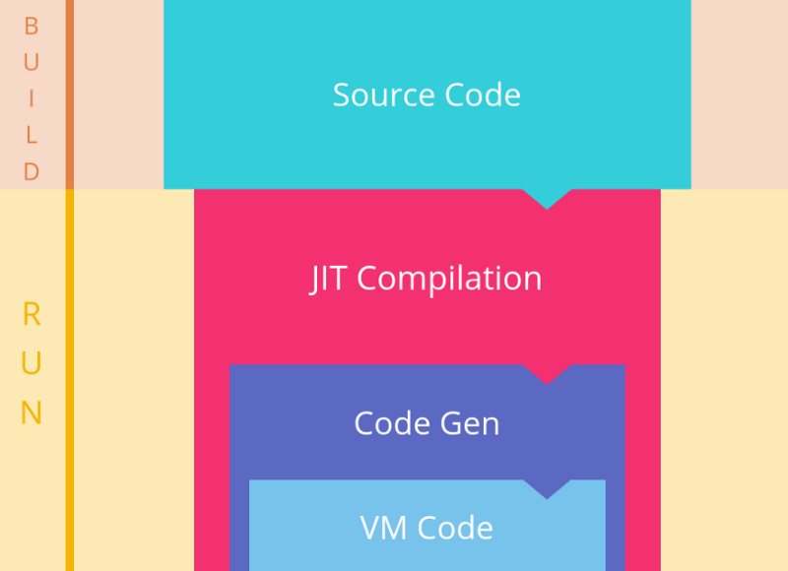
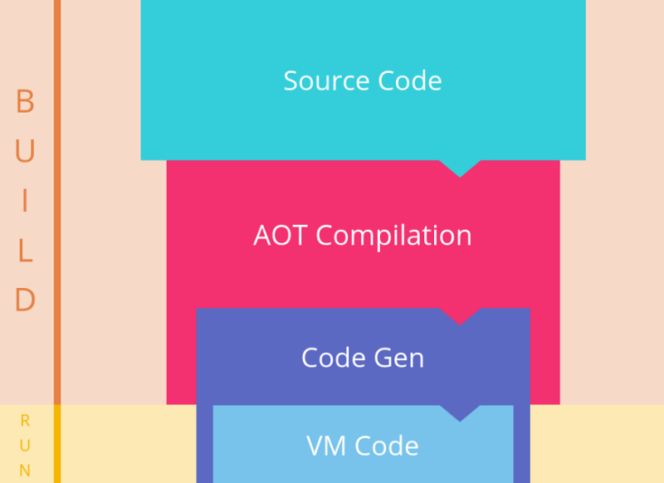
AOT and JIT

Slide 29
environments.ts
  The list of env maps are found in angular-.json
Found in the folder src/environments.
  contains the contents for the current environment.
  In the production environment, environment.prod.ts will be used.
Can be used to specify different values depending on the environment where the application is running
  export const environment = {
  production: false,
  title =‘Application’
  };

Slide 30
Using Environment Variable
  import { Component } from '@angular/core';
  import { environment } from '../environments/environment';
  @Component({ ... })
  export class AppComponent {
  title: string = environment.title;
  }

Slide 31
Detecting Development Mode
Can use an utility function isDevMode to check if the app in running in dev mode:
  import { Component, OnInit, isDevMode } from '@angular/core'; @Component({ ... })
  export class AppComponent implements OnInit {
  ngOnInit() {
  if (isDevMode()) {
  console.log(‘Development!'); }
  else { console.log(‘Production!'); }
  } }

Slide 32
Configuring Environment
angular.json file
"environments": {
"dev": "environments/environment.ts",
"prod": "environments/environment.prod.ts"
}
ng serve --dev
ng serve –prod

Slide 33
Production Build Using AOT
AOT compiling is now the default compilation method with Angular CLI
To Build with AOT
  ng build --prod
To build with JIT
  ng build
  ng build --prod --no-aot
  npm install enhanced-resolve@3.3.0

Slide 34
Production Build
ng build
  creates a /dist folder.
vendor.bundle.js
polyfills.bundle.js
main.bundle.js
inline.bundle.js
styles.bundle.js

Slide 35
Production Build
ng build --prod flag
  Removes unwanted white space by minifying files.
  Uglifies files by renaming functions and variable names.
  AoT compilation, which removes the compilation process at runtime and instead performs compilation during the build process.
Can put the contents of the /dist folder and upload them to site.

Slide 36
MODEL DRIVEN FORM
https://tinyurl.com/ng-hadson

Slide 37
Model Driven Forms
Forms are represented as a composed instances of FormGroups and FormControls.
FormControl
  Basic building blocks
  represents a single input field
  Encapsulate the field's value, and states such as if it is valid, dirty (changed), or has errors.
FormControls can be nested inside FormGroups

Slide 38
Form Group
FormGroup is a collection/group of FormControls.
  Offers many api’s for tracking validity and values of the whole formGroup.
  Encapsulates the state of all of it’s inner controls
  Valid only if all of it’s inner controls are also valid.
Values are received as an object with key-value pairs.
  Eliminates the need to iterate over each FormControl

Slide 39
Model Driven Forms
class ModelFormComponent implements OnInit {
  myform: FormGroup;
  duration: string[];
  constructor() {
  this.duration = [ 'One Week','One Month','Six Month',];
  }
  onSubmit(){
  console.log(this.myform.value);
  }

Slide 40
Model Driven Forms
  ngOnInit() {
  this.myform = new FormGroup(
  { name: new FormGroup(
  {firstName: new FormControl(),
  lastName: new FormControl(),
  }),
  email: new FormControl(),
  duration: new FormControl(),
  password: new FormControl()
  });
  }

Slide 41
Mode Driven Template
  <form [formGroup]="myform" (ngSubmit)="onSubmit()">
  <fieldset formGroupName='name'>
  <input type="text" formControlName="firstName" required>
  <input type="text" formControlName="lastName" required>
  </fieldset>
  <input type="email" formControlName="email" required>
  <input type="password" formControlName="password" required>
  <select formControlName="duration">
    <option *ngFor="let eachEntry of duration"
    [value]="eachEntry">{{eachEntry}}
    </option>
  </select>
  <input type='submit' value="submit">
  </form>

Slide 42
Form Builder
A "factory" object.
Injected to the constructor of component class:
  Uses formGroup and formControl directives
FormGroups are created with a map of configuration.
  Valid keys can be the extra parameter

Slide 43
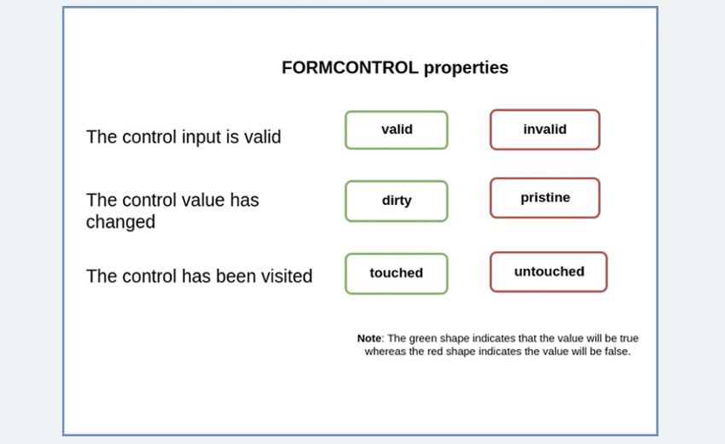
Validation
Angular tracks three form field states
  Applies CSS classes to both the form and its controls:
  touched or untouched
  valid or invalid
  pristine or dirty

Slide 44
Validators
Can be defined by directives and HTML5 attributes in template
  <input type="email“ name="email" [(ngModel)]="model.email" required>
Angular built-in validators.
  Validators.required
  Validators.minLength
  Validators.maxlength
  Validators.pattern
Assigned to the FormControl object
  Can Check the status of the validator in the view and take action accordingly

Slide 45
novalidate
We’ve added the novalidate attribute to the form element, by default browsers perform their own validation and show their own error popups.
Since we want to handle the form validation ourselves we can switch off this behaviour by adding novalidate to the form element.
<form (submit)="savePhone(phone);" ngNativeValidate>

Slide 46
Custom Validator
Apart from the built-in validators can have custom validators too
Can access control’s value and validity
  import { AbstractControl } from '@angular/forms';
  export function hasExclamationMark(input: AbstractControl) {
  const hasExclamation = input.value.indexOf('!') >= 0;
  return hasExclamation ? null : { 'needsExclamation': true };
  }

Slide 47
Form Builder
  bookFrm: FormGroup;
  constructor(private frmBuilder: FormBuilder) { }
  ngOnInit() {
  this.bookFrm = this.frmBuilder.group({
  'bookName': ['', Validators.required],
  'author': ['', Validators.required],
  'city': ['', [Validators.required , hasExclamationMark]]
  });
  }
  submit(){
  console.log(this.bookFrm.value);
  }

Slide 48
Template with Validation
  <form [formGroup]="bookFrm" (ngSubmit)='submit()' class="form" novalidate>
  <input type="text" formControlName="bookName" class="form-control">
  <div *ngIf="bookFrm.controls.bookName.invalid && bookFrm.controls.bookName.touched"> Book Name is Required </div>
  <input type="text" formControlName="author" class="form-control">
  <div *ngIf="bookFrm.controls.author.invalid">Error</div>
  <input type="text" formControlName="city" class="form-control">
  <div *ngIf="bookFrm.controls.city.invalid">city should have exclamation</div>
<input type="submit" value='submit' class="btn btn-info">
</form>
{{bookFrm.value | json}}.

Slide 49
LIFE CYCLE HOOKS

Slide 50
Lifecycle Hooks
Components have lifecycle managed by Angular.
  Provide visibility into life moments
  Can act when they occur.
  Represented by interfaces which is optional .
  Hook methods are called if they are defined.
Life Cycle Hooks are Called
  When Angular Creates ,renders its children,
  While checking its data-bound properties change,
  While destroying and before removing from the DOM.

Slide 51
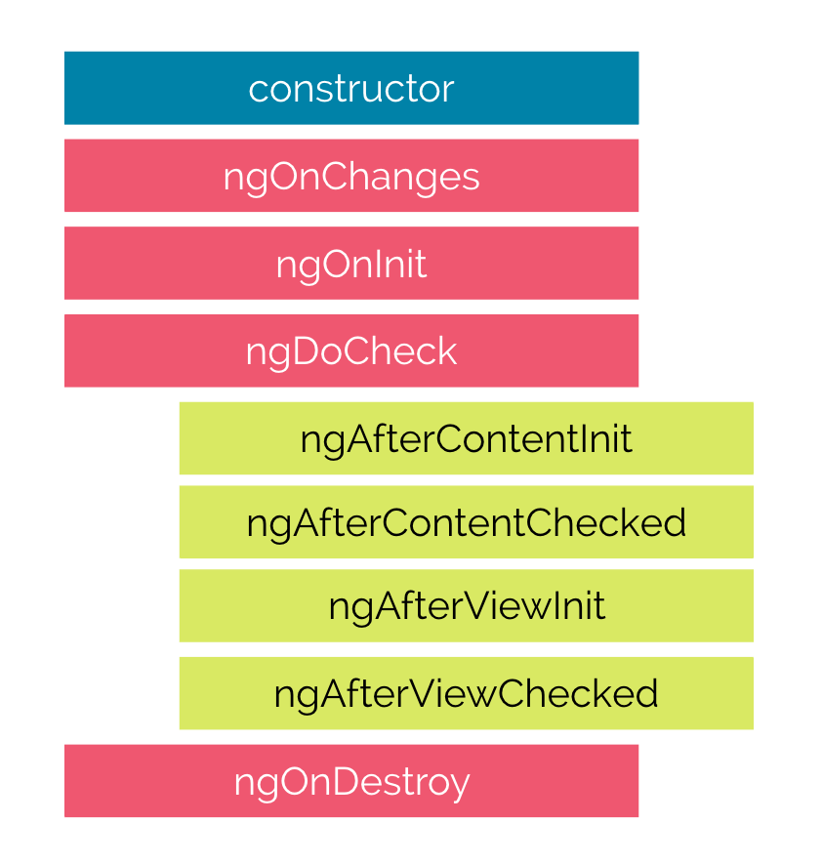
Lifecycle Hooks

Slide 52
Constructors
Invoked when a component or directive are created by calling new on the class.
A typescript feature and used only for a class instantiations
  Has nothing to do with Angular
  JavaScript engine calls the constructor, and not directly by Angular
Its called first time before the ngOnInit().
Dependencies Required for the Component are Injected through Constructor

Slide 53
ngOnInit()
Called after the first ngOnChanges, but only once.
Fires when the component is ready for use when all queries (content child and view child queries) and inputs have been resolved.
It’s the place to perform complex initializations shortly after construction;
Can fetch or set initial data
@Input() properties are available inside ngOnInit
Added to every component by default by the Angular CLI.

Slide 54
ngOnChanges()
ngOnChanges()
ngOnInit()
ngAfterViewInit()
ngOnDestory()
Fired when Angular sets and resets data-bound input properties.
The method receives a SimpleChanges object of current and previous property values.
Called when an input or output binding value changes.
  Is called the first time before ngOnInit

Slide 55
Simple Changes
  ngOnInit() {
  this.currentValue = 'Ramesh';
  this.previousValue = 'Kumar';
  }
  ngOnChanges(changes: SimpleChanges): void {
  for (const propertyName in changes) {
  if (propertyName) {
  const change = changes[propertyName];
  const current = JSON.stringify(change.currentValue);
  this.currentValue = change.currentValue;
  const previous = JSON.stringify(change.previousValue);
  this.previousValue = change.previousValue;
  }
  }

Slide 56
ngAfterViewInit()
Fired after component’s view(s) are initialized.
Used for initializing third party library, that needs the view be composed before taking any action
View data and content data exist in two different areas
The content is apart of the parent components template
change detection will be processed in the content area first and then the view that houses the content.
ngOnDestroy()
  Used to clean up any necessary code when a component is removed from the DOM.
  Used to unsubscribe from things like services.

Slide 57
Other Life Cycle Hooks
ngDoCheck:
  Fired each time anything that can trigger change detection has fired (e.g. click handlers, http requests, route changes, etc…).
  Used for debug purposes;
ngAfterContentInit:
  called after external content has been projected into the component.
ngAfterContentChecked:
  called after every check of component content;
ngAfterViewChecked:
  called after every check of a component’s view(s);

Slide 58
ROUTING

Slide 59
Routing
Used for navigation from one view to the next as users perform application tasks.
  The browser is a familiar model of application navigation:
A router is bound to links on a page and it will navigate to the appropriate application view when the user clicks a link.
  “router“ can interpret a browser URL to a client-generated view.
  Can pass optional parameters to display specific content
  Logs activity in the browser's history journal
  so the back and forward buttons work

Slide 60
Why Routing
Routing allows to:
  Implement modular applications
  Implement the application based on the roles (certain roles have access to certain URLs)
To express some aspects of the application's state in the URL.
Allows the user to go straight into certain aspects of the application.
  can keep application linkable and bookmarkable
  allow users to share links with others.

Slide 61
RouterModule
Router module must be specified in the list of imports of the app module.
  import { RouterModule, Routes } from '@angular/router';
Two Locations where Routing can be defined
  Main application module
  A separate module for routing alone
    Need to create a app.routing.ts file inside the src/app folder.
Separate Routing Module can be created by two ways
  ng new app-name –routing
  ng generate module –routing about

Slide 62
Route Configuration -Attributes
path
  - URL to be shown in the browser when application is on the specific route
component
  - component to be rendered when the application is on the specific route
redirectTo
  - redirect route if needed; each route can have either component or redirect attribute defined in the route (covered later in this chapter)
pathMatch
  optional property that defaults to 'prefix'; determines whether to match full URLs or just the beginning.
  When defining a route with empty path string set pathMatch to 'full', otherwise it will match all paths.

Slide 63
Router Module
RouterModule.forRoot()
  Creates a module with all the router directives
  A provider for registering routes.
RouterModule.forChild
  To Create routes for lazy loaded modules.
  RouterModule.forRoot([
  { path: '', redirectTo: 'home', pathMatch: 'full' },
  { path: 'home/:id', component: HomeComponent },
  { path: 'login', component: LoginComponent },
  { path: 'registration', component: RegistrationComponent },
  { path: '**', redirectTo: 'home' }
  ])

Slide 64
Routing Order
Routes are configured in a correct order.
  There is no notion of route precision.
  When a match is found, stops processing the configuration.
  A wildcard route as the first route would always be matched.
  They need as the last route r configuration.

Slide 65
Router-link Directrive
Directive is use to declare link into view instead of href in the <a> tags,
Can pass an expression ,with an array containing URL path
Can contains optional parameters also.
  <a routerLink="">Home</a>
  <a [routerLink]="['lessons']">Lessons</a>
routerLinkActive:
  To add a CSS class to an element when the link's route becomes active.

Slide 66
Router-outlet directive:
To render the components for specific location of the applications.
Both the template and templateUrl render the components
  <router-outlet></router-outlet>

Slide 67
ROUTING WITH PARAMETERS

Slide 68
Declaring Route Parameters
  const routes: Routes = [
  {path:'',redirectTo:'login',pathMatch:'full'},
  {path:'player',component:PlayersComponent},
  {path:'player/:name',component:PlayersComponent},
  {path:'login',component:LoginComponent},
  {path:'**',redirectTo:'sponsor'}
  ];

Slide 69
Linking to Routes with Parameters
RouterLink directive passes an array which specifies the path and the route parameter.
  <a *ngFor="let product of products“
  [routerLink]="['/product-details', product.id]"> {{ product.name }} </a>
  localhost:3000/product-details/5
  <tr *ngFor="let eachPlayer of playerList">
  <td>{{eachPlayer.playerName}}</td>
  <td><a style="margin: 15px;“ [routerLink]="['/player',eachPlayer.playerName]“>View</a>
  </td>
  </tr>
  <p>{{data}}</p>

Slide 70
Reading Route Parameters
Params property on ActivatedRoute is an Observable
  The component must read the parameter
  By subscribed to get the route parameters
  router may not recreate the component when navigating to the same component.
Component will be notified, whenever the value of the parameter changes

Slide 71
Reading Route Parameters
  export class PlayersComponent implements OnInit , OnDestroy {
  private sub: any;
  name: string;
  data: any;
  constructor(private route: ActivatedRoute,private router:Router) { }
  ngOnInit() {
    this.sub = this.route.params.subscribe(params => {
    this.name = params['name'];
    this.data = this.details.get(this.name);
    });
  }
  ngOnDestroy() {
  this.sub.unsubscribe();
  }
  }

Slide 72
Linking to Routes with Parameters
  goToProductDetails(id) {
  this.router.navigate(['/product-details', id]);
  // this.router.navigateByUrl('/product-details/‘+id);
  }
Can navigate to the route programmatically:
  Need to inject the router into component,
  Can use navigate or navigateByUrl methods:
navigateByUrl
  need to provide the “whole” new URL.
navigate
  creates a new URL by applying an array of passed-in commands,
  A patch, to the current URL.

Slide 73
NESTED ROUTES

Slide 74
Child Routes – Nested Routes
Angular applications are Collection of Components.
The Components follows a Tree structure
  With a root component at the top.
  Can add child components forming loosely coupled components resembling a Tree
The Routes also follows the component tree structure
  To define the nested or child routes.
The child route definition also has path and component
We can add child routes to a child route.

Slide 75
Child Routes
When some routes may only be accessible and viewed within other routes we can create them as child routes.
  const routes: Routes = [
  { path: '', redirectTo: 'home', pathMatch: 'full' },
  { path: 'home', component: HomeComponent },
  { path: 'user', component: userComponent,
  children: [
  { path: 'userList', component: userListComponent, outlet: 'userList' },
  { path: ':id', component: userInfoComponent, outlet: 'userInfo' }]
  }];
  <router-outlet name="userList"></router-outlet>
  <router-outlet name="userInfo"></router-outlet>

Slide 76
ROUTER GUARDS

Slide 77
Router Guards
Traditional server side applications would check permissions on the server
  if the user didn’t have permissions, and return a 403 error page
  May redirect to a login/register page.
Angular can implement the same functionality with Router Guards
Router Guards
  can prevent users from accessing areas that they’re not allowed to access,
  Can also ask them for confirmation when leaving a certain area.

Slide 78
Guard Types
User must login or authenticate
User has logged in but is not authorized to navigate to the target component.
User has to confirm if it’s OK to discard pending changes rather than save them.
For a given route we can implement zero or any number of Guards.

Slide 79
Types of Guards:
CanActivateChecks
  to see if a user can visit a route.
CanActivateChildChecks
  to see if a user can visit a routes children.
CanDeactivateChecks
  to see if a user can exit a route.

Slide 80
Implementing a Guard
Guards are implemented as services
Created with @Injectable Decorator
Guards return either true if the user can access a route or false if they can’t.
They can also return an Observable or Promise that later on resolves to a boolean
@NgModule({ . . providers: [ . . AlwaysAuthGuard ] })

Slide 81
Guard function parameters
A guard should accept or deny access the guard function can be passed certain arguments:
component: Component this is the component itself.
ActivatedRouteSnapshot
url: UrlSegment[]
params: Params
queryParams: Params
RouterStateSnapshot

Slide 82
RouterStateSnapshot
Represents the state of the router at a moment in time.
This is a tree of activated route snapshots.
Every node in this tree knows about the "consumed" URL segments, the extracted parameters, and the resolved data.

Slide 83
CanActivate
  @Injectable()
  export class AuthenticationService {
  USERS = [
  new User(1, 'ramesh', 'r123', 'ADMIN'),
  new User(2, 'suresh', 's123', 'USER')
  ];
  usersObservable = Observable.of(this.USERS);
  private redirectUrl = '/first';
  private loginUrl = '/login';
  private isloggedIn = false;
  private loggedInUser: User;
  getAllUsers(): Observable<User[]> {
  return this.usersObservable;
  }

Slide 84
CanActivate
  isUserAuthenticated(username: string, password: string): Observable<boolean> {
  return this.getAllUsers().map(users => {
  const user = users.find(singleuser => (singleuser.username === username) && (singleuser.password === password));
  if (user) {
  this.isloggedIn = true;
  this.loggedInUser = user;
  } else {
  this.isloggedIn = false;
  }
  return this.isloggedIn;
  }); }

Slide 85
CanActivate
    isUserLoggedIn(): boolean {
    return this.isloggedIn;
    }
    getRedirectUrl(): string {
    return this.redirectUrl;
    }
    setRedirectUrl(url: string): void {
    this.redirectUrl = url;
    }
    getLoginUrl(): string {
    return this.loginUrl;
    }
    getLoggedInUser(): User {
    return this.loggedInUser;
    } }

Slide 86
Configuring Guards
  const routes: Routes = [
  { path: '', redirectTo: 'login',pathMatch:'full'},
  { path:'login' ,component:LoginComponent},
  {path:'first' , component: FirstComponent, canActivate: [AuthGuardServiceService]},
  {path:'second' , component: SecondComponent,canActivate: [AuthGuardServiceService]}
  {path:'third' , component: ThirdComponent,canActivate: [AuthGuardServiceService]}
  ];

Slide 87
AuthGuardService
  import { CanActivate, CanActivateChild, Router, ActivatedRouteSnapshot, RouterStateSnapshot } from '@angular/router';
  import { Injectable } from '@angular/core';
  import { AuthenticationService } from './authentication.service';
  @Injectable()
  export class AuthGuardServiceService implements CanActivate {
  constructor(private authService: AuthenticationService, private router: Router) {
  }

Slide 88
AuthGuardService
  canActivate(route: ActivatedRouteSnapshot, state: RouterStateSnapshot): boolean {
  const url: string = state.url;
  if (this.authService.isUserLoggedIn() && url !== '/third') {
  return true;
  } else {
  this.authService.setRedirectUrl(url);
  this.router.navigate( [ this.authService.getLoginUrl() ] );
  console.log('You are not Not Authorized - Or Logged in - Try again');
  return false;
  } } }

Slide 89
Login Component
  export class LoginComponent implements OnInit {
  loginForm: FormGroup;
  invalidCredentialMsg: string;
  constructor(private authService: AuthenticationService, private router: Router) {
  }
  ngOnInit(): void {
  this.loginForm = new FormGroup({
  username: new FormControl('',[Validators.required]),
  password: new FormControl('',[ Validators.required,
  Validators.pattern('^[a-zA-Z][0-9]{3}$')])
  });
  }

Slide 90
Login Component
  onFormSubmit() {
  let uname = this.loginForm.get('username').value;
  let pwd = this.loginForm.get('password').value;
  this.authService.isUserAuthenticated(uname, pwd).subscribe(
  authenticated => {
  if(authenticated) {
  let url = this.authService.getRedirectUrl();
  console.log('Redirect Url:'+ url);
  this.router.navigate([ url ]);
  } else {
  this.invalidCredentialMsg = 'Invalid Credentials. Try again.';
  } } ); } }

Slide 91
Login Template
  <div *ngIf="invalidCredentialMsg" [ngClass]="error">{{invalidCredentialMsg}}</div>
  <div>
  <form [formGroup]="loginForm" (ngSubmit)="onFormSubmit()">
  User Name: <input formControlName="username“>
  <div *ngIf="loginForm.get('username').hasError('required')">
  please provide a name!
  </div>
  Password: <input type="password“ formControlName="password“>
  <div *ngIf="loginForm.controls.password.hasError('pattern')">
  Oops, wrong pattern buddy!
  </div>
  <button type="submit">Submit</button>
  </form>

Slide 92
App Component Template
  <a [routerLink]="['/first']"> First</a>
  <a [routerLink]="['/second']">Second</a>
  <a [routerLink]="['/third']">Third</a>
  <router-outlet></router-outlet>

Slide 93
CanDeactivate
Used to warn people if they are navigating away from a page where they have some unsaved changes.
  canDeactivate() {
  return this.itunes.results.length > 0; }
  yclass UnsearchedTermGuard implements CanDeactivate<SearchComponent>
  {
  canDeactivate(component: SearchComponent, route: ActivatedRouteSnapshot, state: RouterStateSnapshot): boolean {
  console.log("UnsearchedTermGuard");
  console.log(route.params);
  console.log(state.url);
  return component.canDeactivate() ||
  window.confirm("Are you sure?"); } }

Slide 94
TESTING
vatsank@gmail.com

Slide 95


Slide 96
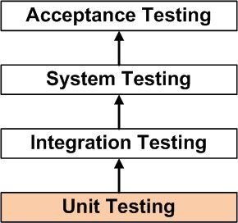
Testing

Slide 97
Unit Testing
Unit Testing is a level of software testing where individual units/ components of a software are tested.
The purpose is to validate that each unit of the software performs as designed.
A unit is the smallest testable part of software.
In object-oriented programming, the smallest unit is a method
Unit testing frameworks, drivers, stubs, and mock/ fake objects are used to assist in unit testing.

Slide 98
What is Not a Unit Test
  It connects to the database
  It communicates across the network
  It touches the file system
  Does special things your environment (such as editing config files) to run it.
Mocks
  Can Use mocks to simulate calls to external services
  Mocks reduce the real dependencies in tests.
Integration Test
  Selenium and Cucumber are used to perform integration tests
  They perform tests by running a browser
  Interacts with the user interface and checking the outcome.

Slide 99
Jasmine
Most popular Unit Testing Framework for JavaScript
Open source technology.
Simple API to test different components of JavaScript.
Capable of testing any kind of JavaScript application.
Follows Behavior Driven Development (BDD) procedure
  to ensure that each line of JavaScript statement is properly unit tested.
  Provides a small syntax to test the smallest unit of the entire application instead of testing it as a whole.

Slide 100
Why Use Jasmine
Jasmine does not depend on any other JavaScript framework.
Jasmine does not require any DOM.
All the syntax used in Jasmine framework is clean and obvious.
Jasmine is easily available in different versions like stand-alone, Node.js, etc.
Getting JASMINE
  Download the standalone library files from the official website http://jasmine.github.io/
  Add the required Files and implement the tests .

Slide 101
Behavior Driven Development
It’s a style of testing where test is described and a code that conveys what it should be doing.
  Then it expects the code to do something.
  Describe + it reads like a sentence.
  describe ( 'presentation.js' , function(){
  it ( 'should be informative', function(){
  expect( presentation.inform() ).toBeTruthy();
  )};
  });

Slide 102
Suite Block
Suite is the basic building block of Jasmine framework.
The collection of similar test cases written for a specific file or function is known as one suite.
Suite block can have only two parameters,
  “name of that suite”
  “Function declaration”
Functional Declaration
  makes a call to test the unit functionality
It contains two other blocks,
  “Describe()”
  “It()”.

Slide 103
Creating Spec
Creating a Class Animals
  Animals have got a certain number of legs, depending on what kind of animal they are.
A spec to specify that insects should have six legs:
function Animal() {}
  describe("Animal", function() {
  it("should have 6 legs if it is an insect", function() {
  var insect = new Animal();
  insect.kind = "insect";
  expect(insect.numLegs()).toBe(6);
  });
  });

Slide 104
Describe Block
Describe block is a part of Suite block.
It contains two parameters
  “the name of the describe block”
  “function declaration”.
  describe("Adding single number ",function (){
  it("should add numbers",function(){ expect(nested.add(5)).toEqual(5); expect(nested.add(5)).toEqual(10);
  });
  }

Slide 105
IT Block
IT block goes within a describe block.
This is the block which actually contains each unit test case.
  describe("Adding single number ",function (){
  it("should add numbers",function(){
  expect(obj.add(5)).toEqual(5);
  });
  it("should add numbers",function(){
  expect(nested.addAny(1,2,3)).toEqual(6); });
  }

Slide 106
Expect Block
Jasmine Expect allows you to write your expectation from the required function or JavaScript file.
It comes under IT block. One IT block can have more than one Expect block.
This expect block provides a wide variety of methods to unit test your JavaScript function or JavaScript file.

Slide 107
Matchers
Each of the Expect block is known as a matcher.
Two different types of matchers,
  Inbuilt matcher
  User defined matchers.
toEqual( 'expected' )
  General compare, can compare objects
expect(nested.add(5)).toEqual(5);
expect(nested.add(5)).toEqual(10);
expect( 5 ).not.toEqual( 3 );
  Matchers can be "reversed" by including the not keyword.

Slide 108
Before and after
To help a test suite DRY up any duplicated setup and teardown code
Jasmine provides beforeEach() and afterEach().
beforeEach().
  code to be run before every spec;
  A variable set, a function defined
afterEach()
  Code to be to run after each spec

Slide 109
Pending Specs
Pending specs do not run, but their names will show up in the results as pending.
xit
  Any spec declared with marked as pending.
  xit("can be declared 'xit'", function() { expect(true).toBe(false); });
Any spec declared without a function body will also be marked pending in results.
it("can be declared with 'it' but without a function");
Suites can be disabled with the xdescribe function.
  Suites and any specs inside them are skipped

Slide 110
Testing Components
  describe('AppComponent', () => {
  beforeEach(async(() => {
  TestBed.configureTestingModule({
  declarations: [
  AppComponent
  ],
  }).compileComponents();
  }));

Slide 111
Test Spec
  it('should create the app', async(() => {
  const fixture = TestBed.createComponent(AppComponent);
  const app = fixture.debugElement.componentInstance;
  expect(app).toBeTruthy();
  }));

Slide 112
Angular Test Bed
Creates an Angular testing module
Used to detach the tested component from its own application module
  Reattach it to a dynamically-constructed Angular test module
To test the interaction of a directive or component with it’s template.
  It can instantiate components and resolve dependencies
  Used to extract the component and service
  Creats an instance of a component fixture
  A fixture is a wrapper for a component and it’s template.
    To test user interaction via clicks & input fields

Slide 113
TestBed.configureTestingModule()
The method takes an metadata object.
  Declares the component to test
Called within a beforeEach
  TestBed can reset itself to a base state before each test runs.
Has a base state Which includes
  default testing module configuration consisting of the components, directives
  pipes and providers which may be mocked

Slide 114
CompileComponents() Method
  asynchronously compiles all the components configured in the testing module.
  The external templates and css files will be "inlined“ and create new instances synchronously.
  returns the TestBed class
  Can chain calls to other TestBed static methods

Slide 115
createComponent
Test Bed creates an instance of the component-under-test.
  It returns a component test fixture.
The fixture provides access :
  To component instance itself
  To a DebugElement
DebugElement
  A handle to the component's DOM element.
  used to query for the html element by CSS selector.
  Has a property nativeElement to return the html Element
  Can get references to other child nodes with a By class.
  The By class can query using a a number of methods,

Slide 116
Querying
Query()
  A predicate is a function that returns a boolean.
  A query predicate receives a DebugElement and returns true if the element meets the selection criteria.
  takes a predicate function and searches the fixture's entire DOM tree for the first element that satisfies the predicate.
    Returns a different Debug Element associated with matching DOM
QueryAll()
  returns an array of all DebugElements that satisfy the predicate.

Slide 117
By Class
  beforeEach( () => {
  TestBed.configureTestingModule(
  { declarations: [LoginComponent],
  providers: [AuthService]
  });
  TestBed.createComponent(LoginComponent);
  component = fixture.componentInstance;
  authService = TestBed.get(AuthService);
  el = fixture.debugElement.query(By.css('a')); }); });

Slide 118
detectChanges:
The tests frequently call detectChanges.
Each test tells Angular when to perform change detection by calling fixture.detectChanges().
ComponentFixtureAutoDetect
  A provider for the TestBed
  Used to run change detection automatically.

Slide 119
Test Spec
  it('should render title in a h1 tag', async(() => {
  const fixture = TestBed.createComponent(AppComponent);
  fixture.detectChanges();
  const compiled = fixture.debugElement.nativeElement;
  expect(compiled.querySelector('h2').textContent).toContain('Angular Project');
  }));

Slide 120
Component
  export class LoginComponent implements OnInit {
  @Output() loggedIn = new EventEmitter<User>();
  @Input() enabled = true;
  constructor() { }
  ngOnInit() { }
  login(email, password) {
  if (email && password) {
  this.loggedIn.emit(new User(email, password));
  }
  } }

Slide 121
Template
  <form>
  <label>Email</label>
  <input type="email" #email>
  <label>Password</label>
  <input type="password" #password>
  <button type="button" (click)="login(email.value, password.value)" [disabled]="!enabled">Login
  </button>
  </form>

Slide 122
Imports
  import {TestBed, ComponentFixture, inject, async} from '@angular/core/testing';
  import {LoginComponent, User} from './login.component';
  import {Component, DebugElement} from '@angular/core';
  import {By} from '@angular/platform-browser';

Slide 123
Setting Up Test Bed
  describe('Component: Login', () => {
  let component: LoginComponent;
  let fixture: ComponentFixture<LoginComponent>;
  let submitEl: DebugElement;
  let loginEl: DebugElement;
  let passwordEl: DebugElement;
  beforeEach(() => {
  TestBed.configureTestingModule({
  declarations: [LoginComponent]
  });
  fixture = TestBed.createComponent(LoginComponent);
  component = fixture.componentInstance;
  submitEl = fixture.debugElement.query(By.css('button'));
  loginEl = fixture.debugElement.query(By.css('input[type=email]'));
  passwordEl = fixture.debugElement.query(By.css('input[type=password]'));
  });

Slide 124
Spec - 1
  it('Setting enabled to false disable the submit button', () => {
  component.enabled = false;
  fixture.detectChanges();
  expect(submitEl.nativeElement.disabled).toBeTruthy();
  });

Slide 125
Spec - 2
  it('Entering email and password emits loggedIn event', () => {
  let user: User;
  loginEl.nativeElement.value = 'test@example.com';
  passwordEl.nativeElement.value = '123456';
  component.loggedIn.subscribe((value) => user = value);
  submitEl.triggerEventHandler('click', null);
  expect(user.email).toBe('test@example.com');
  expect(user.password).toBe('123456');
  });
  })
  ;

Slide 126
Directive
  import { Directive, HostListener, HostBinding } from '@angular/core';
  @Directive({
  selector: '[appHoverFocus]'
  })
  export class HoverFocusDirective {
  constructor() { }
  @HostBinding('style.background-color') backgroundColor: string;
  @HostListener('mouseover') onHover() {
  this.backgroundColor = 'blue';
  }
  @HostListener('mouseout') onLeave() {
  this.backgroundColor = 'inherit';
  }
  }

Slide 127
Testing Directive
  @Component({
  template: `<input type="text" appHoverFocus>`
  })
  class TestHoverFocusComponent {
  }

Slide 128
Testing Directive
  describe('Directive: HoverFocusDirective', () => {
  let component: TestHoverFocusComponent;
  let fixture: ComponentFixture<TestHoverFocusComponent>;
  let inputEl: DebugElement;
  beforeEach(() => {
  TestBed.configureTestingModule({
  declarations: [TestHoverFocusComponent, HoverFocusDirective]
  });
  fixture = TestBed.createComponent(TestHoverFocusComponent);
  component = fixture.componentInstance;
  inputEl = fixture.debugElement.query(By.css('input'));
  });

Slide 129
Testing Spec
  it('hovering over input', () => {
  inputEl.triggerEventHandler('mouseover', null); //event Object is 2nd Arg
  fixture.detectChanges();
  expect(inputEl.nativeElement.style.backgroundColor).toBe('green');
  inputEl.triggerEventHandler('mouseout', null);
  fixture.detectChanges();
  expect(inputEl.nativeElement.style.backgroundColor).toBe('inherit');
  });
  });

