Slide 1
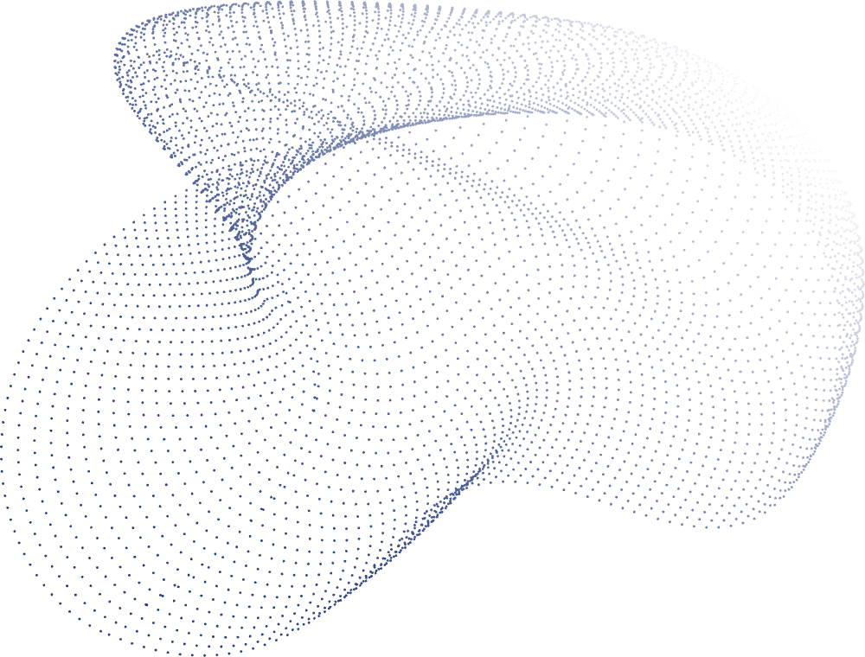
Medisyn Labs
Assignment Submission
Saurabh Prajapati

Slide 2
Agenda
Sentiment Analysis
Effectiveness ML Model
Customer Clustering
Medicine Recommendation

Slide 3
Assumption
Assuming positive Sentiment if Rating > 6. To Prepare the Target Label
Sentiment Analysis
Binary Classification Problem
0: Negative Sentiment
1: Positive Sentiment

Slide 4

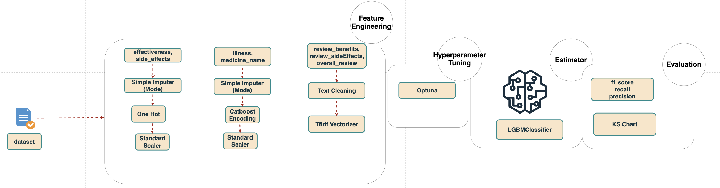
Solution Architecture

Slide 5
Dataset Name | # Sample | Positive Rate(%)
Train | 3107 | 68.55
Test | 1036 | 64.67
Features | # Unique | Type
Effectiveness | 5 | Low Cardinality
Side-effects | 5 | Low Cardinality
Illness | 1426 | High Cardinality
Medicine Name | 502 | High Cardinality
Review benefits | NA | Text Feature
Review Side Effects | NA | Text Feature
Review Overall | NA | Text Feature
Dataset

Slide 6
Evaluation Metrics
type | f1_score | precision | recall
train | 0.93 | 0.9 | 0.96
test | 0.91 | 0.89 | 0.94
Best Probability Threshold | 0.456
Training KS Chart
decile | volume | cum_volume | positive | min_proba | max_proba | negative | cum_positive | cum_negative | positive_rate | negative_rate | cum_positive_rate | cum_negative_rate | capture_rate | non_capture_rate | ks
1 | 311 | 311 | 310 | 0.983 | 0.99 | 1 | 310 | 1 | 99.68 | 0.32 | 99.68 | 0.32 | 14.55 | 0.1 | 14.45
2 | 311 | 622 | 311 | 0.977 | 0.983 | 0 | 621 | 1 | 100 | 0 | 99.84 | 0.16 | 29.15 | 0.1 | 29.05
3 | 311 | 933 | 307 | 0.9673 | 0.977 | 4 | 928 | 5 | 98.71 | 1.29 | 99.46 | 0.54 | 43.57 | 0.51 | 43.06
4 | 310 | 1243 | 304 | 0.9539 | 0.9673 | 6 | 1232 | 11 | 98.06 | 1.94 | 99.12 | 0.88 | 57.84 | 1.13 | 56.71
5 | 311 | 1554 | 298 | 0.9282 | 0.9539 | 13 | 1530 | 24 | 95.82 | 4.18 | 98.46 | 1.54 | 71.83 | 2.46 | 69.37
6 | 311 | 1865 | 269 | 0.7673 | 0.9278 | 42 | 1799 | 66 | 86.5 | 13.5 | 96.46 | 3.54 | 84.46 | 6.76 | 77.7
7 | 310 | 2175 | 214 | 0.5685 | 0.766 | 96 | 2013 | 162 | 69.03 | 30.97 | 92.55 | 7.45 | 94.51 | 16.58 | 77.93
8 | 311 | 2486 | 95 | 0.1758 | 0.5675 | 216 | 2108 | 378 | 30.55 | 69.45 | 84.79 | 15.21 | 98.97 | 38.69 | 60.28
9 | 311 | 2797 | 20 | 0.0455 | 0.1749 | 291 | 2128 | 669 | 6.43 | 93.57 | 76.08 | 23.92 | 99.91 | 68.47 | 31.44
10 | 310 | 3107 | 2 | 0.0111 | 0.0455 | 308 | 2130 | 977 | 0.65 | 99.35 | 68.55 | 31.45 | 100 | 100 | 0
Evaluation
Max KS Score is 71 for test and 78 for train
Test KS Chart
decile | volume | cum_volume | positive | min_proba | max_proba | negative | cum_positive | cum_negative | positive_rate | negative_rate | cum_positive_rate | cum_negative_rate | capture_rate | non_capture_rate | ks
1 | 104 | 104 | 104 | 0.9826 | 0.9902 | 0 | 104 | 0 | 100 | 0 | 100 | 0 | 15.52 | 0 | 15.52
2 | 104 | 208 | 103 | 0.9738 | 0.9824 | 1 | 207 | 1 | 99.04 | 0.96 | 99.52 | 0.48 | 30.9 | 0.27 | 30.63
3 | 103 | 311 | 102 | 0.9627 | 0.9737 | 1 | 309 | 2 | 99.03 | 0.97 | 99.36 | 0.64 | 46.12 | 0.55 | 45.57
4 | 104 | 415 | 102 | 0.9474 | 0.9624 | 2 | 411 | 4 | 98.08 | 1.92 | 99.04 | 0.96 | 61.34 | 1.09 | 60.25
5 | 103 | 518 | 91 | 0.8812 | 0.9473 | 12 | 502 | 16 | 88.35 | 11.65 | 96.91 | 3.09 | 74.93 | 4.37 | 70.56
6 | 104 | 622 | 69 | 0.6788 | 0.8793 | 35 | 571 | 51 | 66.35 | 33.65 | 91.8 | 8.2 | 85.22 | 13.93 | 71.29
7 | 104 | 726 | 64 | 0.3529 | 0.678 | 40 | 635 | 91 | 61.54 | 38.46 | 87.47 | 12.53 | 94.78 | 24.86 | 69.92
8 | 103 | 829 | 23 | 0.1488 | 0.3472 | 80 | 658 | 171 | 22.33 | 77.67 | 79.37 | 20.63 | 98.21 | 46.72 | 51.49
9 | 104 | 933 | 11 | 0.0375 | 0.1477 | 93 | 669 | 264 | 10.58 | 89.42 | 71.7 | 28.3 | 99.85 | 72.13 | 27.72
10 | 103 | 1036 | 1 | 0.0117 | 0.0375 | 102 | 670 | 366 | 0.97 | 99.03 | 64.67 | 35.33 | 100 | 100 | 0

Slide 7
Effectiveness Rating Model
Multi-Class Classification Problem
0: Ineffective
1: Marginally Effective
2: Moderately Effective
3: Considerably Effective
4: Highly Effective

Slide 8
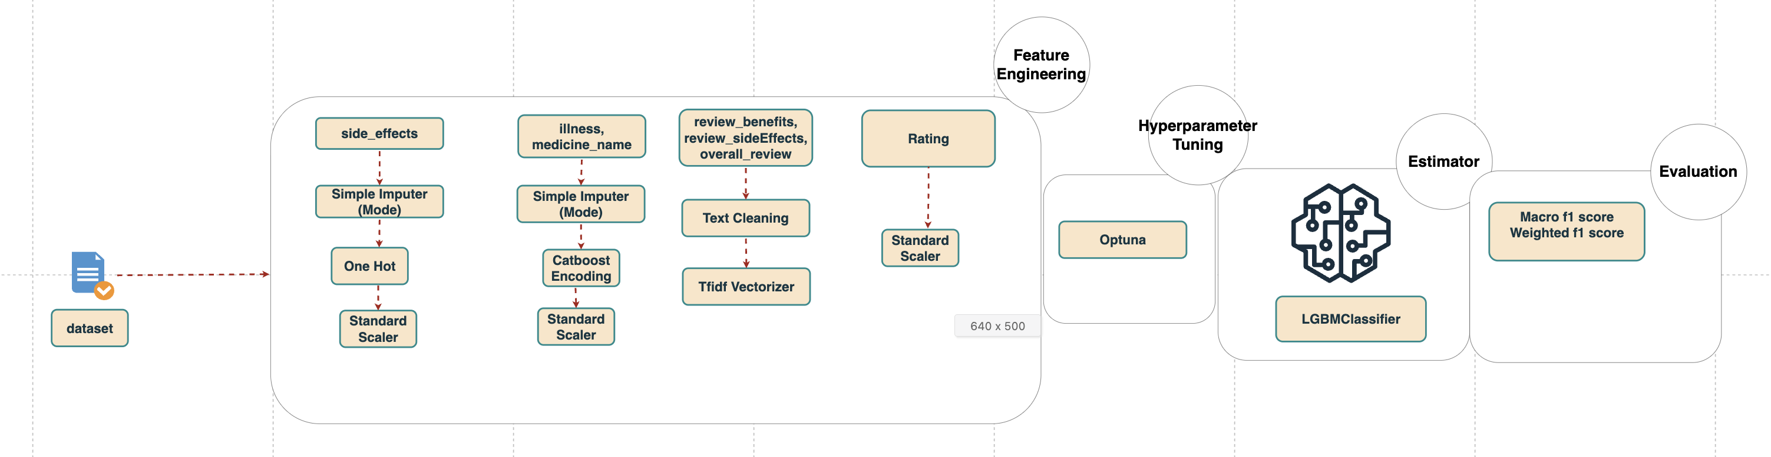
Solution Architecture

Slide 9
Training Classification Report
 | precision | recall | f1-score | support
0 | 0.51 | 0.85 | 0.64 | 247
1 | 0.34 | 0.45 | 0.39 | 187
2 | 0.37 | 0.60 | 0.46 | 415
3 | 0.60 | 0.36 | 0.45 | 928
4 | 0.79 | 0.73 | 0.76 | 1330
accuracy |  |  | 0.59
macro avg | 0.52 | 0.60 | 0.54 | 3107
weighted avg | 0.63 | 0.59 | 0.59 | 3107
Evaluation
Test Classification Report
 | precision | recall | f1-score | support
0 | 0.49 | 0.88 | 0.63 | 82
1 | 0.31 | 0.38 | 0.34 | 76
2 | 0.37 | 0.58 | 0.45 | 157
3 | 0.62 | 0.38 | 0.47 | 310
4 | 0.79 | 0.69 | 0.74 | 411
accuracy |  |  | 0.57
macro avg | 0.52 | 0.58 | 0.53 | 1036
weighted avg | 0.62 | 0.57 | 0.58 | 1036

Slide 10
Customer Cohorts Analysis
Clustering Analysis Problem

Slide 11
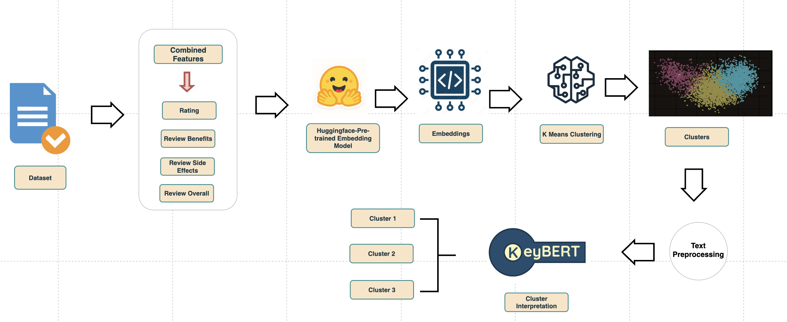
Solution Architecture

Slide 12
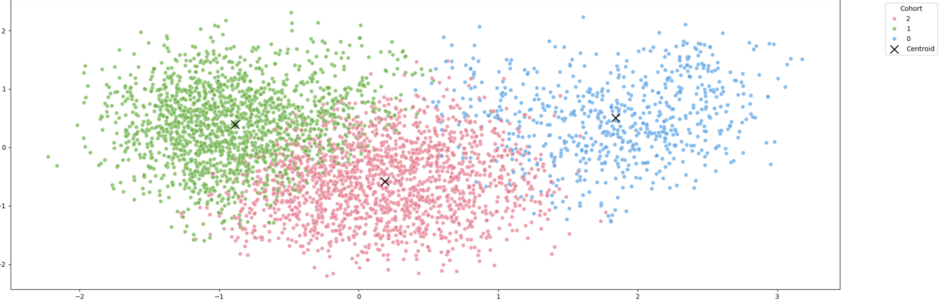
Text Embedding Model Used
S-PubMedBert-MS-MARCO
This is a sentence-transformers model : It maps sentences & paragraphs to a 768 dimensional dense vector space. It can be used for information retrieval task in medical/health text domain
Cluster
Cluster View

Slide 13
Cluster | Avg Rating | Top Medicine | Top Illness | # Reviews | Key Theme
Dermatology / Cosmetic Treatment | 7.12 | Retin-A | Acne | 620 | Dermatology & Cosmetic Skin Care
Hormonal / Menopause / Pain-Related | 6.75 | nexium | Birth Control / Menopause | 2,028 | Hormonal & Pain Management
Mental Health / Depression Treatment | 7.14 | Lexapro | Depression | 1,495 | Mental Health & Antidepressants
Cluster 0 – Dermatology / Cosmetic Treatment
Top Terms: acne, skin, retin, tazorac
User Sentiment: High satisfaction with topical improvement
Side Effects: Redness, irritation
Benefit Keywords: “skin improvement”, “acne cured”
Interpretation: Cluster 0 represents topical treatments for acne & skincare, often used for cosmetic improvement.
Cluster 1 – Hormonal / Menopause / Pain-Related
Top Terms: migraines, menopause, fibromyalgia, pill
User Sentiment: Moderate satisfaction
Side Effects: Severe or recurring symptoms (“fatigue”, “severe symptom”)
Benefit Keywords: “relief reflux”, “reduced reflux”
nterpretation: Cluster 1 reflects complex hormonal or pain management therapies — often with mixed outcomes and strong side effects.
Cluster 2 – Mental Health / Depression Treatment
Top Terms: depression, insomnia, lexapro, xanax
User Sentiment: High satisfaction
Side Effects: Drowsiness, fatigue, restlessness
Benefit Keywords: “effective antidepressant”, “anxiety relief”
Interpretation: Cluster 2 represents antidepressants for mental health improvement, with consistent benefit patterns but notable fatigue side effects.
Cluster Interpretation

Slide 14
Medicine Recommendation

Slide 15
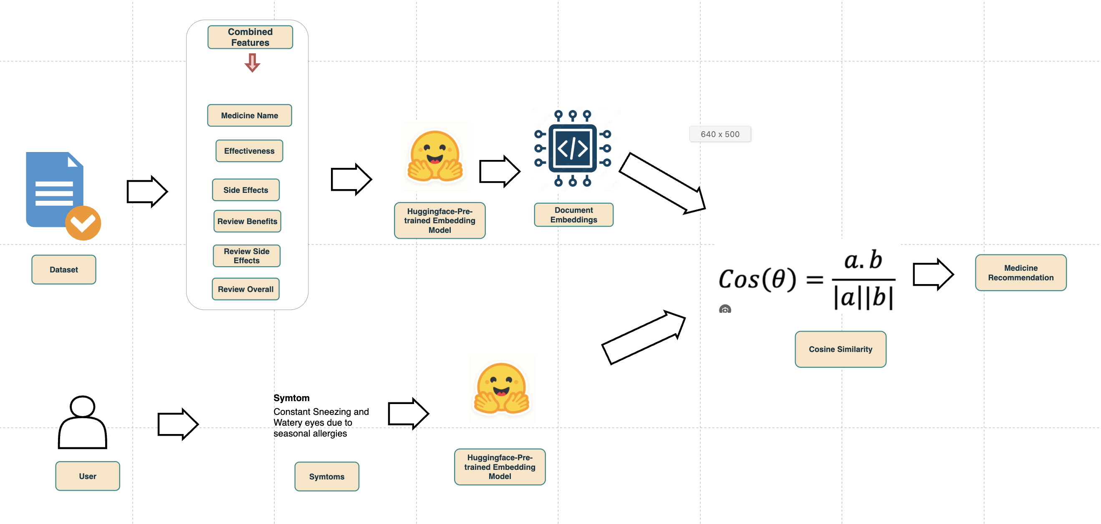
Solution Architecture

Slide 16
Symptoms | Recommended Medicine (Top 2)
Having trouble sleeping and mild anxiety. | Ativan, klonopin
Constant sneezing and watery eyes due to seasonal allergies. | Allegra, rhinocort
Experiencing hot flashes, mood swings, and irregular periods. | Femhrt, climara
I’m looking for something that can help reduce acne scars and improve overall skin texture. My pores are large and skin looks dull. | Avita, retin-a-micro
Sample Recommendation

Slide 17
Thank You

