Slide 1
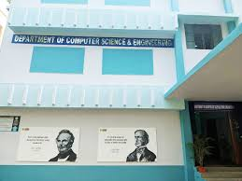
Arbiter PUF Based Mutual Authentication and Session Key Agreement Scheme for IoT
Presented By
Saurabh Soni
MTech CSE
24CS4131
Guided By
Dr. Subhas Chandra Sahana
Department of Computer Science & Engineering
National Institute of Technology Durgapur

Slide 2
Introduction
IoT devices are rapidly increasing in modern applications.
Traditional authentication relies on stored secret keys.
Stored keys are vulnerable to attacks and cloning.
Lightweight hardware-based security is required.
PUFs provide unique hardware fingerprints.

Slide 3
Problem Statement
Issue :
Secret keys stored in memory can be extracted.
Software-based authentication is vulnerable.
Existing systems authenticate only one device.
Secure session key establishment is challenging.
Need:
A lightweight hardware-based mutual authentication framework.

Slide 4
Literature Review
Existing Arbiter PUF systems support only single-device authentication.
Many lightweight IoT security systems lack secure communication.
Existing PUF-based methods do not support dynamic session key generation.
Research gap exists in mutual authentication and encrypted communication.

Slide 5
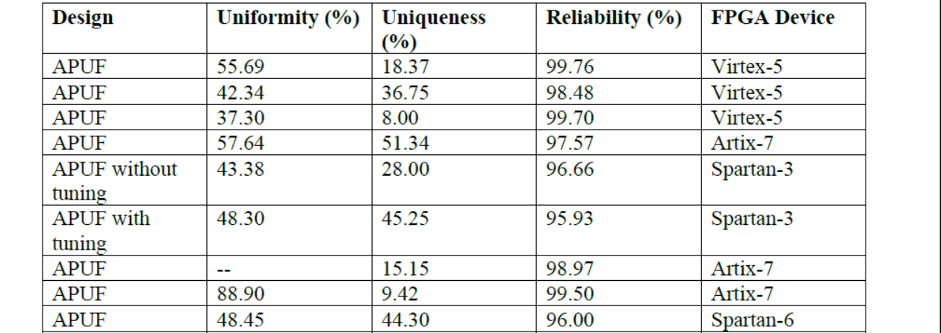
Existing APUF RESULT
[2]

Slide 6
Existing PUF-Based Authentication Schemes
Paper | Mutual Auth | Session Key | FPGA
LFSR-APUF (2023) | Yes | Partial | Yes
PUF Key-Exchange (2023) | Yes | Yes | No
PA-PUF (2022) | No | No | Yes

Slide 7
Objectives
FPGA-based Arbiter PUF implementation
Generate CRPs
Mutual authentication
Multi-challenge verification
Session key generation
AES-based secure communication
Replay attack protection

Slide 8
Why PUF Instead of Classical Cryptography?
Limitations of Classical Cryptography
Advantages of APUF-Based Security
Secret keys are permanently stored in memory
Stored keys are vulnerable to:
Physical attacks
Key extraction
Cloning
Reverse engineering
Heavy cryptographic operations increase computational overhead
Resource-constrained IoT devices have limited power and memory
No permanent secret key storage required
Responses generated from intrinsic hardware variations
Extremely difficult to clone or duplicate
Lightweight and low-power implementation
Dynamic session key generation improves security
Suitable for secure IoT authentication application

Slide 9
Physical Unclonable Function
PUF acts as a hardware fingerprint.
Uses manufacturing variations.
Generates unique responses.
No permanent key storage required.
Suitable for lightweight IoT security.

Slide 10
Arbiter PUF Architecture
Two parallel signal paths are created.
Challenge bits control multiplexers.
Arbiter detects faster path.
Top path faster → Response = 1
Bottom path faster → Response = 0
Hardware:
Basys-3 FPGA | Artix-7 | Vivado

Slide 11
CRP Generation Workflow
Challenge Input → APUF → Response Generation → UART Transmission → CSV Database
CRPs are used for:
Authentication
Session key generation

Slide 12
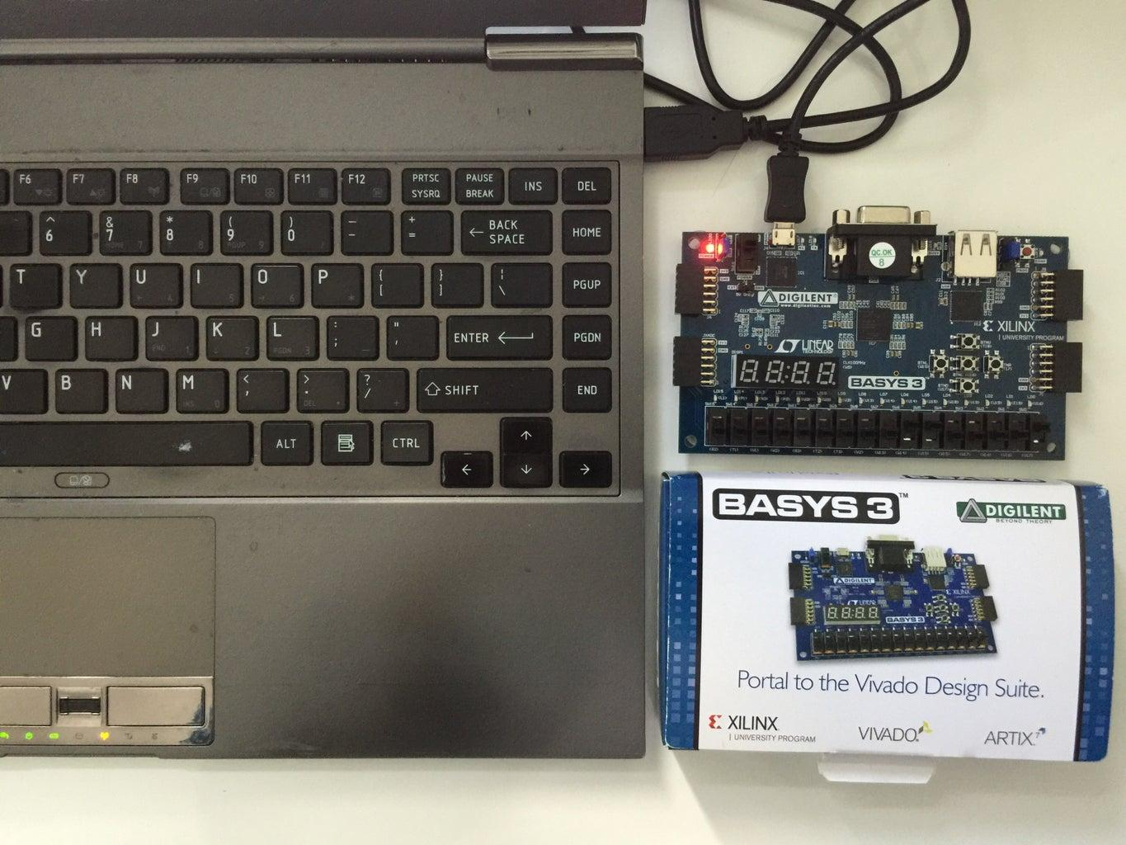

Slide 13
Proposed System Architecture
Components:
IoT-A
Authentication Server
IoT-B
Features:
Mutual authentication
Session key agreement
AES secure communication
Timestamp-based replay protection

Slide 14
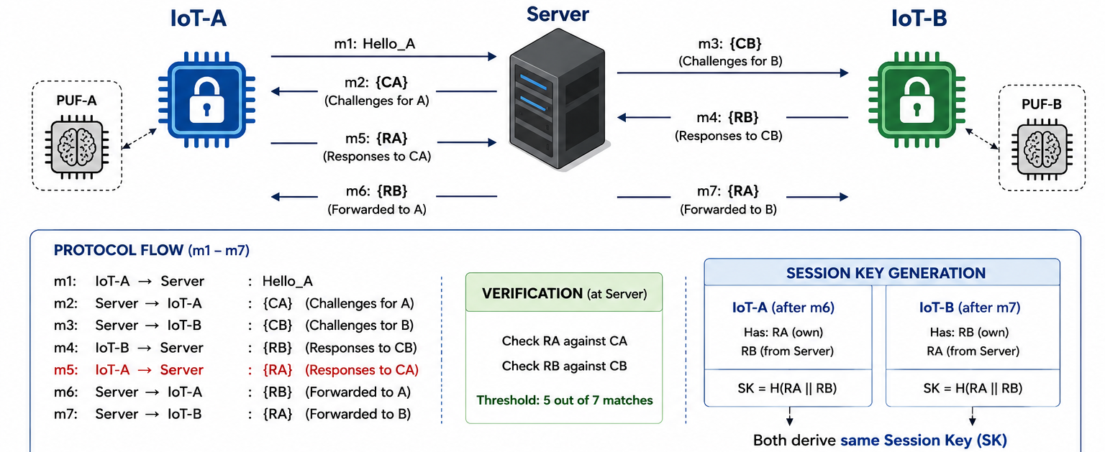

Slide 15
Mutual Authentication Scheme
m1 : IoT-A → Server
m2 : Server → IoT-A (CA)
m3 : Server → IoT-B (CB)
m4 : IoT-A → Server (RA)
m5 : IoT-B → Server (RB)
m6 : Server → IoT-A (RB)
m7 : Server → IoT-B (RA)

Slide 16
Authentication & Session Key
7 random challenges generated
Threshold verification: Match ≥ 5/7
Session Key:
SK = SHA256(RA || RB || Timestamp)
Features:
Dynamic session key
Unique per session
No permanent key storage

Slide 17
Replay Attack Protection
Timestamp included during authentication.
Server validates session freshness.
Expired authentication requests are rejected.
Prevents replay attacks.

Slide 18
Secure Communication
Plain Text → AES Encryption → Socket Communication → AES Decryption
Example:
Encrypted Message:
GGSfSEIHWMvliFtXCuX8eSSHNPdvbA6MXyibDfJYTTI=
Decrypted Message:
Hello from IoT-A

Slide 19
Experimental Results
SINGLE APUF
DOUBLE APUF
Uniformity : 50.23%
Reliability : 98.98%
Uniqueness : --
Observations:
High reliability
Near-ideal uniformity
Strong uniqueness
Uniformity : 51.40/48.60
Reliability : 92.61%
Uniqueness : 100%

Slide 20
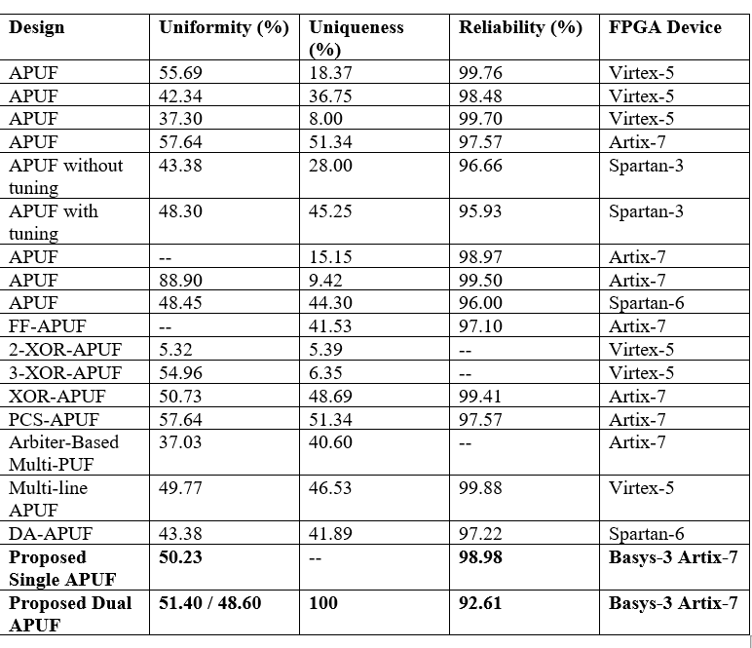
comparison with APUF result

Slide 21
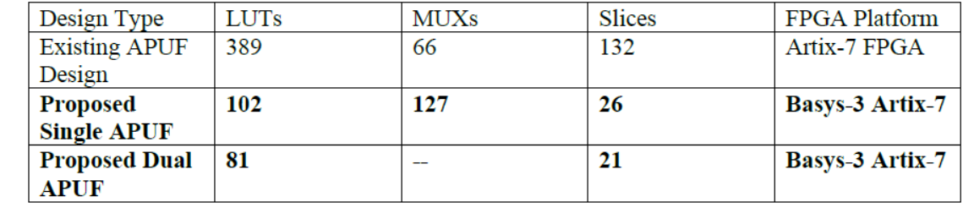
FPGA Resource Utilization
LUTs : 102
MUXs : 127
Slices : 26
[1]
Observations:
Lightweight implementation
Area efficient
Suitable for IoT devices

Slide 22
Comparison Existing PUF-Based Authentication Schemes
Paper | Mutual Auth | Session key | FPGA
LFSR APUF (2023)[4] | Yes | Partial | Yes
PUF Key Exchange 2023[2] | Yes | Yes | No
PA-PUF 2022[3] | No | No | Yes
Proposed Scheme | Yes | Yes | Yes

Slide 23
Security Analysis
Resistant to cloning attacks
Resistant to replay attacks
Resistant to key extraction
Resistant to hardware tampering
Partial risk against ML modeling attacks

Slide 24
Proposed Work
Implemented a lightweight FPGA-based Arbiter PUF authentication system for IoT security.
Achieved mutual authentication between two IoT devices instead of only single-device authentication.
Introduced multi-challenge threshold verification to improve authentication reliability.
Generated a dynamic session key using PUF responses and SHA-256 without storing permanent secret keys.
Integrated AES-based secure communication after authentication.
Added timestamp-based replay attack protection.
Designed an area-efficient hardware architecture suitable for resource-constrained IoT devices.

Slide 25
Conclusion & Future Work
Successfully implemented FPGA-based APUF authentication.
Achieved mutual authentication.
Generated shared session key.
Established AES secure communication.
Future Work:
XOR PUF
Wireless communication

Slide 26
REFERENCES
[1] S. Roy, D. Das, and B. Sen, “Secure and Lightweight Authentication Protocol Using PUF for the IoT-Based Wireless Sensor Network,” ACM Journal on Emerging Technologies in Computing Systems, vol. 20, no. 1, Article 3, Nov. 2023.
[2] V. P. Yanambaka, S. P. Mohanty, E. Kougianos, and D. Puthal, “PMsec: Physical Unclonable Function-Based Robust and Lightweight Authentication in the Internet of Medical Things,” IEEE Transactions on Consumer Electronics, vol. 65, no. 3, pp. 388–397, Aug. 2019.
[3] C. Prabhunath G. and A. P. Shah, “Fredkin Gate-Based Arbiter PUF Design Through Challenge Obfuscation Using Garbage Outputs,” Integration, the VLSI Journal, vol. 106, 2026.
[4] Al-Meer, A., & Al-Kuwari, S. (2022). Physical Unclonable Functions (PUF) for IoT Devices. arXiv preprint arXiv:2205.08587.

Slide 27
Thank You
Saurabh Soni
MTech CSE
24CS4131
NIT Durgapur

