Slide 1
USE VEHICLE NETWORK DATA TO TRAIN A ML MODEL AND PREDICT SPECIFIC CONDITIONS ON AUTOMOTIVE VEHICLES

Slide 2
Contents
Data Preparation
Data extraction
Exploratory Data Analysis
Data cleaning
Model Selection
RFC model
LSTM model
Model Training
Model Comparison
Conclusion

Slide 3
Data Preparation
Input CAN log data was in J1939 format, hexadecimal values.
It was converted to CSV format using John Deere internal tool.
44 Features were identified in this data.
93 CAN logs(.asc format) were converted to 93 CSV files.
These CSV files were combined into 1 large Dataframe.

Slide 4
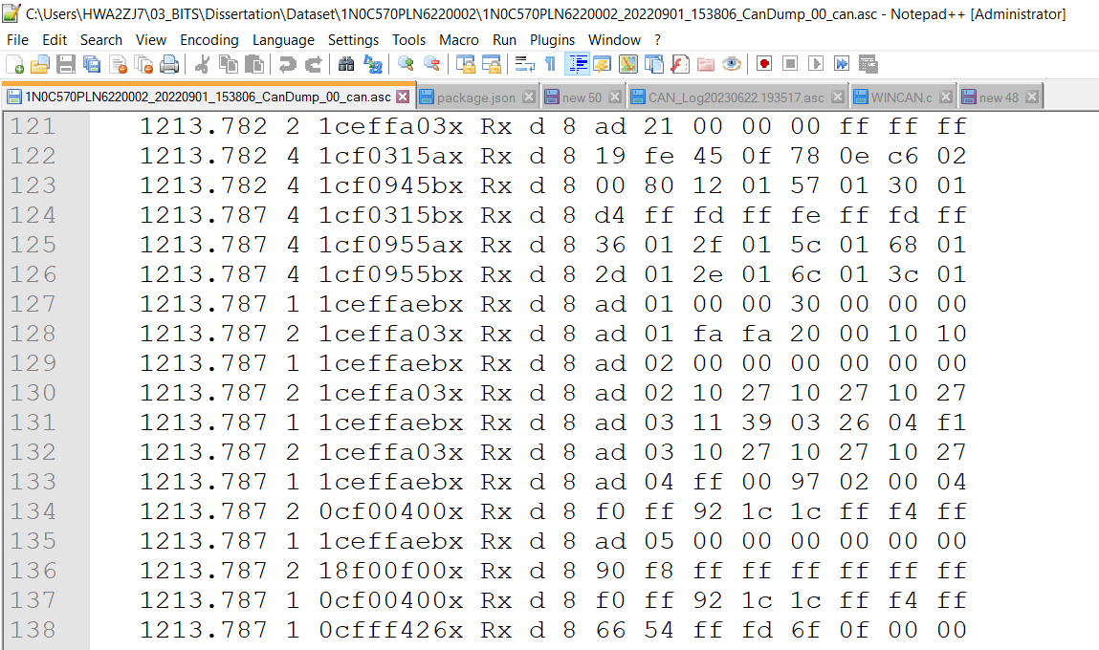
Dataset – CAN J1939 Protocol

Slide 5
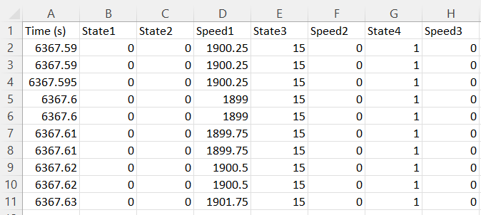
Data Extraction

Slide 6
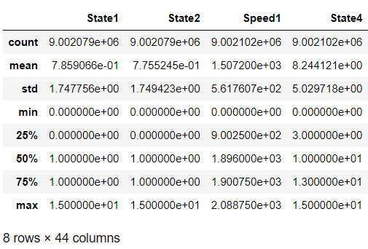
Exploratory Data Analysis
Data was described to find out datatype, min, max, mean etc.
Missing data was analyzed.
Plots were taken for Univariate and Bivariate analysis.
Heatmap was plotted to Bivariate analysis.

Slide 7
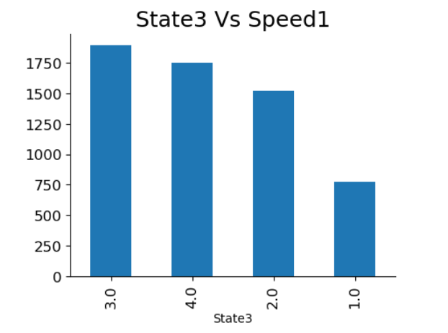
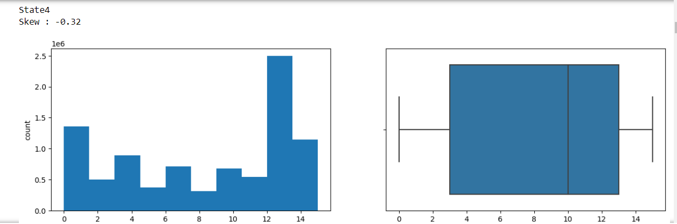
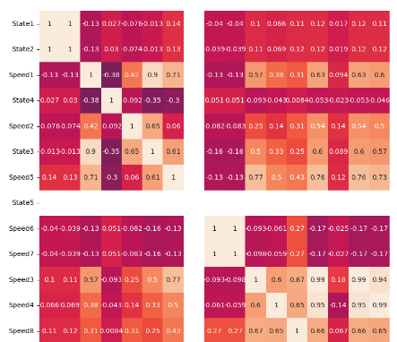
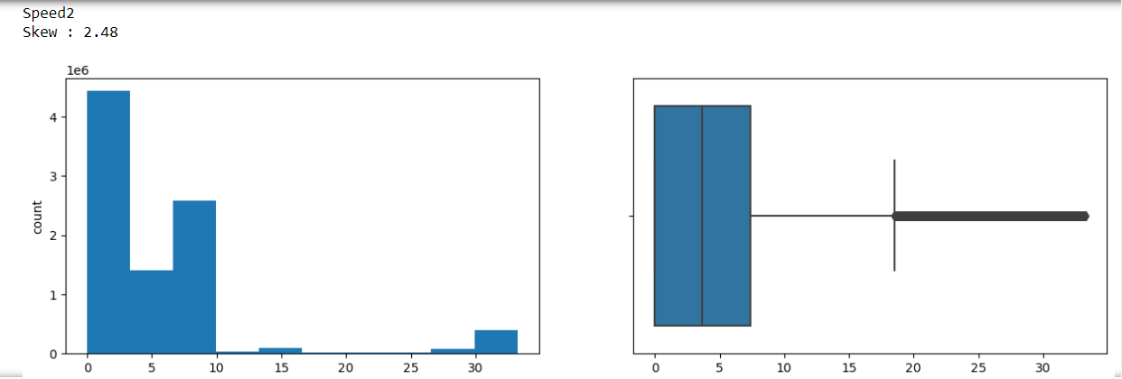
Univariate Analysis
Bivariate Analysis

Slide 8
Data Cleaning
Columns not required for model training were removed.
Intermediate missing values were replaced with the previous valid values.
Reason: sometimes CAN data is missed on the network due to heavy traffic
Top missing values were replaced with 0.

Slide 9
Model Selection
Prediction of specific condition which occurred in the data.
Binary Classification problem.
Supervised Machine learning is used:
Random Forest Classifier
Long Short Term Memory (LSTM)

Slide 10
Random Forest Classifier
2 types of models are trained:
RFC with directly dependent inputs
RFC without directly dependent inputs
RFC with directly dependent inputs
All inputs and 1 output were given to train the model
Output contains 0(not occurred) and 1(occurred) events
Model with estimators = 50 and 100 were trained
Model predicted only the not occurred events
Model couldn’t predict occurred events
Validation with untrained dataset:
Accuracy: 0.9956238410596027 Precision: 0.9564332724502799 Recall: 0.9543492746490835 F1-score: 0.9320614355825253

Slide 11
Random Forest Classifier
RFC without directly dependent inputs
Directly dependent inputs were removed from the given data and given to train the model
Model with estimators = 50 and 100 were trained
Model predicted only the not occurred events
Model couldn’t predict occurred events
Validation with untrained dataset:
Accuracy: 0.9956238410596027 Precision: 0.9102838457261793 Recall: 0.9540879654026557 F1-score: 0.9316713083984506

Slide 12
Long Short Term Memory (LSTM)
This model was taken because of time-series nature of the data.
The specific event occurs in the data after a certain sequence in the data.
Input data was scaled using MinMaxScaler.
Timeseries was generated of 100 window length
Input layer of LSTM model with 32 units and 2 different activation functions were tried: Sigmoid and Softmax.
Due to binary classification problem, ‘binary_crossentropy’ loss function was taken.
1 Dense layer is taken as final output layer.

Slide 13
Long Short Term Memory (LSTM)
LSTM with directly dependent inputs
Model is trained with all the inputs and 1 output.
2 activation functions were taken – Softmax and Sigmoid
Sigmoid gave higher accuracy
Softmax activation training metrics: | Sigmoid activation training metrics:
loss: 0.1530 - accuracy: 0.1338 | loss: 0.1529 - accuracy: 0.9242
Softmax activation untrained data metrics: | Sigmoid activation untrained data metrics:
loss: 0.3330 - accuracy: 0.0044 | loss: 1.0622 - accuracy: 0.2912

Slide 14
Long Short Term Memory (LSTM)
LSTM without directly dependent inputs
Directly dependent inputs were removed from the data.
Model was trained with remaining inputs and 1 output.
2 activation functions were taken – Softmax and Sigmoid
Sigmoid gave higher accuracy
Softmax activation training metrics | Sigmoid activation training metrics
loss: 0.3406 - accuracy: 0.1069 | loss: 0.1529 - accuracy: 0.9242
Softmax activation untrained data metrics: | Sigmoid activation untrained data metrics:
loss: 0.3330 - accuracy: 0.0044 | loss: 1.0622 - accuracy: 0.2912

Slide 15
Long Short Term Memory (LSTM)
LSTM without directly dependent inputs
Directly dependent inputs were removed from the given data and given to train the model
Model predicted only 1(occurred events)
Model couldn’t predict 0(not occurred events)
Validation with untrained dataset:
Loss: 0.3402 Accuracy: 0.1069

Slide 16
Model Comparison (Loss, Accuracy)
 | With AB inputs | Without AB inputs
RFC | Accuracy: 0.9956238410596027 Precision: 0.9564332724502799 Recall: 0.9543492746490835 F1-score: 0.9320614355825253 | Accuracy: 0.9956238410596027 Precision: 0.9102838457261793 Recall: 0.9540879654026557 F1-score: 0.9316713083984506
LSTM | Softmax: Loss: 0.3330, Accuracy: 0.0044 Sigmoid: Loss: 1.0622, Accuracy: 0.2912 | Softmax: Loss: 0.1114, Accuracy: 0.0044 Sigmoid: Loss: 0.1193 - Accuracy: 0.9956

Slide 17
Model Comparison (Execution Time)
Time Comparison | Dataset | Config | Time
RFC | 50 can csv | Estimators 50 | ~25 mins
LSTM | 6 can csv | 1 LSTM with 32 nodes 1 dense with 1 node activation sigmoid | 2 hours per epoch
LSTM | 6 can csv | 1 LSTM with 32 nodes 1 dense with 1 node activation softmax | 40 mins per epoch

Slide 18
Conclusion
• CAN logs in J1939 format were successfully pipelined to Python as Dataframe.
• Exploratory Data Analysis was performed on the data.
• Data was cleaned and prepared for model.
• RFC and LSTM models were trained with multiple configurations.
• The RFC model predicted 0(not observed) but couldn’t predict 1(observed).
• LSTM models couldn’t predict the specific condition in the data.
• In the whole dataset, availability of true value for specific condition was in 3 instances.
• More dataset is needed with true instances for specific condition.
• Model is needed which can truly predict the specific condition in the machine with atleast > 60%.

Slide 19
Thank You!

