Slide 1
PropLead
Real estate lead management
Implemented CRM, architecture and future scope
13 October 2026
Notes:
Source: user requirements and D:/PropLead repository. Future scope is explicitly excluded from current implementation.

Slide 2
Requirement coverage
Requirement | Implemented behavior
Lead capture | Name, phone, email, budget, location, property type and source
Lead listing | Search by name/phone, source/status filters, date/budget sorting
Lead detail | View, edit, notes and four lead statuses
Dashboard | Totals, source breakdown, status distribution and conversion
REST APIs | CRUD, validation, stored functions and role checks
PROPLEAD
02
Notes:
Sources: frontend/app/(protected), backend/src/routes, backend/sql/functions.sql. Coverage describes implemented functionality, not production deployment.

Slide 3
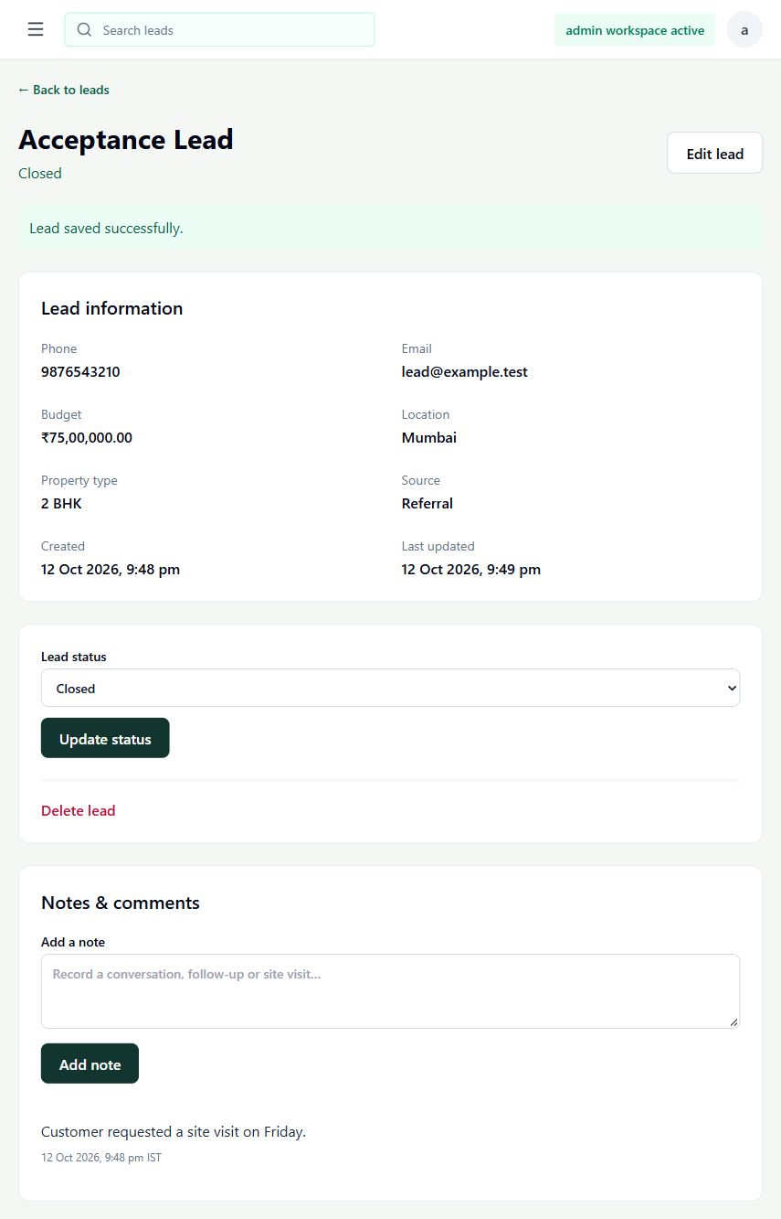
Lead capture and follow-up
New
Contacted
Site Visit
Closed
Notes preserve the follow-up context. Admins can delete a lead with confirmation.
PROPLEAD
03
Notes:
Source: frontend/components/Leads, backend/src/services/leadService.js. Screenshot: local lead-detail.png, synthetic acceptance record.

Slide 4
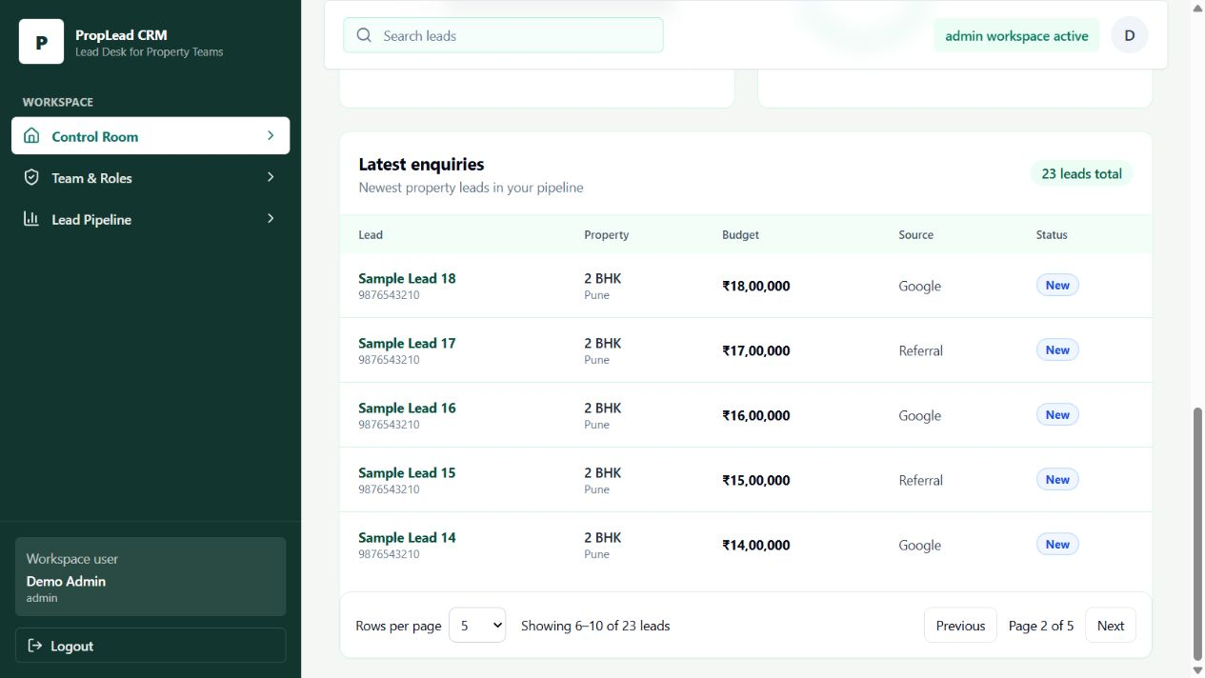
Dashboard and recent leads
Global metrics
All leads contribute to totals and charts.
Paged rows
The dropdown controls recent leads per page.
PROPLEAD
04
Notes:
Source: backend/sql/functions.sql crm_dashboard, frontend/components/Dashboard/DashboardComp.js. Screenshot uses 23 synthetic leads, not business results.

Slide 5
Current architecture
Layer | Responsibility
Next.js and React | Pages, forms, charts and client navigation
Express REST API | Validation, authorization, password checks and token signing
Repository gateway | Allowlisted, parameterized stored-function calls
PostgreSQL | CRUD, aggregation, ordering, pagination and success JSON
PROPLEAD
05
Notes:
Sources: frontend/package.json, backend/package.json, backend/src/db/routines.js, backend/sql/functions.sql.

Slide 6
PostgreSQL owns the success JSON
Lists use jsonb_agg. Objects use jsonb_build_object and to_jsonb.
SELECT jsonb_build_object(
'message', 'Lead notes retrieved successfully',
'data', COALESCE(
jsonb_agg(to_jsonb(r) ORDER BY created_at DESC, id DESC),
'[]'::jsonb))
FROM crm_list_notes(p_lead_id) r;
Controllers forward the result. Backend validation and error responses remain in Node.
PROPLEAD
06
Notes:
Source: backend/sql/functions.sql crm_json_* routines and backend/src/controllers. Code is an abbreviated illustration of the implemented note-list routine.

Slide 7
Pagination and response size
User choice
5, 10, 20, 50 or 100 rows. Default: 10. API maximum: 100.
Request
GET /api/dashboard?page=2&pageSize=5
Response
Up to 5 recent leads, full metrics and page/total metadata.
Example
With 23 leads: page 2 shows rows 6–10. Total pages: 5.
PROPLEAD
07
Notes:
Sources: backend/src/utils/pagination.js, backend/sql/functions.sql, frontend/components/Pagination.jsx. Example uses synthetic fixture data.

Slide 8
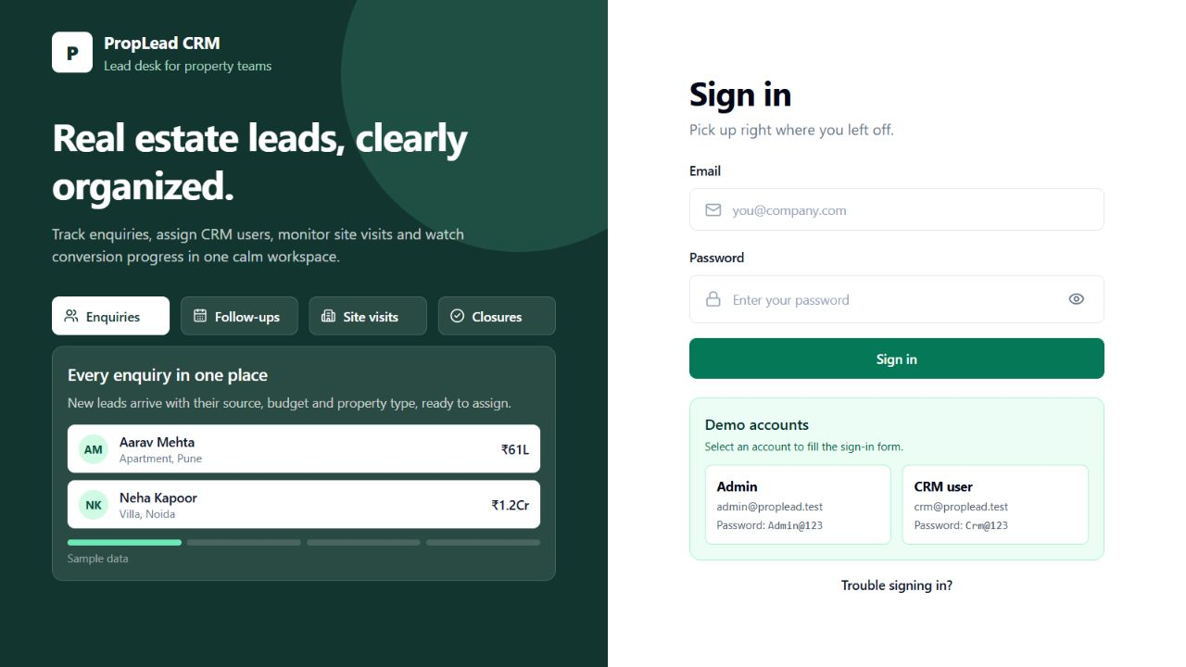
Login and navigation
Demo credentials stay visible and can fill the form.
Client navigation updates pages and filters without a full document reload.
The active sidebar link is a no-op.
PROPLEAD
08
Notes:
Sources: frontend/app/login/LoginForm.jsx, frontend/components/AppShell.js, frontend/components/Leads/LeadsComp.js, frontend/lib/auth.js. Screenshot: demo-login.png.

Slide 9
Verification and deployment
Verified
Eight backend tests cover CRUD, auth, SQL JSON and pagination.
Frontend checks
Production build, lint and browser acceptance completed.
Database setup
Stored functions installed. PostgreSQL JSON/page-size check passed.
Demo setup
Run seed-demo to install the accounts shown on the login page.
PROPLEAD
09
Notes:
Sources: backend/test/crm.test.js, backend/test/database.test.js, README.md. Eight automated backend tests passed against isolated fixtures and PGlite. Earlier frontend lint/build and browser acceptance passed. Configured PostgreSQL schema installation and JSON page-size verification completed successfully.

Slide 10
Assumptions and boundaries
Business scope
One shared real estate lead pool. Tenant isolation is future work.
Conversion
Closed leads divided by total leads, multiplied by 100.
Data meaning
Budget is the prospect’s budget. It is not collected revenue.
Access model
Current roles are Admin and CRM. Dynamic permissions are future scope.
PROPLEAD
10
Notes:
Sources: user requirements, README.md, backend/sql/schema.sql. Product assumptions should be confirmed before expanding scope.

Slide 11
Future frontend: dynamic RBAC
Permission model
Define permissions such as lead.read, lead.edit and user.manage.
Dynamic UI
Use permission metadata to control routes, menus and actions.
Enforcement
Apply the same policy at API boundaries and resource access.
Administration
Add role-permission management and permission-focused tests.
FUTURE SCOPE (NOT IMPLEMENTED)
11
Notes:
Source: user-provided future scope. Proposed design only. Backend enforcement remains necessary even when the UI hides actions.

Slide 12
Future frontend: shared library
1. Foundation
Shared styles, accessible controls and a permission hook.
2. Forms
Reusable fields, validation, error states and submission behavior.
3. Tables
Reusable columns, filters, sorting and server pagination.
4. Feature modules
Lazy-load suitable modules and add Suspense/loading boundaries.
FUTURE SCOPE (NOT IMPLEMENTED)
12
Notes:
Source: user-provided future scope. Proposed sequence only. Existing reusable components and route loading do not equal this broader library.

Slide 13
Future backend capabilities
Audit log
Record actor, action, timestamp and relevant before/after values.
Ledger
Add immutable financial entries only if payments enter scope.
Caching
Cache suitable reads with explicit invalidation after writes.
Refresh tokens
Plan rotation, revocation and reuse detection for longer sessions.
FUTURE SCOPE (NOT IMPLEMENTED)
13
Notes:
Source: user-provided future scope. No refresh tokens, audit log, ledger or cache was added in this implementation. Ledger assumes payment/accounting requirements are introduced.

Slide 14
Proposed delivery sequence
First
Confirm permission rules, tenant boundaries and audit requirements.
Next
Build the shared library, dynamic RBAC and focused loading states.
Then
Add audit and session improvements with security tests.
When justified
Introduce caching from measured demand and a ledger from financial scope.
FUTURE SCOPE (NOT IMPLEMENTED)
14
Notes:
Source: proposed implementation plan based on user future-scope requests. No dates, cost or effort estimates are committed.

