Slide 1


Slide 2

Data Visualizations on Tableau
By
Saurabh Potdukhe

Slide 3

Table of content
Problem Statement (Task 1)
Structure Creation of Teams in excel
Implementation and dashboard Visualization in Tableau
Problem statement (task 3)
The alignment type representation by Bar-Graph
Pie-Chart representation of alignment type using alignment link
Target count value using left_goal_start_date and supp_start date
Target count value using left_goal_Target_date and supp_Target date
Dashboard representation of alignment
Problem statement (task 2)
Solution method by Area graph(Goal confidence level and Confidence level)
Solution method by Area graph(Goal progress and Progress)
Start, Target and Current Kr visualization
Dashboard representation of Team Okr and Team key Result

Slide 4
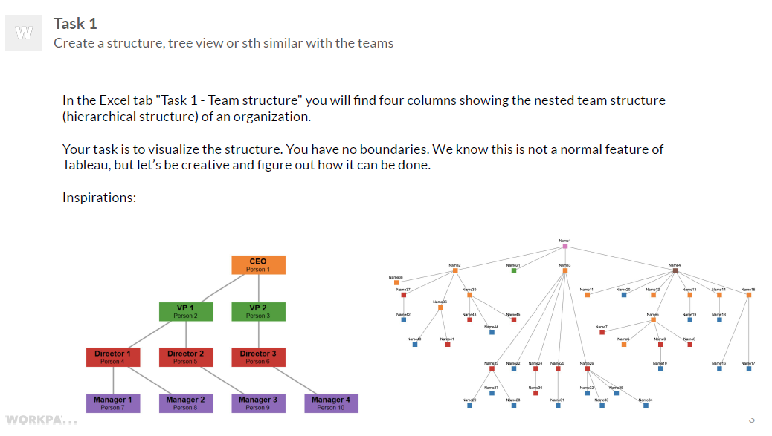

Slide 5
Solution method for task 1
Organisational chart
FINAL_OBJECT
OBJECT_NAME
DEPENDECY_NAME
DEPENDENCY_TYPE
START_NODE_LEVEL
END_NODE_LEVEL
DRILL_DOWN_FLAG
START_NODE_ID
END_NODE_ID
PATH
Range
An organizational chart, also called organigram or organogram, is a diagram that shows the structure of an organization.
Steps:
Main idea is to Create a drill down for each node
Fields:

Slide 6
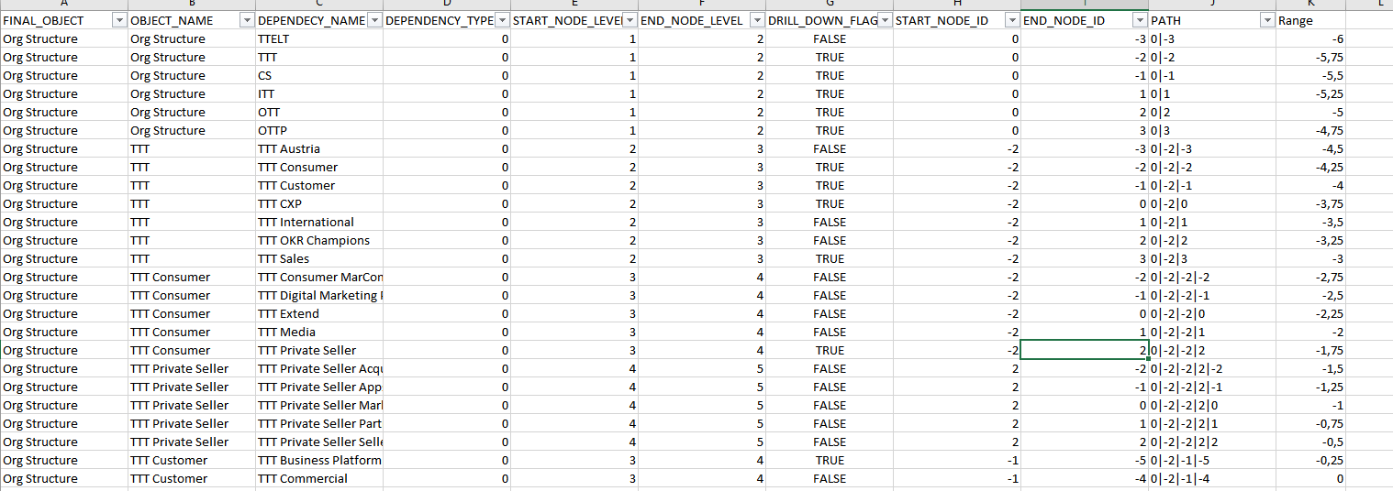
organizational chart (Data analysis in excel)

Slide 7
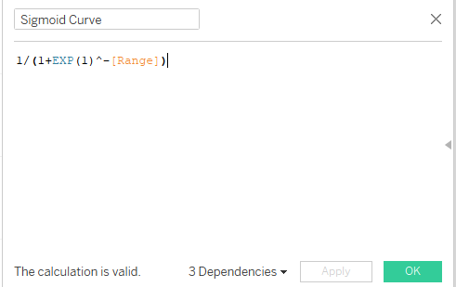
Organsational chart
The organisational chart is created in tableau is created with the help of calculated field of sigmoid curve, curve, points, X-Axis, Path calculation, Label, Show path, Parameters.
Steps:
First create sigmoid curve calculated measure

Slide 8
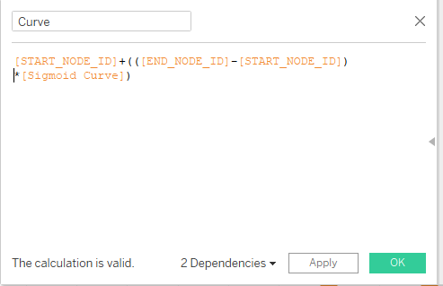
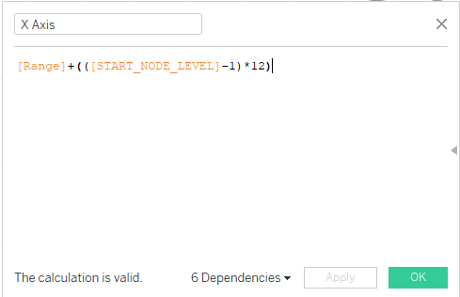
create X axis coordinate calculated measure
Create Curve calculated measure

Slide 9
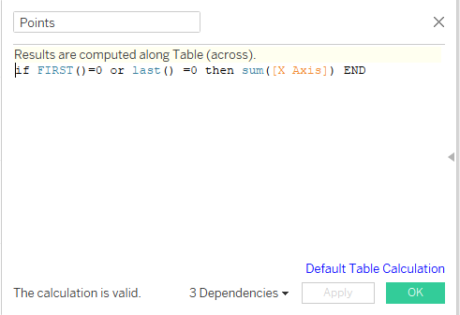
Create points calculated measure
Drag Curve in row and X axis in column
Drag Final object , Dependency name in marks(detailed ) and range should be converted into dimension.
Drag points(measure ) into row to give the first or last values of X axis.

Slide 10
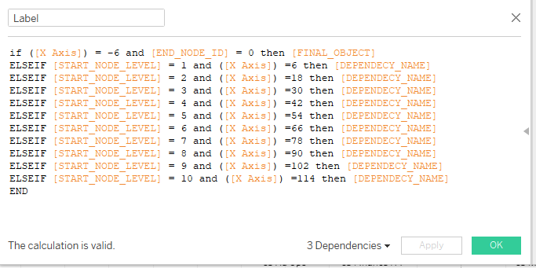
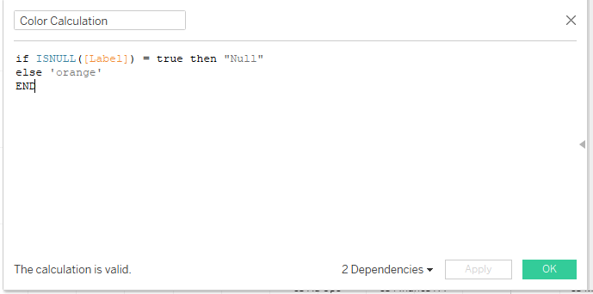
Create Label under the table and
add calculation
Create Color calculation field

Slide 11
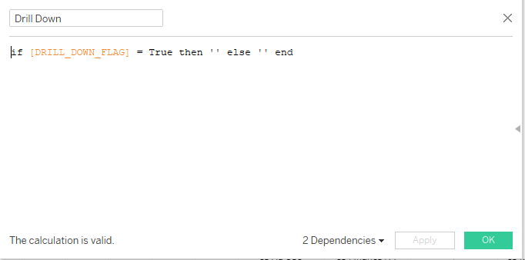
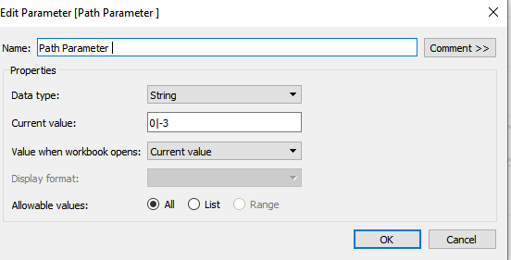
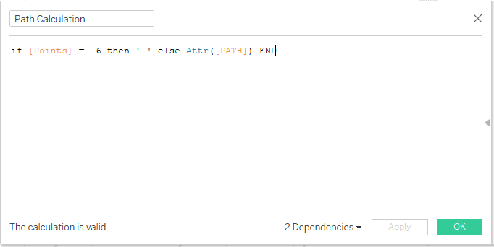
Create calculation filed for drill down
Drag into Marks(Text)
Create parameter for path to get the drill
down for each node
Create path calculation field
Drag path calculation into Marks(Detailed)
Create an action to set an target parameter(path parameter)
and field as path calculation

Slide 12
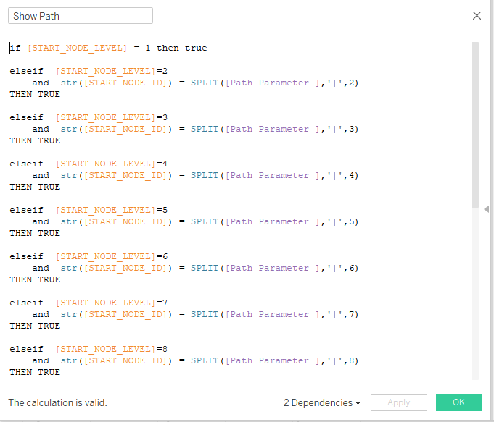
Create Show path calculation field .
Drag show into filter and set as ‘True’
Then the drill down for each node is present.

Slide 13
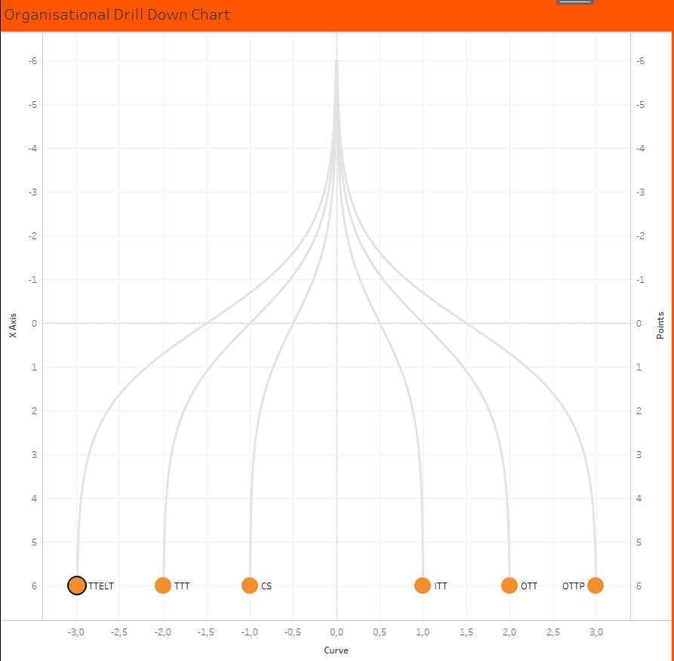
Dashboard for organizational chart

Slide 14
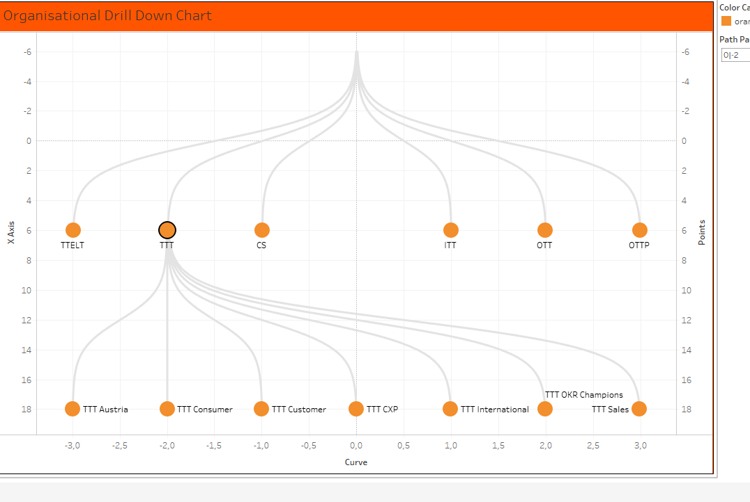
Dashboard for organizational chart

Slide 15
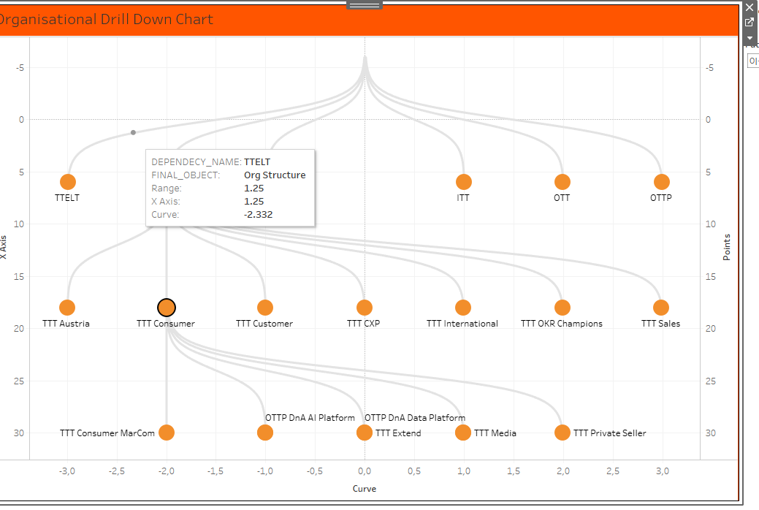
Dashboard for organizational chart

Slide 16
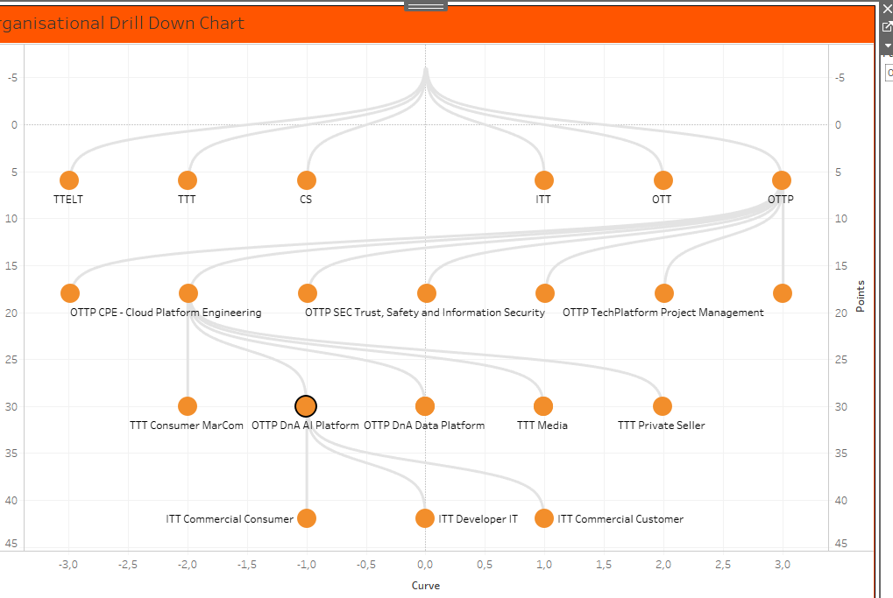
Dashboard for organizational chart

Slide 17
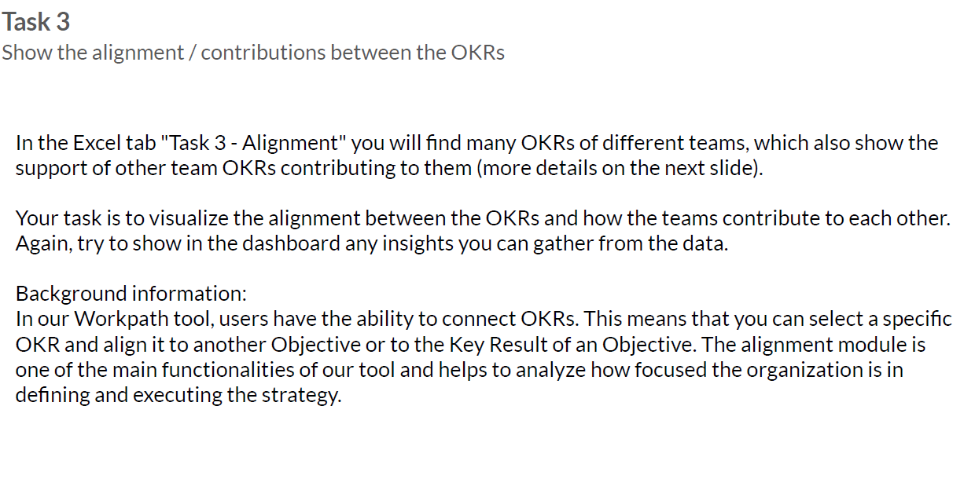

Slide 18
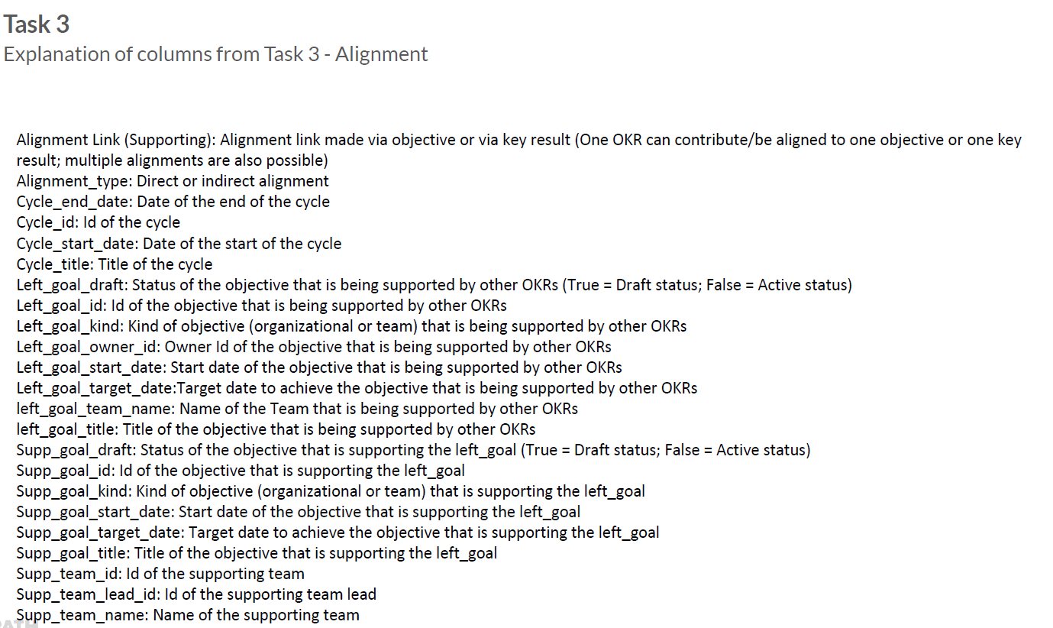

Slide 19
Solution Method for task 3
The Alignment is represented by Bar-Graph for each cycle with each alignment type:
Direct alignment
Indirect alignment level 1
Indirect alignment level 2
This represent the which is highest cycle_id among alignment type

Slide 20
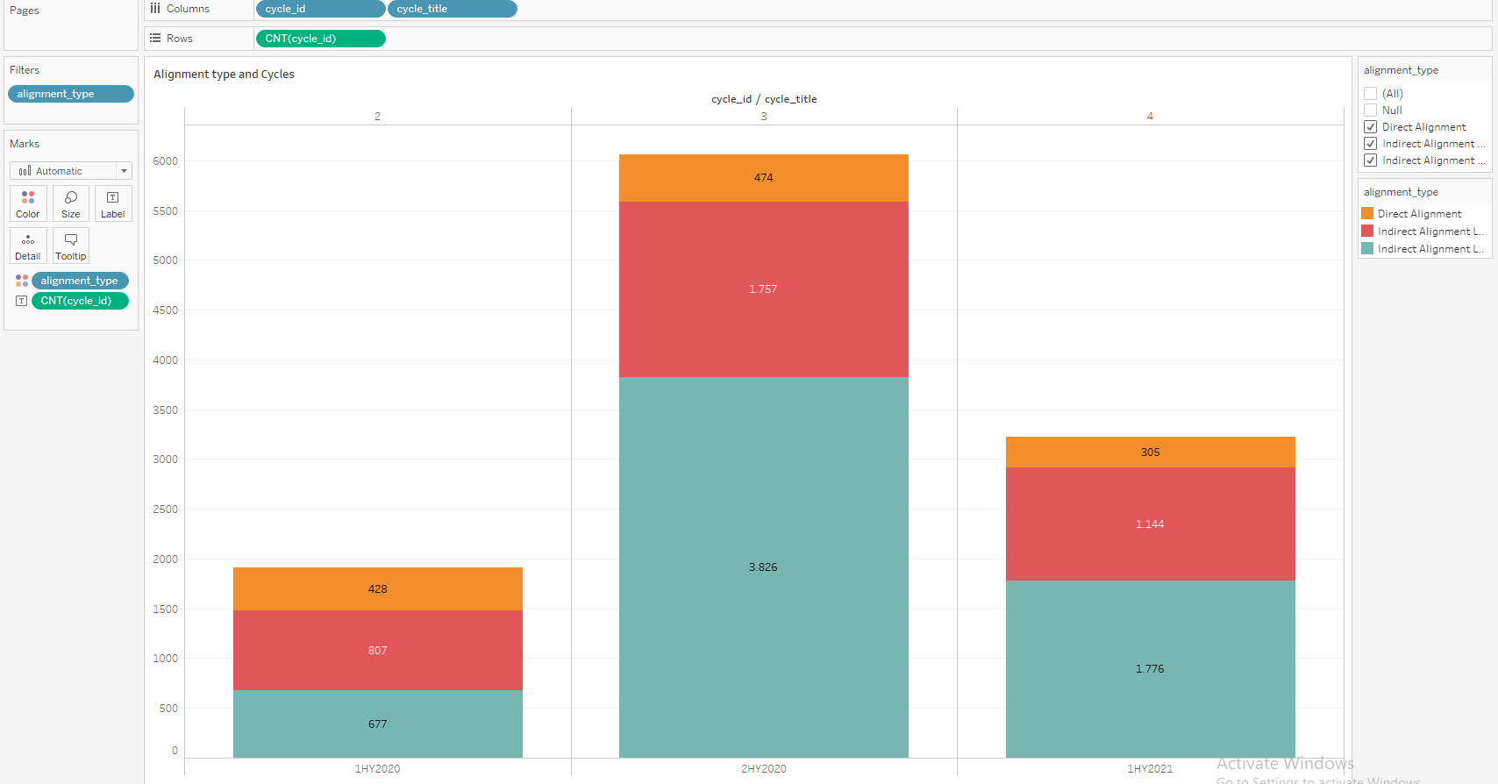
Alignment Distribution

Slide 21
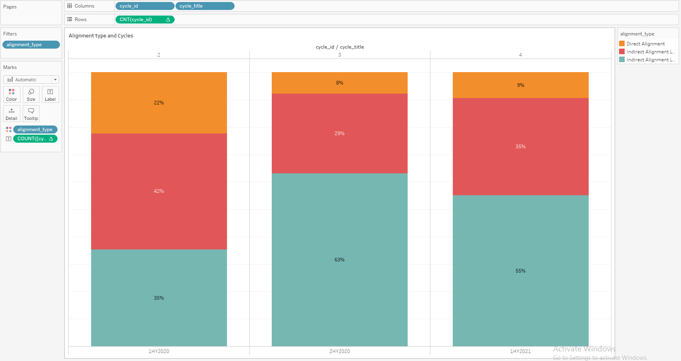
Alignment Distribution (percentage)

Slide 22
Solution Method for task 3
Alignment type and link is represented by pie chart for each cycle:
Direct alignment
Indirect alignment level 1
Indirect alignment level 2
Via key result
Via objective
The pie chart represents for each alignment type how much area covered by alignment link

Slide 23
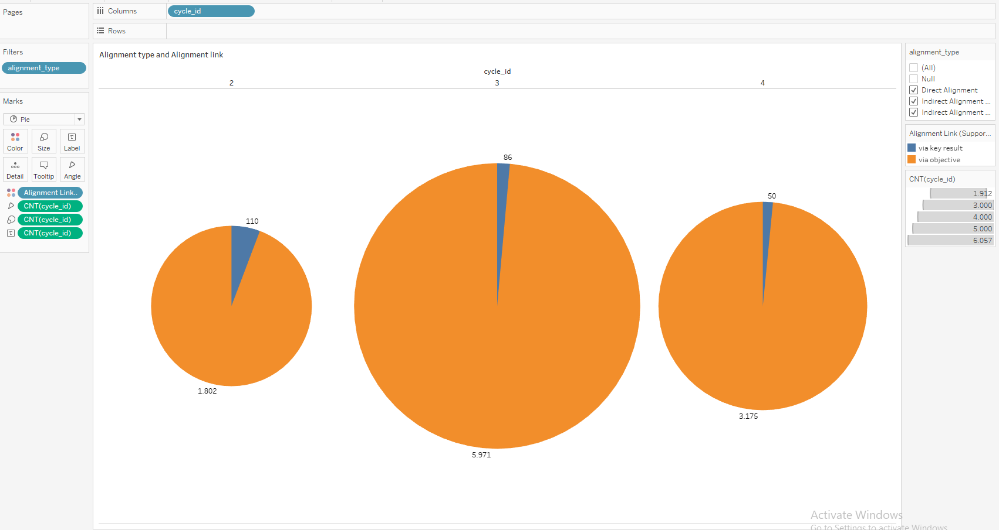
Alignment Distribution (percentage)

Slide 24
Solution Method for task 3
To find the count achieved by left_goal_target_date is represented by square graph.
Fields used:
left_goal_start_date
left_goal_target_date
Supp_goal_start_date
Supp_goal_target_date
By using these field to calulate the count of left_goal_target_date to achieve the objective.
First Sqaure Graph:
Using left_goal_start_date and Supp_goal_start_date founded the left_goal_target_date to achieve objective as in the given description (Supp_goal_start_date: Start date of the objective that is supporting the left_goal)

Slide 25
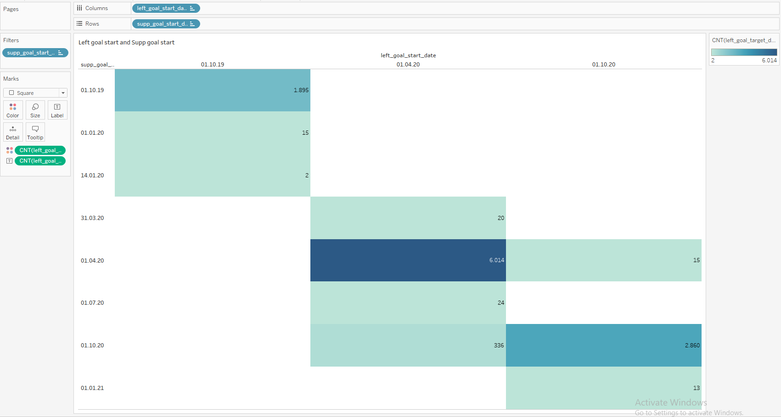
Target count(left_goal_start_date and supp_goal_start_date)

Slide 26
Solution Method for task 3
Second Square Graph:
Using left_goal_target_date and Supp_goal_target_date founded the left_goal_target_date to achieve objective as in the given description (Supp_goal_start_date: Start date of the objective that is supporting the left_goal)

Slide 27
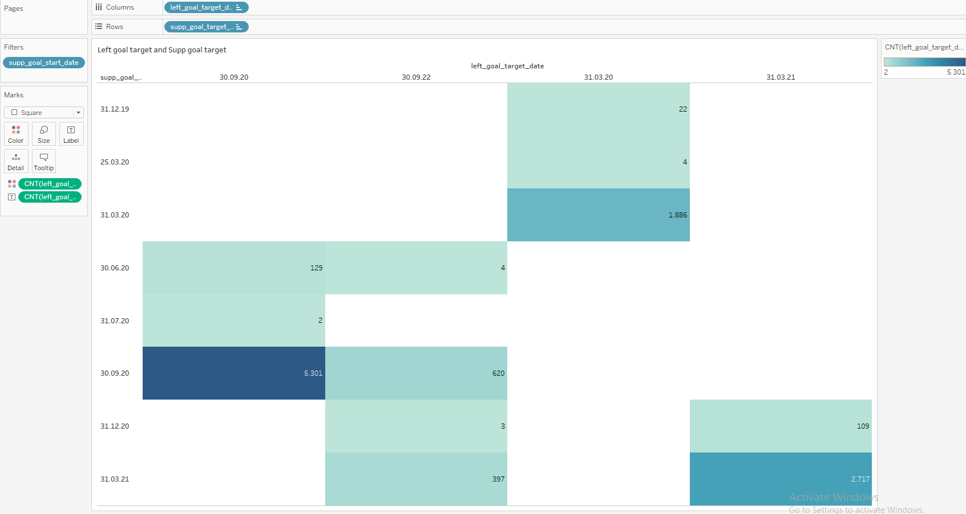
Target count(left_goal_start_date and supp_goal_start_date)

Slide 28
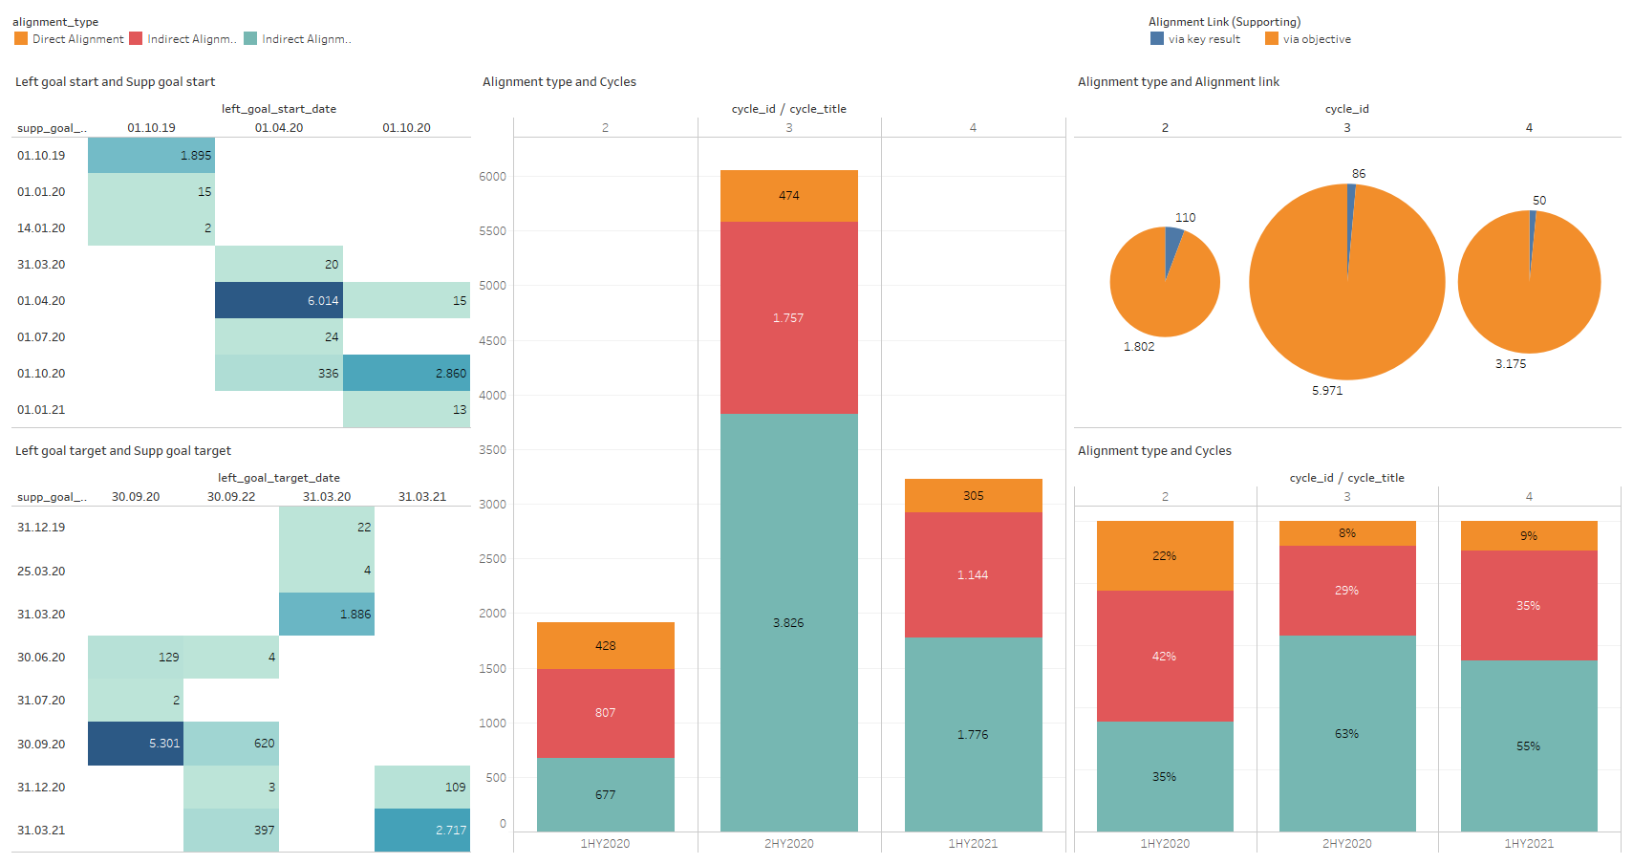
Dashboard for alignment

Slide 29
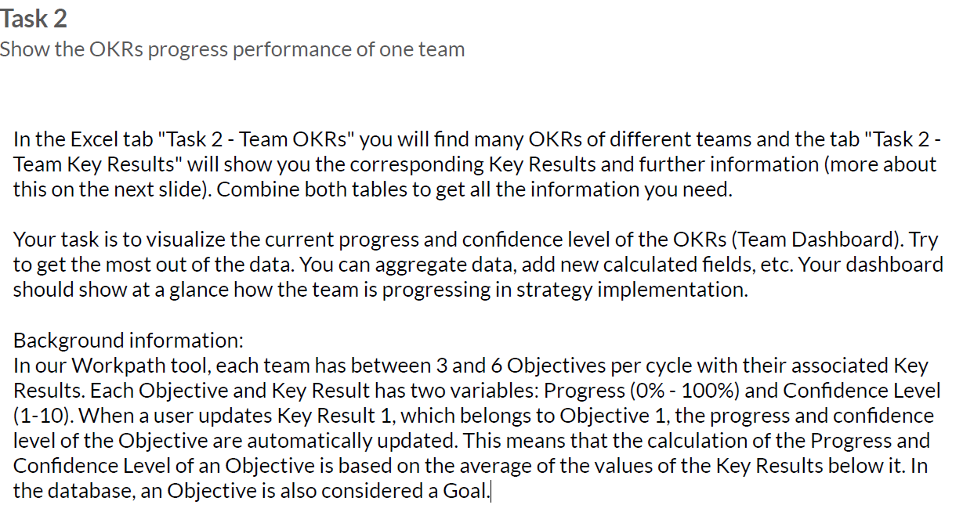

Slide 30
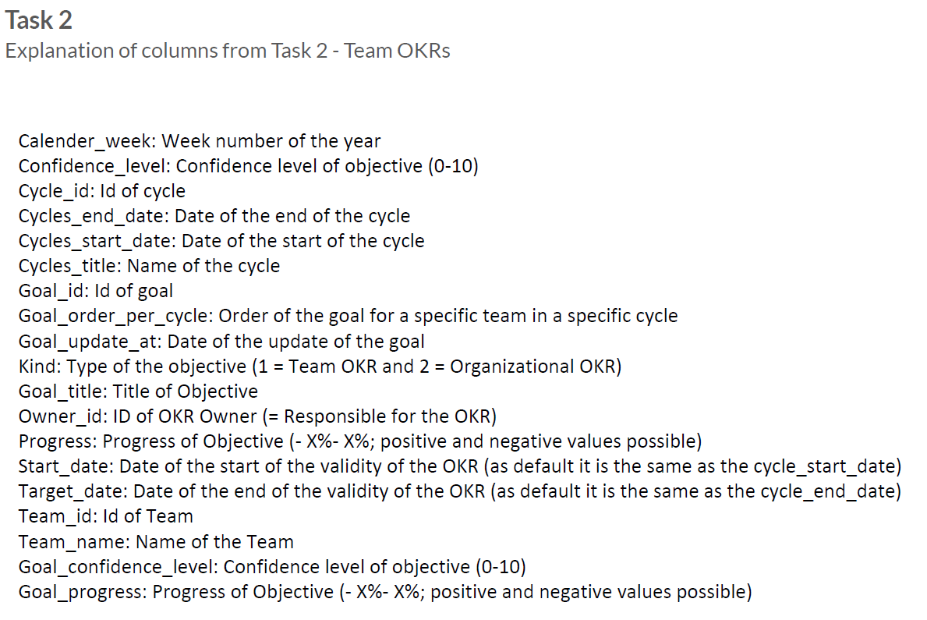

Slide 31
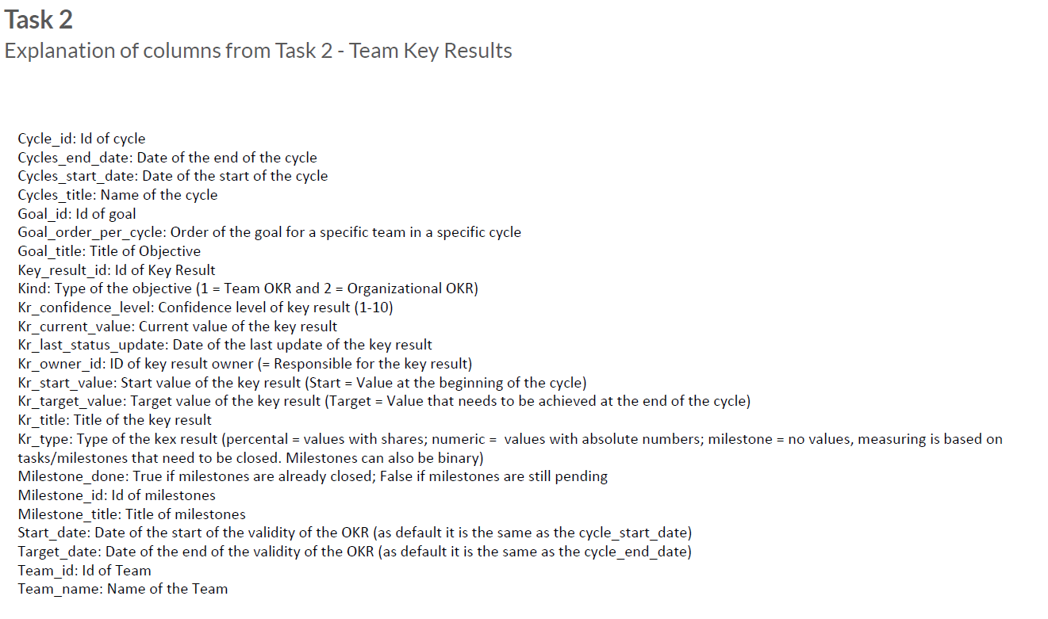

Slide 32
Solution Method for task 2
Steps :
As excel sheet(Team OKR and Team_key_result) is imported in tableau.
To visualize the current progress and confidence level of the OKRs:
I have visualized the data with the help of Area and Line graph.
Confidence level and Goal _confidence _level:
Setting the parameter as team_id will provide the confidence and goal_confidence_level progress individually.

Slide 33
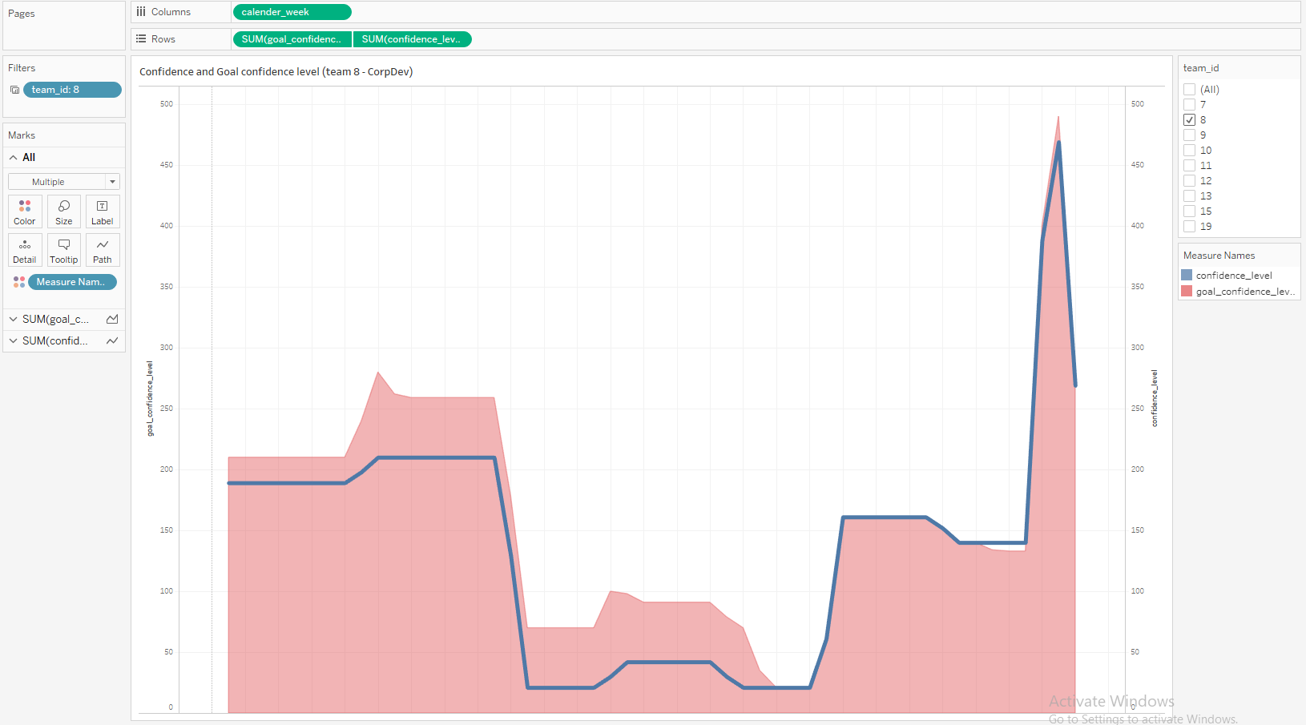
Confidence level and Goal_confidence_level

Slide 34
Solution Method for task 2
Steps :
As excel sheet(Team OKR and Team_key_result) is imported in tableau.
To visualize the current progress and confidence level of the OKRs:
I have visualized the data with the help of Area and Line graph.
Progress and Goal_progress:
Setting the parameter as team_id will provide the Progress and goal_ progress individually.

Slide 35
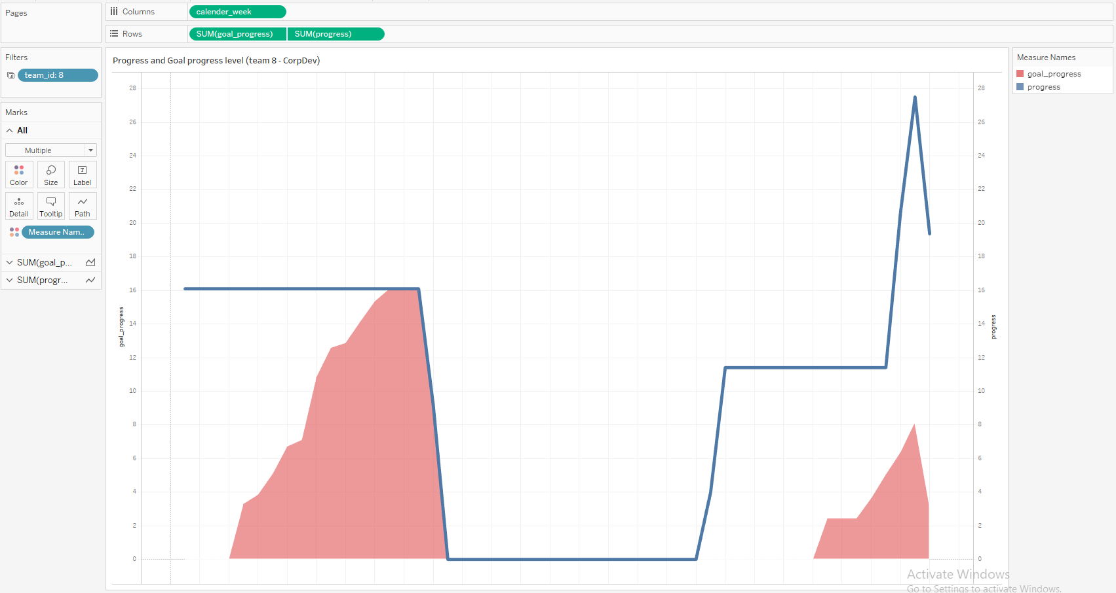
Progress and Goal_progress

Slide 36
Solution Method for task 2
The team key result is represented by Bar graph for all teams with respect to
Kr_Start_value
Kr_Target_value
Kr_Current value
These are the important fields to analyze the values of each team.

Slide 37
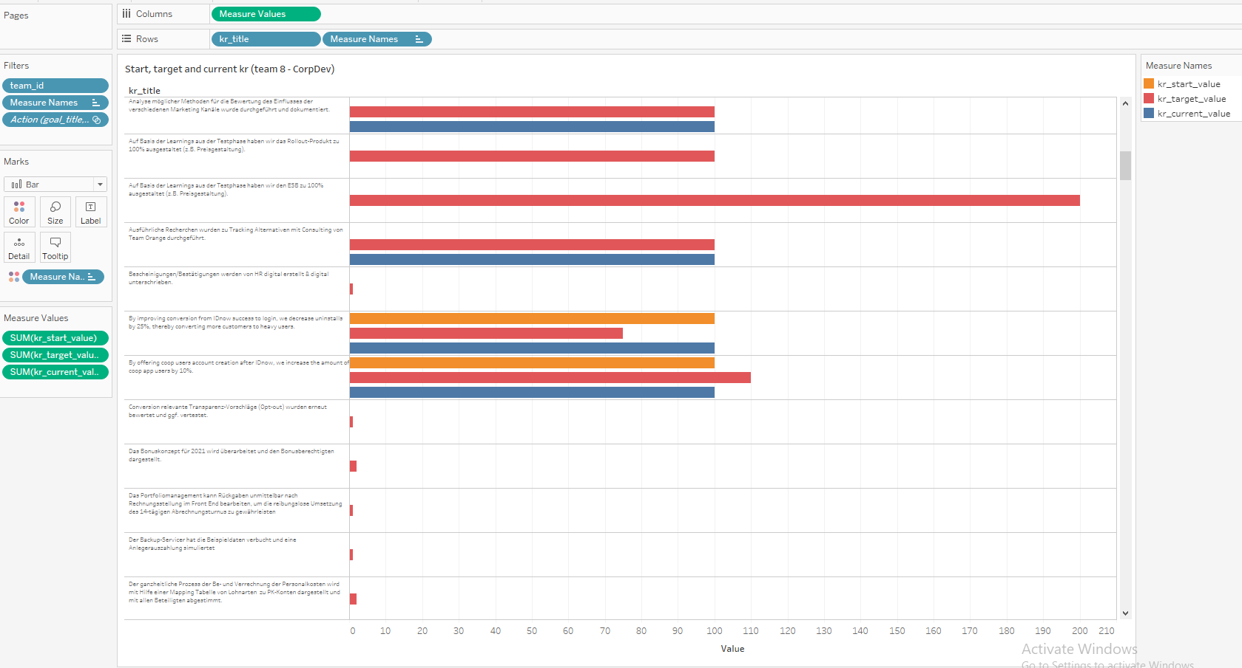
Team_Key_results

Slide 38
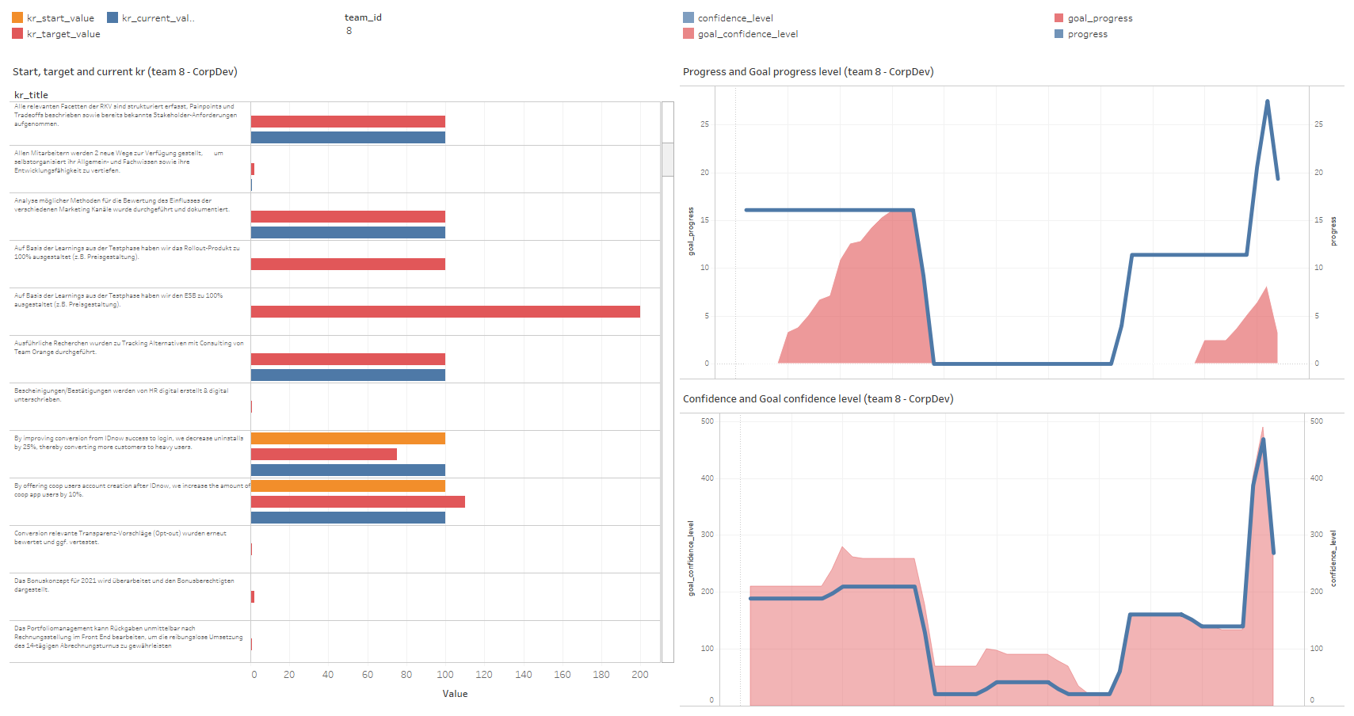
Dashboard for Team Okr and Team_key _Results

Slide 39

Thank you

