Slide 1
Questions and Solutions By Saurabh Potdukhe

Slide 2
Question 1
Kaufnekuh wants to know the performance of the new/existing/revived customers on a daily level since the beginning of 2020, along with their revenue and their average order value. Write an SQL query that can provide this information, keeping the following definitions in mind:

Slide 3
Question 1
Solution:
Query to find the orders within the selected date:
select order,item_id,date,order_total_incl_vat,order_value_ex_vat from orders
where date <= '2020-01-01'
AND date >= '2020-12-31';
Query to find the revenue and average order value within the selected date:
select sum(order_total_incl_vat),(sum(order_value_ex_vat)/max(orders)) from orders
where date <= '2020-01-01'
AND date >= '2020-12-31';

Slide 4
Question 1
performance of customer
Number of customer at the start of that period (S) :select count(email) from orders.
Number of customers at the end of that period (E) : select count(email) from orders date not in (N)
Number of new customers in a given period (N) :select count(email) from orders where date <= '2020-01-01'
Performance of customer: (E - N /S)*100

Slide 5
Question 2
Kaufnekuh is planning to send two email campaigns, one aimed at high value customers that have purchased special categories in the past six (6) months. The other audience aims to reactivate existing customers that have not purchased anything in over 12 months (to bring them as revived) and it should target everyone that bought either Bio or Classic from Place 2 exclusively (assume that there are more places). Please explain what would be your logic or steps to generate these email audiences (using any programming language of your preference as a baseline, but preferably Python) using the table orders as input and assuring that there is no overlap between these two audiences (so the customers don’t get both emails)

Slide 6
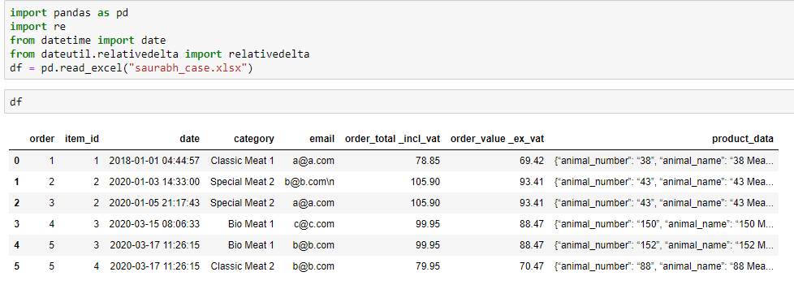
Question 2
Solution:
1st email campaign purchased special categories in the past six (6) months.
Step 1:Loaded the dataset in python

Slide 7
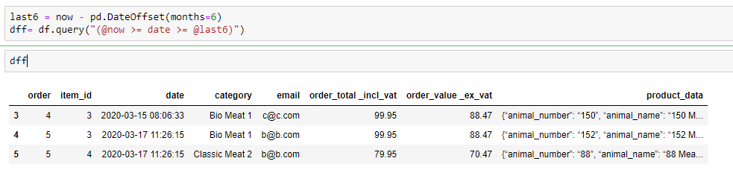
Question 2
Step 2:Calculated the dataset of last 6 months

Slide 8
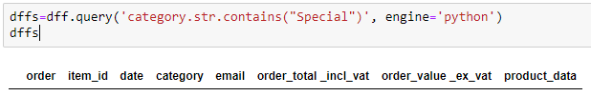
Question 2
Step 3:From the last query filter the “special” from the category column.
No data is available from past 6 months with “Special” purchased

Slide 9
Question 2
Solution: The other audience aims to reactivate existing customers that have not purchased anything in over 12 months (to bring them as revived) and it should target everyone that bought either Bio or Classic from Place 2 exclusively (assume that there are more places).
Steps followed in next slides

Slide 10
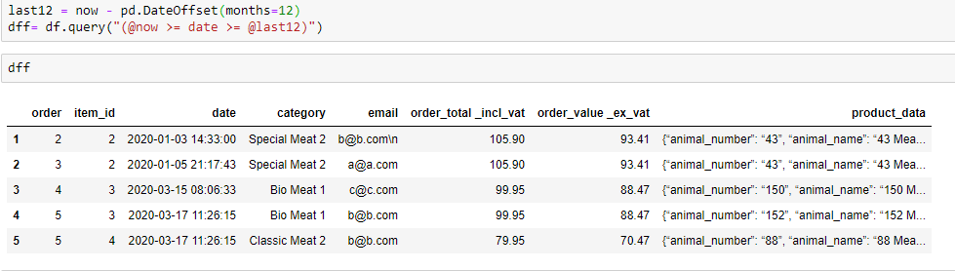
Question 2
Step 1 : I have calculated the customer purchased in 12 months.

Slide 11
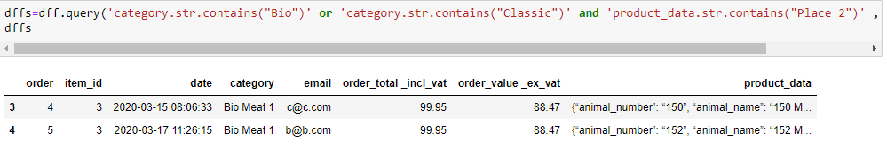
Question 2
Step 2 :From previous query filtered bio or classic and place to get the data.
This is solution of the purchased data in 12 months

Slide 12
Question 2
From previous slide it was clear there are 2 rows according to the condition mentioned in the question.
As it was stated that the customer not purchased over 12 months of the data, So it is clearly got the output

Slide 13
Question 3
AGU wants to know why the performance of the new website is not living up to the expectations. Please give a small list of the potential KPIs that you would include in your analysis (with the reason why), when trying to identify the cause behind the lack of transactions since the relaunch and potential improvements to be made (Layout, Homepage, Product Detail Pages, Checkout Process, etc). https://agu.com/de/

Slide 14
Question 3
Solution:
Key Performance Indicator(KPI)
Sales :Sales key performance indicators are measures that tell you how your business is doing in terms of conversions and revenue.
In order to explain the sales there are some related factors:
Average order size, Gross profit, Number of transactions, Conversion rate, New customer orders vs. returning customer orders, Competitive pricing.

Slide 15
Question 3
Marketing: Marketing will tell you how well you’re doing in relation to your marketing and advertising goals. These also impact your sales KPIs. Marketers use KPIs to understand which products are selling, who’s buying them, how they’re buying them, and why they’re buying them. This can help you market more strategically in the future and inform product development.
In order to explain the marketing there are some related factors:
Site traffic, social media, Average session duration, Day part monitoring, Chat sessions, Social followers and fans, Social media engagement, Clicks, Pay-per-click (PPC) traffic volume, Unsubscribes.

Slide 16
Question 3
customer service: Customer service KPIs tell you how effective your customer service is and if you’re meeting expectations. You might be wondering : what should the KPIs be in our call center, for our email support team, for our social media support team, etc. Measuring and tracking these KPIs will help you ensure you’re providing a positive customer experience.
In order to explain the customer service there are some related factors:
Customer satisfaction, Customer service email count, Customer service chat count, Active issues, Backlogs, Concern classification.

Slide 17






Thanks

