Slide 1
Fine & Course Grained Memory
By: Saurabh Roychowdhury

Slide 2
Contents
Fine Grained vs Course Grained
MTYPEs
Atomic APIs
Testcases and Results
Some Hardware Implementation Details

Slide 3
Fine Grained vs Course Grained
Fine grained and course grained differ on boundaries of synchronization.
For fine grained memory. must make system coherence happen at the points in the kernel the programmer requests it.
For coarse-grained memory, the programmer cannot attain coherency except at kernel dispatch boundaries.
MTYPEs are contained in page table entries and describe how that page will be accessed by this GPU. For multi-GPU environments, we set up a separate page table for each GPU, so a particular physical address can be accessed from different GPUs each with their own MTYPE.
Extended-Scope Fine Grained memory is a memory type that is used when the user applications want to have system-scope coherent atomics. Note that on systems with HDP, flushes are still required when using this type of memory to guarantee the system-scope coherency.

Slide 4
Fine Grained vs Course Grained
For coarse-grained memory, the programmer cannot attain coherency except at kernel dispatch boundaries. The application can decide what form of dispatch boundary coherence is needed. If kernels are launched such that they execute on the same device, we only need device scope synchronization between them if they wish to communicate. That does not require any L2 invalidation as both kernels share the same L2. If they do not communicate, then no coherence is required. So the programming language/runtime give the controls and the application decides how to use them. In ROCm we provide that control through the HSA defined AQL packet format. We implement that in CP microcode which performs the appropriate cache writeback and invalidations depending on what the packet created by the application program requests.
For fine-grained memory, the programming language/runtime provides a different set of axiomatic primitives that allow an executing kernel to communicate with another executing kernel or the CPU code. In the languages based on C++ this is done using language level atomic statements defined in terms of acquire release semantics. The compiler will typically generate specific ISA instructions for these, and will limit optimization to adhere to the formal language memory model that is defined in terms of a synchronizes-with relation that is used to define a happens-before relation. A program that does not follow the correct usage of these primitive is termed undefined behavior. The advantage is that the implementation does not have to make every program work, only those programs that follow the rules. The rules are defined to allow implementations tremendous freedom in how to implement them, and in particular allow implementations to greatly optimize the necessary work.

Slide 5
MTYPEs
MTYPE_UC: UnCached memory. When the GPU thread accesses this memory, it will not be cached in this GPU.
MTYPE_NC: Non-Coherent memory. When the GPU thread accesses this type of memory, it can be cached in the TCP and/or TCC of this GPU.
MTYPE_CC: Coherent Caching of local reads. Cached reads and uncached writes. Probes to this local memory can come in from other devices and invalidate these read-only lines.
MTYPE_RW: Read/Write coherent caching. Lot like MTYPE_NC except write-probes from other devices to this GPU's local RW memory can invalidate these lines

Slide 6
MTYPEs
Memory types not specified by programmers, depending upon:
the memory is coarse grain or fine grain
the memory mapping is for CPU or GPU access
the memory target is system memory or frame buffer (FB)
the physical connection/HW path of the memory access (xGMI or PCIe)
A+A and dGPU configuration:
dGPU-> CPU-GPU is PCIe
A+A-> CPU-GPU is XGMI

Slide 7
Difference in memory type for course grain and fine grain
CPU map of FB through PCIe (dGPU, no caching)
GPU map of sysmem throug xGMI(A+A) vmid0 is UC(explore NC)
GPU map of sysmem through PCIe (dGPU) vmid0 is UC
Below table defines the cache coherence policy (GPU page table mtype/snoop bit or CPU page table cache type: WC or WB) all the combinations.
 | GPU map of local FB (A+A) VMID0 is FB aperture (==NC) | GPU map of local FB (dGPU) VMID0 is FB aperture (==NC) | GPU map of remote FB through xGMI (A+A and dGPU) VMID0 is FB aperture (==NC) | GPU map of remote FB through PCIe (dGPU, HDP path) | SDMA access FB (A+A and dGPU) | CPU map of FB through xGMI (A+A mode) (HW managed coherece) | CPU map of FB through PCIe (dGPU, no caching) | GPU map of sysmem throug xGMI (A+A) vmid0 is UC(explore NC) | GPU map of sysmem through PCIe (dGPU) vmid0 is UC | CPU map of sysmem (dGPU and A+A)
Coarse grain | option 1: NC option 2: RW (+C to probe CPU) | option 1: NC option 2: RW | option1: NC option2: NC+C(to probe remote gL2 or CPU $) | NC (+ register HDP_MMHUB_GCC) | SDMA is not client of gL2 so regardless the mapping in PTE, SDMA access memory like UC | cached/probable (WB, like RW) CPU probe gL2 on write (like +C) Driver change see 2.3 | WC && UNCACHED | NC+C (probe CPU $) | NC+C | CACHED (WB) (Kernel is WC, see 2.5)
Fine grain | RW (+C to probe CPU) | RW | NC+C(to probe remote gL2 or CPU $) | NC(+ register HDP_MMHUB_GCC to probe GPU cache) | Same as above | cached/probable (WB, like RW) CPU probe gL2 on write (like +C) Driver change see 2.3 | WC (doesn't support fineGrain, see 2.4) todo: explore cached case. | NC+C (probe CPU $) UC+C for some special cases see 2.6 | UC+C (to probe CPU$) | CACHED (WB) (Kernel is WC, see 2.5)

Slide 8
Atomic APIs
Atomic_store_release (Flag) = 1 is equivalent to: __atomic_store(size_t size, void *ptr, void *val, int ordering)
Atomic_load_acquire (Flag) is equivalent to: __atomic_load(size_t size, void *ptr, void *ret, int ordering)
The “acquire” memory order options:
memory_order_acquire
memory_order_acquire_release,
memory_order_sequentially_consistent.
The “release” memory order options:
memory_order_release
memory_order_acquire_release,
memory_order_sequentially_consistent.
Description of these consistency models can be found in: std::memory_order - cppreference.com

Slide 9
Atomic APIs
Since we are compiling with hip, you can’t use the “ordinary” names for the memory orders and memory scopes. We must instead use:
memory_order_relaxed -> __ATOMIC_RELAXED
memory_order_acquire -> __ATOMIC_ACQUIRE
memory_order_release -> __ATOMIC_RELEASE
memory_order_acq_rel -> __ATOMIC_ACQ_REL
memory_order_seq_cst -> __ATOMIC_SEQ_CST
and similarly
memory_scope_work_item -> __OPENCL_MEMORY_SCOPE_WORK_ITEM
memory_scope_work_group -> __OPENCL_MEMORY_SCOPE_WORK_GROUP
memory_scope_device -> __OPENCL_MEMORY_SCOPE_DEVICE
memory_scope_all_svm_devices -> __OPENCL_MEMORY_SCOPE_ALL_SVM_DEVICES
memory_scope_sub_group -> __OPENCL_MEMORY_SCOPE_SUB_GROUP

Slide 10
Atomics APIs usage example
GPU1 GPU2
A = 23; while (Atomic_load_acquire (Flag) != 1)
B = 37; … = B;
Atomic_store_release (Flag) = 1; … = A;
The “release” process in the example above is what must be done at completion of work-load execution to guarantee visibility of what was produced, to other consuming GPU/CPUs.
The “acquire” process in the example above is what must be done prior to work-load start to ensure the work-load reads are getting correct data.

Slide 11
Atomic APIs
__atomic_store_n(&(((int*) kp.ptrs_done[j])[hipBlockIdx_x*nranks + myrank]), iter, __ATOMIC_RELAXED);
__atomic_load_n(&done[hipBlockIdx_x*nranks + tid], __ATOMIC_RELAXED) != iter);
memory_order_sequentially_consistent is the default option chosen by compiler when nothing is specified.
No atomic multiplication.
https://llvm.org/docs/Atomics.html#id17

Slide 12
Test Cases
If users attempt to do fine-grained (within-kernel) synchronization without properly using software-level synchronization, then their application may not work as desired. For instance, in the C++ memory model, programs that do not properly use acquire and release atomics can have data races, and the output of programs with data races is undefined. If users write correct, defined programs in these languages, then the mapping from the language to our hardware should ensure correct execution.

Slide 13
Allreduce Code
hipExtMallocWithFlags((void**)&currentData, allreduceArgs.N*sizeof(int), hipDeviceMallocFinegrained);
hipExtMallocWithFlags((void**)&currentData, allreduceArgs.N*sizeof(int), hipDeviceMallocUncached);
sum[idx] = dataA[idx] + dataB[idx];
atomicAdd(&sum[idx],data[idx]);
->can’t use hipDeviceMallocFinegrained for atomicAdd
Code: saurabhAMD/Cache_coherency: Fine grained vs course grained memory (github.com)

Slide 14
Testing Code
// --Print results after Allreduce Operation
int sum[N];
int prev[N];
for (int i = 0; i < allreduceArgs.numGPUs; ++i) {
hipSetDevice(i);
hipMemcpy(sum, allreduceArgs.recvBuffers[i], N * sizeof(int), hipMemcpyDeviceToHost);
std::cout << "GPU " << i << " has data: ";
for (int j = 0; j < N; ++j) {
std::cout << sum[j] << " ";
if((i>0) && (sum[j]!=prev[j])) std::cout<<"Error found: "<< prev[j]<< "<- ";
prev[j] = sum[j];
}
std::cout << std::endl;
}

Slide 15
Results
Total time spent for Allreduce:
For fine grained with sequential consistent memory ordering (default) : 18277.00 us., 18137.00 us, 18443.00 us.
For course grained: 16248.00 us., 16488.00 us., 16388.00 us.
Without atomic: 12649.00 us., 12666.00 us., 12798.00 us.
With atomic: 13705.00 us, 13448.00 us., 13684.00 us.

Slide 16
HDP
"Host Data Path" is a widget that sits in our GPUs between the PCIe(not xGMI) connection and the DRAM.
An important thing about HDP, as far as our memory models are concerned, is that it will temporarily buffer reads coming from PCIe-connected peer GPUs, and it will temporarily write-combine writes coming from PCIe-connected peer GPUs.
This is harmful to our memory models, because (until MI200) this can't be turned off. As such, when GPU_a writes or reads directly to GPU_b, it does not necessarily know writes will actually go to DRAM, and whether reads are seeing updated data from DRAM or previously buffered data sitting in the HDP. In addition, HDP can cause reads and writes to be silently re-ordered.

Slide 17
GPU specific cache architecture
Streaming caches
TCP - Texture Cache per processor (L1) -> Replicated with each CU to ensure full scalability of the shader system
SQC/SL1 - Sequencer instruction/data cache(s)-> Shared by all the CUs in a shader array
Sequencer Cache (SQ1) -> Shared by all the CUs in a shader array
TCC - Texture Cache per Channel (L2) -> Cache on the memory side; attached to the controllers on each channel. The TCCs see all the TCPs in the CUs; operations in TCC are atomic
CP: Command Processor
Compute Unit (CU) run multiple warps.
Local Data Share (LDS): Very close to the registers (user managed cache)
Global Data Share (GDS): Similar to the shared memory (LDS) in functionality but way smaller.

Slide 18
Cache coherence for fine & course grained
In classic kernel-boundary (coarse-grained) guarantees for system scope, the CP runs WBINVL on this local cache a system-scope acquire and does write-back on release. NC is what we've traditionally run in our GPUs.
In fine-grained models for system scope, the shader kernel must do WB (on release) or INVL (on acquire) on its local cache.
WB on release will push the modified lines (with valid bits) out to the remote owner for probing/invalidating.
This cannot be used for fine-grained coherent accesses to other GPUs, because this GPU may write to a remote location and have that write still in its cache. If another device sends a read into its memory controller, the memory controller will _not_ reach into this cache to get it. The read will be sourced from DRAM and the other device will see an old, stale value.

Slide 19
Directory Based MESI cache coherence
To reduce coherence traffic over XGMI, GPU will add probe filter (PF) as part of the CS to keep track of frame buffer memory cache lines consumed accessed by the CPU
Without a probe filter, the CS has no knowledge of where a cache line might be held and must send a multicast probe to all the CPUs in the system. GPU memory bandwidth will be limited to available link bandwidth and hence a directory is crucial to stall GPU only in cases when the data is held in the CPU cache
On a GPU read hit (RdBlkS), cache line in M/E/S will transition to S state.
On a GPU write hit, a cache line in any of the M/E/S states will be invalidated. If the CPU state is invalidated, the state of the system at the end of the transaction is that nobody has the line. PF simply doesn’t track GPU ownership.

Slide 20
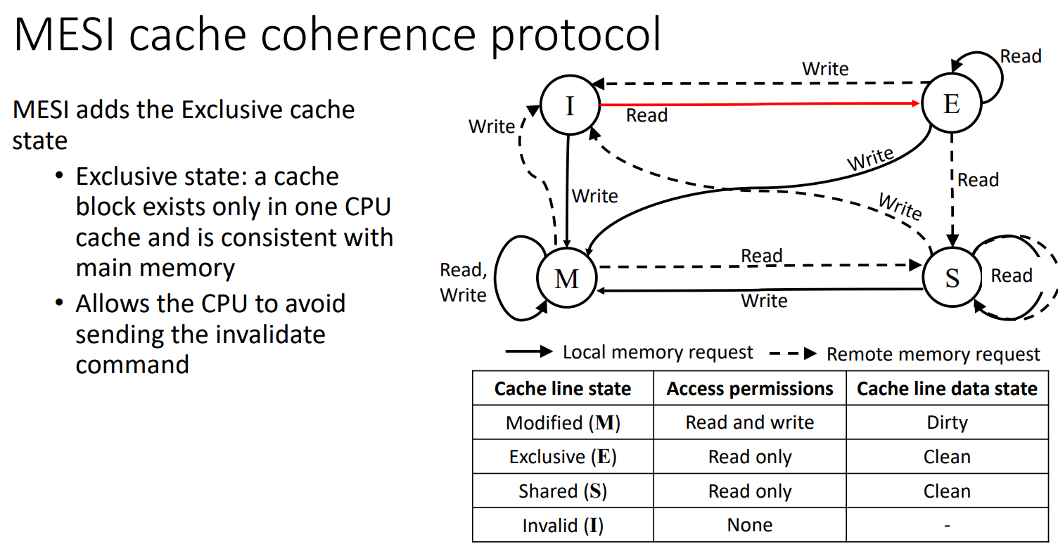
Reference: AMD DF Silicon Team

