Slide 1

SERPENT CIPHER
THE SECOND FINALIST IN AES CONTEST
security
working
about
CONCLUSION
Literature Survey
Software used
SUBMITTED BY
17BCI0044 – SHUBHAM GUPTA
17BCI0058 – SAURABH AMBAR
17BCI0145 – KUMAR ABHISHEK

Slide 2
INTRODUCTION
Serpent is a symmetric key block cipher which comes at second place in the Advanced Encryption Standard (AES) contest after Rijndael.
Serpent has a block size of 128 bits and support a key size of 256 bits. Basically, it is a 32-round permutation-substitution network which operates on a block of four 32-bit words which is total to 128 bits.
security
Literature Survey
CONCLUSION
working
about
Software used
It is inspired by ideas for bit slice implementation of ciphers. However, unlike the bit slice implementation of DES, which encrypts 64 diﬀerent blocks in parallel in order to gain extra speed, Serpent is designed to allow a single block to be encrypted eﬃciently by bit slicing.

Slide 3
Performance in various environment: On a 133MHz Pentium/MMX processor, our bitslice implementation of Serpent runs about as fast as DES: it encrypts 9,791,000 bits per second, or about 1738 clock cycles per block, while the best optimized DES implementation (Eric Young’s Libdes) encrypts 9,824,864 bits per second. We estimate that on the NIST platform of a 200 MHz Pentium, it will run at about 14.7 Mbit/s. Our bitslice Java implementation performs 10,000 encryptions in 3.3 seconds on a 133 MHz Pentium MMX which translates to 388 kbit/s, and we expect 583 kbit/s on a 200 MHz machine.
security
CONCLUSION
working
about
Software used
Literature Survey
Advocating for serpent cipher as AES(by Ross J. Anderson): Serpent should be chosen because it is most secure of the AES finalist. Not only does it have ample safety margin, but its simple structure enables us to be secure that none of the currently known attack will work. It is also simple to check that an implementation is correct.

Slide 4
Design of Serpent cipher: In the first design, the linear transformations were just bit permutations, which were applied as rotations of the 32-bit words in the bitslice implementation. In order to ensure maximal avalanche, the idea was to choose these rotations in a way that ensured maximal avalanche in the fewest number of rounds. Thus, we chose three rotations at each round: we used (0, 1, 3, 7) for the even rounds and (0, 5, 13, 22) for the odd rounds.
security
working
about
CONCLUSION
Literature Survey
Software used
The reason for this was that
rotating all four words is useless
a single set of rotations did not suffice for full avalanche
these sets of rotations have the property that no difference of pairs in either of them coincides with a difference either in the same set or the other set.

Slide 5
Total Round : 32
Plain Text : 128 bit
There are 3 steps for encryption and decryption:
1. Key Mixing
2. S box Implementation
3. Linear Transformation
Before this we need to generate keys for each round:
Given Key Length : 256 bit
Total Key required : 33 keys
(Total Round :32 Why 33 keys ??)
The given key is divided into 8 pre-keys with each consist of 32 bits. (w0,w1,w2,w3,w4,w5,w6,w7)
(8 x 32bit=256bit )
For generating keys for each (32) round we need 132 pre-keys.
security
Literature Survey
Software used
working
about
CONCLUSION

Slide 6
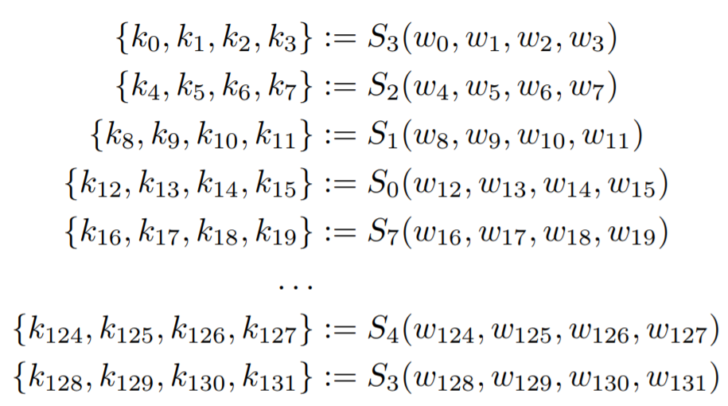
For generating w_{i} where i > 7 we use the formula:
where φ is the fractional part of the golden ratio (√5 + 1)/2
The round keys are now calculated from the pre-keys using the S-boxes. We use the S-boxes to transform the pre-keys w_{i} into words k_{i} of round key in the following way:
security
Literature Survey
CONCLUSION
working
about
Software used

Slide 7

Now we will find the final key for each round:
Where k is called pretext key
The three operations for encryption are:
Key Mixing: At each round, a 128-bit subkey Ki is exclusive-or with the current intermediate data Bi.
S-Boxes: The 128-bit combination of input and key is considered as four 32-bit words. The S-box, which is implemented as a sequence of logical operations is applied to these four words, and the result is four output words. The CPU is thus employed to execute the 32 copies of the S-box simultaneously, resulting with Si(Bi ⊕ Ki).
Linear Transformation: The 32 bits in each of the output words are linearly mixed, by
security
Literature Survey
Software used
working
about
CONCLUSION

Slide 8
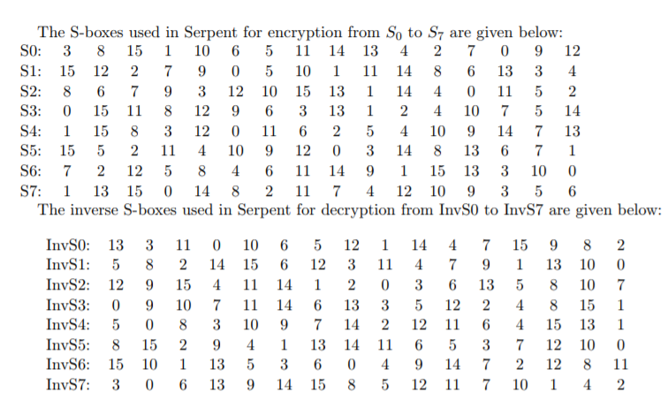
S-BOXES
security
Literature Survey
CONCLUSION
working
about
Software used

Slide 9
S-BOXES
The S-box:
The S-boxes of Serpent are 4-bit permutations with the following properties:
each differential characteristic has a probability of at most 1=4, and a one-bit input difference will never lead to a one-bit output difference;
each linear characteristic has a probability in the range 1=2 _ 1=4, and a linear relation between one single bit in the input and one single bit in the output has a probability in the range 1=2 ± 1=8;
the nonlinear order of the output bits as a function of the input bits is the maximum, namely 3.
security
Literature Survey
CONCLUSION
working
about
Software used

Slide 10
S-BOXES
The S-boxes were generated in the following manner, which was inspired by RC4. We used a matrix with 32 arrays each with 16 entries. The matrix was initialised with
the 32 rows of the DES S-boxes and transformed by swapping the entries in the r^{th} array depending on the value of the entries in the (r+1)^{st} array and on an initial string representing a key. If the resulting array has the desired (differential and linear) properties, save the array as a Serpent S-box.
security
Literature Survey
CONCLUSION
working
about
Software used
Repeat the procedure until 8 S-boxes have been generated. More formally, let serpent[°] be an array containing the least significant four bits of each of the 16 ASCII characters in the expression “sboxesforserpent".

Slide 11
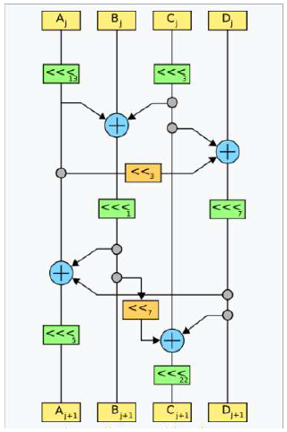
LINEAR TRANSFORMATION
<<< - CIRCULAR ROTIONAL
13- ONE BY ONE 13 BIT
<< - CIRCULAR SHIFT
security
Literature Survey
CONCLUSION
working
about
Software used

Slide 12
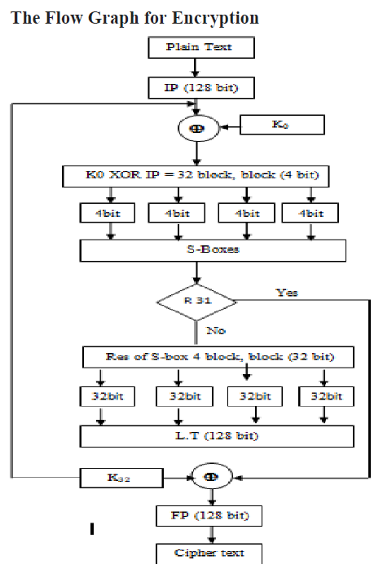
security
Literature Survey
CONCLUSION
working
about
Software used

Slide 13
Decryption:
Decryption is diﬀerent from encryption in that the inverse of the S-boxes must be used in the reverse order, as well as the inverse linear transformation and reverse order of the subkeys.
security
Literature Survey
CONCLUSION
working
about
Software used

Slide 14
Security
01
02
03
The XSL attack, if effective, would weaken Serpent (though not as much as it would weaken Rijndael, which became AES). However, many cryptanalysts believe that once implementation considerations are taken into account the XSL attack would be more expensive than a brute force attack.
security
conclusion
working
about
Software used
Literature Survey
In 2000, a paper by Kohno et al. presents a meet-in-the-middle attack against 6 of 32 rounds of Serpent and an amplified boomerang attack against 9 of 32 rounds in Serpent.
A 2001 attack by Eli Biham, Orr Dunkelman and Nathan Keller presents a linear cryptanalysis attack that breaks 10 of 32 rounds of Serpent-128 with 2¹¹⁸ known plaintexts and 2⁸⁹ time, and 11 rounds of Serpent-192/256 with 2¹¹⁸ known plaintexts and 2¹⁸⁷ time.

Slide 15
Security
01
02
03
A 2009 paper has noticed that the nonlinear order of Serpent S-boxes were not 3 as was claimed by the designers.
security
conclusion
working
about
Software used
Literature Survey
A 2011 attack by Hongjun Wu, Huaxiong Wang and Phuong Ha Nguyen, also using linear cryptanalysis, breaks
rounds of Serpent-128 with 2¹¹⁶ known plaintexts,
^{107.5} time and 2¹⁰⁴memory.
The same paper also describes two attacks which break 12 rounds of Serpent-256. The first requires 2¹¹⁸ known plaintexts, 2^{228.8} time and 2²²⁸ memory.

Slide 16
Software Used:
C++, ubuntu terminal
security
conclusion
working
about
Software used
Literature Survey

Slide 17
We have presented a cipher which is as fast as DES, and we believe it to be more secure than three-key triple DES. It is believe that it would still be as secure as three-key triple DES if its number of rounds were reduced by half. Its security is partially based on the reuse of the thoroughly studied components of DES, and even although the final version of the cipher no longer reuses the DES S-boxes, we can still draw on the wide literature of block cipher cryptanalysis. Our design strategy should also give a high level of confidence that we have not inserted any trapdoors. The algorithm's performance comes from allowing an efficient bitslice implementation on a range of processors, including the market leading Intel/MMX and compatible chips.
security
conclusion
working
about
Software used
Literature Survey

Slide 18
References:
DG Abraham, GM Dolan, GP Double, JV Stevens, \Transaction Security System", in IBM Systems Journal vno 2 (1991) pp 206-229
RJ Anderson, \UEPS | a Second Generation Electronic Wallet" in Computer Security | ESORICS 92, Springer LNCS vol 648 pp 411-418
3. RJ Anderson, SJ Bezuidenhoudt, \On the Reliability of Electronic Payment Systems", in IEEE Transactions on Software Engineering v 22 no 5 (May 1996) pp 294-301
4. RJ Anderson, MG Kuhn, \Tamper Resistance | a Cautionary Note", in The Second USENIX Workshop on Electronic Commerce Proceedings (Nov 1996) pp 1-11 5. RJ Anderson, MG Kuhn, \Low Cost Attacks on Tamper Resistant Devices", in Security Protocols | Proceedings of the 5th International Workshop, Springer LNCS v 1361 pp 125-136
security
conclusion
working
about
Software used
Literature Survey
5. RJ Anderson, MG Kuhn, \Tamper Resistance | a Cautionary Note", in The Second USENIX Workshop on Electronic Commerce Proceedings (Nov 1996) pp 1-11
E Biham, \A Fast New DES Implementation in Software", in Fast Software Encryption | 4th International Workshop, FSE '97, Springer LNCS v 1267 pp 260-2717. E Biham, \Higher Order Di_erential Cryptanalysis", unpublished paper, 19948. E Biham, How to Forge DES-Encrypted Messages in 228 Steps, Technical ReportCS884, Technion, August 1996.

