Slide 1


Seminar
Sardar Vallabhbhai National Institute Of Technology, Surat
Department of Computer Science and Engineering
Subject:
Design and Analysis of Algorithm
Topic :
“Maximum profit in share market”
Submitted by
Joshi Prashant Manubhai(U19CS005)
Amin Saurabhkumar Rajeshbhai(U19CS007)
Vaghela Jaykumar harjibhai(U19CS013)
Sandeep Rathod(U19CS022)
Submitted to
Dr. Keyur Parmar
(Assistant Professor)

Slide 2
Problem Statement:
We are given stock prices of certain days and we have to maximize the profit by doing at most ‘k’ transaction
Condition: Transaction cannot have in parallel one transaction has to end before other starts
Example:
Array of prize is given below of 6 days and at most ‘k’ transaction is given and output will be maximum profit of k transaction.
Input:
Price = {10,22,5,75,65,80}
k = 2
Output: 87
Explanation: We buy at price 10 and sell at 22 so profit would be 12.(1st transaction)
again we buy at price 5 and sell at 80 so profit would be 75.(2nd transaction)
total profit = 75 + 12 = 87

Slide 3
Naive recursive solution of MPS problem
GOAL : TO FIND THE MAXIMUM PROFIT BY SELLING THE STOCKS
WITH K TRANSACTOINS
WITH AN EXAMPLE WITH TABULAR COLUMN
EXAMPLE : LET THE GIVEN STOCK VALUES OF 7 DAYS BE
[43 , 52 , 45 , 78 , 69 , 72 , 50]
THE TRANSCTOINS ALLOWED ARE 3.
FROM THE QUESTION THE MAXIMUM TRANSACTIONS
ALLOWED THAT IS K = 3.

Slide 4
FROM THE PROBLEM HERE
In The tabular column
Row are transactions (0-3)
And columns are days(1-7) And includes the prize of stocks of that day
 | 1-[43] | 2-[52] | 3-[45] | 4-[78] | 5-[69] | 6-[72] | 7-[50]
1 | 0
2 | 0
3 | 0
1ST COLUMN IS ALL ARE ZERO AS THERE IS NO PROFIT FROM THE 1ST DAY THERE WE
CAN JUST BUY

Slide 5
ADDING VALUES IN TABULAR COLUMN
IN THE FIRST ROW WHERE 1 TRANSCATIONS IS POSIBLE
WE ARE GOING TO SUBRACT THE THE CURRENT VALULE OF STOCKS WITH
EACH DAY’S STOCK VALUE AND CHOOSING THE MAXIMUM OF ALL
WE GET THE MAX PROFIT
SO THE 2ND ROW FILLS UP
 | 1-[43] | 2-[52] | 3-[45] | 4-[78] | 5-[69] | 6-[72] | 7-[50]
1 | 0 | 9 | 9 | 35 | 35 | 35 | 35
2 | 0
3 | 0
SO FROM THE TABLE VALUES WE THE MAXIMUM PROFIT FROM THE CURRENT STOCK PRIZE IS LESS THAN THE PREVIOUS PROFIT
SO FOR ROW 1 WE CAN DEDUSE A FROMULA IN THE NEXT SLIDE

Slide 6
DEDUSING THE FORMULA WHEN K = 1
SO AS FROM THE PREVIOUS SLIDE DISCUSSION THE FOUMULA FOR THE FIRST ROW WILL BE
P[ 1 ][ i ] = MAX( P[ 1 ][ i-1 ] , MAX(P[ i ] – P[ j ]) )
j IN RANGE [1 TO i-1]
WHERE HERE
P[ 1 ][ I ] : IS THE PROFIT WITH 1 TRASACTION AND IN THE i th DAY
HERE WE ARE TAKING THE MAX OF OF
ALL STOCK EXCHANGE VALUES WITH THE PREVIOUS DAYS PROFIT
AND J IS GONNA RUN FROM 1 TO i-1
FORM 1ST DAY TO THE i-1 th DAY

Slide 7
ADDING VALUES IN 2ND ROW TABULAR COLUMN
IN THE SECOND ROW WHERE K=2 TRANSCATIONS IS POSIBLE
WE ARE GOING TO SUBRACT THE THE i th DAY OF STOCKS WITH
ROW VALUE OF SAME COLUMN BECAUSE
IN THE PREVIOUS ROW OF THE SAME COLUMN WE ARE GOING TO HAVE
THE MAXIMUM PROFIT WITH THE “K-1” TRASACTIONS TILL i th DAY
AND WITH THAT WITH EACH DAY
SO THE 2ND ROW FILLS UP
 | 1-[43] | 2-[52] | 3-[45] | 4-[78] | 5-[69] | 6-[72] | 7-[50]
1 | 0 | 9 | 9 | 35 | 35 | 35 | 35
2 | 0 | 52-43+0 =9 | 9 | 78-45+9=42 | 42 | 42 | 42
3 | 0
HERE (2,3) IS FILLED WITH DIRECT 9 AS ITS MAX VALUE IS LESS THAN PREVIOUS CALCULETED
SO THE UPDATED FORMULA FOR ALL ROWS IS IN THE NEXT SLIDE

Slide 8
DEDUSING THE FORMULA WHEN FOR ALL K VALUES
SO AS FROM THE PREVIOUS SLIDE DISCUSSION THE FOUMULA FOR THE FIRST ROW
WAS
P[ 1 ][ i ] = MAX( P[ 1 ][ i-1 ] , MAX(P[ i ] – P[ j ]) )
j IN RANGE [1 TO i-1]
AS WE ARE ADDING THE PREVIOUS TARSACTIONS MAX PROFIT
IN THE PREVIOUS SLIDE THE UPDATED FORMULA WILL BE
P[ K ][ i ] = MAX( P[ K ][ i-1 ] , MAX(P[ i ] – P[ j ] + P[K-1][J]) )
j IN RANGE [1 TO i-1]
THE ADDITIONAL ADDED P[K-1][J] IS THE MAX PROFIT GOT WITH K-1 TRANSACTIONS TILL J th DAY
USING THIS FORMULA LETS CALCULATE THE NEXT ROW VALUE

Slide 9
ADDING VALUES IN 3RD ROW TABULAR COLUMN USING FORMULA
THE FORMULA IS
P[ K ][ i ] = MAX( P[ K ][ i-1 ] , MAX(P[ i ] – P[ j ] + P[K-1][j]) )
j IN RANGE [1 TO i-1]
FOR K = 3 FILLING THE TABLE
 | 1-[43] | 2-[52] | 3-[45] | 4-[78] | 5-[69] | 6-[72] | 7-[50]
1 | 0 | 9 | 9 | 35 | 35 | 35 | 35
2 | 0 | 9 | 9 | 42 | 42 | 42 | 42
3 | 0 | 9 | 9 | 42 | 42 | 45 | 45
SO THE MAXIMUM PROFIT IS THE LAST ELEMENT OF THE TABULAR COLUMN IS = 45.

Slide 10
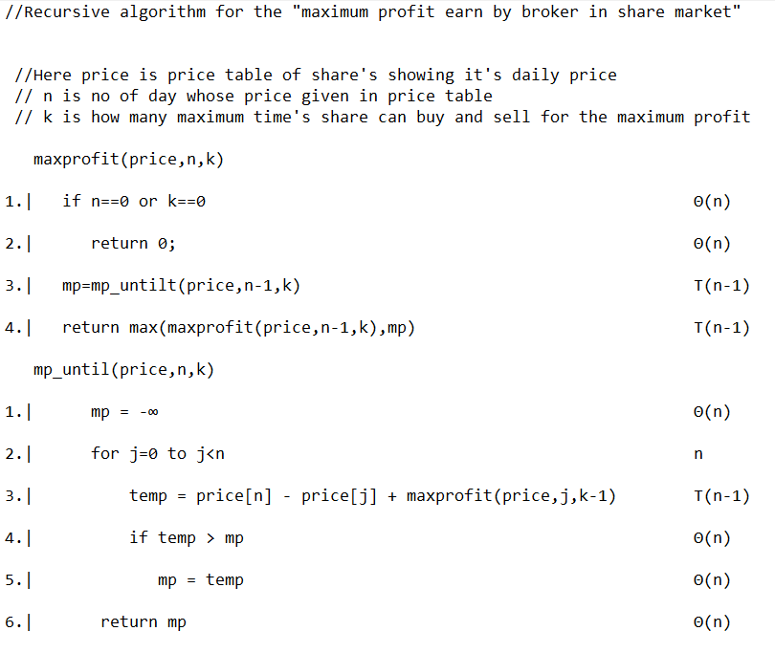
cost

Slide 11
Time Complexity calculation:
  as above we got recurrence relation as below
  T(n) = 2T(n-1) + c ------------------------(1)
  T(1) = c = 1
  T(n) = 2T(n-1) + 1 -------------------------(2)
  T(n-1) = 2T(n-2) + 1
  T(n-3) = 2T(n-3) + 1
  For equation (1) we got
  T(n) = 2(2T(n-2) + 1) +1
  = 4(2T(n-3) + 1) + 3
  = 8T(n-3) + 7
  = 2³T(n-3) //removing the constant term 7
  for k^{th} term we get below equation
  T(n) = 2^{k}T(n-k)
  T(n-k) = 1
  T(n) = O(2^{k})
  So the time complexity will be exponential;

Slide 12
Dynamic Method solution of MPS problem
TO APPLY THE DYNAMIC METHOD THE PROBLEM SHOULD SATISFY THE
1.) OVERLAPPING SUB PROBLEM
2.) OPTIMAL SUB STRUCTURE PROPERTY
1.) OVERLAPPING SUB PROBLEM
For the “mps” problem the formula for solving it is
mp = max( mp , price[j] - price[m] + profit[i-1][m]
profit[i][j] = max( profit[i][j-1] , mp )
For these when we have to find profit for lets take i=3 and m=4
profit[2][4] profit[3][3]
profit[1][4] profit[2][3] profit[2][3] profit[3][2]
SO HERE WE CAN SEE THAT OVERLAPPING SUBPROBLEM PROPERTY SATISFY BY “MPS” PROBLEM

Slide 13
2.) OPTIMAL SUB STRUCTURE PROPERTY
mp = max( mp , price[j] - price[m] + profit[i-1][m]
profit[i][j] = max( profit[i][j-1] , mp )
LETS TAKE THAT THAT OPTIMAL SOLUTION DOESN’T CONTAIN OPTIMAL SUBPROBLEM MEANS MAX.PROFIT OF PROFIT[I][M] POSES WHEN THE PROFIT GENERATED BY THE PROFIT[I-1][M] IS NOT MAX.
SO IF WE REPLACE PROFIT[I-1][M] BY IT’S MAX. PROFIT THAN WE GET THE PROFIT[I][M] HIGHER THAN PREVIOUS WHICH IS CONTRADICT WITH THE OPTIMAL SOLUTION IS PROFIT[I][M]
SO WE CAN SAY THAT THE MAIN PROBLEM GIVES THE OPTIMAL SOLUTION ONLY WHEN RELATED SUBPROBLEM ALSO GIVE THE OPTIMAL SOLUTION.
THE GIVEN PROBLEM IS SATISFYING BOTH OF THE PROPERTY SO WE CAN APPLY THE DYNAMIC METHOD TO SOLVE IT.
AS THE DYNAMIC METHOD TO SOLVE ANY PROBLEM IT HAS TWO METHOD
I.) TOP DOWN
II.) BOTTOM UP
GENERALLY TOP DOWN METHOD USES THE RECURSIVE APPROACH AND THE BOTTOM UP METHOD USES THE ITERATIVE APPROACH TO SOLVE THE PROBLEM BY THE RESPECTIVE METHOD.

Slide 14
BOTTOM UP
GOAL : TO FIND THE MAXIMUM PROFIT BY SELLING THE STOCKS
WITH K TRANSACTOINS
WITH AN EXAMPLE WITH TABULAR COLUMN
IN BOTTOM UP HERE WE ARE USING THE ITERATIVE METHOD TO SOLVE THE GIVEN PROBLEM STATEMENT.
AS IT IS BOTTOM UP DYNAMIC APPROACH SO WE JUST SOLVE EACH UNIQUE QUESTION ONLY ONE TIME AFTER THAT WHEN EVER THE SAME QUESTION APPEARS AGAIN IN THE PROBLEM WE JUST REUSE THE STORED ANS FOR THAT OVERLAPPING SUBPROBLEM.
FOR THE BOTTOM UP METHOD WE ARE STARTING FROM THE LEAST POSSIBLE NUMBER OF MEMBERS TO THE MAXIMUM NUMBER OF POSSIBLE MEMBERS.
FOR OUR QUESTION THE MINIMUM NUMBER OF THE TRANSACTION AND THE MINIMUM DAYS FOR THE SHARE BUY AND SELL IS STARTS WITH ONE AND IT WILL GO THE AS MAXIMUM VALUE OF TRANSACTION AND DAYS GIVEN ACCORDING TO THE QUESTION.
FOR THE ZERO TRANSACTION OR ZERO DAYS WE ARE TAKING ITS MAXIMUM PROFIT GENERATION AS ZERO.

Slide 15
ITS DYNAMIC BOTTOM UP SOLUTION ALGORITHM IS GIVEN AS BELOW BUT HERE SOME ASSUMTION FOR THE QUESTION ARE GIVEN AS BELOW
//Dynamic[Bottom up] algorithm for the "maximum profit earn by broker in share market"
//Here price is price table of share's showing it's daily price
// n is no of day whose price given in price table
// k is how many maximum time's share can buy and sell for the maximum profit

Slide 16
maxprofit(price,n,k)
cost
1.| profit [k+1][n+1] // stores the maximum profit of at most | Θ(n)
k+1 transaction up to n+1 day |
2.| for i = 0 to i <= k | (k+1)
|
3.| pofit[i][0] = 0 | (k)
|
4.| for j = 0 to j <= n | (n+1)
|
5.| profit[0][j] = 0 | (n)
|
6.| for i = 1 to i <= k | (k+1)
|
7.| for j = 1 to j < n | (k+1)(n)
|
8.| mp = -∞ | (k+1)(n)
|
9.| for m = 0 to m < j | (k+1)(n)∑ ^{n}_{j=1}(j)
|
10.| mp = max( mp , price[j] - price[m] + profit[i-1][m] | (k+1)(n)∑ ^{n}_{j=1}(j)
|
11.| profit[i][j] = max( profit[i][j-1] , mp ) | (k+1)(n)
|
12.| return profit[k][n-1] | (n)

Slide 17
Time complexity:
in above pseudo code we can see that the time complexity
will be dominated By line number 9 and 10 by observing the loops we will be getting time complexity as O(kn²).

Slide 18
Solution of MPS Problem using Top Down Method
DEFINITION OF TOP DOWN APPROACH :
Top-Down breaks the large problem into multiple subproblems. if the subproblem solved already just reuse the answer. Otherwise, Solve the subproblem and store the result.
Top-Down uses memoization to avoid recomputing the same subproblem again.

Slide 19
MEMOIZATION :
Memoization is a technique for improving the performance of recursive algorithms.
It involves rewriting the recursive algorithm so that as answers to problems are found, they are stored in an array.
Recursive calls can look up results in the array rather than having to recalculate them.
OVERLAPPING PROBLEM :
A problem is said to have overlapping subproblems if the problem can be broken down into subproblems which are reused several times or a recursive algorithm for the problem solves the same subproblem over and over rather than always generating new subproblems

Slide 20
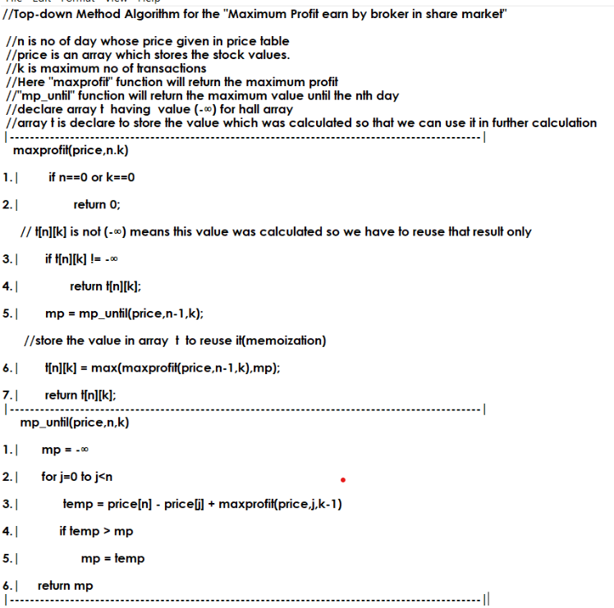

Slide 21
Time Complexity:
  As we are memoizing the result so we are going to solve maximum n*k subproblems As The size of the array.
  And the overlapping problem result are directly called from the array
  So time complexity of the problem will be reduced to exponential to kn² times.
  We are taking n² time to calculate the each day’s profit.

Slide 22
Thank You

