Slide 1
ELK Stack
Elasticsearch – Logstash - Kibana
Installation on CentOS 7
https://github.com/saurabharch/rollout

Slide 2

The pieces
Client
Filebeat
ELK Server
Logstash
Elasticsearch
Kibana
Nginx

Slide 3
Elasticsearch
Logs Storage
Requires Java 8 or later
Installation methods
  Tar ball (.zip/.tar.gz)
  Manual RPM
  Using Yum Repository
Ports
  9200 (REST)
  9300 (Node communications)
Config file - /etc/elasticsearch/elasticsearch.yml
Log files - /var/log/elasticsearch
Tweak to enable Journal logging

Slide 4
Kibana
Logs Visualization
Installation methods
  Tar ball (.zip/.tar.gz)
  Manual RPM
  Using Yum Repository
Ports
  5601 (localhost)
  Use Nginx as reverse proxy
Config file - /etc/kibana/kibana.yml
Log files
  Journal enabled (journalctl -f --unit=kibana)

Slide 5
Nginx
Reverse Proxy
/etc/nginx/nginx.conf
  Delete the default server block
/etc/nginx/conf.d/kibana.conf
server {
listen 80;
server_name server.example.com;
location / {
proxy_pass http://localhost:5601;
}
}

Slide 6
Logstash
Receive, process and index logs
Installation methods
  Tar ball (.zip/.tar.gz)
  Manual RPM
  Using Yum Repository
Ports
  5601 (localhost)
  Use Nginx as reverse proxy
Config file - /etc/kibana/kibana.yml
Log files
  Journal enabled (journalctl -f --unit=kibana)

Slide 7
Filebeat
Data collection and shipping
Installation methods
  Tar ball (.zip/.tar.gz)
  Manual RPM
  Using Yum Repository
Config file - /etc/filebeat/filebeat.yml
Log files
  /var/log/filebeat
  Journal enabled (journalctl -f --unit=filebeat)

Slide 8
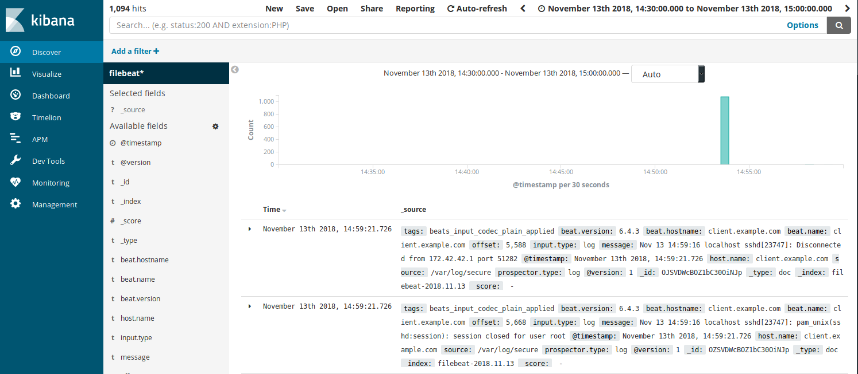
Kibana Dashboard

Slide 9
Thank You
By Rollout Team

