Slide 2
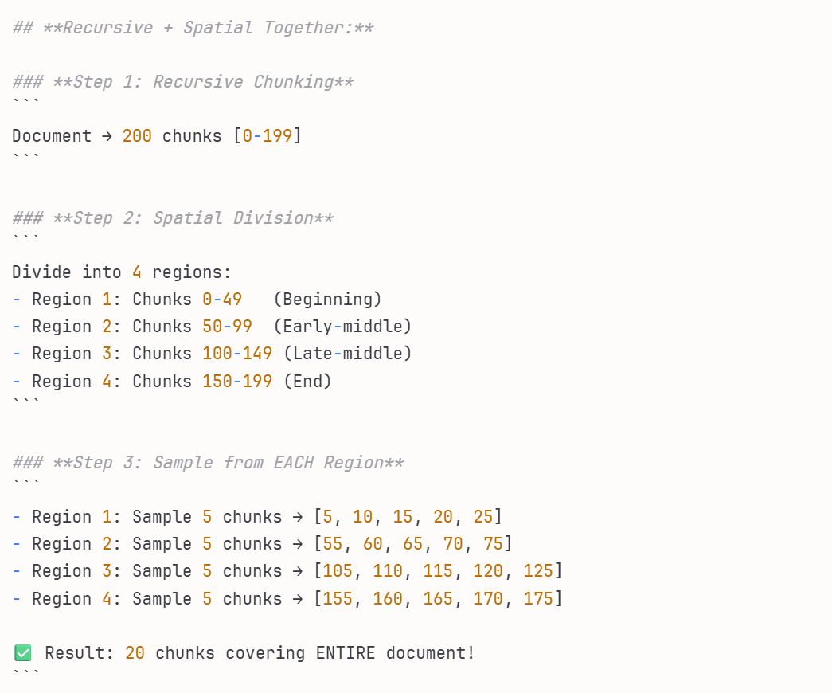

Slide 3
# STEP 1: Prepare 20 positions for questions
positions = [0, 1, 2, 3, 4, 5, 6, 7, 8, 9, 10, 11, 12, 13, 14, 15, 16, 17, 18, 19]
# STEP 2: Randomly decide which positions are multi-turn (BEFORE generating)
multi_turn_ratio = 0.40 # 40%
n_multiturn = int(20 * 0.40) # = 8 positions
# Randomly pick 8 positions
multiturn_indices = np.random.choice(20, 8, replace=False)
# Result: [2, 5, 7, 9, 12, 15, 17, 19] ← These will be multi-turn
# STEP 3: Generate questions
for idx in range(20):
# Generate initial question using LLM
question = llm.generate(chunk, type) # ← LLM generates the question
# Mark it based on our pre-decided list
if idx in multiturn_indices: # ← WE decide, not LLM!
question['conversation_type'] = 'multi_turn'
# Later, generate follow-ups
else:
question['conversation_type'] = 'single_turn'
# No follow-ups needed

Slide 4
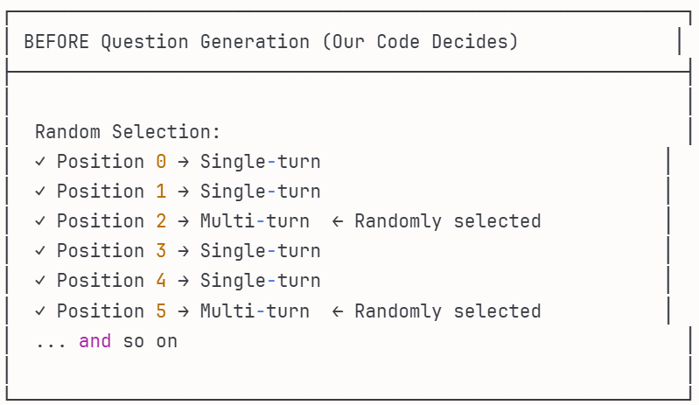
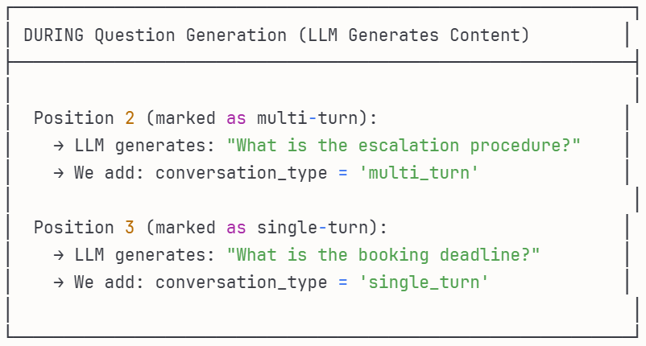
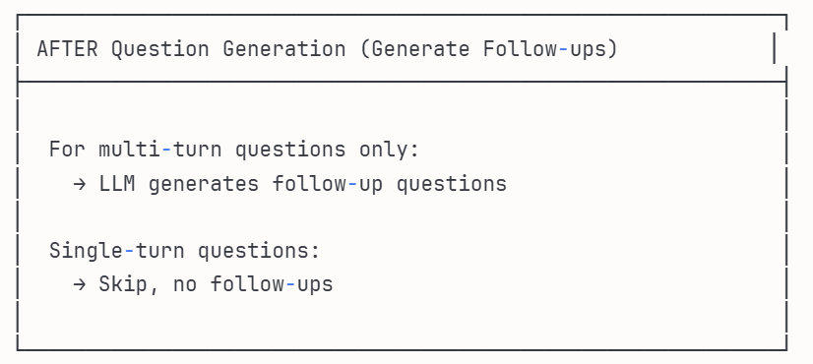

Slide 5
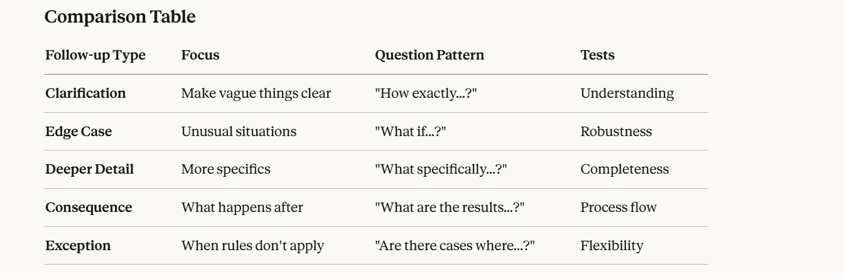

Slide 6
Turn 1 (Initial):
Q: "What is the escalation procedure for compliance issues?"
A: "Contact the compliance officer within 2 hours of discovery."
Turn 2 (Clarification):
Q: "How should I contact the compliance officer - email or phone?"
A: "Phone call first, then email confirmation within 30 minutes."
Turn 3 (Edge Case):
Q: "What if the compliance officer is on vacation?"
A: "Contact the backup officer listed in the escalation matrix."
Turn 4 (Deeper Detail):
Q: "What specific information must be included in the email confirmation?"
A: "Issue description, discovery time, potential impact, and initial assessment."
Turn 5 (Consequence):
Q: "What happens after the compliance officer is notified?"
A: "They will conduct an investigation within 24 hours and provide remediation steps."
Turn 6 (Exception):
Q: "Are there any situations where the 2-hour notification requirement doesn't apply?"
A: "Low-severity issues flagged by automated systems can be batched for next-day review."

