Slide 1
Sales & Financial Performance Dashboard
Task 4 — Data Analyst Internship | Dashboard Design

Slide 2
Objective & Dashboard Design
Create an interactive view of sales and financial performance for business stakeholders.
Use KPI cards for Total Sales, Total Profit, Orders, and Profit Margin.
Use a consistent visual theme and clear labels for quick interpretation.
Provide date, region, and category filters so users can explore the data.

Slide 3
KPIs & Visuals
KPI cards: summarize business performance at a glance.
Line chart: shows monthly sales and profit trends over time.
Grouped bar chart: compares sales and profit across regions.
Category/product charts: highlight sales contribution and top-selling products.
Data table and CSV download: support detailed follow-up analysis.

Slide 4
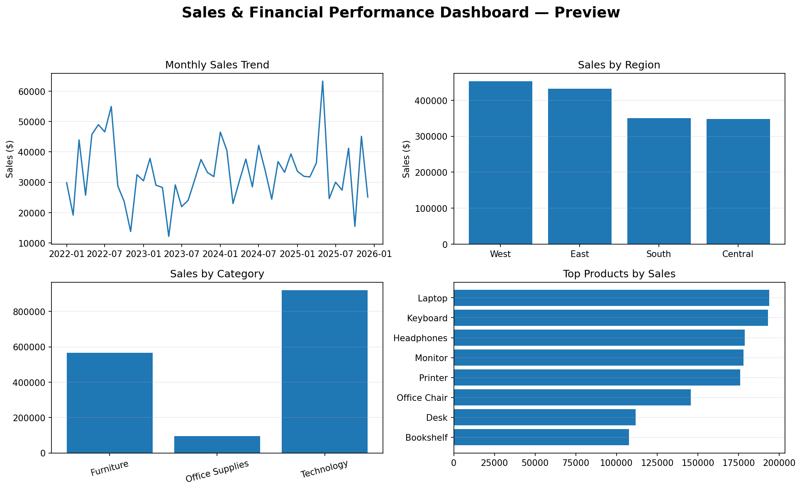
Dashboard Preview

Slide 5
Business Questions & Decisions
Which region and category contribute most to sales?
Are sales and profit moving in the same direction over time?
Which products deserve more attention based on sales contribution?
Recommended next step: investigate low-profit products and regions before increasing discounts.
Use the filters to validate whether a pattern holds across different periods and categories.

Slide 6
Tools, Dataset & Limitations
Tools: Python, Pandas, Streamlit, Plotly, and PowerPoint.
Streamlit is used as a free interactive alternative to Power BI/Tableau.
The included CSV is generated sample data for a ready-to-run demo.
For strict compliance with the task sheet, replace the sample CSV with a licensed Kaggle Sales/Financial dataset.
The dashboard is an app, not a Power BI .pbix or Tableau workbook.

