Slide 1
Business Objectives
Identify the reasons behind low sales
Understand the best-selling and least-selling pizzas
Analyze order peak hours and customer behavior
Develop data-driven strategies to increase revenue
This analysis will help the restaurant improve its pricing, inventory planning, promotions, and customer service, enabling the business to grow faster and remain consistently profitable.

Slide 2

Retrieve the total number of orders placed.
SELECT COUNT(order_id)as total_orders FROM orders

Slide 3

Calculate the total revenue generated from pizza sales.
select round(sum (order_details.quantity * pizzas.price), 2) as total_revenue
from order_details join pizzas
on order_details . pizza_id = pizzas. pizza_id

Slide 4

Identify the highest-priced pizza.
select top 1 pizza_types.name , pizzas.price
from pizza_types join pizzas
on pizza_types.pizza_type_id = pizzas.pizza_type_id
order by pizzas.price desc

Slide 5
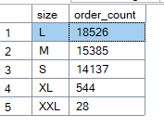
Identify the most common pizza size ordered.
select pizzas.size ,count(order_details.order_details_id) as order_count
from pizzas join order_details
on pizzas.pizza_id = order_details.pizza_id
group by pizzas.size order by order_count desc

Slide 6
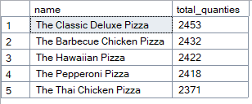
List the top 5 most ordered pizza types along with their quantities.
select top (5) pizza_types.name ,sum(order_details.quantity) as total_quanties
from pizza_types join pizzas
on pizza_types.pizza_type_id = pizzas.pizza_type_id
join order_details
on order_details.pizza_id = pizzas.pizza_id
group by pizza_types.name order by total_quanties desc

Slide 7
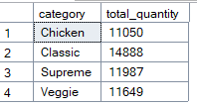
Join the necessary tables to find the total quantity of each pizza category ordered.
select pizza_types.category, sum(order_details.quantity) as total_quantity from
pizzas join order_details
on pizzas.pizza_id = order_details.pizza_id
join pizza_types
on pizza_types.pizza_type_id = pizzas.pizza_type_id
group by pizza_types.category

Slide 8
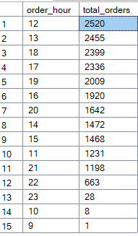
Determine the distribution of orders by hour of the day.
select datepart (hour ,time) as order_hour, count(order_id)as total_orders from orders
group by datepart (hour ,time)
order by total_orders desc

Slide 9
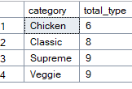
Join relevant tables to find the category-wise distribution of pizzas.
select category , count(name)as total_type from pizza_types
group by category

Slide 10

Group the orders by date and calculate the average number of pizzas ordered per day.
select avg (quantity) as per_day_avg from
(select orders.date , sum (order_details.quantity ) as quantity from
orders join order_details
on orders.order_id = order_details.order_id
group by date) as order_quantity

Slide 11

Q11.Determine the top 3 most ordered pizza types based on revenue.
select top (3) pizza_types.name,sum (pizzas.price* order_details.quantity) as total_revenue from
pizzas join order_details
on pizzas.pizza_id = order_details.pizza_id
join pizza_types
on pizzas.pizza_type_id = pizza_types.pizza_type_id
group by name
order by total_revenue desc

Slide 12
Calculate the percentage contribution of each pizza type to total revenue.
Select pizza_types.category,round(sum(pizzas.price* order_details.quantity)/(select sum (order_details.quantity * pizzas.price)
from order_details join pizzas
on order_details . pizza_id = pizzas. pizza_id)*100,2)
as total_revenue from
pizzas join order_details
on pizzas.pizza_id = order_details.pizza_id
join pizza_types
on pizzas.pizza_type_id = pizza_types.pizza_type_id
group by category
order by total_revenue desc
------------------------------------------------------------------------------------
with pizza_category as (
select pizza_types.category,sum(pizzas.price*order_details.quantity) as total_revenue
from order_details join pizzas
on order_details.pizza_id = pizzas.pizza_id
join pizza_types
on pizza_types.pizza_type_id = pizzas.pizza_type_id
group by category
),
total_revenue as(
select round(sum (order_details.quantity * pizzas.price), 2) as total_revenue
from order_details join pizzas
on order_details . pizza_id = pizzas. pizza_id
)
select pizza_category.category , pizza_category.total_revenue ,round((pizza_category.category/total_revenue.total_revenue)*100,2) as p
from pizza_category
cross join total_revenue

Slide 13
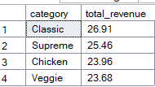

Slide 14
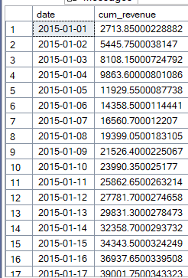
        Analyze the cumulative revenue generated over time.
select date,sum(total_revenue) over (order by date) as cum_revenue from
(select orders.date ,
sum(pizzas.price * order_details.quantity) as total_revenue from pizzas
join order_details
on order_details.pizza_id = pizzas.pizza_id
join orders
on orders.order_id = order_details.order_id
group by date) as sales

Slide 15
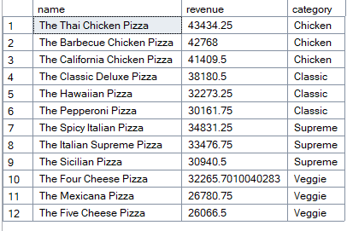
Determine the top 3 most ordered pizza types based on revenue for each pizza category
select name , revenue ,category from
(select category ,name, revenue ,
rank() over(partition by category order by revenue desc ) as rn
from
(select pizza_types.category , pizza_types.name,sum((order_details.quantity)*pizzas.price) as revenue
from pizza_types join pizzas
on pizza_types.pizza_type_id = pizzas.pizza_type_id
join order_details
on order_details.pizza_id = pizzas.pizza_id
group by pizza_types.category , pizza_types.name) as a) as b
where rn <= 3

