Slide 2
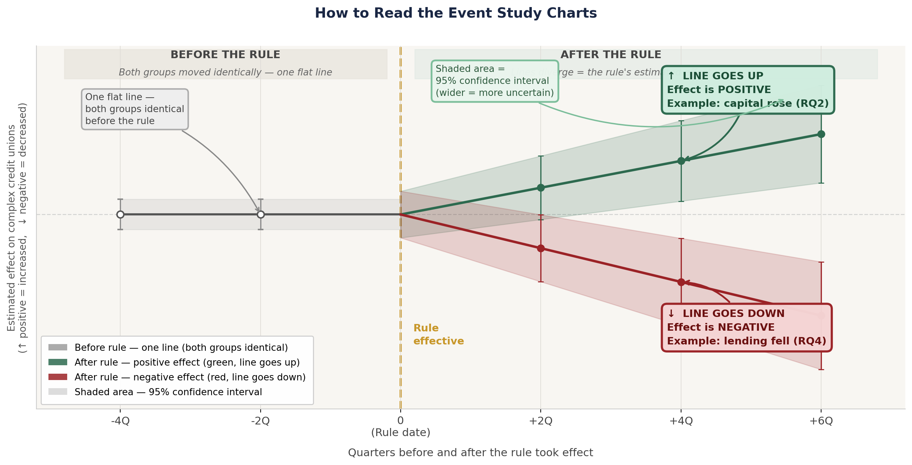
What We Studied — and How
THE DATA
HOW TO READ THE EVENT STUDY CHARTS
696 complex credit unions — avg assets ≥ $500M, classified using 2021 data
~4,488 non-complex credit unions as the comparison group
150,000+ CU-quarters of NCUA Call Report data, 2000–2025
12 outcomes: capital, loan rates, volume, portfolio mix, profitability, loan quality
▶ Before Q0 — flat lines near zero: both groups moved together. The comparison is valid.
▶ After Q0 — line moves away from zero: that movement is the rule’s estimated effect on complex CUs.
▶ Shaded band: uncertainty range. If it crosses zero, the effect at that point is not statistically conclusive.
THE RULE’S TIMELINE
↑ UP = increased ↓ DOWN = decreased (relative to non-complex CUs, after Q0)
2014–2015
Rule first proposed by NCUA; revised after industry comment
2015–2021
Implementation delayed multiple times due to industry pushback and congressional scrutiny
Jan 2022
Rule takes effect — institutions had 7+ years of advance notice
THE METHOD: DIFFERENCE-IN-DIFFERENCES (DiD)
Change in
complex CUs
Change in
non-complex CUs
The Rule’s Effect
−
=
Before vs. after rule
Same time window
Isolated from
the economy
Why this works: Non-complex CUs faced the same economic conditions but were not subject to the RBC rule. Any difference between the two groups, after accounting for pre-existing trends, isolates the rule’s effect.

