Slide 1


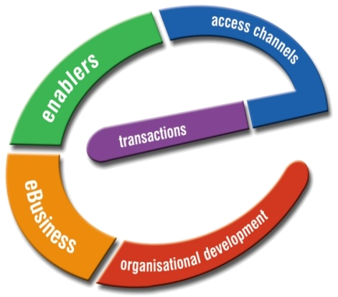
E-HRMS
E- Human Resource Management System
Product
OVERVIEW
Presenter

Slide 2
Index
About Us
Objective
Modules of e-HRMS
System Architecture
System Data Flow
Application Screens
Technical Overview
What’s Inside….
Deliverables

Slide 3
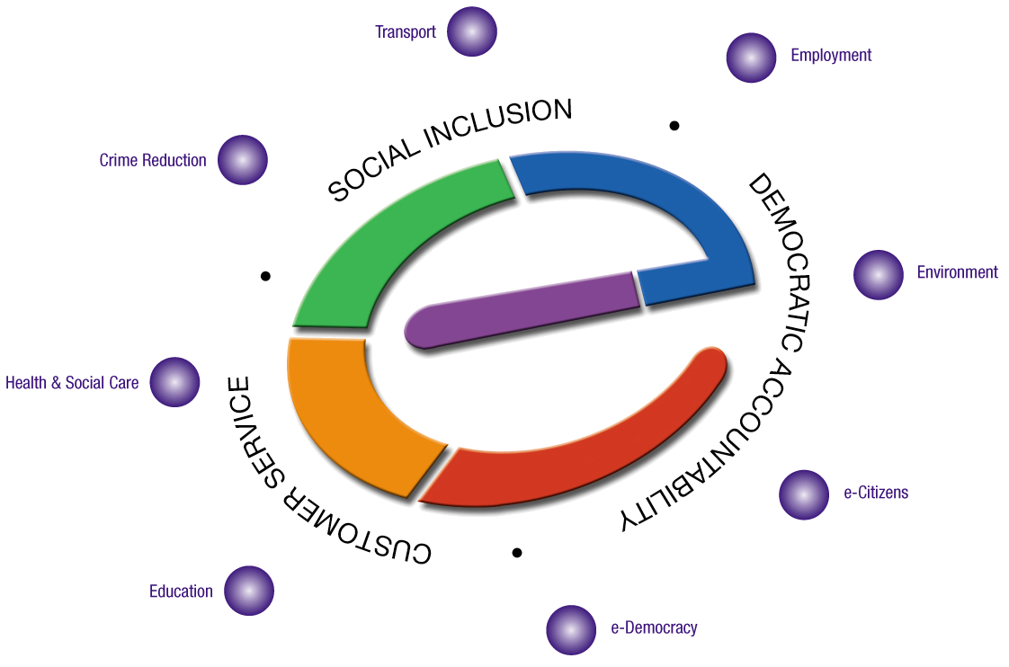
Corpus e-governance Preposition
Creating e-Readiness In e-Governance
Work force Development
ICT
English
e-Training of Govt. Employees
Application Development & support services
Consulting
e-Panchayat Solution - PRABANDH
Services Delivery Gateway
Biometric Applications for
Identification and Authentication
E Learning Platform for schools
With content and E-Training
Applications
E-Applications for capacity building
SMS Voting
Public Opinion
Interactive Opinion

Slide 4
Objective
The main objective of this web based application is to automate above 90% of the HR operations.
System would behave Intelligently according the changes in the Basic data and events triggering.
Art of the system is, system would reach the exact person at exact time with exact information.
It is Centralized to serve all Government Institution Units and sub centers with each person has role based access.
promoting participation and entrenching efficient and effective government

Slide 5
Modules of e-HRMS
It Consists of following Modules.
    Salary
    Loan
    Leave
    Claims
    Income Tax
    Reports
    Reminders
    Alerts
    Notifications
    Approval
Note: Present Modules can be customized as per user Requirement and new can also be integrated.

Slide 6
Roles List
The Product comes with following User Roles:
    Director General
    Senior Director
    Director
    Additional Director
    Joint Director
    Deputy Director
    Assistant Director
    Admin Officer
    Group Head
    Department Head
    Admin
    User
    Administrator
    Secretary
    Joint Secretary
    Director
    Additional Director
    Joint Director
    Deputy Director
    Assistant Director
    Admin Officer
    Group Head
    Department Head
    Under Secretary
    Admin
    User
    Administrator
OR

Slide 7
System Architecture
HRMS
Recruitment/
Appointments
Promotions
Administrator
Loan and Advances
Resignations
Payroll processing
Basic Information
Increments
Career History
LTC Processing
Retirements
Taxes, PF Management
Pay Details
Promotions
ACR’s
Medical Reimbursement
Pension
Bill Processing
DA & Probation
Charge Transfer
Vehicle, House Loans
Time & Attendance
Deputation
Leave Management
CGHS Bills
Complaints & Grievances

Slide 8
System Data Flow
User
User
Login
Admin
Role
Basic Data
Data Entry
Modules
Location

Slide 9
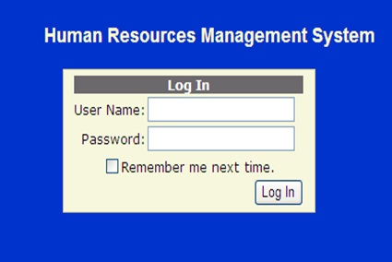
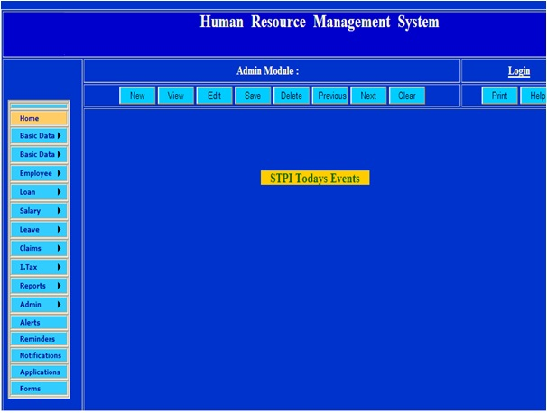
Screens

Slide 10
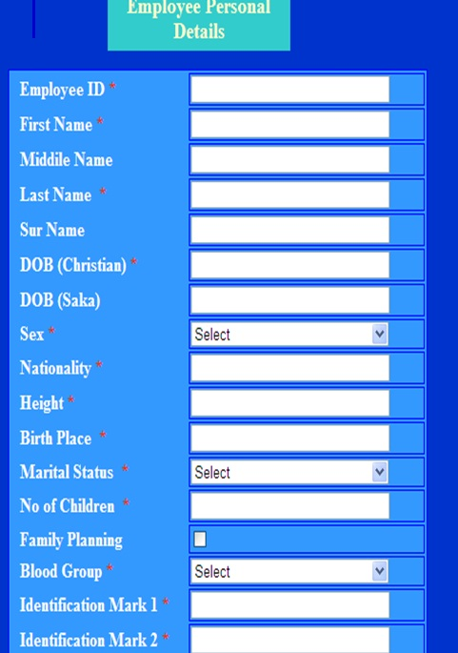
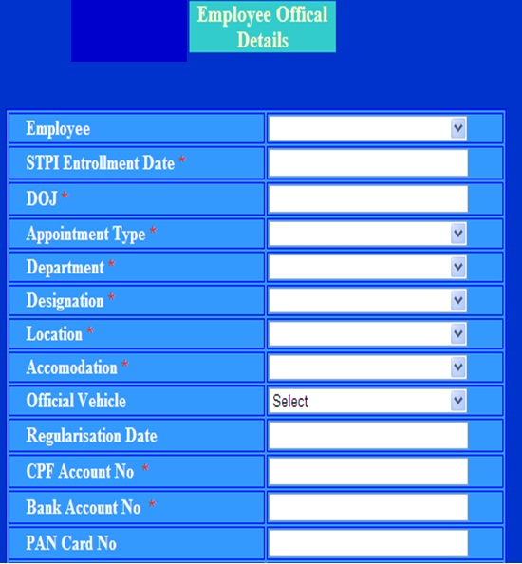
Screens

Slide 11
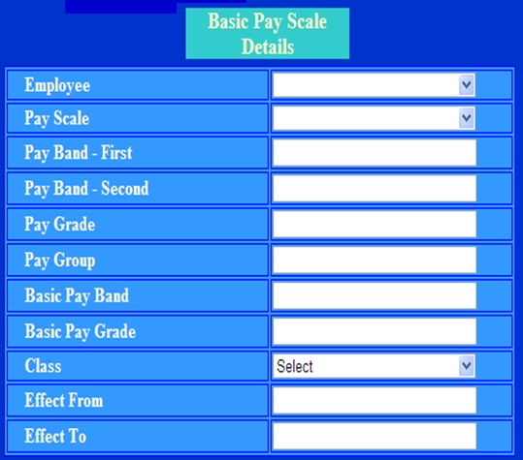
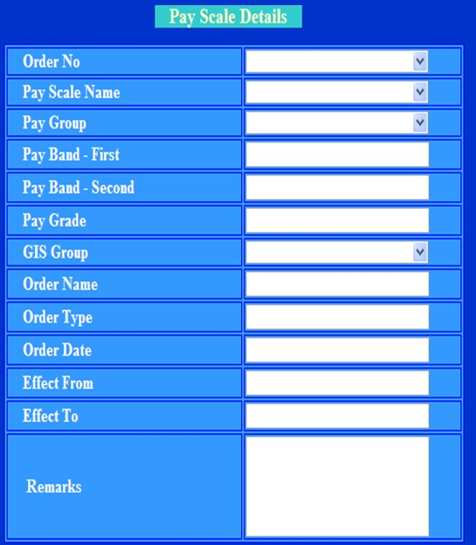
Screens

Slide 12
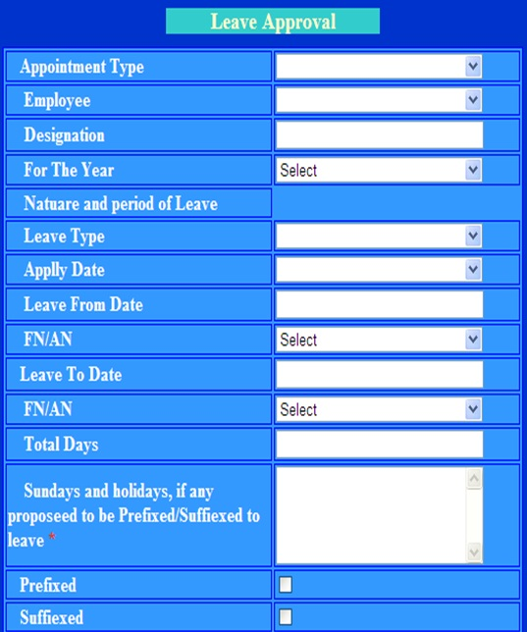
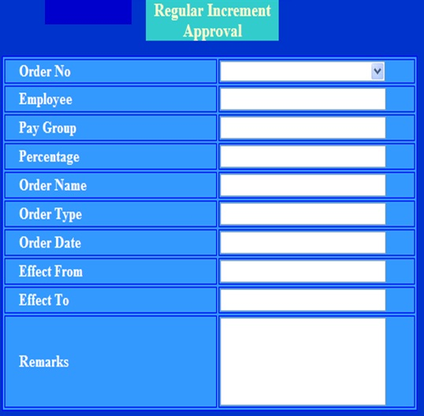
Screens

Slide 13
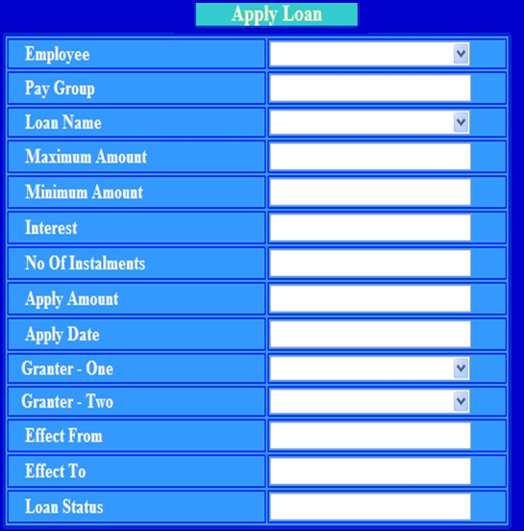
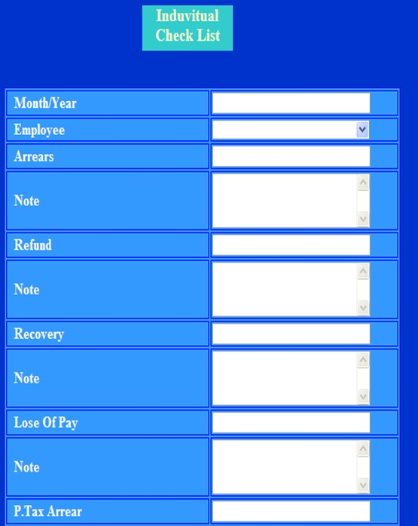
Screens

Slide 14
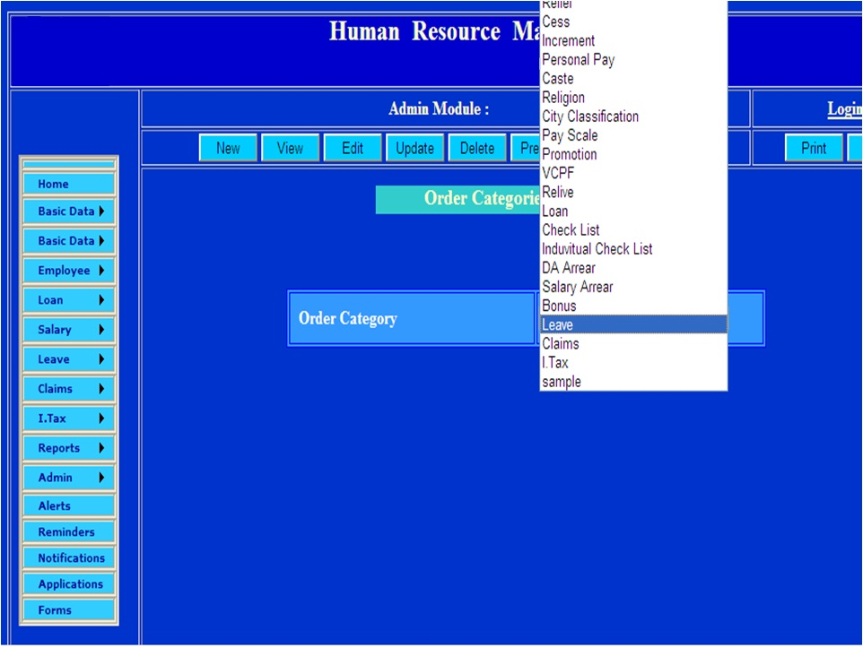
Screens

Slide 15
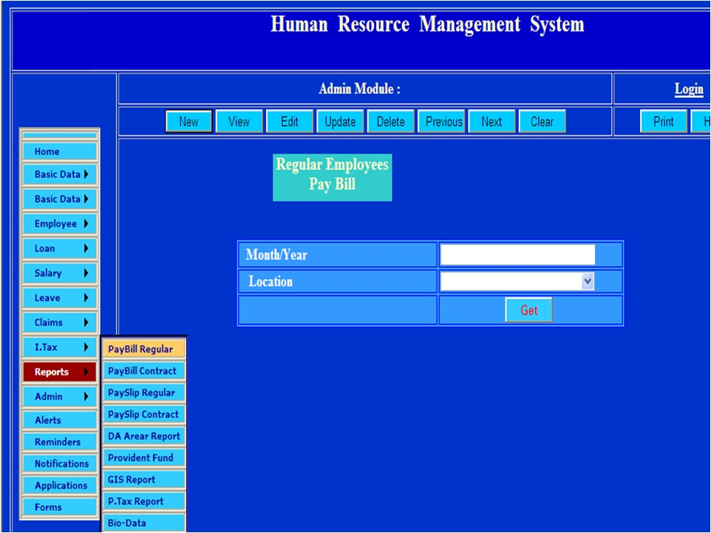
Screens

Slide 16
Technical Overview
e-HRMS is based on Open source Technologies using
PhP and My SQL, Post Gre SQL can aslo be used as a Database
Can be implemented on Intranet or Public Server both
Can work in distributed Mode
Customized as per User Requirement
At all the important events system can generate email Alerts
SMS Alerts can also be integrated

Slide 17
Deliverables
e- HRMS (Human Resource Management System Software)
Training on site at the time of Implementation & installation
User manual and Quick Manual of Application
Training Presentation
Additional training may also be provided if required
Support after implementation

Slide 18

Thanks
Thanks for all your support and time,
Please let us know your ideas how we can take it further.
Presenter

