Slide 1


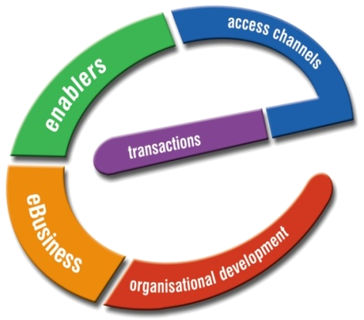
e-Recruitment
Electronic Recruitment Management System
Product
CONCEPTIONALIZATION
Presenter

Slide 2
Index
About Us
Target Area
Objectives
Standard Flow
Product Modules
Imp. Functions
Product Features
Deliverables
Go-Live Requirement
What’s Inside….

Slide 3
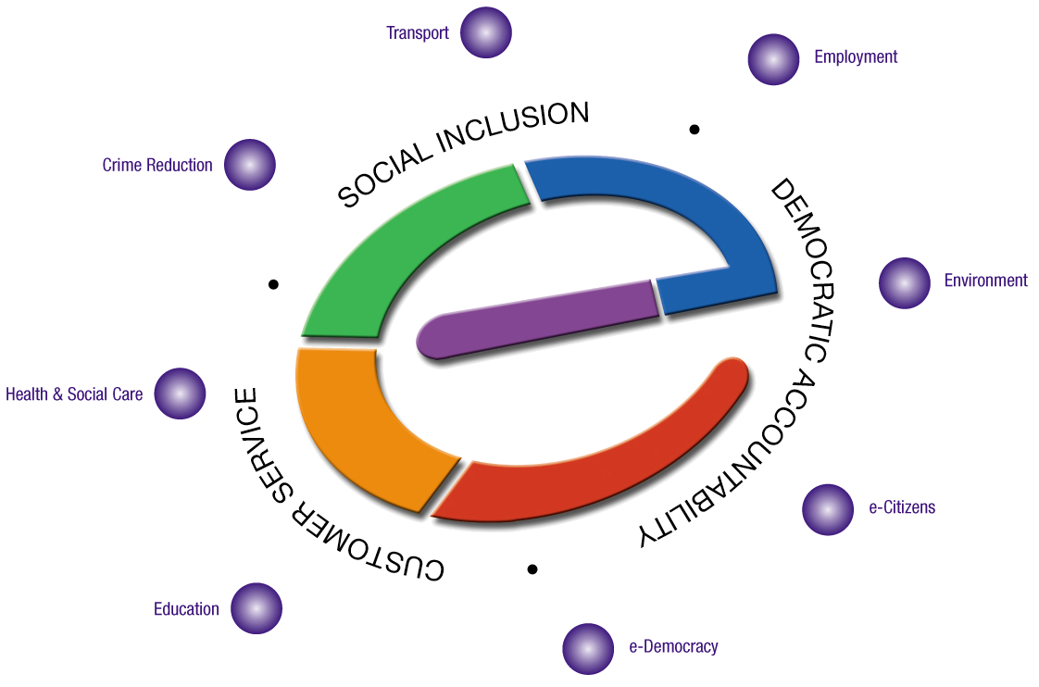
Corpus e-governance Preposition
Creating e-Readiness In e-Governance
Work force Development
ICT
English
e-Training of Govt. Employees
Application Development & support services
Consulting
e-Panchayat Solution - PRABANDH
Services Delivery Gateway
Biometric Applications for
Identification and Authentication
E Learning Platform for schools
With content and E-Training
Applications
E-Applications for capacity building
SMS Voting
Public Opinion
Interactive Opinion

Slide 4
Target Area
Effective Recruitment Management of all Types
Availability of accurate and up-to-date information
Improve Resume and Filtering requirements
Effective Management of Recruitment Process
Detailed MIS reports of all Data and Statistics
Opened Positions / Position validities management
Job - servers advertisement Management
Export list to Excel, XML or HTM

Slide 5
Objectives
The objectives of Inventory Management are:
To identify and track all processes involved in Recruitment of different types.
To track the activities of all the job applicants; Includes interview process flow, Job management, candidate pipelines etc
To define the process by which openings are identified and maintained in the System.
Effective Search to reach the right requirement.
To provide System access to all necessary personnel (data entry, Filteration, update and deletion).
To provide a full range of reports that will satisfy informational requirements.
To document the Recruitment System within the Standards and Procedures Manual.
To provide training to personnel responsible for supporting the System.

Slide 6
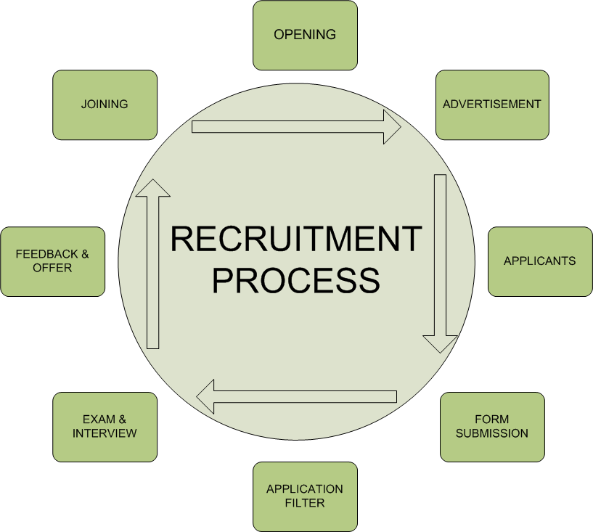
Standard Flow

Slide 7
Product Modules
List of Modules for Inventory Management are:
Openings
Filter Engine
Form Designer
Advertising
Interview Process
Requirements & Forecasting
Reporting
Role Management
Other Standard Modules

Slide 8
Important Functions
Some of the Important Functions of the Application are:
Efficient Record Maintenance
Job Management
Alarms & Exception Messages
Interconnecting with in Department concerned
Reports will be generated giving
  Opening pattern
  Institution & department wise opening
  Job wise report with Classification provision
  Reports between two Dates

Slide 9
Product Features
The Application will come with all these key features
Search: With inbuilt search functionality user will be able to query both structured and unstructured content by keywords
Consistent: Easy-to-use interface for all the users
Minimal client deployment: Portal typically do not require that the users install new software to use it
Aggregation: Pulling links and content together into a single place helps the users know where to go
Alerts: At all the important events system can generate On Screen & email Alerts
Distributed Control: Distributed control via a content management system allows individual owners to manage the content aspects of the portal in their areas
Disconnected Mode: The portal can be deployed where internet connectivity is available for a very less time
Reliable Transactions : Reliability and integrity of services are important feature implies that best practices for the same are used in the Application
Multilingual : Works in both English and Hindi, can be customized for regional languages also

Slide 10
Deliverables
E- Recruitment Application
Training on site at the time of Implementation & installation
User manual and Quick Manual of Application
Training Presentation
Additional training may also be provided for other Offices
Support required

Slide 11
Go-Live Requirement
The Basic Requirements to use the application are:
Electricity Connection
Computer (Includes CPU, Monitor, Keyboard, Mouse)
UPS
Printer
Modem
Internet Connection
Computer Table and Chair
Data Entry Operator (if Required)

Slide 12

Thanks
Thanks for all your support and time,
Please let us know your ideas how we can take it further.
Lalit M Joshi
lalit.joshi@corpus.com

