Slide 1
UNIT-2 : CPU SHEDULING
by
Abdul Quyoom
Assistant Professor
Dept. of System Programing
Lovely Professional University

Slide 2
Sheduling
Scheduling of processes/work is done to finish the work on time.
CPU Scheduling is a process that allows one process to use the CPU while another process is delayed (in standby) due to unavailability of any resources. such as I/O etc,
Making full use of the CPU.
The purpose of CPU Scheduling is to make the system more efficient, faster, and fairer.
Whenever the CPU becomes idle, the operating system must select one of the processes in the line which is ready for/to launch.
The Scheduler selects between memory processes ready to launch and assigns the CPU to one of them.

Slide 3
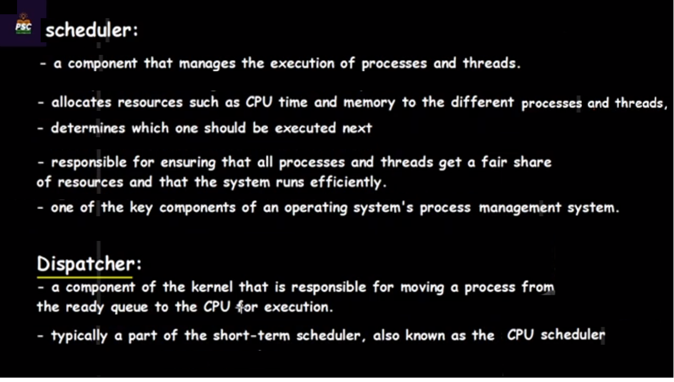

Slide 4
Types of Process schedulers
Here are three types of process schedulers.
Long Term or Job Scheduler
Short-Term or CPU Scheduler
Medium-Term Scheduler

Slide 5
Various time Related to a Process
1. Arrival Time : The time at which the process enters into the ready queue is called the arrival time.
2. Burst Time : The total amount of time required by the CPU to execute the whole process is called the Burst Time. This does not include the waiting time. It is confusing to calculate the execution time for a process even before executing it hence the scheduling problems based on the burst time cannot be implemented in reality.
3. Completion Time : The Time at which the process enters into the completion state or the time at which the process completes its execution, is called completion time.
4. Turnaround time : The total amount of time spent by the process from its arrival to its completion, is called Turnaround time.
5. Waiting Time : The Total amount of time for which the process waits for the CPU to be assigned is called waiting time.
6. Response Time : it is the amount of time processor take to respond to the command i.e request.
T.

Slide 6
Types of CPU sheduling
First Come First Serve
Shortest job first
Shortest remaining time first
Priority based scheduling
Round Robin

Slide 7
1. First Come First Serve Scheduling Algorithm
FCFS considered to be the simplest of all operating system scheduling algorithms.
FCFS states that the process that requests the CPU first is allocated the CPU first and is implemented by using FIFO queue.
Advantages of FCFS:
Easy to implement
First come, first serve method
Disadvantages of FCFS:
FCFS suffers from Convoy effect.
The average waiting time is much higher than the other algorithms.
FCFS is easy to implement and hence not much efficient.

Slide 8
First-Come First-Serve Scheduling (FCFS) Algorithm
Criteria : Arrival time of process
Mode of execution :: Non Preemptive
Turn Around Time = Completion Time - Arrival Time
Waiting Time = Turn Around Time - Burst Time
Find the average waiting time ?
Process No. | Arrival time | Burst time | Competition Time | Turnaround time | Waiting time
P0 | 0 | 4
P1 | 1 | 3
P2 | 2 | 1
P3 | 3 | 2

Slide 9
First-Come First-Serve Scheduling (FCFS) Algorithm
Criteria : Arrival time of process
Mode of execution :: Non Preemptive
Turn Around Time = Completion Time - Arrival Time
Waiting Time = Turn Around Time - Burst Time
Find the average waiting time ?
Process No. | Arrival time | Burst time | Competition Time | Turnaround time | Waiting time
P0 | 0 | 4 | 4 | 4 | 0
P1 | 1 | 3 | 7 | 6 | 3
P2 | 2 | 1 | 8 | 6 | 5
P3 | 3 | 2 | 10 | 7 | 5

Slide 10
First-Come First-Serve Scheduling (FCFS) Algorithm
Criteria : Arrival time of process
Mode of execution :: Non Preemptive
Find the average waiting time ?
Process No. | Arrival time | Burst time | Competition Time | Turnaround time | Waiting time
P0 | 0 | 6
P1 | 1 | 3
P2 | 1 | 5
P3 | 2 | 4
P4 | 3 | 2

Slide 11
Convoy Effect --In First Come First Serve (FCFS )
There may be a few cases, which might cause the Central Processing Unit (CPU) to allot a too much time.
Due, to this shorter jobs or processes behind the larger processes or jobs takes too much time to complete its execution.
Due, to this the Waiting Time, Turn Around Time, Completion Time is very high.
So, the first process is large or completion time is too high, then this Convoy effect in the First Come First Serve Algorithm is occurred.

Slide 12
Convey effect
Find the average waiting time
Process Number | Arival time | Burst time | Completion time | Turnaround time | Waiting time
P0 | 0 | 20
P1 | 1 | 2
P2 | 2 | 1
P3 | 2 | 2

Slide 13
Without Convey effect
Find the average waiting time ?
Process Number | Arrival time | Burst time | Completion time | Turnaround time | Waiting time
P3 | 0 | 2
P1 | 1 | 2
P2 | 2 | 1
P0 | 2 | 20

Slide 14
Shortest job first (SJF) Algorithm
SJF is a scheduling process that selects the waiting process with the smallest execution time to execute next.
This scheduling method may or may not be preemptive.
Significantly reduces the average waiting time for other processes waiting to be executed.

Slide 15
Shortest Job First (SJF) Algorithm
Criteria : Burst time of process
Mode of execution :: Non Preemptive
Turn Around Time = Completion Time - Arrival Time
Waiting Time = Turn Around Time - Burst Time
Find the average waiting time ?
Process No. | Arrival time | Burst time | Competition Time | Turnaround time | Waiting time
P0 | 0 | 4
P1 | 1 | 3
P2 | 2 | 1
P3 | 3 | 2

Slide 16
Shortest Job First (SJF) Algorithm
Criteria : Burst time of process
Mode of execution :: Non Preemptive
Turn Around Time = Completion Time - Arrival Time
Waiting Time = Turn Around Time - Burst Time
Find the average waiting time ?
Process No. | Arrival time | Burst time | Competition Time | Turnaround time | Waiting time
P0 | 1 | 3
P1 | 2 | 4
P2 | 1 | 2
P3 | 4 | 2

Slide 17
Shortest Job First (SJF) Algorithm
Criteria : Minimum-Brust time of process
Mode of execution :: Non Preemptive
Special case : SJF with Same burst time
Find the average waiting time & TAT ?
Process No. | Arrival time | Burst time | Competition Time | Turnaround time | Waiting time
P0 | 0 | 7
P1 | 2 | 5
P2 | 3 | 1
P3 | 1 | 2
P4 | 2 | 5

Slide 18
Shortest Job First (SJF) Algorithm
Criteria : Minimum-Brust time of process
Mode of execution :: Non Preemptive
Special case : SJF with priority of process
Find the average waiting time & TAT ?
Process No. | Arrival time | Burst time | Priority | Competition Time | Turnaround time | Waiting time
P0 | 0 | 7 | 4
P1 | 2 | 5 | 1
P2 | 3 | 1 | 3
P3 | 1 | 2 | 5
P4 | 2 | 5 | 2

Slide 19
Advantages and disadvantages of SJF
Advantages
SJF reduces the average waiting time thus, it is better than FCFS.
Minimum Average Waiting time & turnaround time.
SJF is generally used for long term scheduling
Disadvantages
Starvation occur to the longest process/job.
It is not implementable
Many times it becomes complicated to predict the length of the upcoming CPU request

Slide 20
Shortest Job Remaining First (SJRF) Algorithm
Criteria : Brust time of process
Mode of execution :: Preemptive
Find the average waiting time ?
Process No. | Arrival time | Burst time |  | Competition Time | Turnaround time | Waiting time
P0 | 0 | 4
P1 | 1 | 3
P2 | 2 | 1
P3 | 3 | 2

Slide 21
Shortest Job Remaining First (SJRF) Algorithm
Criteria : Brust time of process
Mode of execution :: Preemptive
Find the average waiting time ?
Process No. | Arrival time | Burst time | Priority (Don’t apply) | Competition Time | Turnaround time | Waiting time
P0 | 0 | 4 | 3
P1 | 1 | 3 | 1
P2 | 2 | 1 | 2
P3 | 3 | 2 | 3

Slide 22
Shortest Job Remaining First (SJRF) Algorithm
Criteria : Brust time of process
Mode of execution :: Preemptive
Find the average waiting time ?
Process No. | Arrival time | Burst time | Competition Time | Turnaround time | Waiting time
P0 | 0 | 7
P1 | 1 | 5
P2 | 2 | 3
P3 | 3 | 1
P4 | 4 | 2
P5 | 5 | 1

Slide 23
Longest Job First (SJF) Algorithm
Criteria : Maximum-Brust time of process
Mode of execution :: Non-Preemptive
Find the average waiting time & TAT ?
Process No. | Arrival time | Burst time | Competition Time | Turnaround time | Waiting time
P0 | 0 | 7
P1 | 1 | 5
P2 | 3 | 1
P3 | 1 | 2
P4 | 2 | 5

Slide 24
Priority Scheduling
Priority Scheduling -is a method of scheduling processes that is based on priority.
In this algorithm, the scheduler selects the tasks to work as per the priority.
The processes with higher priority should be carried out first,
whereas jobs with equal priorities are carried out on a round-robin or FCFS basis.
Priority depends upon memory requirements, time requirements, etc.
Types of Priority Scheduling
Pre-emptive Priority Scheduling
Non-Pre-emptive Priority Scheduling

Slide 25
Characteristics of Priority Scheduling
A CPU algorithm that schedules processes based on priority.
It used in Operating systems for performing batch processes.
If two jobs having the same priority are READY, it works on a FIRST COME, FIRST SERVED basis.
In priority scheduling, a number is assigned to each process that indicates its priority level.
Lower the number, higher is the priority.
if a newer process arrives, that is having a higher priority than the currently running process, then the currently running process is preempted.

Slide 26
Priority Scheduling Algorithm
Criteria : Priority of process
Mode of execution :: Non-Preemptive
Find the average waiting time ?
Note :: higher the number, higher the priority
Process No. | Arrival time | Burst time | priority | Competition Time | Turnaround time | Waiting time
P1 | 0 | 5 | 1
P2 | 1 | 4 | 2
P3 | 2 | 2 | 3
P4 | 4 | 1 | 4

Slide 27
Priority Scheduling Algorithm
Criteria : Priority of process
Mode of execution :: Non-Preemptive
Find the average waiting time ?
Note :: Lower the number, higher the priority
Process No. | Arrival time | Burst time | priority | Competition Time | Turnaround time | Waiting time
P1 | 0 | 5 | 1
P2 | 1 | 4 | 2
P3 | 2 | 2 | 3
P4 | 4 | 1 | 4

Slide 28
Priority Scheduling Algorithm
Criteria : Priority of process
Mode of execution :: Preemptive
Find the average waiting time ?
Note :: higher the number, higher the priority
Process No. | Arrival time | Burst time | priority | Competition Time | Turnaround time | Waiting time
P1 | 0 | 5 | 1 (LP)
P2 | 1 | 4 | 2
P3 | 2 | 2 | 3
P4 | 4 | 1 | 4 (HP)

Slide 29
Priority Scheduling Algorithm
Criteria : Priority of process
Mode of execution :: Preemptive
Find the average waiting time ?
Note :: Lower the number, higher the priority
Process No. | Arrival time | Burst time | priority | Competition Time | Turnaround time | Waiting time
P0 | 0 | 4 | 8 (L P)
P1 | 1 | 3 | 2 (H P)
P2 | 2 | 1 | 4
P3 | 3 | 2 | 5

Slide 30
Priority Scheduling Algorithm
Criteria : Priority of process
Mode of execution :: Preemptive
Find the average waiting time ?
Note :: Lower the number, higher the priority
Process No. | Arrival time | Burst time | priority | Competition Time | Turnaround time | Waiting time
P0 | 0 | 4 | 3
P1 | 1 | 3 | 4
P2 | 2 | 4 | 2
P4 | 4 | 1 | 1

Slide 31
Disadvantages of priority scheduling
If the system eventually crashes, all low priority processes get lost.
If high priority processes take lots of CPU time, then
the lower priority processes may starve and will be postponed for an indefinite time.
If a new higher priority process keeps on coming in the ready queue, then the process which is in the waiting state may need to wait for a long duration of time.
This scheduling algorithm may leave some low priority processes waiting indefinitely.
Solution :: Aging of Process

Slide 32
Round Robin
Round Robin is the preemptive process scheduling algorithm.
Each process is provided a fix time to execute, it is called a quantum.
Once a process is executed for a given time period, it is preempted and other process executes for a given time period.
Context switching is used to save states of preempted processes.
If time quantum is more, it act like FCFS
If time quantum is less, Multiple context-switching take place.

Slide 33
Round Robin Scheduling Algorithm
Criteria : Time Quantum
Mode of execution :: Preemptive
Time Quantum = n units
Find the average waiting time ?
Process No. | Arrival time | Burst time | Competition Time | Turnaround time | Waiting time
P0 | 0 | 6
P1 | 1 | 3
P2 | 3 | 4
P3 | 2 | 2

Slide 34
Round Robin Scheduling Algorithm
Criteria :Time Quantum
Mode of execution :: Preemptive
Time Quantum = n units
Find the average waiting time ?
Process No. | Arrival time ( AT ) | Burst time ( BT ) | Competition Time (CT) | Turnaround time (TAT) | Waiting time ( WT)
P0 | 0 | 4
P1 | 1 | 3
P2 | 2 | 5
P3 | 3 | 2
P4 | 4 | 7

Slide 35
MULTILEVEL QUEUE SCHEDULING
It may happen that processes in the ready queue can be divided into different classes
where each class has its own scheduling needs.
For example, a common division is a foreground (interactive) process and a background (batch) process.
These two classes have different scheduling needs.
For this kind of situation, Multilevel Queue Scheduling is used.

Slide 36
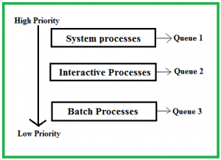
MULTILEVEL QUEUE SCHEDULING

Slide 37
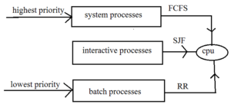
MULTILEVEL QUEUE SCHEDULING

Slide 38
Features of Multilevel Queue (MLQ) Scheduling
Multiple queues
Priorities assigned
Pre-emption
Scheduling algorithm
Efficient allocation of CPU time

Slide 39
Disadvantages of Multilevel Queue CPU Scheduling:
Some processes may starve for CPU if some higher priority queues are never becoming empty.
It is inflexible in nature.
There may be added complexity in
Maintaining multiple queues and
Scheduling algorithms.

Slide 40
Multi-level Feedback Queue Scheduling (MLFQ)
MLFQ CPU Scheduling is like Multilevel Queue(MLQ) Scheduling
But in this process can move between the queues.
Much more efficient than multilevel queue scheduling.
It has the advantage of low scheduling overhead.
Feedback of one queue is given to the next queue.

Slide 41
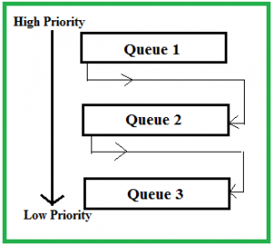
Multilevel Feedback Queue Scheduling (MLFQ)

Slide 42
Features of MLFQ CPU Scheduling:
Multiple queues
Priorities adjusted dynamically
Time-slicing
Feedback mechanism
Pre-emption

Slide 43
Advantages of Multilevel Feedback Queue Scheduling:
It is more flexible.
It allows different processes to move between different queues.
It prevents starvation
Disadvantages of Multilevel Feedback Queue Scheduling:
The selection of the best scheduler, it requires other means to select the values.
It produces more CPU overheads.
It is the most complex algorithm.

Slide 44
Multiple-processor scheduling(MPS)
Here multiple CPU’s are available and
hence Load Sharing becomes possible.
However mit is more complex as compared to single processor scheduling.
when the processors are identical i.e. HOMOGENEOUS, in terms of their functionality, we can use any processor available to run any process in the queue.
It is important because it enables a computer system to perform multiple tasks simultaneously,
which can greatly improve overall system performance and efficiency.
MPS works by dividing tasks among multiple processors in a computer system,
which allows tasks to be processed simultaneously and reduces the overall time needed to complete them.

Slide 45
Processor affinity
Processor affinity is also known as CPU pinning or "cache affinity“,
It enables the binding and unbinding of a process or a thread to a central processing unit (CPU) or a range of CPUs,
so that the process will execute only on the designated CPU or CPUs rather than any CPU.
There are two types of processor affinity:
Soft Affinity – When an operating system has a policy of attempting to keep a process running on the same processor but not guaranteeing it will do so.
Hard Affinity – it allows a process to specify a subset of processors on which it may run.

Slide 46
Real time operating system scheduling
Real-time operating systems (RTOS) are used in environments
where a large number of events, mostly external to the computer system,
must be accepted and processed in a short/fixed time or within certain deadlines.
Examples are industrial control, telephone switching equipment, flight control, and real-time simulations.
This system is time-bound and has a fixed deadline.

Slide 47
Types of Real time operating system
Hard Real-Time operating system:
These operating systems guarantee that critical tasks be completed within a range of time.
Example:- a robot is hired to weld a car body. If the robot welds too early or too late, the car cannot be sold, so it is a hard real-time system that requires complete car welding by robot hardly on the time.,
Scientific experiments, medical imaging systems, industrial control systems, weapon systems, robots, air traffic control systems, etc.
Soft real-time operating system:
This operating system provides some relaxation in the time limit.
Example – Multimedia systems, digital audio systems etc.
Explicit, programmer-defined and controlled processes are encountered in real-time systems.
The process is activated upon occurrence of the related event signaled by an interrupt.

Slide 48
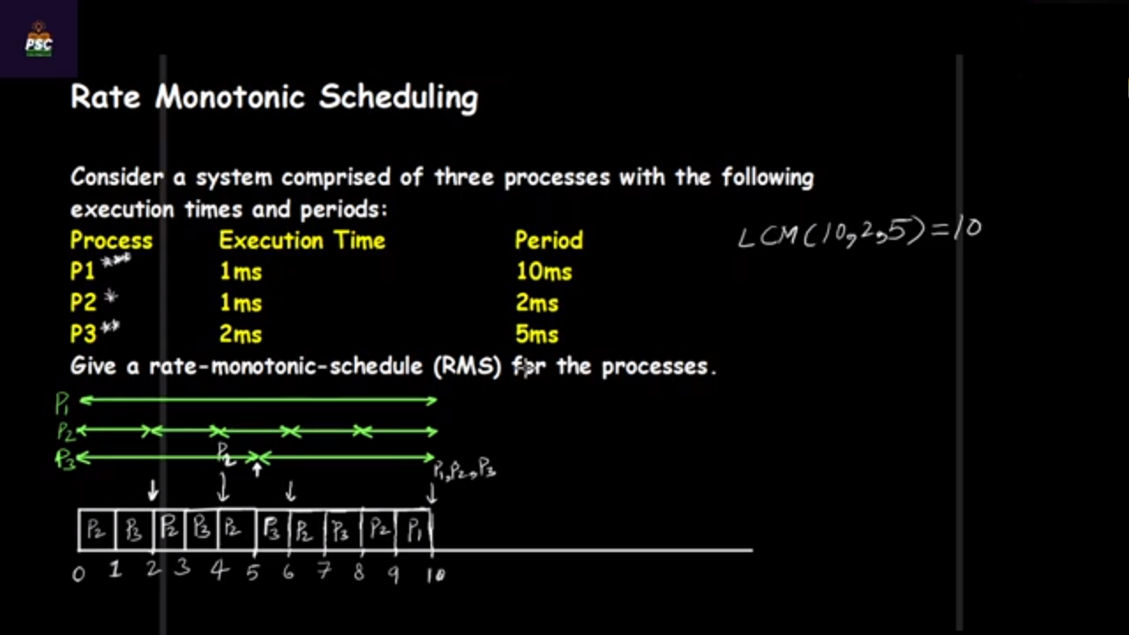

Slide 49
Earliest Deadline First (EDF)
EDF is an optimal dynamic priority scheduling algorithm used in real-time systems.
EDF uses priorities to the jobs for scheduling.
It assigns priorities to the task according to the absolute deadline.
The task whose deadline is closest, will gets the highest priority.
The priorities are assigned and changed in a dynamic fashion.
EDF is very efficient.
It make the CPU utilization to about 100% while still guaranteeing the deadlines of all the tasks.

Slide 50
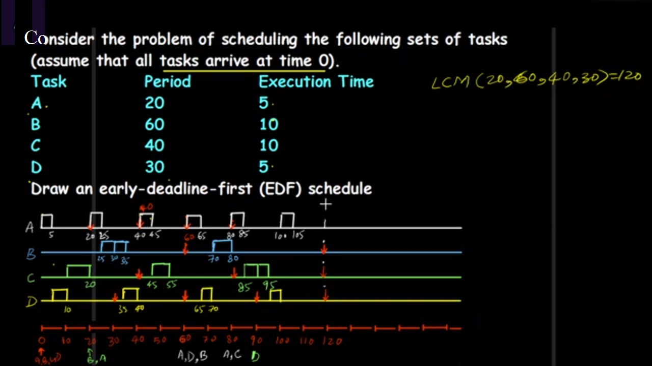

Slide 51
Advantages of the EDF scheduling algorithm:
Meeting Deadlines
Optimal Utilization
Responsiveness
Predictability
Flexibility

Slide 52
Thread
A thread is a single sequence stream within a process.
A thread is the unit of execution within a process.
Threads are also called lightweight processes as they possess some of the properties of processes.
Each thread belongs to exactly one process.
In an operating system that supports multithreading, the process can consist of many threads.
The operating system creates and manages threads, and
Threads share the same memory and resources as the program that created them.
This enables multiple threads to collaborate and work efficiently within a single program.

Slide 54
Advantages of Thread
Responsiveness : If the process is divided into multiple threads, if one thread completes its execution, then its output can be immediately returned.
Faster context switch: Context switch time between threads is lower compared to the process context switch. Process context switching requires more overhead from the CPU.
Effective utilization of multiprocessor system: If we have multiple threads in a single process, then we can schedule multiple threads on multiple processors. This will make process execution faster.
Resource sharing: Resources like code, data, and files can be shared among all threads within a process.
Note: Stacks and registers can’t be shared among the threads. Each thread has its own stack and registers.
Communication: Communication between multiple threads is easier, as the threads share a common address space.

Slide 55
Types of Threads
Threads are of two types
User Level Threads(ULT)
ULTs can be easily implemented by the user.
ULTs is a type of thread that is not created using system calls.
The kernel has no work in the management of user-level threads.
Kernel Level Threads(KLT)
A KLT is a type of thread that can recognize the Operating system easily.
Kernel Level Threads has its own thread table where it keeps track of the system.
The operating System Kernel helps in managing threads.
Kernel Threads have somehow longer context switching time.
Kernel helps in the management of threads.

