Slide 1
Unit-4 Lecture 1
Logic Gates
Basic Electrical and Electronics Engineering
ECE 249
Anil Kumar Rawat
Assistant Professor

Slide 2
Basic Logic Gates
NOT, AND, and OR Gates
NAND and NOR Gates
Exclusive-OR (XOR) Gate

Slide 3
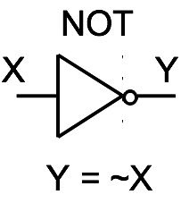
NOT Gate – Inverter (7404)
X
Y
0
1
1
0

Slide 4
AND Gate (7408)
AND
X Y Z
0 0 0
0 1 0
1 0 0
1 1 1
X
Z
Y
Z = X & Y

Slide 5
OR Gate (7432)
OR
X Y Z
0 0 0
0 1 1
1 0 1
1 1 1
X
Z
Y
Z = X | Y

Slide 6
Poll 1
What is the IC number of AND gate?
7432
7404
7408
7400
Notes:
7408

Slide 7
Poll 2
What is the IC number of NOT gate?
7432
7404
7408
7400
Notes:
7404

Slide 8
NAND Gate (7400)
NAND
X Y Z
0 0 1
0 1 1
1 0 1
1 1 0
X
Z
Y
Z = ~(X & Y)
nand(Z,X,Y)

Slide 9
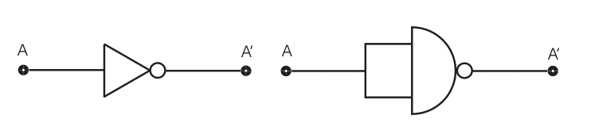
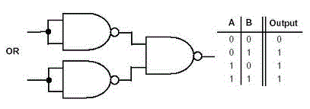
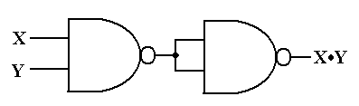

Slide 10
NOR Gate (7402)
NOR
X Y Z
0 0 1
0 1 0
1 0 0
1 1 0
X
Z
Y
Z = ~(X | Y)
nor(Z,X,Y)

Slide 11

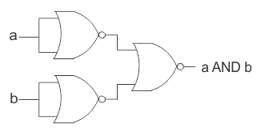


Slide 12
Poll 3
Which of the following IC numbers can perform universal logic gate operation.
7400
7408
7404
7432
Notes:
7400

Slide 13
NOR Gate
X
X
Z
Z
Y
Y
Z = ~(X | Y)
Z = ~X & ~Y
X Y Z
0 0 1
0 1 0
1 0 0
1 1 0
X Y ~X ~Y Z
0 0 1 1 1
0 1 1 0 0
1 0 0 1 0
1 1 0 0 0

Slide 14

Exclusive-OR Gate (7486)
XOR
X Y Z
X
Z
0 0 0
Y
0 1 1
Z = X ^ Y
xor(Z,X,Y)
1 0 1
1 1 0

Slide 15

Exclusive-NOR Gate (74266)
XNOR
X Y Z
X
Z
0 0 1
Y
0 1 0
Z = ~(X ^ Y)
Z = X ~^ Y
xnor(Z,X,Y)
1 0 0
1 1 1

Slide 16
Poll 4
How many basic gates are required to implement EX-OR gate
3
4
5
6
Notes:
5

Slide 17
Poll 5
How many basic gates are required to implement EX-OR gate
3
4
5
6
Notes:
6

Slide 18
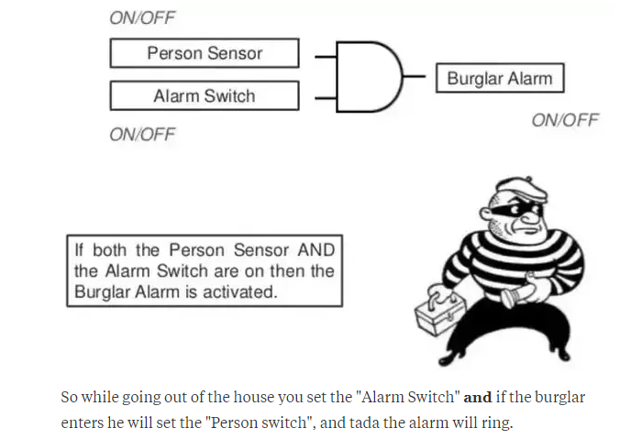

Slide 19
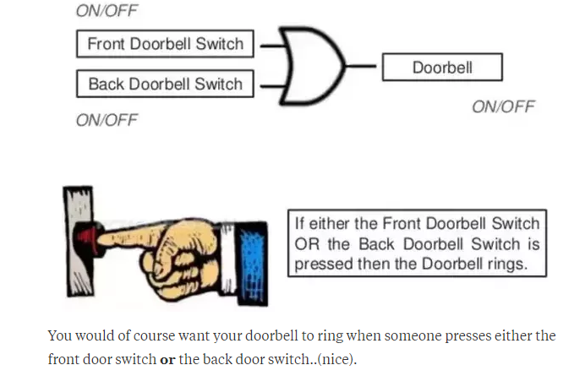

Slide 20
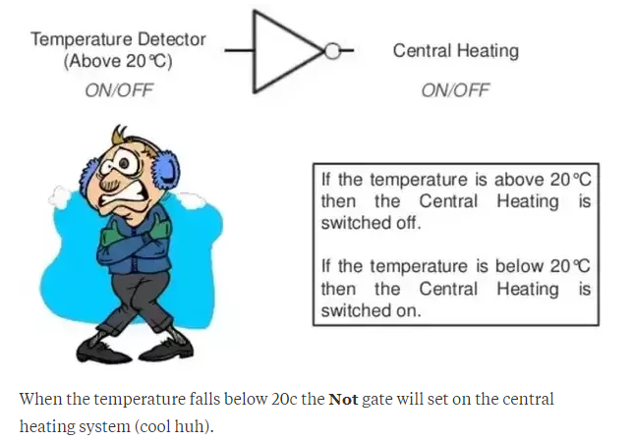

Slide 21
Boolean Algebra

Slide 22
Boolean Algebra
Commutative law

Slide 23
Poll
Which of the following is incorrect?
A.B = B.A
A+B = B+A
A-B = B-A
None of the above

Slide 24
Boolean Algebra
Associative law

Slide 25
Boolean Algebra
Distributive law

Slide 26
Poll
Which of the following is correct?
(A.B).C = A.(B.C)
(A+B)+C = A+(B+C)
A(B+C) = AB +AC
All of the above

Slide 27

Boolean Algebra
AND law

Slide 28

Boolean Algebra
OR law

Slide 29
Boolean Algebra
Inversion law

Slide 30
Poll
Which of the following is not correct
A) A.1=1
B) A+A=A
A+1=1
A.A=A

Slide 31
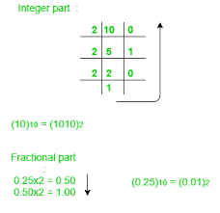
Number conversion
Methods or techniques used to convert numbers from one base to another
Decimal to Other
Step 1 − Divide the decimal number to be converted by the value of the other base.
Step 2 − Get the remainder from Step 1 as (least significant digit) of new base number
Step 3 − Divide the quotient of the previous divide by the new base.
Step 4 − Record the remainder from Step 3 as the next digit
Repeat Steps 3 and 4, getting remainders until the quotient becomes zero
The last remainder thus obtained will be the Most Significant bit(MSB) of the new base number.
LSB
Recorded Carry
MSB

Slide 32
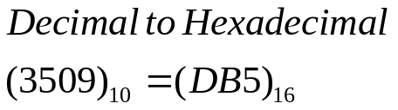
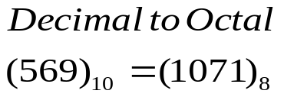
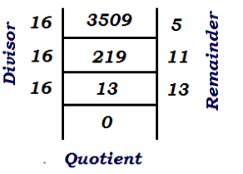
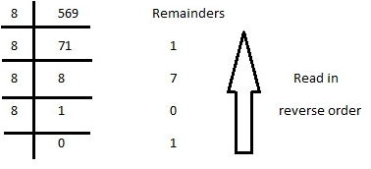
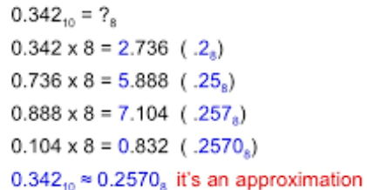
Recorded Carry
MSB
LSB

Slide 33
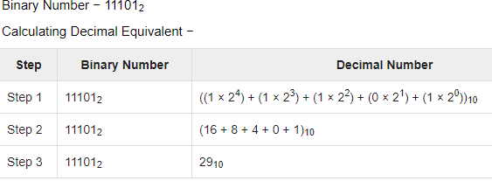
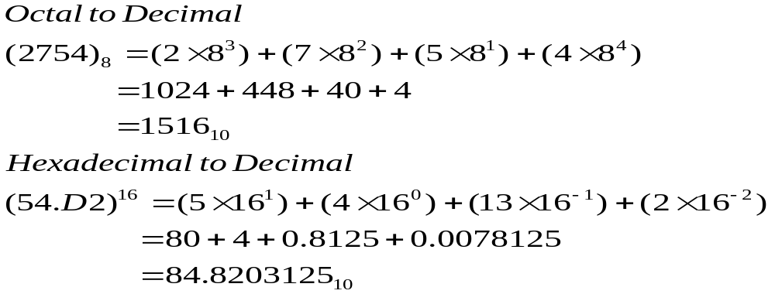
Other Base System to Decimal System
Step 1 − Determine positional value of each digit
Step 2 − Multiply the obtained position values by the digits in the corresponding columns.
Step 3 − Sum the products calculated in Step 2.
32 16 8 4 2 1 (Base)
1 0 0 1 1 1 (Binary No.)
=32 +0+0+ 4 +2 +1 = (39)10

Slide 34
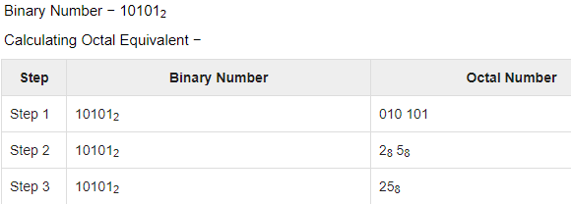
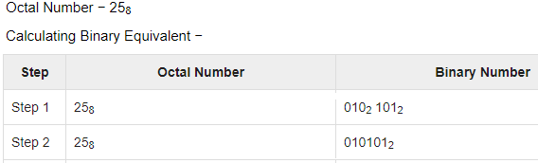
Binary to Octal
Step 1 − Divide the binary digits into groups of three (starting from the right).
Step 2 − Convert each group of three binary digits to one octal digit.
Octal to Binary
Step 1 − Convert each octal digit to a 3 digit binary number.
Step 2 − Combine all the resulting binary groups (of 3 digits each) into a single binary number

Slide 35
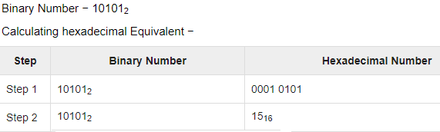
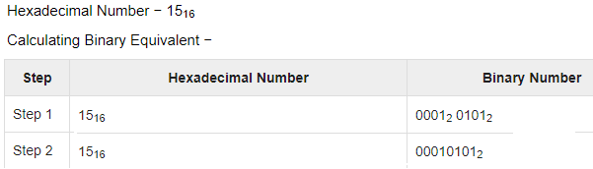
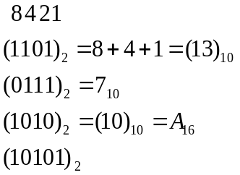
Binary to Hexadecimal
Step 1 − Divide the binary digits into groups of four (starting from the right).
Step 2 − Convert each group of four binary digits to one hexadecimal symbol.
Hexadecimal to Binary
Step 1 − Convert each hexadecimal digit to a 4 digit binary number.
Step 2 − Combine all the resulting binary groups (4 digits each) into a single binary number.

Slide 36
Poll 5
The octal equivalent of (DB)₁₆
_{(a) 333}
_{(b) 325}
_{(c) 285}
_{(d) None of these}

Slide 37
Poll 6
The Hexadecimal equivalent of (156)₈
_{(a) 6F}
_{(b) 6D}
_{(c) 6E}
_{(d) None of these}

