Slide 1
ECE249
UNIT-4
Lecture 3

Slide 2
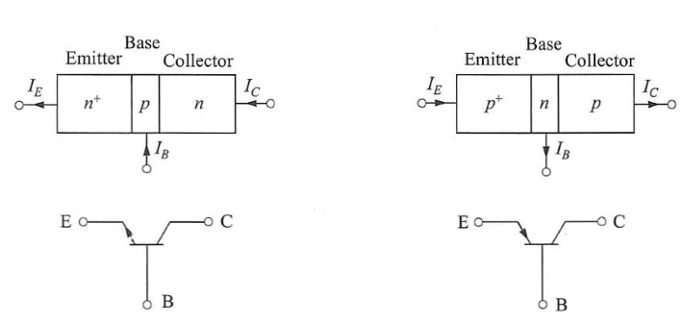
BIPOLAR JUNCTION TRANSITOR (BJT)
Transistor is a solid state device
It is a current controlled device
It has three terminals
Emitter
Base
Collector
There are two types of Transistor
PNP
NPN
Doping of Terminals
Emitter- highly doped
Base- Lightly doped
Collector- Moderately doped

Slide 3
Transistor wrt Vaccum Triode
Advantages
Compact Size
Light weight
Rugged Construction
Resistive to shock and vibration
Instantaneous operation
High operation point
Long life
No aging effect
Disadvantages
Loud hum noise
Restricted operation up to 75 degree
Operating frequency – Few MHz

Slide 4
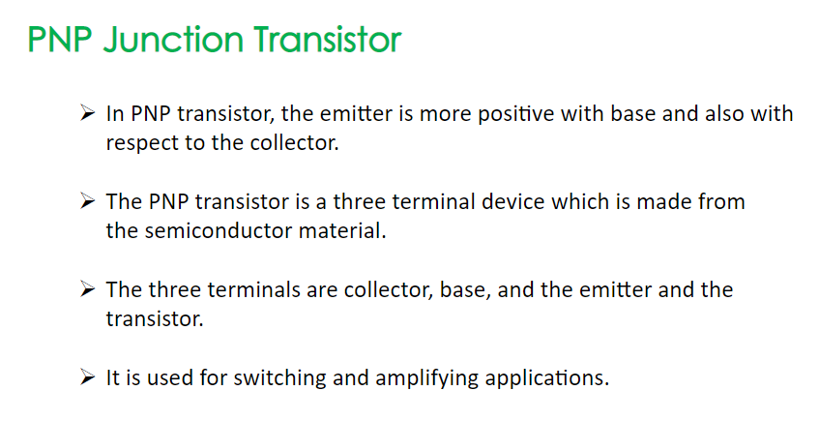

Slide 5
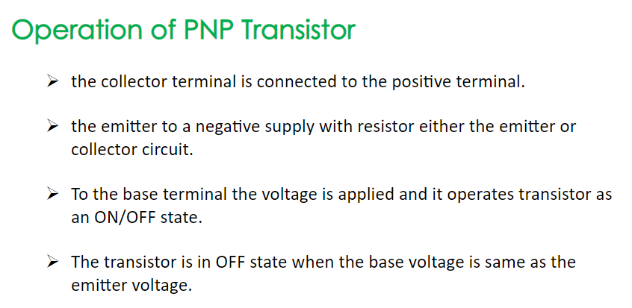

Slide 6
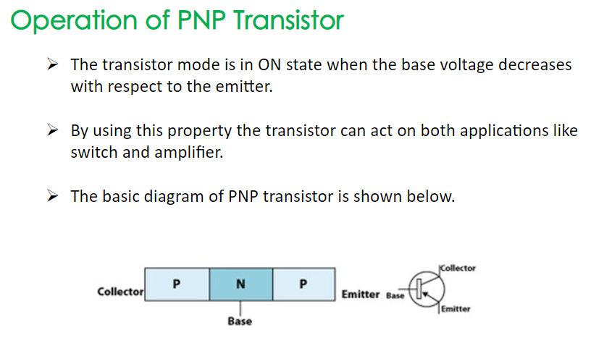

Slide 7
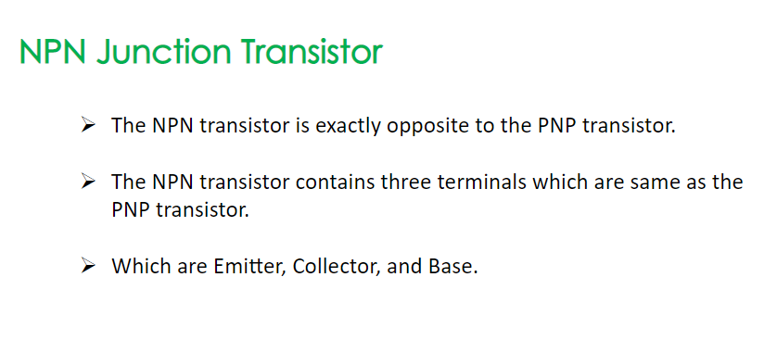

Slide 8
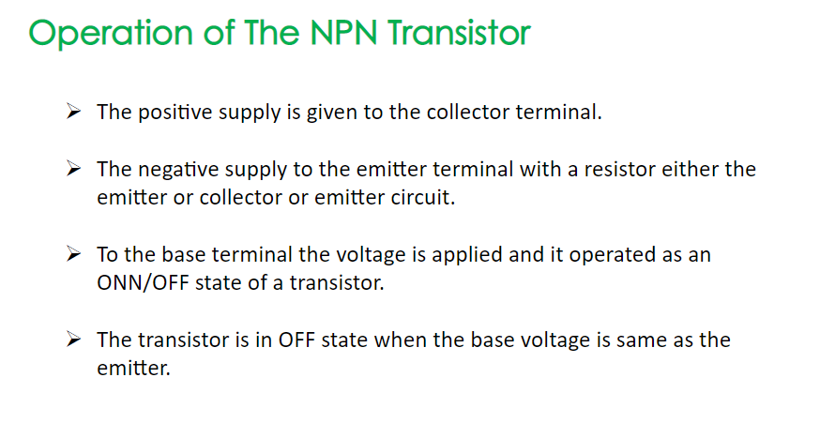

Slide 9
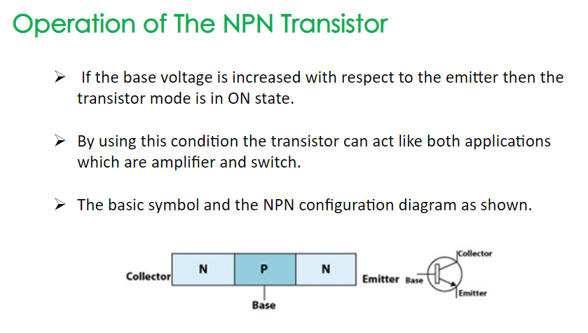

Slide 10
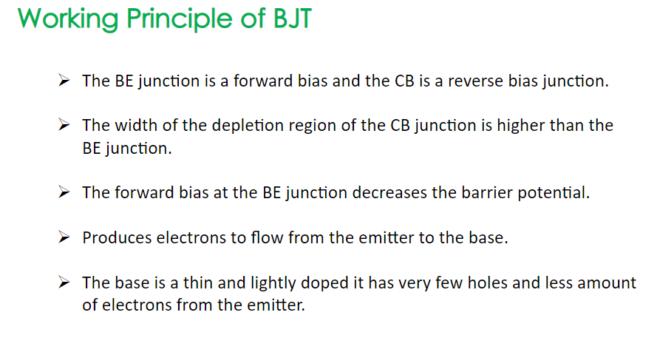

Slide 11
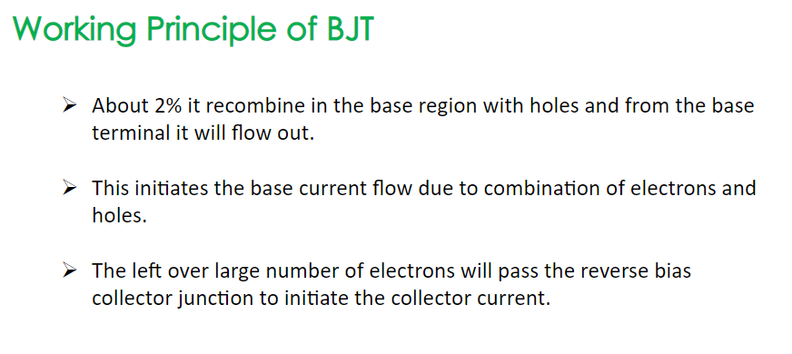

Slide 12
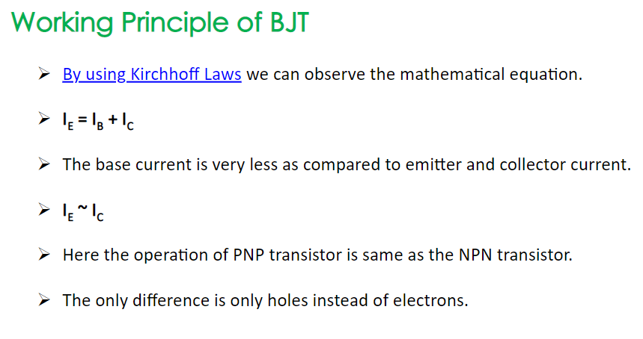

Slide 13
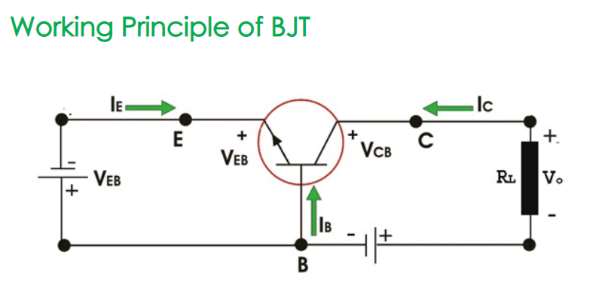

Slide 14
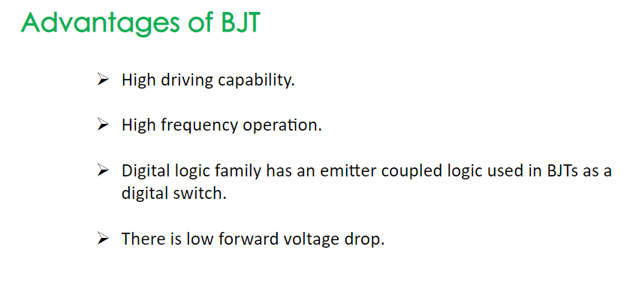

Slide 15
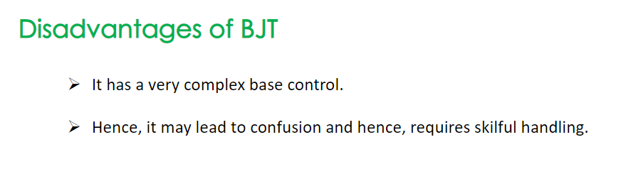

Slide 16
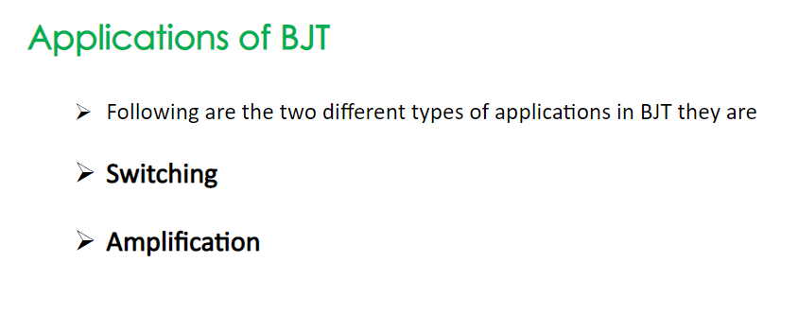

Slide 17
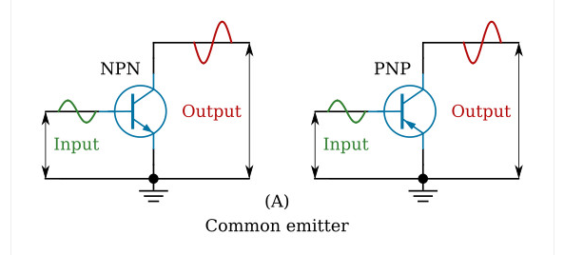

Slide 18
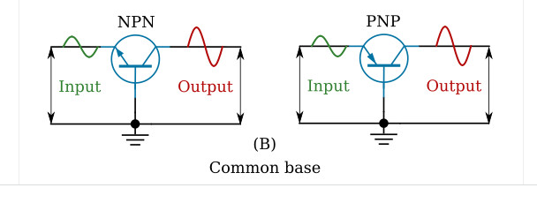

Slide 19
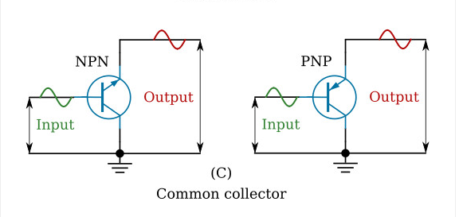

Slide 20
