Slide 1

Environmental Pollution

Slide 2
Soil Pollution
Any change in the physical, chemical, and biological properties of soil due to natural or anthropogenic activities that leads to adverse effects on human health, plants, animals or environment is known as soil pollution.
Major Soil Pollutants and their effects
1) Heavy Metal (Mercury, Lead, Arsenic, Cadmium)
2) Chemical waste
3) Pesticides, fertilizers and other agricultural products
5) Radioactve waste

Slide 3
Soil Pollution
Causes of Soil Pollution
Industrial waste
Mining
Agricultural waste
Domestic waste
Radioactive wastes
Effects of Soil Pollution
Reduces the fertility of the soil
Causes an increase in the number of mosquitoes and flies, which are vectors of several deadly diseases
Reduces the aesthetic value of land
Radioactive elements present in polluted soil enter human body and cause a number of adverse health effects such as cancer, deformities in bones, etc.

Slide 4
Soil Pollution
Control of Soil Pollution
Treatment of industrial waste before being disposed to reduce soil pollution.
Garbage from urban waste should be segregated into biodegradable and non-biodegradable waste products. Biodegradable waste can be used for production of manures and biogas, non-biodegradable waste can be recycled and reused.
Planting of trees must be encouraged.
Reduction in the amount of radioactive materials released in the soil
Reduction in the use of chemical fertilizers and pesticides
Solid waste can be used for electricity generation.

Slide 5
Q. How does soil pollution affect plants?
Hurts its feelings
Raises the toxicity level in the plant
Can't be used
Doesn't effect them

Slide 6
Q. How do humans consume soil pollution?
Eating the plants
They can't eat soil
No effect
By breathing the air

Slide 7
Q. How do humans consume soil pollution
No effect
They can't eat soil
Eating the meat from animals that consumed plants
By breathing the air

Slide 8
Solid waste
Solid waste is that material (such as domestic trash, garbage, metal scrap etc.) which arises from various human activities and which is normally discarded as useless or unwanted. It is responsible for land pollution in urban and industrial areas.
Garbage refers to the putrescible solid waste (Solid waste that contains organic matter capable of being decomposed by microorganisms easily) constituents produced during the preparation or storage of meat, vegetables, etc.
Rubbish is the non-putrescible solid waste constituents, either combustible or non combustible. Combustible waste includes paper, wood, wood scrap, rubber, leather, etc. Non-combustible wastes are metals, glass, ceramics etc.
Refuse means all decomposing and non-decomposing combustible and non-combustible solid wastes such as garbage, ashes, paper, cans, wood scraps, plastic etc.

Slide 9
Important source of solid waste
Domestic garbage refers to household wastes such as plastic, paper, glass pieces, metal objects etc.
Pathological wastes include dead animals and human waste.
Industrial wastes generally include chemicals, paints, sand, metal ore processing, fly ash, sewage treatment sludge, etc.
Agricultural wastes contain mainly farm animal manure and crop residues.
Municipal Solid waste (MSW) is commonly known as trash or garbage and consists of everyday items such as product packaging, furniture, bottles etc.
Mining wastes result from mining activities. Eg. Heavy metals.
Radioactive wastes: Nuclear explosions, nuclear testing, use of radioactive substances in medical and scientific research etc.
Hospital wastes (BMW) includes disposable needles, syringes, blades, tissues etc.
E-waste refers to electrical and electronic equipment wastes.
12/03/19

Slide 10
Effects of Solid Waste
Solid waste helps disease-causing organisms such as mosquitoes, flies, etc., to thrive freely and increase in population.
It runs off with rainwater and mixes with the nearby water bodies causing water pollution.
Burning of solid waste leads to air pollution.
Radioactive substances present in solid waste cause a number of diseases in human beings.
Solid waste reduces the aesthetic value of land.
Non-biodegradable solid wastes such as polythene, plastic, rubber, etc., release toxic gases when burnt hence causing air pollution.

Slide 11
Solid waste management
Indiscriminate disposal of solid wastes-especially of hazardous waste causes adverse environment effects.
The main objective of solid waste management is to minimize these adverse effects before it becomes too difficult to rectify in the future.

Slide 12
Solid waste management
Main Functional Elements:
Waste generation
Waste management
Storage
Collection
Transfer/transport
Processing/recovery
Disposal

Slide 13
Solid waste management
Solid waste management (SWM) is a three-step process:
Collection of solid waste
Transportation of solid waste
Disposal of solid waste

Slide 14
Collection of solid waste
Large number of dustbins must be provided to enable proper collection of solid wastes according to categories.
Door to door collection of domestic garbage, is the most common and popular practice.
Rag pickers contribute to waste management. They segregate recyclable materials from other wastes and hence save the cost and time.

Slide 15
Transportation of solid waste
Transportation of solid wastes from urban areas to the dumping grounds with the help of tractors, trucks etc.
Transfer station
Reduces
transportation cost
vehicular emission
maintenance cost.
12/03/19

Slide 16
Processing/Recovery of solid waste
Reduction of the use of raw materials
Reuse of waste materials
Repair
Recycling of materials
Reformation of old products
Formation of new products

Slide 17
Disposal of solid waste
Open dumping
Land fill
Ocean dumping
Burning (Incineration)
Composting
Reduction at source
12/03/19

Slide 18
Disposal of solid waste
Sanitary landfill
Garbage is spread out in thin layers, compacted and covered with clay/plastic foam
Bottom is covered with impermeable linings to prevent the percolation of leachates.
When the landfill is full, it is covered with clay, sand and gravels
Monitoring wells are drilled near the landfill area
Landfill gas (Methane) is produced.
Composting
It is done due to the shortage of landfill area
Decomposed in oxygen-rich medium
Nutrient rich manure is produced
Incineration
Burning of waste in very high temperature
Initial cost is very high
Dioxin, furan, lead, cadmium etc. can be released. So, battery or plastics should be removed before burning

Slide 19
Q. A process in which mixed garbage is burned at very high temperatures is:
recovery
incineration
leachate
source reduction

Slide 20
Q. Which item should you NOT put in your compost pile?
food scraps
autumn leaves
wood chips
plastic

Slide 21
Noise Pollution
Noise: Unpleasant/ unwanted sound
Noise pollution: The noise propagates through the atmosphere that leads to discomfort and health hazards is known as noise pollution.
Noise measurement is expressed as Sound Pressure Level (SPL)
SPL is a logarithmic ratio of sound pressure to a reference pressure.
International reference pressure is 2 X 10 ⁻⁵ Pa. (average threshold of hearing)
Unit of SPL is decibel.
Threshold of pain is 130 dB
Types of noise: Continuous, Intermittent, Impact/Impulsive

Slide 22
E-waste is generated from...
electronics
elevated nuclear plants
elephants at the zoo
EPA regulated facilities

Slide 23
Q. Which category produces the greatest amount of waste?
Industrial
Municipal
Hazardous
Litter

Slide 24
Q. Substances that can eat through or dissolve metal storage tanks and equipment are called
ignitable.
corrosive.
reactive.
toxic.

Slide 25
Sources of Noise Pollution
Natural phenomena such as violent volcanic eruptions, thunder, fierce storms, etc.
Domestic appliances such as mixers, washing machines, telephones, etc.
Industries such mills and factories
Automobiles –music system n constant honking by drivers, Noise by Trains, ships, and aircrafts
Bursting of crackers and playing loud music during social gatherings and festivals.
Entertainment devices such as radio, television, etc.

Slide 26
Effects of Noise pollution
Auditory effects:
Temporary or permanent hearing loss
Non-auditory effects:
Heart problems
Change in blood pressure
Loss of working efficiency
Insomnia
Emotional and behavioral change
Effects on wildlife
Habitat loss
Problems in laying eggs
Damage in vocal chords
12/03/19

Slide 27
Control of Noise Pollution
Control at source
Designing, fabricating and using quieter machines to replace the noisy ones
Proper lubrication and better maintenance of machines
Installing noisy machine in soundproof chamber
Using vibration dampener
Using silencers in automobiles
Control in transmission
Noise barrier
Control at receptor
Ear-protection aids like earplugs, noise helmets, headphones etc.

Slide 28
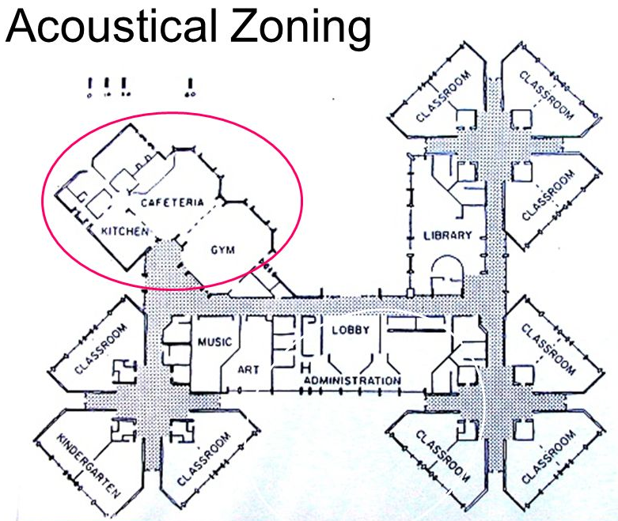
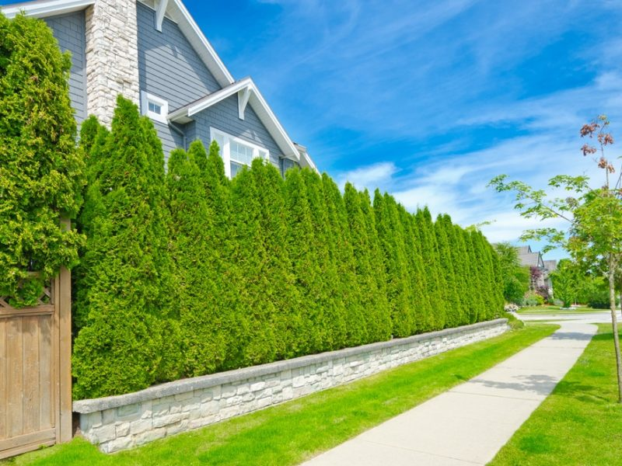
Control of Noise Pollution
Other methods
Acoustic Zoning
Planting of Trees
Legislative measures

Slide 29
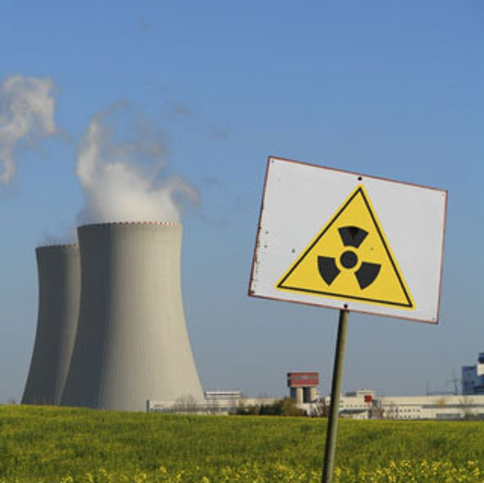
Radiation Pollution
Radiation pollution is the emission of any form of ionizing (alpha and beta) or non-ionizing (gamma) radiation as a result of natural or human activities.
Causes
Natural
Cosmic rays from outer space
Radioactive Radon-222
Soil, rock, water, air and food
may contain radioactive materials
Anthropogenic
Nuclear power plants
Nuclear accidents
Medical X-rays, test laboratories

Slide 30
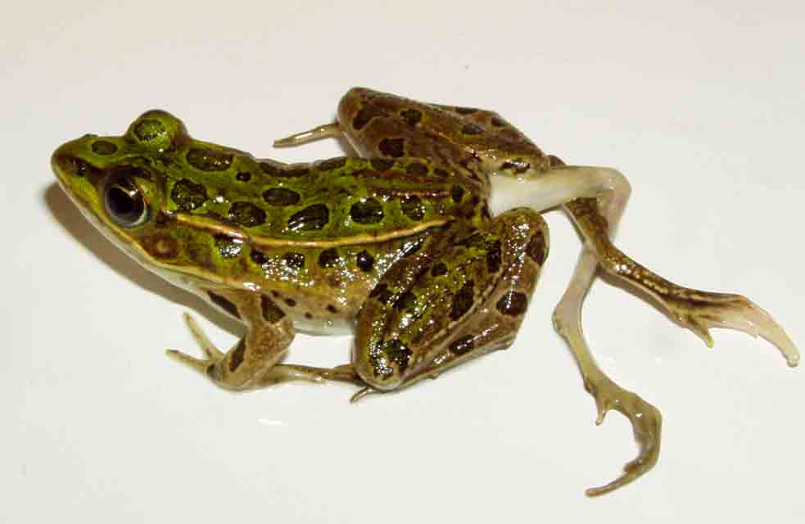
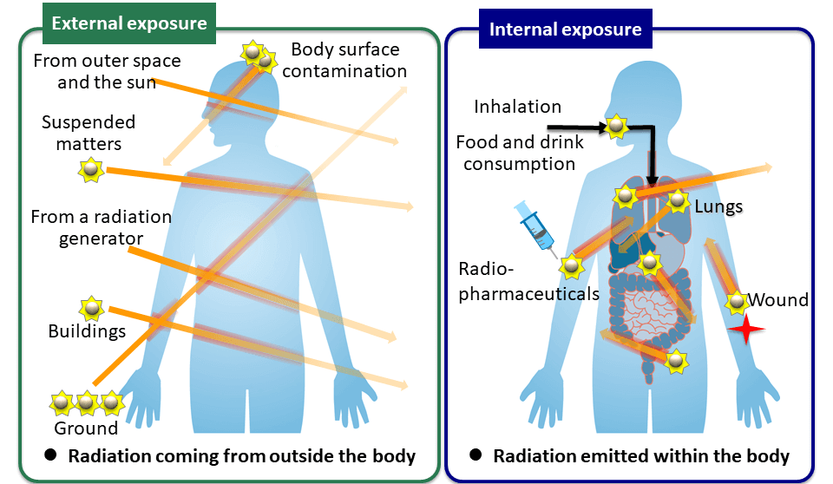
Radiation Pollution
Unit of radioactive exposure
Rem (Roentgen equivalent man)
Effects of Radiation Pollution
Somatic Effects (Change in body cells)
skin cancer
bone cancer
reduction of life span
premature ageing
Genetic Effects (Change in DNA)
Defect in child birth
Infant mortality

Slide 31
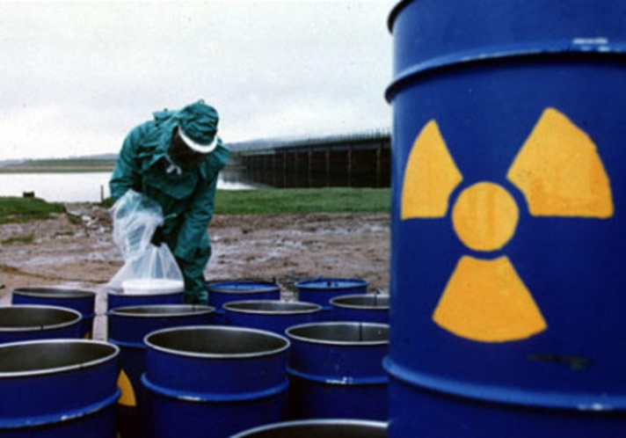
Radiation Pollution
Control of Radiation pollution
Dense trees should be planted around atomic power plants.
Proper management of radioactive waste should be ensured.
Unnecessary X-ray examination should be avoided. Lead shields should be used by workers.
During nuclear installations, various aspects must be considered
Site selection
Design
Construction process
Operating conditions
Precautionary measures and preparedness for disasters

Slide 32
Thank You

