Slide 1
Natural Disasters
Flood and cyclone

Slide 2
Lecture Objective:
Making students aware about cause, effects and control of flood and cyclone
Lecture Outcome:
Students will learn about the types of floods, causes, effects and control of flood
Students will learn about the types of cyclone, causes, effects and management of cyclone

Slide 3
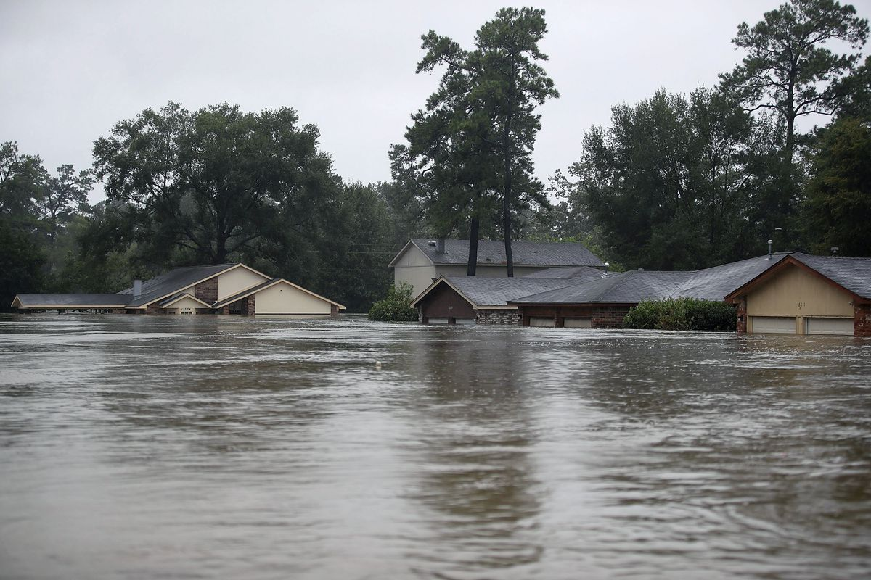
Floods
The accumulation of a large quantity of water at a place or the presence of more water than can be handled by the drainage of the area is known as flood.
Types of Floods
Flash floods
River floods
Coastal floods

Slide 4
Floods
Flash flood
Flash floods are defined as those flood events where the rise in water is either during or within a few hours of the rainfall that produces the rise.
Causes of flash flood
Dam failure
Sudden snowmelt or thawing of glaciers
A sudden release of water by a debris flow or ice jam
Steeply-slopped watershed

Slide 5
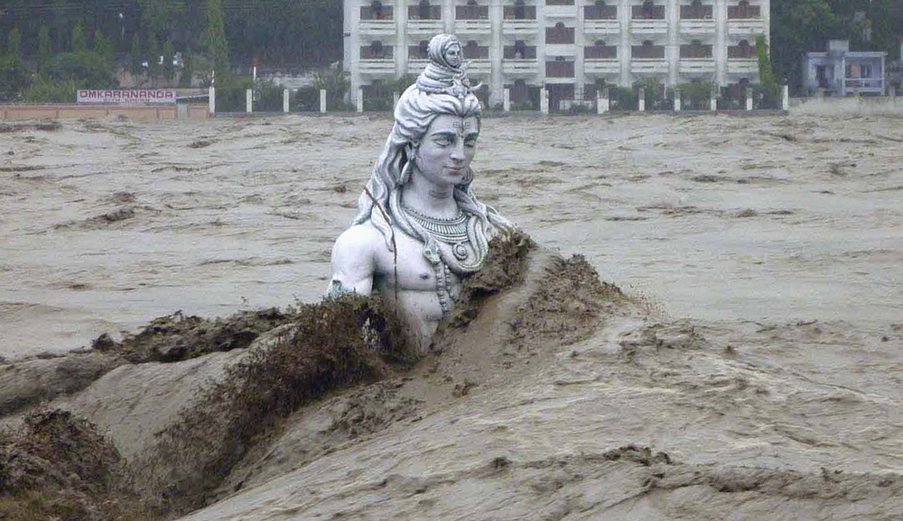
Flash floods

Slide 6
Floods
River flood
A river flood occurs when a river overspills its banks; that is, when its flow can no longer be contained within its channel.
Causes of river Floods
Heavy rain
Snow melt in Spring
Deforestation
Weather events like cyclones

Slide 7
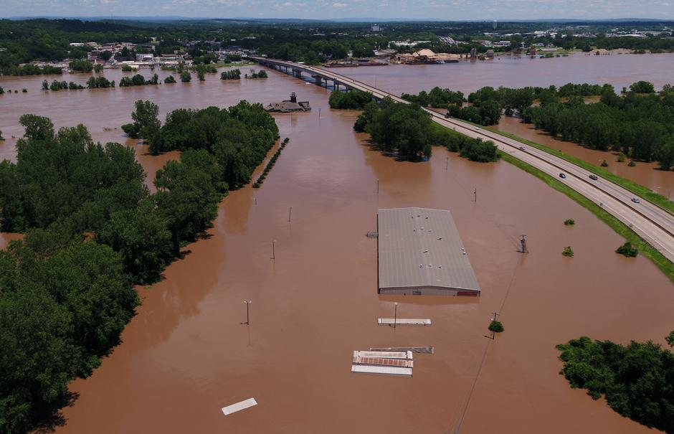
River flood

Slide 8
Floods
Coastal floods
When a coastal process—such as waves, tides, storm surge, or heavy rainfall from coastal storms—produces that flood, it is called a coastal flood.
Causes of coastal floods
Rising Sea Levels
Tsunamis
Reclaimed Land

Slide 9
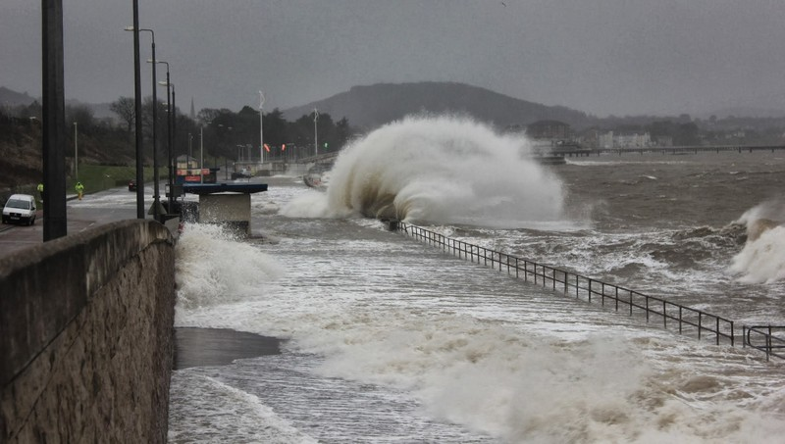
Coastal floods

Slide 10
Floods
Effects of floods
Damage to agricultural crops
Damage to life and property
Disturbances in transportation
Increase in populations of disease vectors and pathogens
Loss of biodiversity
Economic crisis

Slide 11
Floods
Control of floods
Plantation on slopes
Drainage management
Flood plain zoning
Forecasting

Slide 12
Cyclone
In northern hemisphere, a cyclone refers to an area of low atmospheric pressure surrounded by a wind system in a counter-clockwise direction.
Types of cyclone
Tropical Cyclones (Hurricanes, Cyclone, Typhoons and Tornadoes)
Mesocyclones
Extratropical Cyclones
Arctic Hurricanes

Slide 13
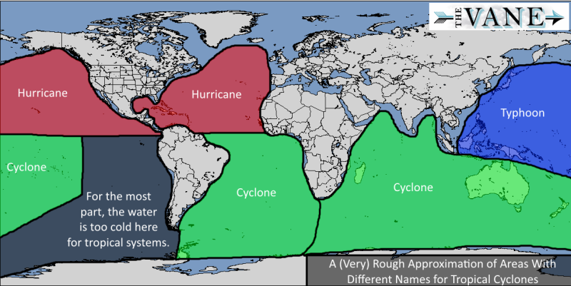
Tropical Cyclones

Slide 14
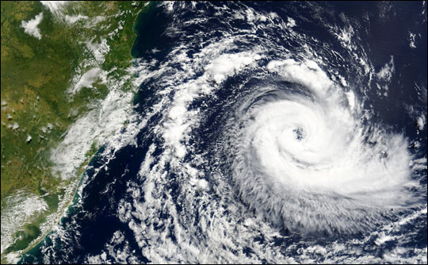
Tropical Cyclone: A tropical cyclone is a rapid rotating storm originating over tropical oceans from where it draws the energy to develop. It has a low pressure centre. Its diameter is typically around 200 to 500 km, but can reach 1000 km. A tropical cyclone brings very violent winds, torrential rain, high waves and, in some cases, very destructive storm surges and coastal flooding. safety.

Slide 15
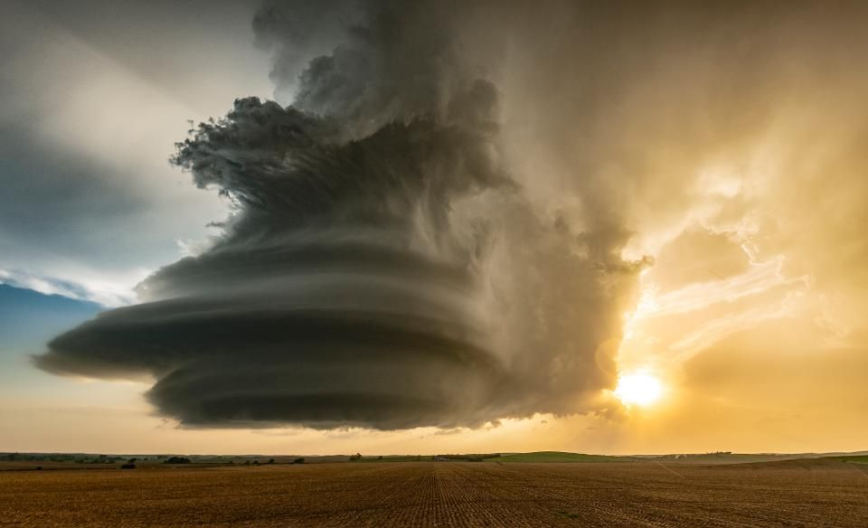
Mesocyclone: A mesocyclone is a vortex of air, approximately 2 to 10 miles in diameter, within a convective storm. In a mesocyclone, air rises and rotates around a vertical axis, usually in the same direction as low pressure systems.

Slide 16
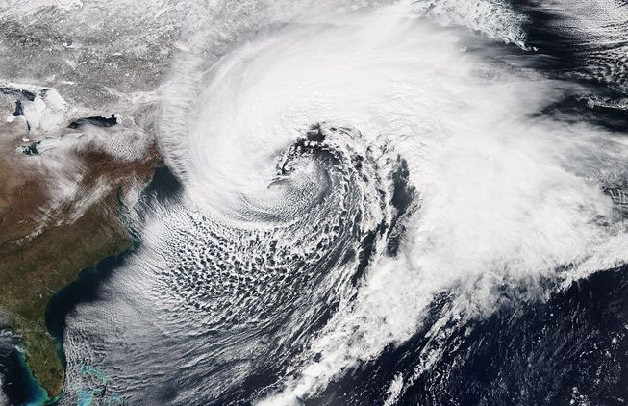
Extratropical Cyclones: Extratropical cyclones are capable of producing anything from cloudiness and mild showers to severe gales, thunderstorms, blizzards, and tornadoes.

Slide 17
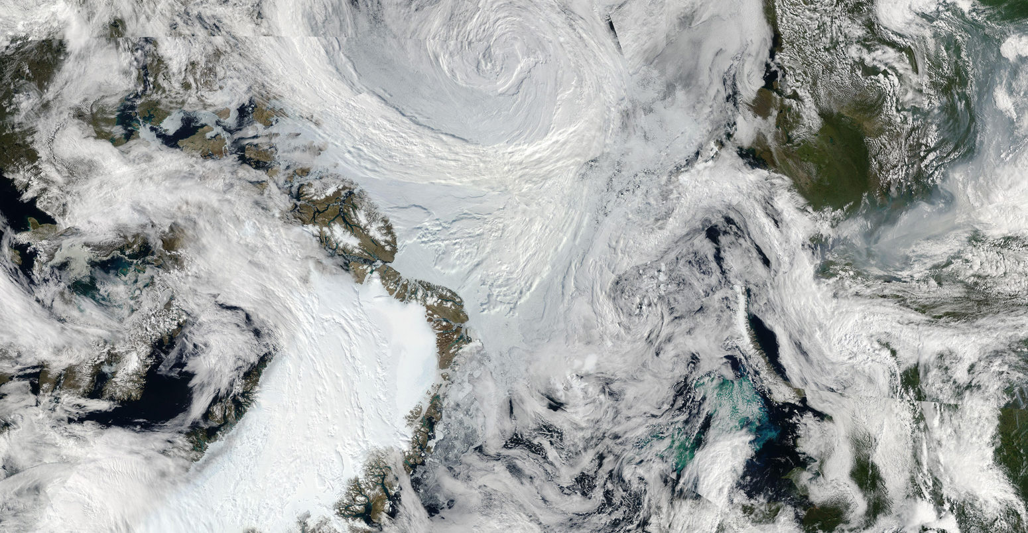
Arctic Hurricanes

Slide 18
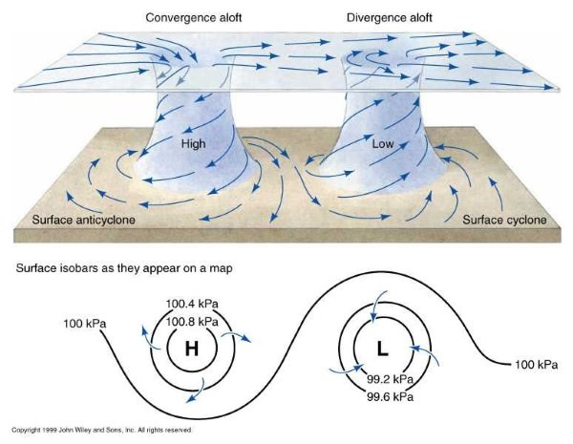
Cyclone and Anticyclone

Slide 19
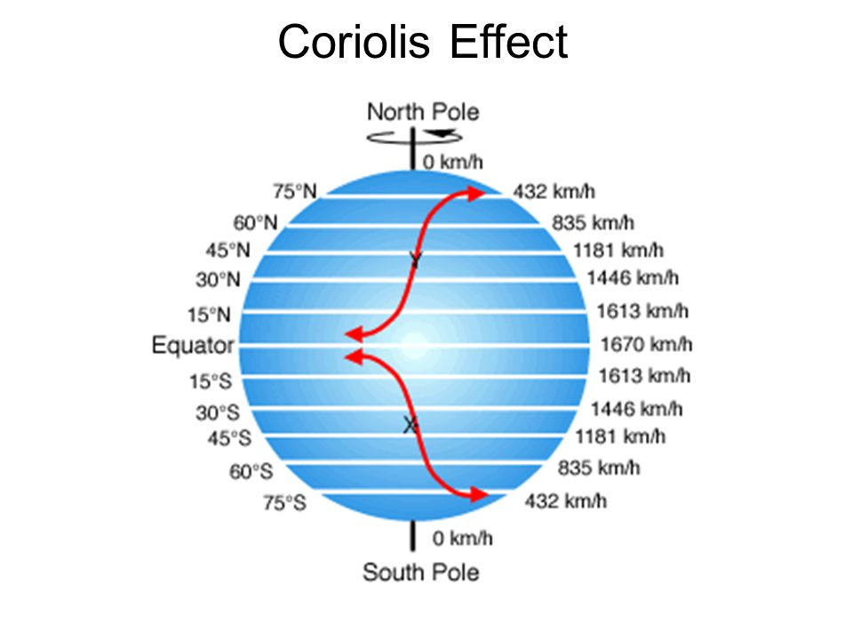
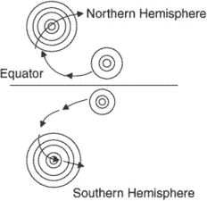
Cyclone and hemispheres
counterclockwise rotation in the Northern Hemisphere
clockwise rotation in the Southern Hemisphere

Slide 20
Cyclones
Effects of Cyclones
They damage installations, communication systems, trees, etc.
Results in loss of life and property
They may cause river floods and submergence of low-lying areas
Management of Cyclones
Proper construction of houses and Construction of cyclone shelters in the cyclone-prone areas
Relief tasks
Development of warning systems
Community preparedness at all levels to deal with emergency situations

