Slide 1
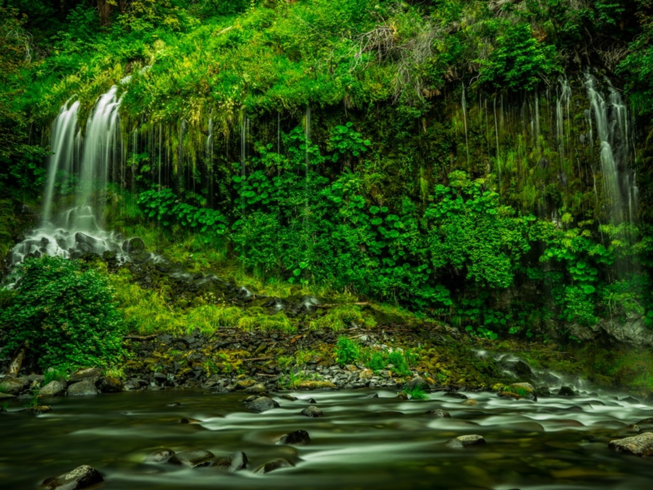
Environmental Pollution - 1

Slide 2
Learning Outcomes
Pollution
Types of pollution
Some methods to control Pollution

Slide 3
Pollution
Pollution is the introduction of contaminants into the natural environment that cause adverse change. Pollution can take the form of chemical substances or energy, such as noise, heat or light.
Pollutants, the components of pollution. They can be either foreign substances/energies or naturally occurring contaminants.
12/03/19

Slide 4
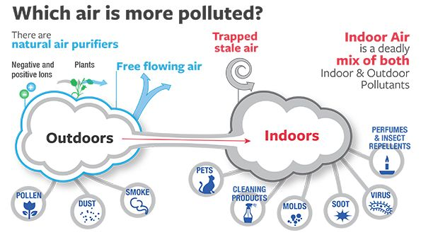
Air Pollution
Air pollution: Air pollution is said to exist if the levels of gases, solids, or liquids present in the atmosphere are high enough to harm humans, other organisms, or materials.
  Indoor Air Pollution
  Outdoor Air Pollution
Soot: a deep black powdery or flaky substance consisting largely of amorphous carbon, produced by the incomplete burning of organic matter.
Molds: Fungus
Pollen: powdery substance that contain grains which represent the male portion of the reproductive process in plants and trees.

Slide 5
Air Pollution
Types of Air Pollutants
  Primary
    harmful chemicals that are released directly from a source into the atmosphere.
    Examples: Particulate matter such as soil particles, lead, and asbestos (used for strengthening cement and plastics as well as for insulation, roofing, fireproofing, and sound absorption) Oxides of carbon and nitrogen and sulphur dioxide, Hydrocarbons like methane and benzene
  Secondary
    produced from chemical reactions involving the primary pollutants.
    Example: Ozone, Sulphur trioxide, PAN (Peroxy Acetyl Nitrate), Photochemical smog

Slide 6
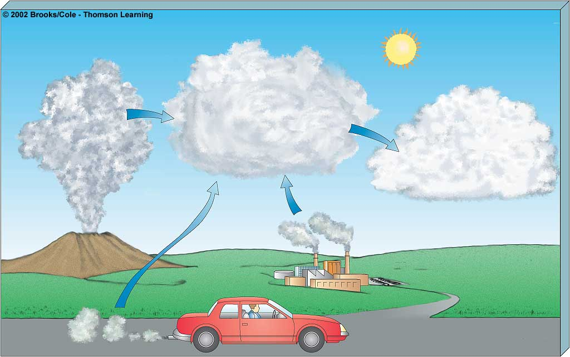
Primary Pollutants
CO
CO₂
Secondary Pollutants
SO₂
NO
NO₂
SO₃
Most hydrocarbons
HNO₃
H₂SO₄
Most suspended
particles
H₂O₂
O₃
₂
Most
NO₃
and
SO₄
–
salts
–
Mobile
Natural
Sources
Stationary

Slide 7
Air Pollution
Major Air Pollutants
  Carbon Monoxide
    Product by incomplete combustion of fuel such as natural gas, coal or wood. Vehicular exhaust is a major source of carbon monoxide.
    Causes carboxyhaemoglobin
  Carbon Dioxide
    A greenhouse gas emitted from combustion but is also a gas vital to living organisms. It is a natural gas in the atmosphere.
  CFCs
    Source: Refrigerators, air conditioners, foam shaving cream, spray cans and cleaning solvents
    Destroy ozone layer
  Ozone
    Ground level ozone (O₃) formed from NO_{x} and VOCs. Ozone (O₃)
    Damages skin and many materials, constituent of smog
12/03/19

Slide 8
Air Pollution
Major Air Pollutants
  Nitrogen oxides
    Especially nitrogen dioxide are emitted from high temperature combustion. Nitrogen dioxide is the chemical compound with the formula N0₂. It is responsible for photochemical smog, acid rain etc.
  Sulphur dioxide
    SO₂ is produced by volcanoes and in various industrial processes. Since coal and petroleum often contain sulphur compounds, their combustion generates sulphur dioxide. Further oxidation of SO₂, forms H₂SO₄, and thus acid rain.
  Suspended Particulate Matter (SPM)
    Particulates, alternatively referred to as particulate matter (PM) or fine particles, are tiny particles of solid or liquid suspended in a gas. Sources of particulate matter can be manmade or natural. Increased levels of fine particles in the air are linked to health hazards such as heart disease, altered lung function and lung cancer.
12/03/19

Slide 9
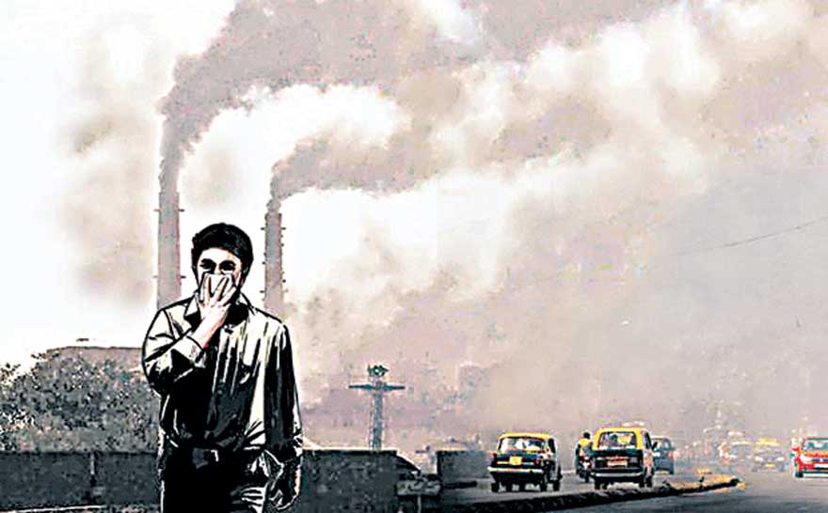
Air Pollution
Causes of Air Pollution
Natural Causes
  Natural disasters like volcanic eruption, cyclones, forest fires, microbes(CH₄)
  Natural emissions from animals, decaying organic matter
Anthropogenic (Man made) Causes
  Industrial emissions
  Automobiles
  Thermal power stations
  Nuclear explosions
  Nuclear power plants
  Agricultural activities
  Disposal of garbage
  Mining activities
12/03/19

Slide 10
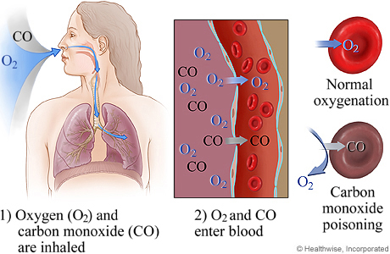
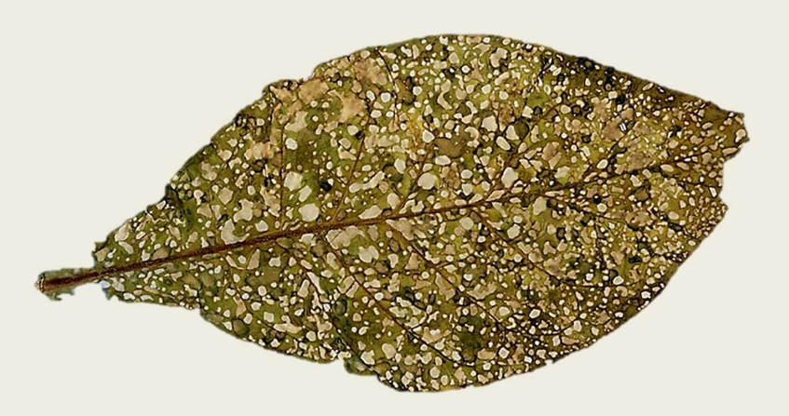
Air Pollution
Effects of Air Pollution
Effects on Human Health
  Carboxyhaemoglobin
  Inflammation of lungs
  Damage to respiratory system, and blood vascular system,
  Cancer
Effects on Plants
  Bleaching of the leaf pigment
  Development of necrotic spots
  Premature falling of leaves
Effects on Climate
  Greenhouse effect and global warming
  Acid rain
  Ozone (O₃) layer depletion

Slide 11
Air Pollution
Prevention and control of air pollution
  Air pollution can be prevented by
    Adopting cleaner technologies,
    Reducing pollution at the source,
    Implementing laws and regulations to make people pollute less,
    Introducing appropriate transportation policies
    Making cleaner and fuel-efficient vehicles
  Air pollution can be controlled by
    Various Air Pollution Control (APC) devices
    Sprinkling water on soil that is being evacuated during road construction

Slide 12
Air Pollution
Air Pollution Control (APC) devices
  Particulate Matter
    Cyclone separator
    Bag house filter
    Scrubbers
    Electrostatic precipitators
  Gaseous pollutants (Adsorption and Absorption)
    Venturi scrubbers
    Packed bed scrubbers
    Spray towers
12/03/19

Slide 13
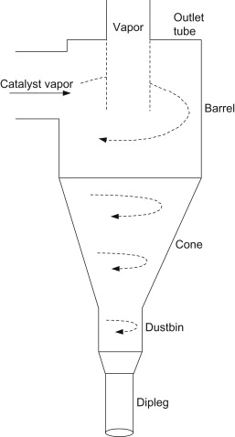
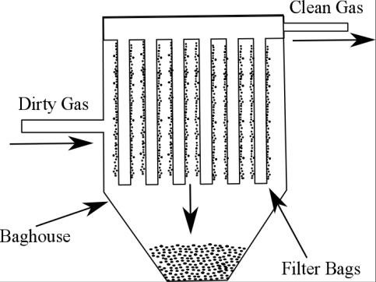
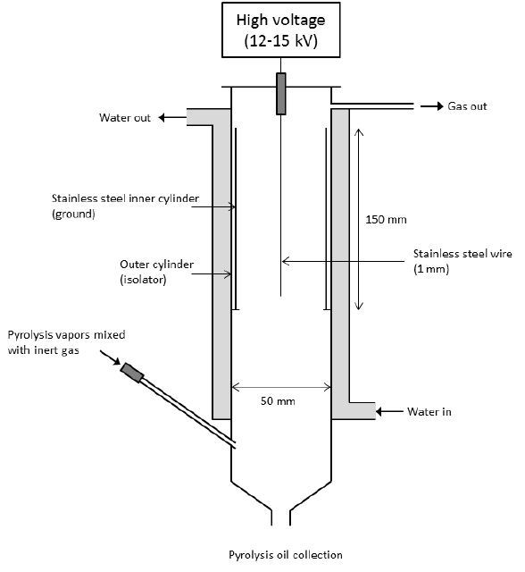
Air Pollution Control Devices
Baghouse Filter
Separates the particles upto 1 μm
Cyclone separator
Separates the particles > 100 μm
Electrostatic Precipitator
efficiencies greater than 99 percent.

Slide 14
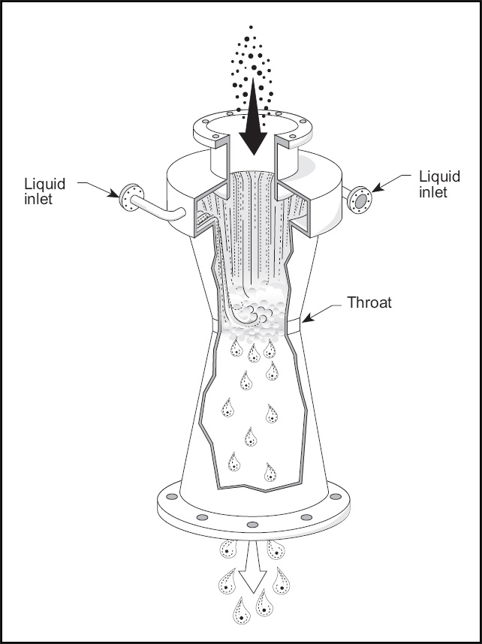
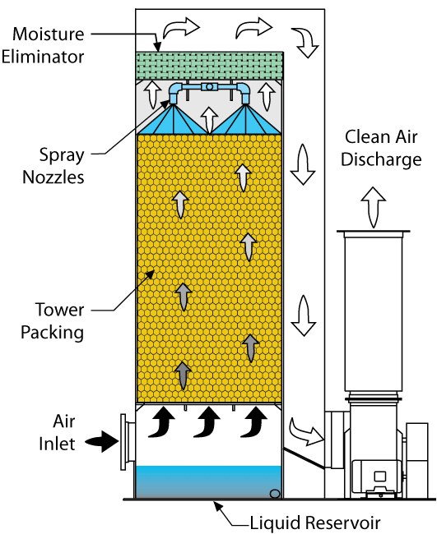
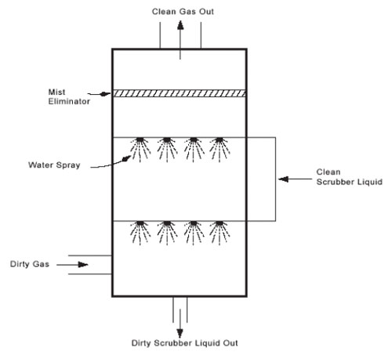
Air Pollution Control Devices
Venturi Scrubber
Packed bed Scrubber
Spray Tower

Slide 15
Q What causes acid rain?
High concentrations of sulfuric or nitric acid from pollution
Fertilizer use
Pesticide use
CFCs

Slide 16
Q. Dust, ash and pollen are examples of which type of air pollutant
Lead
Ground-level ozone
Particulate matter
Nitrogen oxides

Slide 17
Q. Which among following combines with other pollutants to form acid rain
Nitrogen oxides & sulfur dioxide
Particulate matter & lead
Nitrogen oxides & ground-level ozone
Sulfur dioxide & ground-level ozone

Slide 18
Q. Clean air consists mostly of
nitrogen and oxygen
carbon dioxide and argon
oxygen and carbon dioxide
water vapor and oxygen

Slide 19
Q. Secondary pollutants are formed from the reaction of
Primary pollutants
Radon
Carbon monoxide
Smog

Slide 20
Ill Effects of Fireworks
Fire Hazards: Fireworks can set fire to huts, heaps of dry grass and even houses.
Noise Pollution: Firecrackers make more noise than the allowed decibel limit.
Air Pollution: Components of the smog caused by firecrackers are harmful when inhaled. Such as,
  Copper causes irritation in the respiratory tract. Cadmium causes anemia.
  Lead in the body has a harmful effect on the nervous system.
  Magnesium: Magnesium and zinc fumes cause metal fume fever.
  Smokes from fireworks causes reduced visibility.

Slide 21
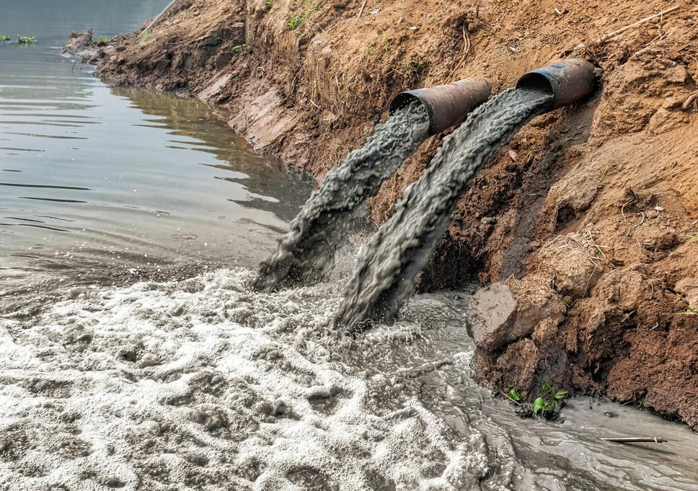
Water Pollution
The addition of various organic and inorganic substances that change the physical and chemical properties of water thereby leading to detrimental effects on living organisms and reducing water usability is termed as water pollution.

Slide 22
Causes of Water Pollution
Natural Causes-
  Soil erosion due to rain, floods, high speed wind.
  Deposition of dead and decaying remains of plants and animals.
Man-made Causes-
  Sewage and other wastes: Includes papers, cloth, soap, detergents, waste.
  Industrial waste: effluents such as oil, grease, plastic, metals, acids and other toxic chemicals.
  Agricultural waste: fertilizers, pesticides.
  Human activities: bathing, washing clothes (use of synthetic detergents).
  Customs and traditions: disposal of dead bodies, immersion of idols of gods.

Slide 23
Sources of water pollutants
Point sources
  Pollutants enter the water at a single point. Examples: sewage treatment plant and factories. These can be regulated through law.
Non point source
  pollutants enter the water over large areas. Examples: Surface run off, mining wastes, municipal wastes, acid rain and soil erosion

Slide 24
Water Pollutants and its effects
Sediments: Excessive amounts of soil particles carried by flowing water, when there is severe soil erosion. Sediments cloud the water and reduces photosynthesis, destroys feeding ground of fishes, clogs reservoirs and channels.
Oxygen-demanding wastes (BOD and COD): Organic waste such as animal manure and plant debris that are decomposed by bacteria, from sewage, animal feedlots, paper mills, and food processing facilities. These bacteria deplete the oxygen and causes death of fish.
Infectious microorganisms (Pathogens): Parasitic worms, viruses and bacteria from infected organisms as well as human and animal wastes. They are responsible for water borne diseases.
Synthetic chemicals: Synthetic chemicals from industrial effluents, surface runoff, and cleaning agents. These chemicals causes health problems for humans and harm fishes.
12/03/19

Slide 25
Water Pollutants and its effects
Inorganic nutrients: Substances like nitrogen and phosphorus from animal waste, plant residues, and fertilizer runoff. These nutrients causes eutrophication.
Radioactive substances: Wastes from nuclear power plants, nuclear weapons production, mining and refining uranium and other ores. Such substances causes cancer and birth defects.
Thermal pollution: Hot water from industrial processes. Heat lowers oxygen demand and makes aquatic life more vulnerable to diseases, parasites. Thermal shock in aquatic organisms.
12/03/19

Slide 26
Effects of Water Pollution
Effect on human health
  Infectious diseases can be spread through contaminated water. These water-borne diseases are caused by bacteria (Typhoid, Cholera, diarrhoea etc. ) or by viruses (Infectious Hepatitis)
  Pesticides – can damage the nervous system and cause cancer.
  Mercury – Minamata disease
  Chlorides can cause reproductive and endocrinal damage.
  Nitrates – are especially dangerous to babies that drink formula milk. It restricts the amount of oxygen in the brain and cause the “blue baby” syndrome.
  Lead – can accumulate in the body and damage the central nervous system.
  Arsenic – causes liver damage, skin cancer and vascular diseases
  Flourides - in excessive amounts can make your teeth yellow and cause damage to the spinal cord.
12/03/19

Slide 27
Effects of Water Pollution
Effects on animals
  Loss of aquatic biodiversity: Harmful chemicals and pollutants in water effect survival of aquatic organisms
Effects on plants
  Eutrophication of water bodies: Nitrate and phosphate fertilizer used to increase nitrogen and phosphate content of soil goes in water and increases the growth of certain plants on surface of water body.
  Polluted water contains high concentration of heavy metals becomes toxic for plants.
12/03/19

Slide 28
Pollution of Groundwater
Excessive extraction of groundwater leads to the natural pollution of groundwater. Examples are fluoride and arsenic contamination.
Groundwater receives pollutants from septic tanks, landfills, hazardous waste dumps, and underground tanks containing petrol, oil, chemicals, etc.
12/03/19

Slide 29
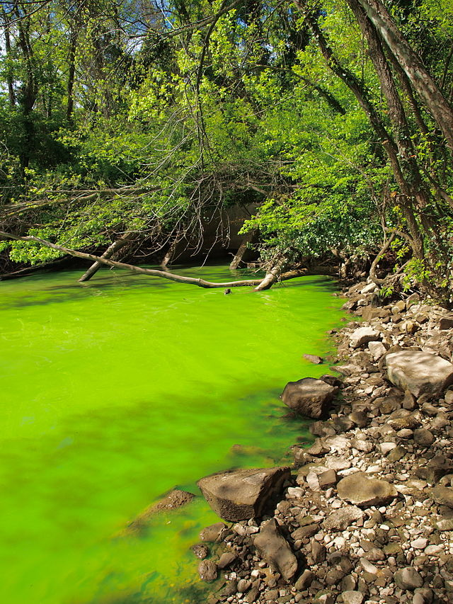
Eutrophication
Enrichment of a standing water body by nutrients, such as phosphorus and nitrogen.
Increased photosynthetic activity.
Excessive algae die, they fall to the bottom and gets decomposed. This process requires dissolved oxygen, some fish species die.
12/03/19

Slide 30
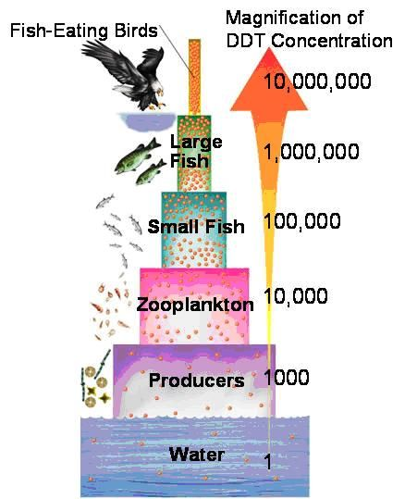
Biomagnification
Biomagnification is the increase in concentration of a substance, such as the pesticide, that occurs in a food chain. The pollutant enters the first organism in a food chain. When the second organism in the chain consumes the first one, the pollutant too moves into the second organism.
As we go up the levels of the ecological pyramid, there is energy loss. Hence, at each succeeding level, the predator consumes more of the prey. As a result, the organisms at higher levels have greater concentrations of the pollutant.
12/03/19

Slide 31
Control of Water Pollution
Treatment of domestic and industrial waste in order to reduce toxicity.
Control on excess use of fertilizers and pesticides in agriculture
Human activities such as bathing, washing ; throwing dead bodies should be stopped.
Non- biodegradable waste material such as plastic should not be disposed in water bodies.
Strict enforcement of rules
Public awareness
12/03/19

Slide 32
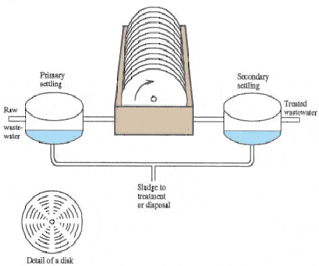
Waste water treatment
Primary treatment
  Grit removal
  Sedimentation
  Floatation
Secondary treatment
  Trickling filters
  Activated sludge process
  Rotating biological contactor
Tertiary treatment
  Chlorination
  Anaerobic treatment
    Hydrolysis, Acidogenesis, Acetogenesis, Metanogenesis
12/03/19

Slide 33
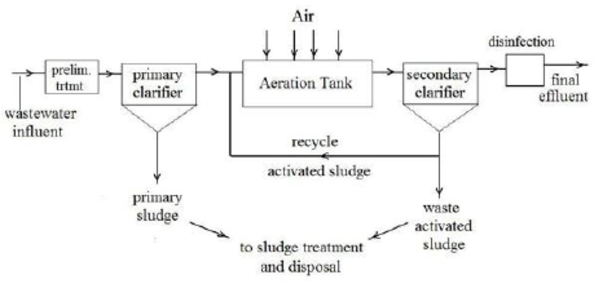

Slide 34
Thermal Pollution
Causes of thermal pollution
  Heat producing industries (thermal power plants, nuclear power plants, refineries, steel mills etc.)
Effects of Thermal Pollution
  The dissolved oxygen content of water is decreased.
  The composition of flora and fauna changes
  Metabolic activities of aquatic organisms increase at high temperature and require more oxygen, whereas oxygen level falls under thermal pollution.
  Toxicity of pesticides, detergents and chemicals in the effluents increases with increase in temperature
  High temperature becomes a barrier for oxygen penetration into deep cold waters
12/03/19

Slide 35
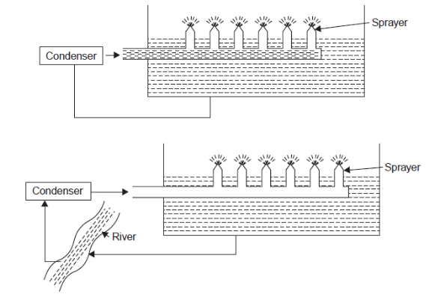
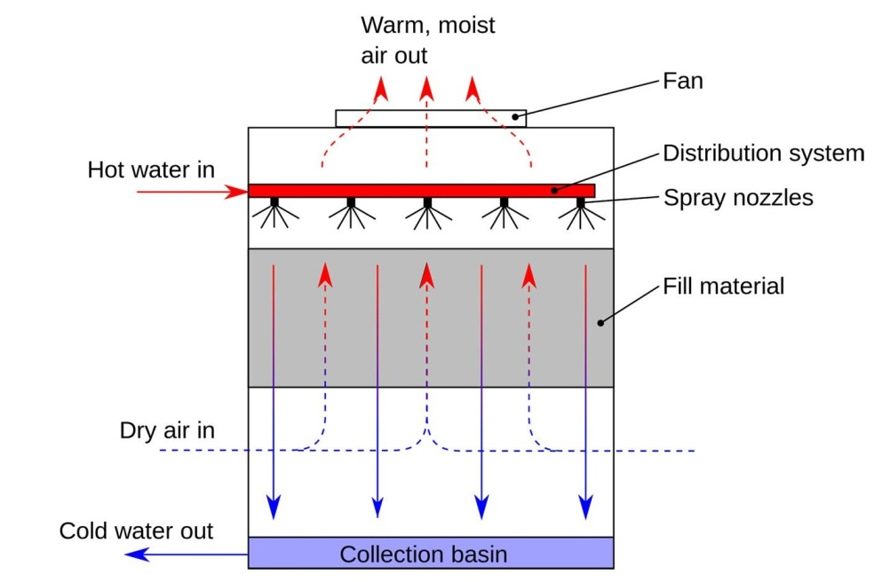
Thermal Pollution
Control of Thermal Pollution
  Cooling towers
  Cooling Ponds
  Spray Ponds

Slide 36
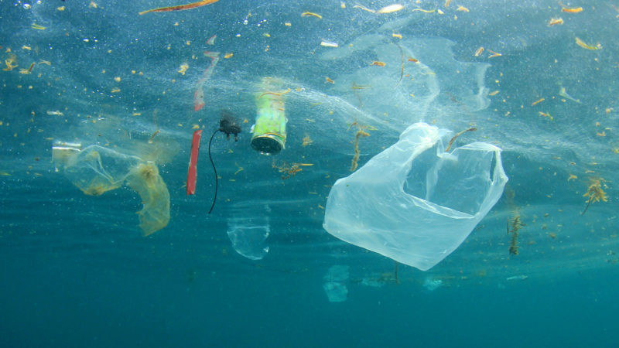
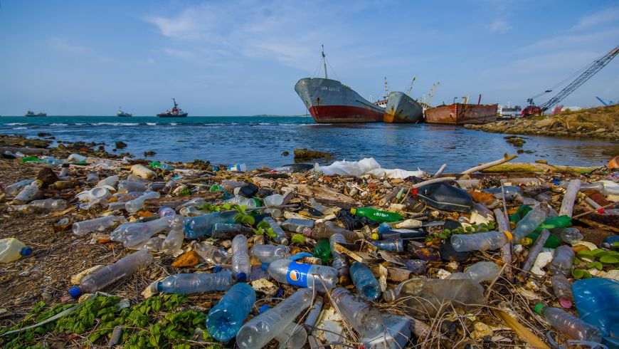
Marine Pollution
Sources of marine pollution
  Rivers, Catchment area, coastline, oil drilling and shipment.
Pollutants
  sewage sludge, industrial effluents, synthetic detergents, agrochemicals, solid wastes, plastics, metals and waste heat
12/03/19

Slide 37
Control of Marine Pollution
Toxic materials from the industrial plants should not be discharged in coastal water.
Run off from non-point source should be controlled.
Sewer overflow should be prevented.
Oil and grease from the service stations should be reused.
Oil balast should not be dumped into the sea.
Developmental activities in the coastal region should be minimized.
12/03/19

Slide 38
To be continued...

