Slide 1
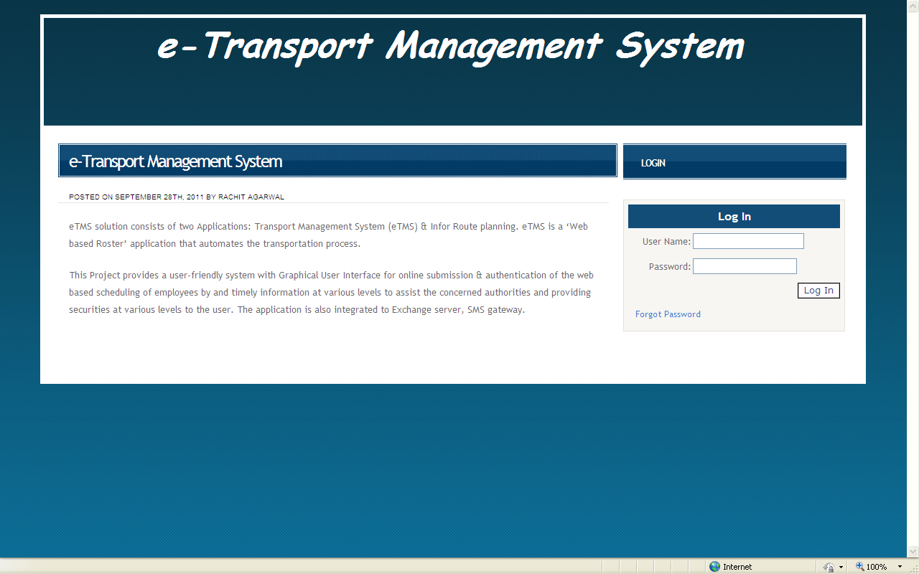
eTMS Login
Link to access eTMS - http://180.179.110.57/etms/login.aspx
Use your Employee Id as your username and default password as Nos@9999.

Slide 2
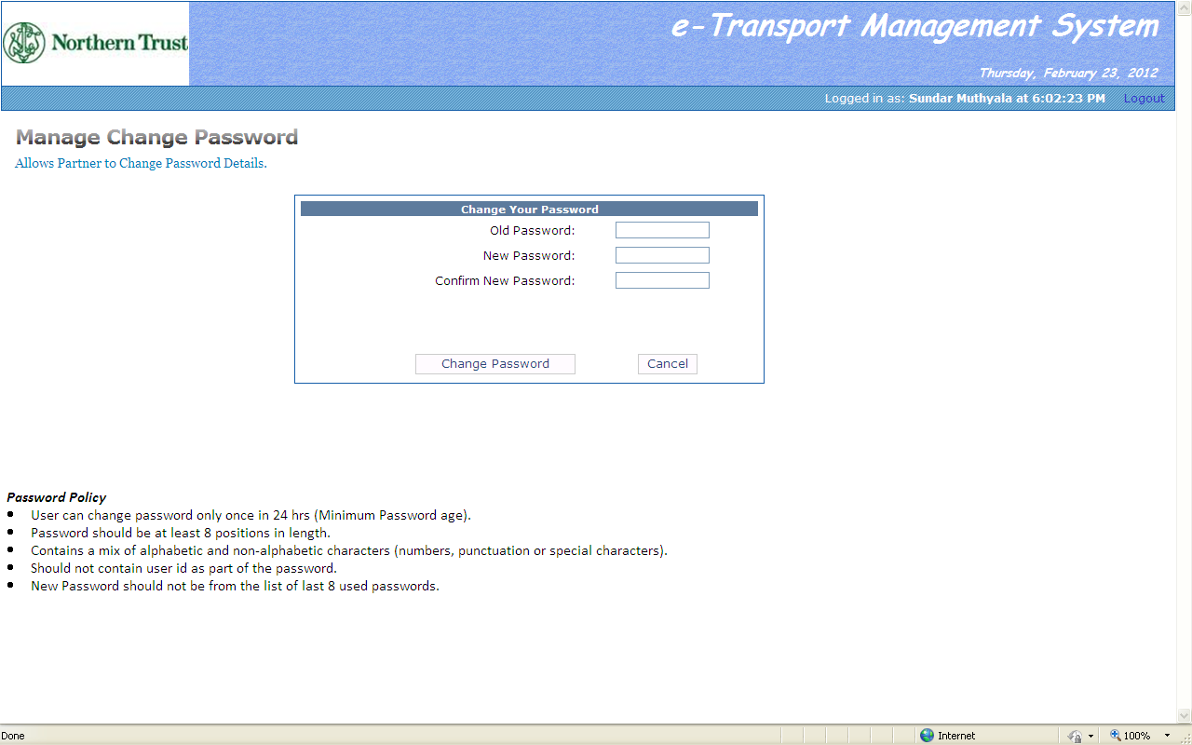
First Time Password Change
Enter your default password and then new password and confirm password,
Please read the password policy and follow the instructions for new password,
Click on “Change Password”,
Once the password is reset, please login again with the new password.

Slide 3
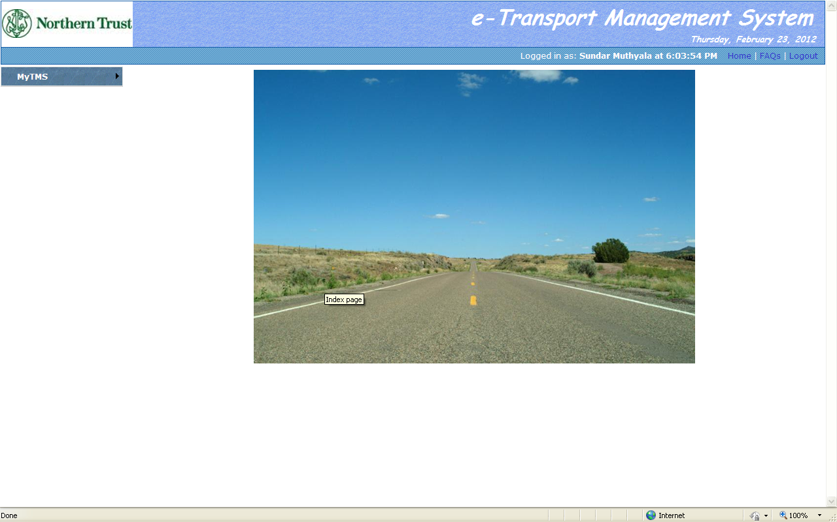
Home Page
The home page will appear with a module “MYTMS” on the left hand side.

Slide 4
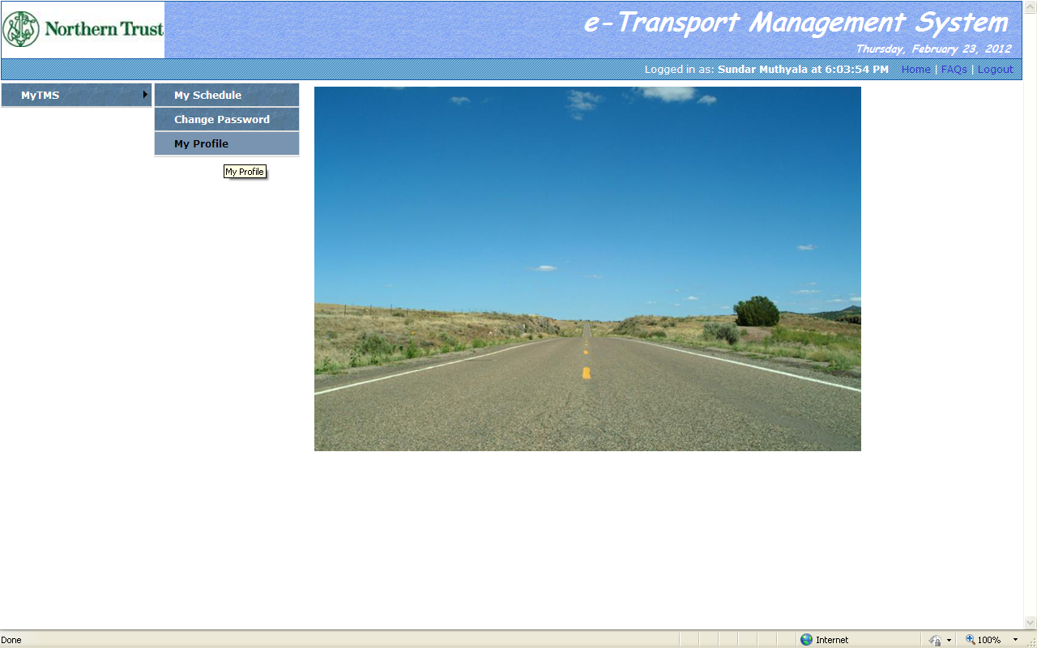
My Profile
Click “My TMS>My Profile” to view your profile,

Slide 5
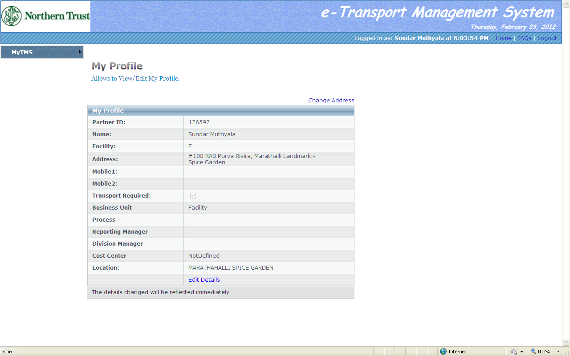
My Profile
Click here to raise request for address change
Click here to edit my profile details
Update the details such as contact number, reporting manager, division manager, process , sub
process and cost center,
Click on “Edit Details” link to update the details,
To raise an address change request, click on “Change Address” link at the top.

Slide 6
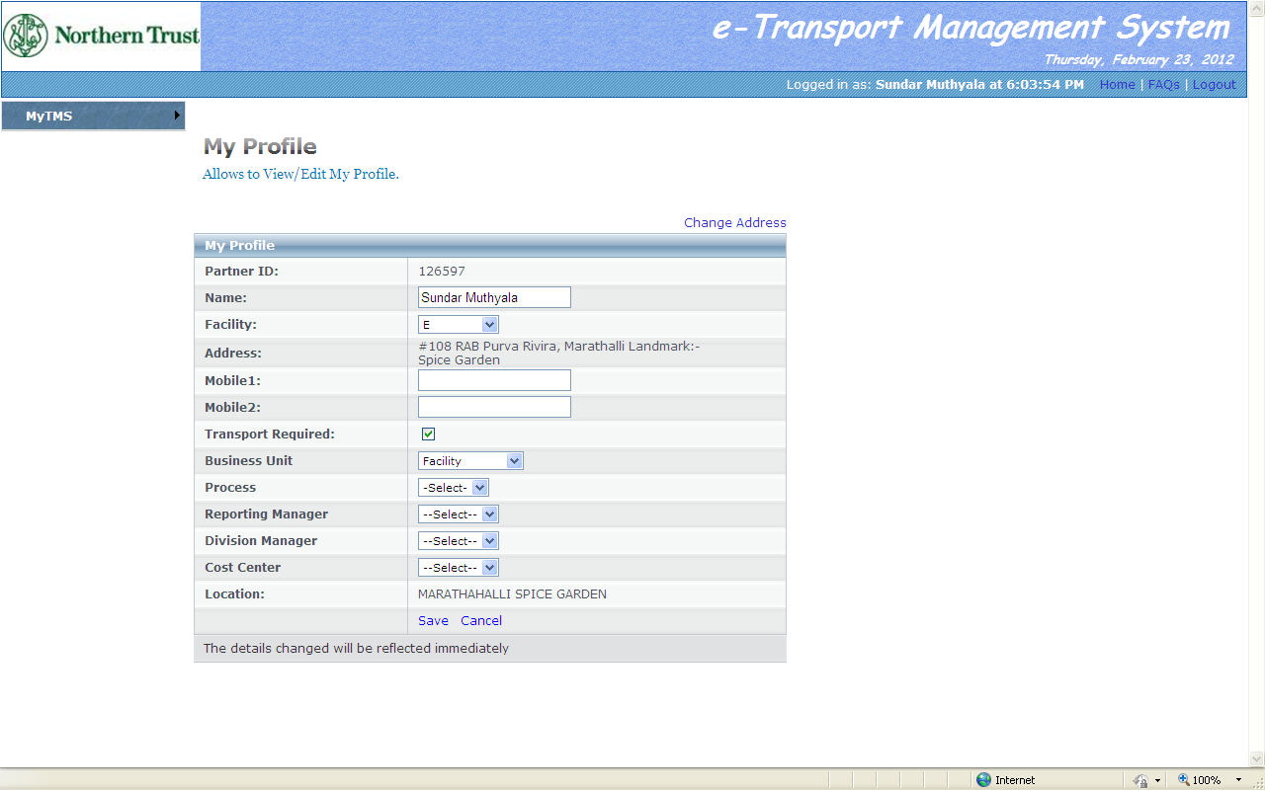
My Profile
Click on “Save” to save changed data
Once the details are entered, click save button and the details will be updated with immediate effect.

Slide 7
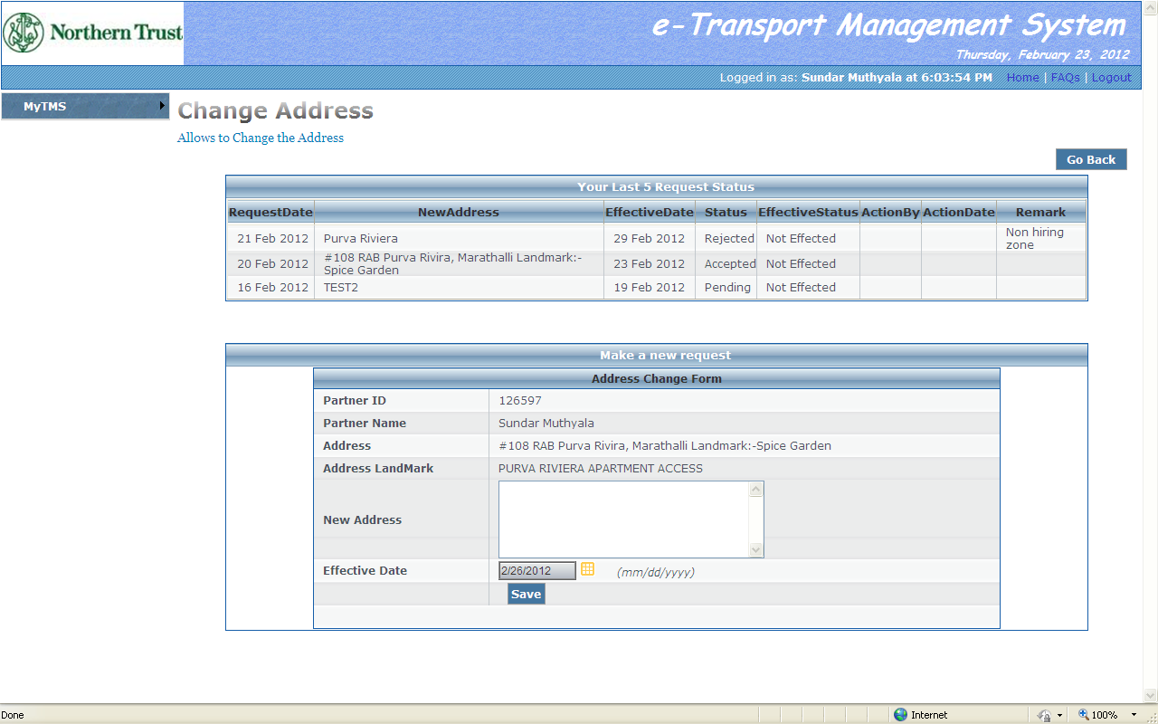
Change Address
Click on “Change Address” link and enter new address and effective date,
Also update the address change in My Place and send the screen shot of the same to the
transport helpdesk,
The transport team will validate and approve the address change request,
The Last five address change request status is displayed at the top.

Slide 8
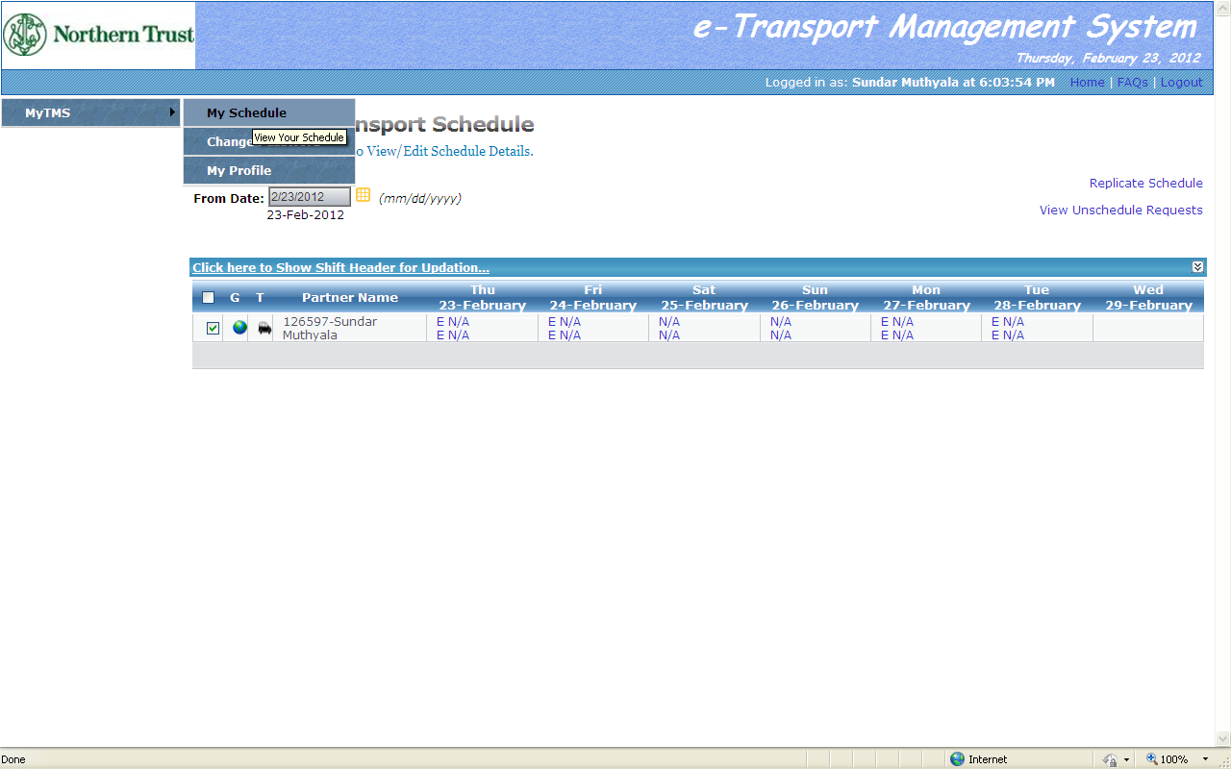
Employee Weekly Schedule
Shows if Employee Address is geo coded by transport team
Shows if Employee has opted for company transport
Click on “My TMS>My Schedule” to raise weekly roster,
The roster data for the next seven days from the current date will be displayed,
Change the “From Date” by clicking on the calendar icon,
To update the weekly roster click on “Click here to Show Shift Header for Updation”.

Slide 9
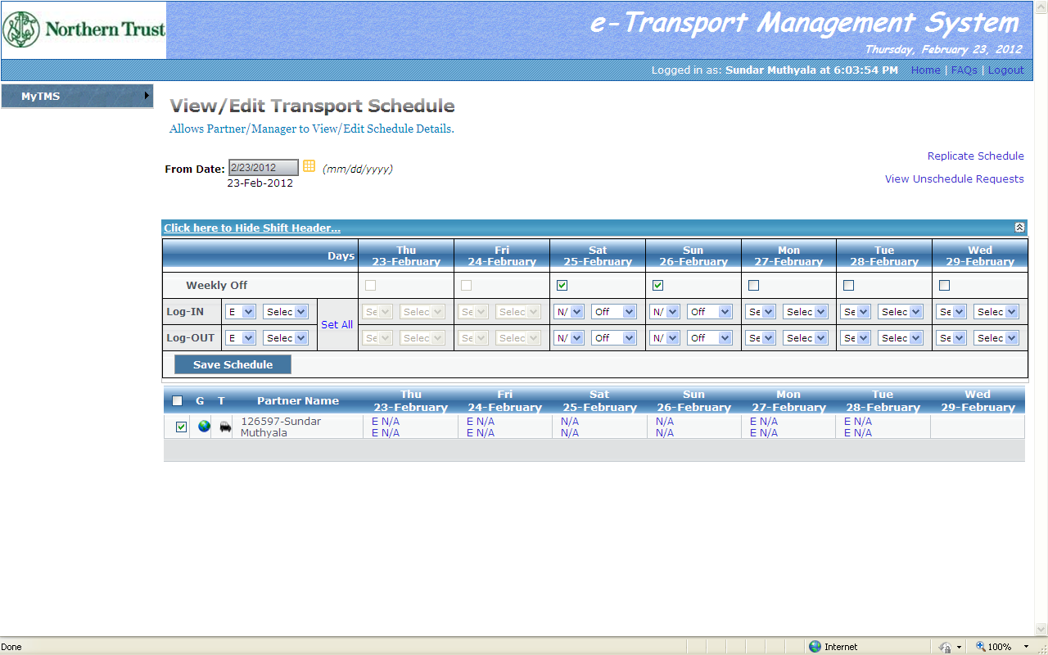
Employee Weekly Schedule
Update the shift roster for the week
First two days window would not be enabled due to roster cut off policy,
Saturdays and Sundays are marked weekly off by default,
The same can be edited by un checking the checkbox

Slide 10
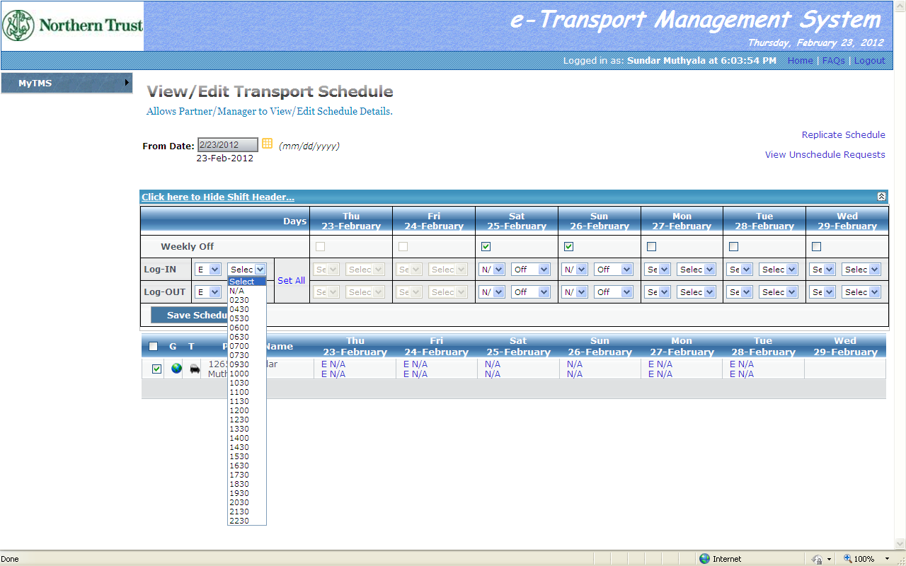
Employee Weekly Schedule
Select arrival and departure shift time according to the facility from the dropdown and click
set all.
Once set all is clicked the arrival and departure time will be updated for the rest of the week.

Slide 11
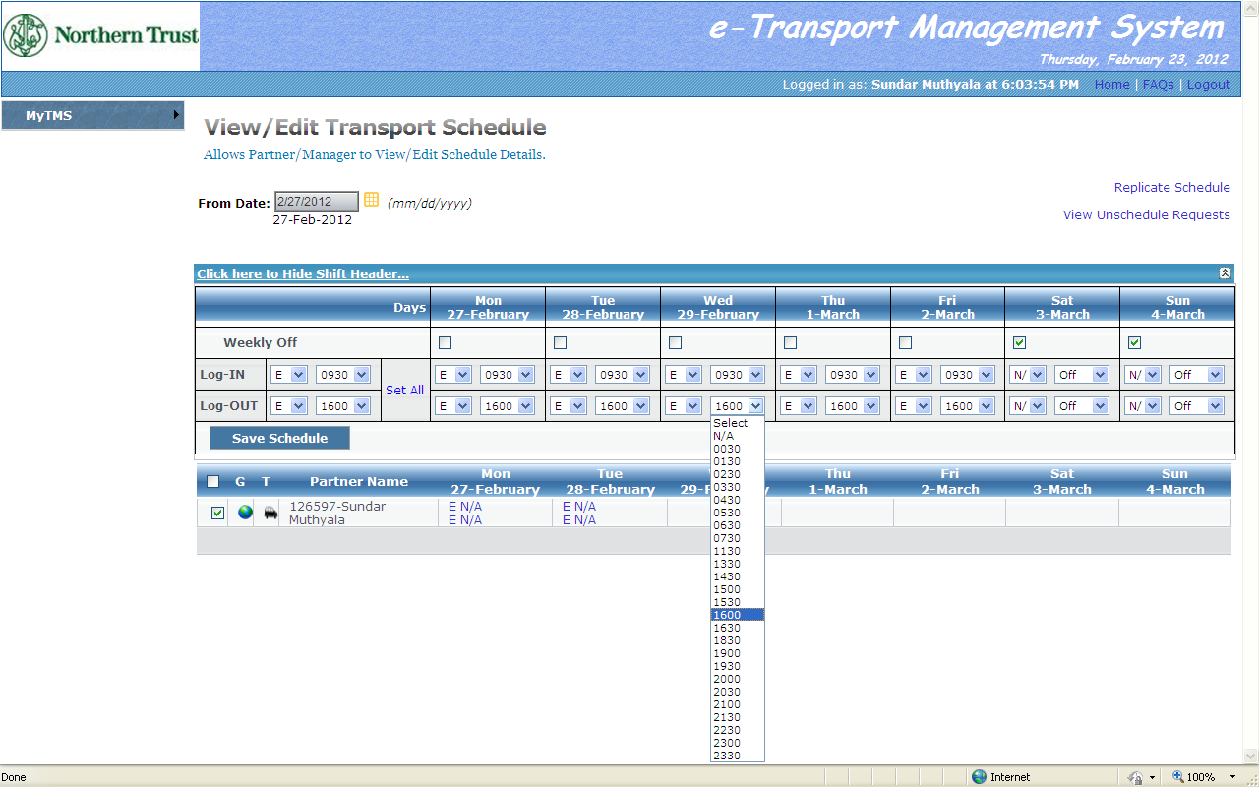
Employee Weekly Schedule - Edit
Click “Save Schedule” to save
To change the arrival and departure time for a particular day, click on that day`s dropdown
Change the arrival and departure time as per the schedule and click on “ Save Schedule” to
update

Slide 12
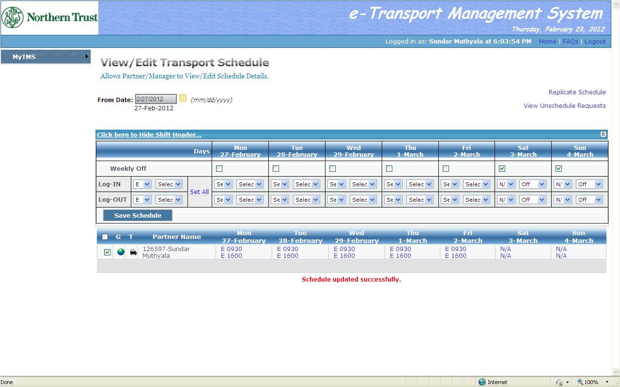
Employee Weekly Schedule - Edit
Once the weekly schedule is updated, the details of arrival and departure time will be displayed
at the bottom,
To raise an unscheduled request for pickup / drop, click on the arrival / departure time

Slide 13
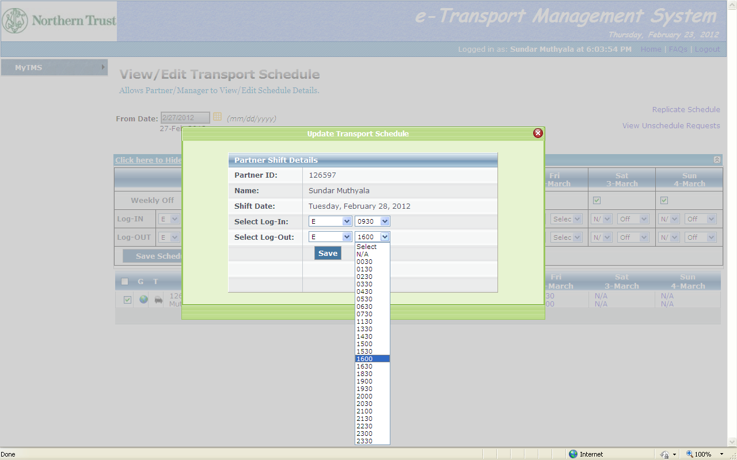
Edit Employee Schedule
To raise an unscheduled pickup request the cutoff time is 12 hours prior to the requested
arrival time,
To raise an unscheduled drop request there are 3 cutoffs,
The first cutoff is 3 hours prior to the departure time (daily change), second cutoff time is 1
hour prior to the departure time (aligned unscheduled) and the last cutoff is 15 minutes to the
departure time (unscheduled),
Select the appropriate arrival / departure time from the dropdown list and raise a request

Slide 14
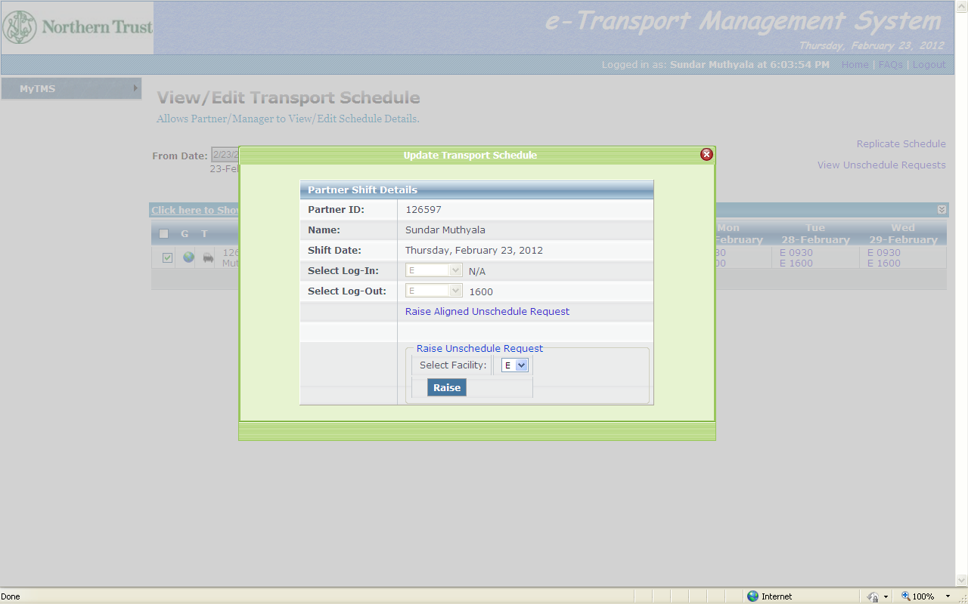
Edit Employee Schedule
Click here to raise aligned unscheduled request
After the daily roster cutoff time, click “Raise aligned unscheduled request” to avail an aligned
unscheduled drop,
The cutoff time to raise an aligned unscheduled request is 3 hours prior to the departure time.

Slide 15
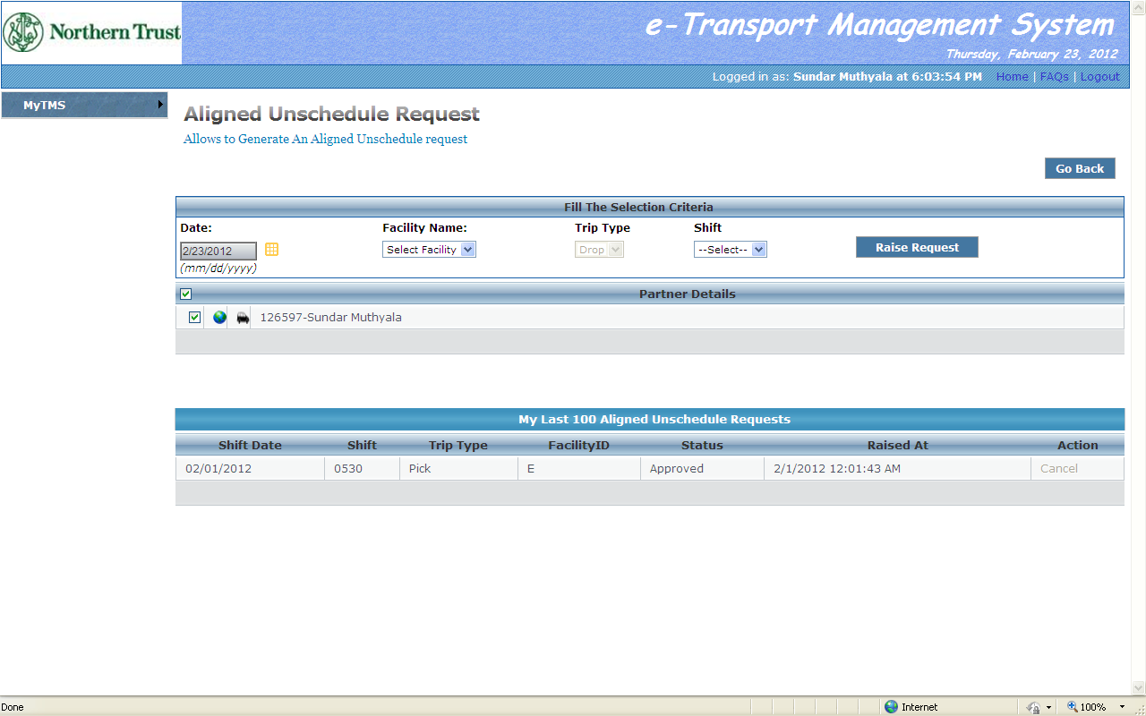
Aligned Unscheduled Drop Request
Click here to raise aligned unscheduled request.
Select the facility and the available shift time accordingly,
The request would be accommodated irrespective of the route / seat availability,
The request cannot be cancelled if it is approved and aligned to a route,
If the request is not approved and aligned yet, the same can be cancelled,
The last 100 aligned unscheduled requests raised will be displayed at the bottom.
If any of the shift is not available in the drop down raise an unscheduled drop request

Slide 16
Unscheduled Drop Request
Click here to raise unscheduled drop request
After the aligned unscheduled drop cutoff, to raise an unscheduled drop request click “Raise”
button by selecting the facility from the drop down,
The cutoff time to raise an unscheduled drop request is 15 minutes prior to the departure time.

Slide 17
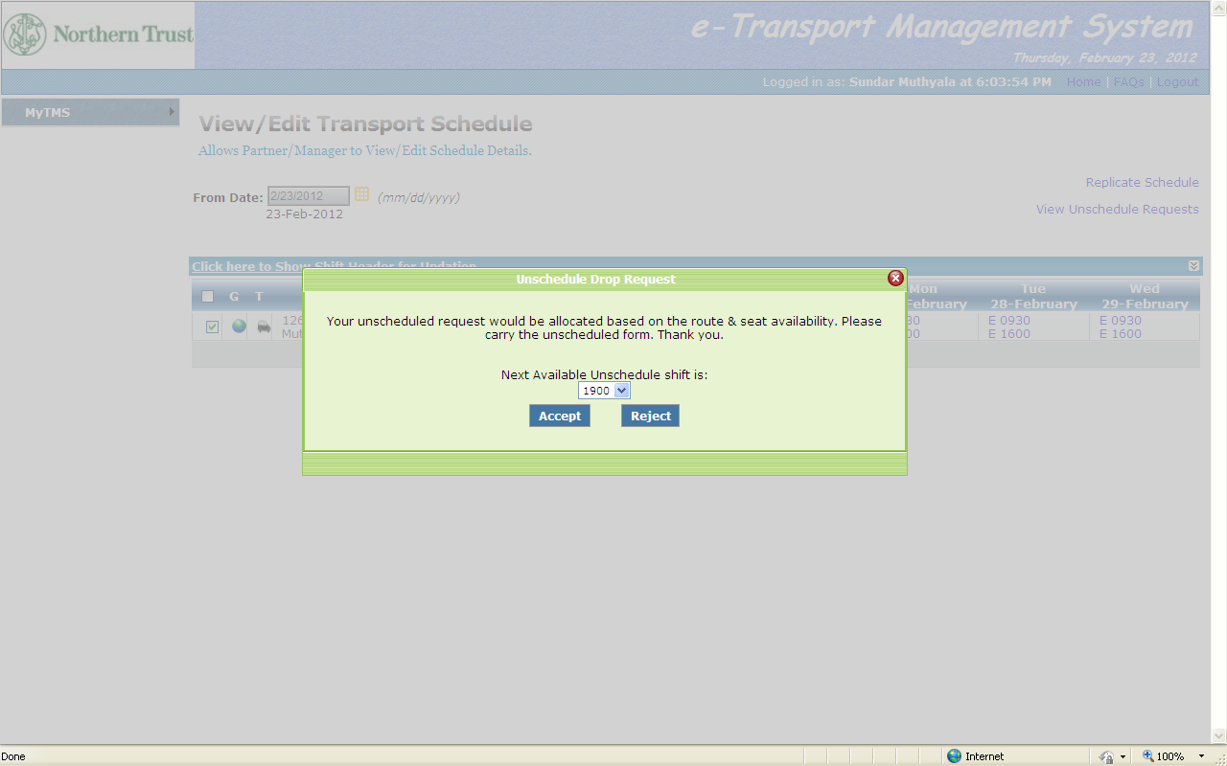
Unscheduled Drop Request
Click here to accept the selected shift for unscheduled drop request
Once “Raise” Button is clicked the drop with the next available unscheduled drop shift will be
displayed. Select the available shift and click “Accept” to raise the request,
The unscheduled drop request would be accommodated based on the route and the seat
availability,

Slide 18
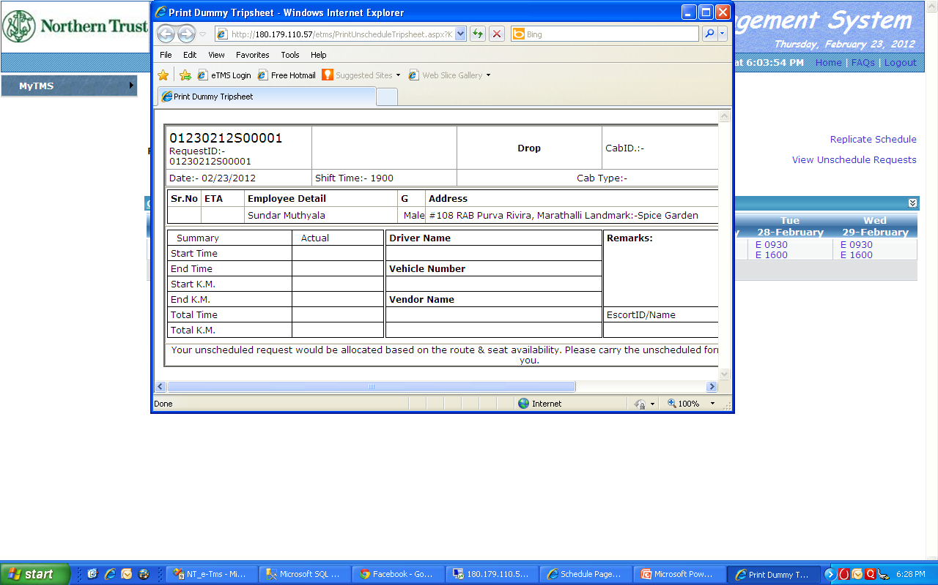
Unscheduled Drop Request
Click here to replicate schedule
Click here to view unscheduled requests
Sheet with unique Request ID
Once “Accept” button is clicked a new window will pop-up displaying the unscheduled form
with a unique request ID
Printout of the unscheduled drop request is to be carried to the departure bay.

Slide 19
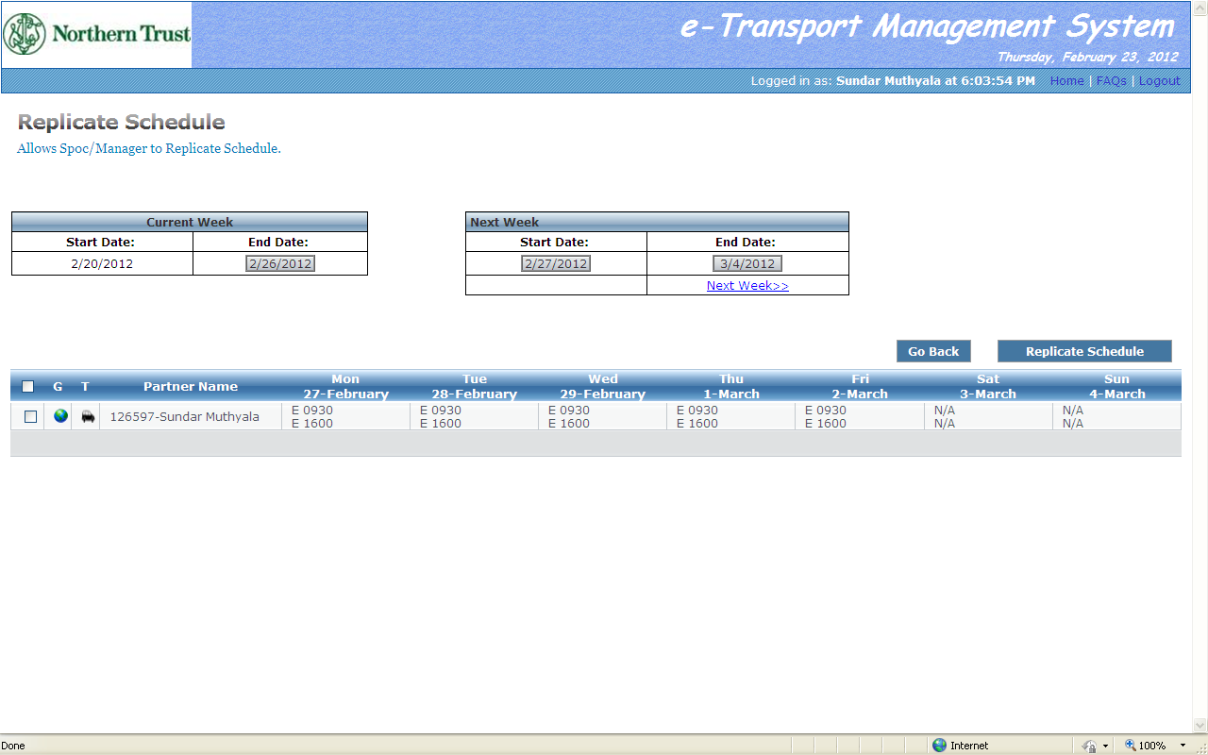
Replicate Schedule
Click here to select the week to replicate the roster
Click here to replicate roster
From My Schedule interface click “Replicate schedule” to replicate the next week roster,
Select the current week as template and replicate the roster for next week.

Slide 20
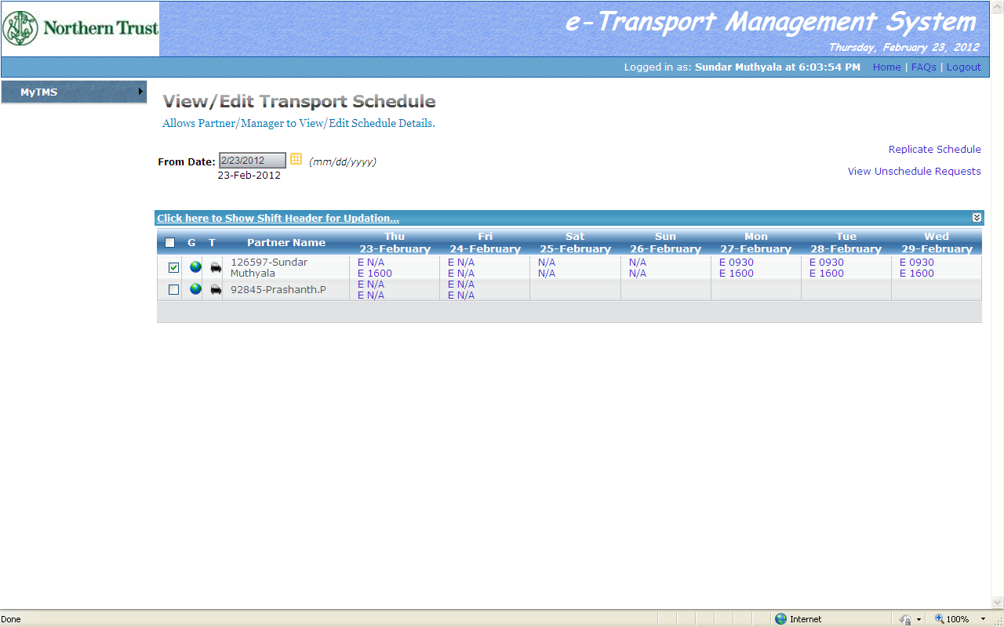
Access to Managers
Managers can update the roster for their team by selecting the checkbox
The managers can view and update the weekly schedule for their respective team,
The managers will not be able to raise any unscheduled request on behalf of the team
members

