Slide 1
Sonarqube Code Quality and Code Security
Saurabh Dhingra (DevOps Trainer and Consultant)

Slide 2
Module 1 Introduction

Slide 3






Continuous Integration
Code
Triggers
Build
Unit Tests
Code Quality/Metrics
Artefacts
Any change made to an application’s configuration, source code, environment or data triggers the pipeline
1. Build process verifies that the syntax of your source code is valid
2. Unit test checks that your application’s code behaves as expected.
3. The software should fulfil certain quality criteria such as test coverage & other technology-specific metrices

Slide 4
Static Testing Vs Dynamic Testing
Static testing is a method of debugging by examining source code before the program is executed, i.e. test code without executing it.
It does so by analyzing the code against a pre-set of coding rules and ensuring that it conforms to the guidelines.
This is done by a static code analysis tool like Sonarqube
Dynamic testing happens during the execution of the code.
It can help identify defects or vulnerabilities at a level where our application integrates with other systems like databases, servers and services.
Usually done by an expert QA

Slide 5






Static Code Analysis
Create an analysis of the code
Represent it visually
Static testing tool
Write code
Developer
Code

Slide 6
Reason to use static code analysis
Finds error earlier in the development
Detects over complexity in the code
(Refactoring/Simplification)
Find security errors
Enforce best coding practice
Automation & integration with CI/CD tools
Project specific rules

Slide 7
Sonarqube
SonarQube empowers all developers to write cleaner and safer code.
SonarQube is a self-managed, automatic code review tool that systematically helps you deliver Clean Code.
SonarQube integrates into your existing workflow and detects issues in your code to help you perform continuous code inspections of your projects.
The tool analyses 30+ programming languages and integrates them into your CI pipeline and DevOps platform to ensure that your code meets high-quality standards.

Slide 8
Sonarqube
Release Quality Code Every. Time.
Quality Gates tells you whether your code is ready to release at every analysis.
Maintainability = Productivity
Clean code means happier developers and higher team velocity
Code Security, for Developers
Detect security issues in code review with Static Application Security Testing (SAST)

Slide 9
Writing clean code
Writing Clean Code is essential to maintaining a healthy codebase.
Clean Code can be defined as code that meets a certain defined standard, i.e. code that is reliable, secure, maintainable, readable, and modular, in addition to having other key attributes.
This applies to all code: source code, test code, Infrastructure as Code, glue code, scripts, etc.

Slide 10
Developing with Sonar
The Sonar solution performs checks at every stage of the development process:
SonarLint provides immediate feedback in your IDE as you write code so you can find and fix issues before a commit.
SonarQube’s PR analysis fits into your CI/CD workflows with SonarQube’s PR analysis & use of Quality Gates.
Quality Gates keeps code with issues from being released to production, a key tool in helping you incorporate the Clean as You Code methodology.
The Clean as You Code approach helps you focus on submitting new, Clean Code for production, knowing that your existing code will be improved over time.

Slide 11
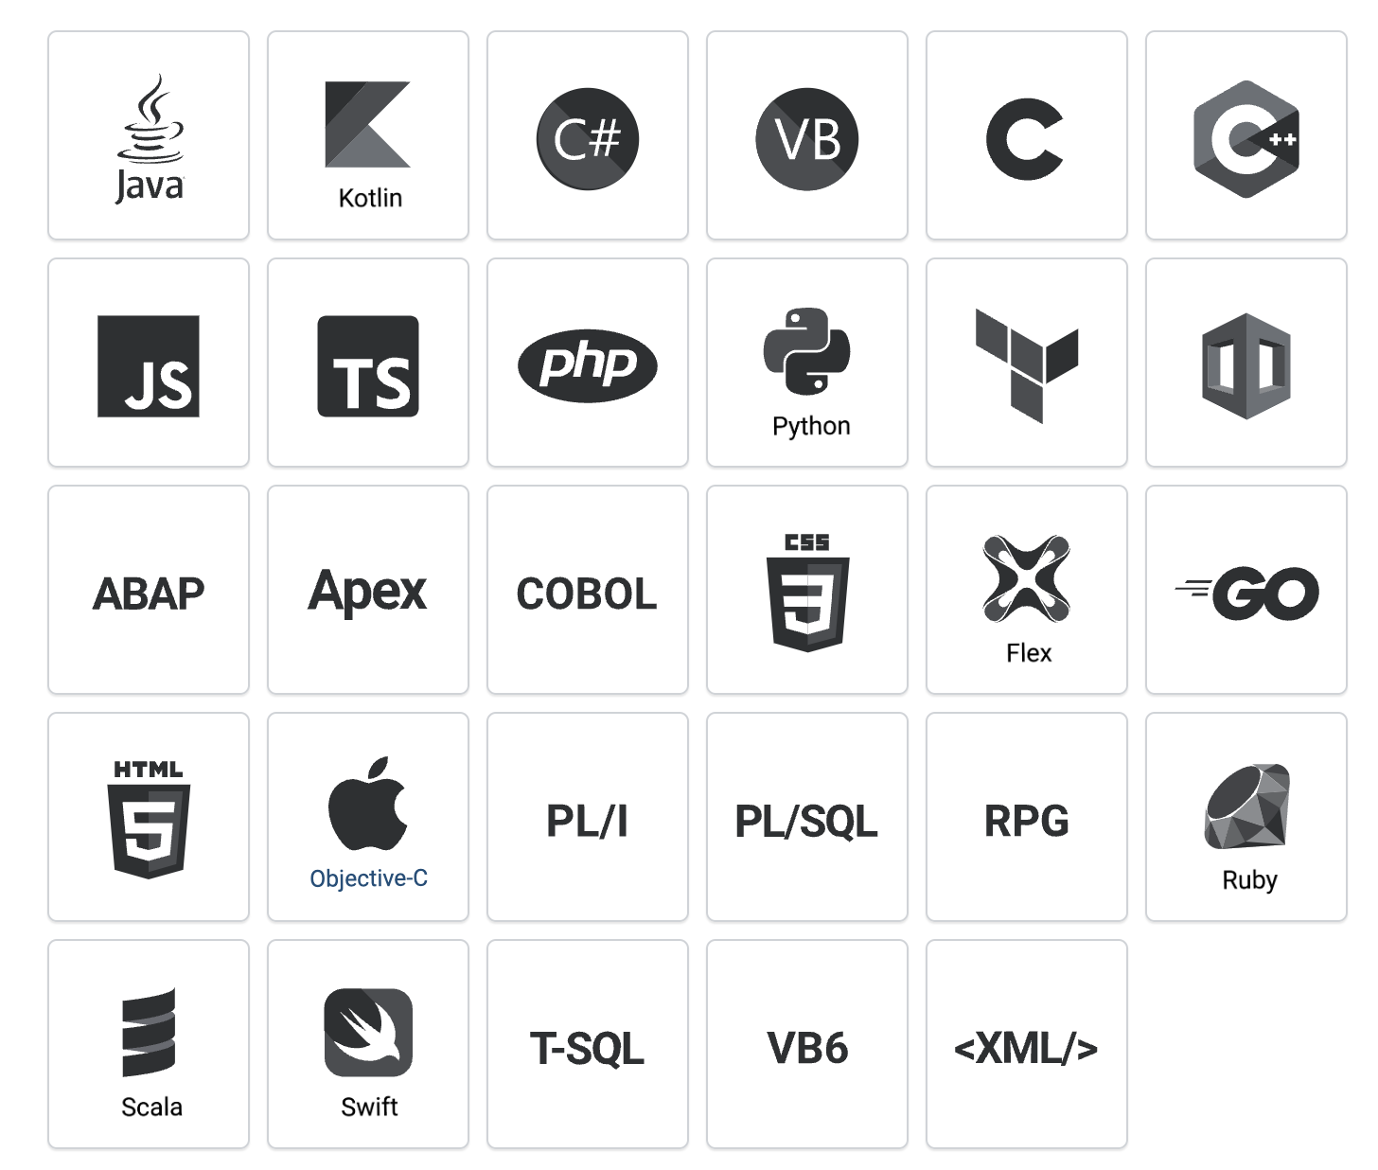
Sonarqube
SonarQube supports 29 programming languages
With SonarQube static analysis you have one place to measure the Reliability, Security, and Maintainability of all the languages in your project, and all the projects in your sphere.

Slide 12
Sonarqube can help
Detect bugs
Detect Code Smells
Security Vulnerabilities
Activate rules needed
Execution path
Notes:
Security issues like a developer forgets to close an open SQL connections
Or If important details like username and password are directly written in the code
Whenever there is data flow in your program, and there is a lot of involment between the different modules.
Sonarqube can figure out if there are any tricky bugs in these executions paths.

Slide 13
Sonarqube can help
Automated code analysis
Integrate with CI/CD tools with Webhooks and APIs
Integration with SCM tools like Github
Analyze branches and Decorate pull requests

Slide 14
Built-in methodologies
Discover memory leaks
Provides a good visualizer
Enforces a quality gate
Digs into issues
Provides plugins for IDEs
(Sonar lint)

Slide 15
Sonarqube License
Community Edition
Developer Edition
Enterprise Edition
Data Center

Slide 16
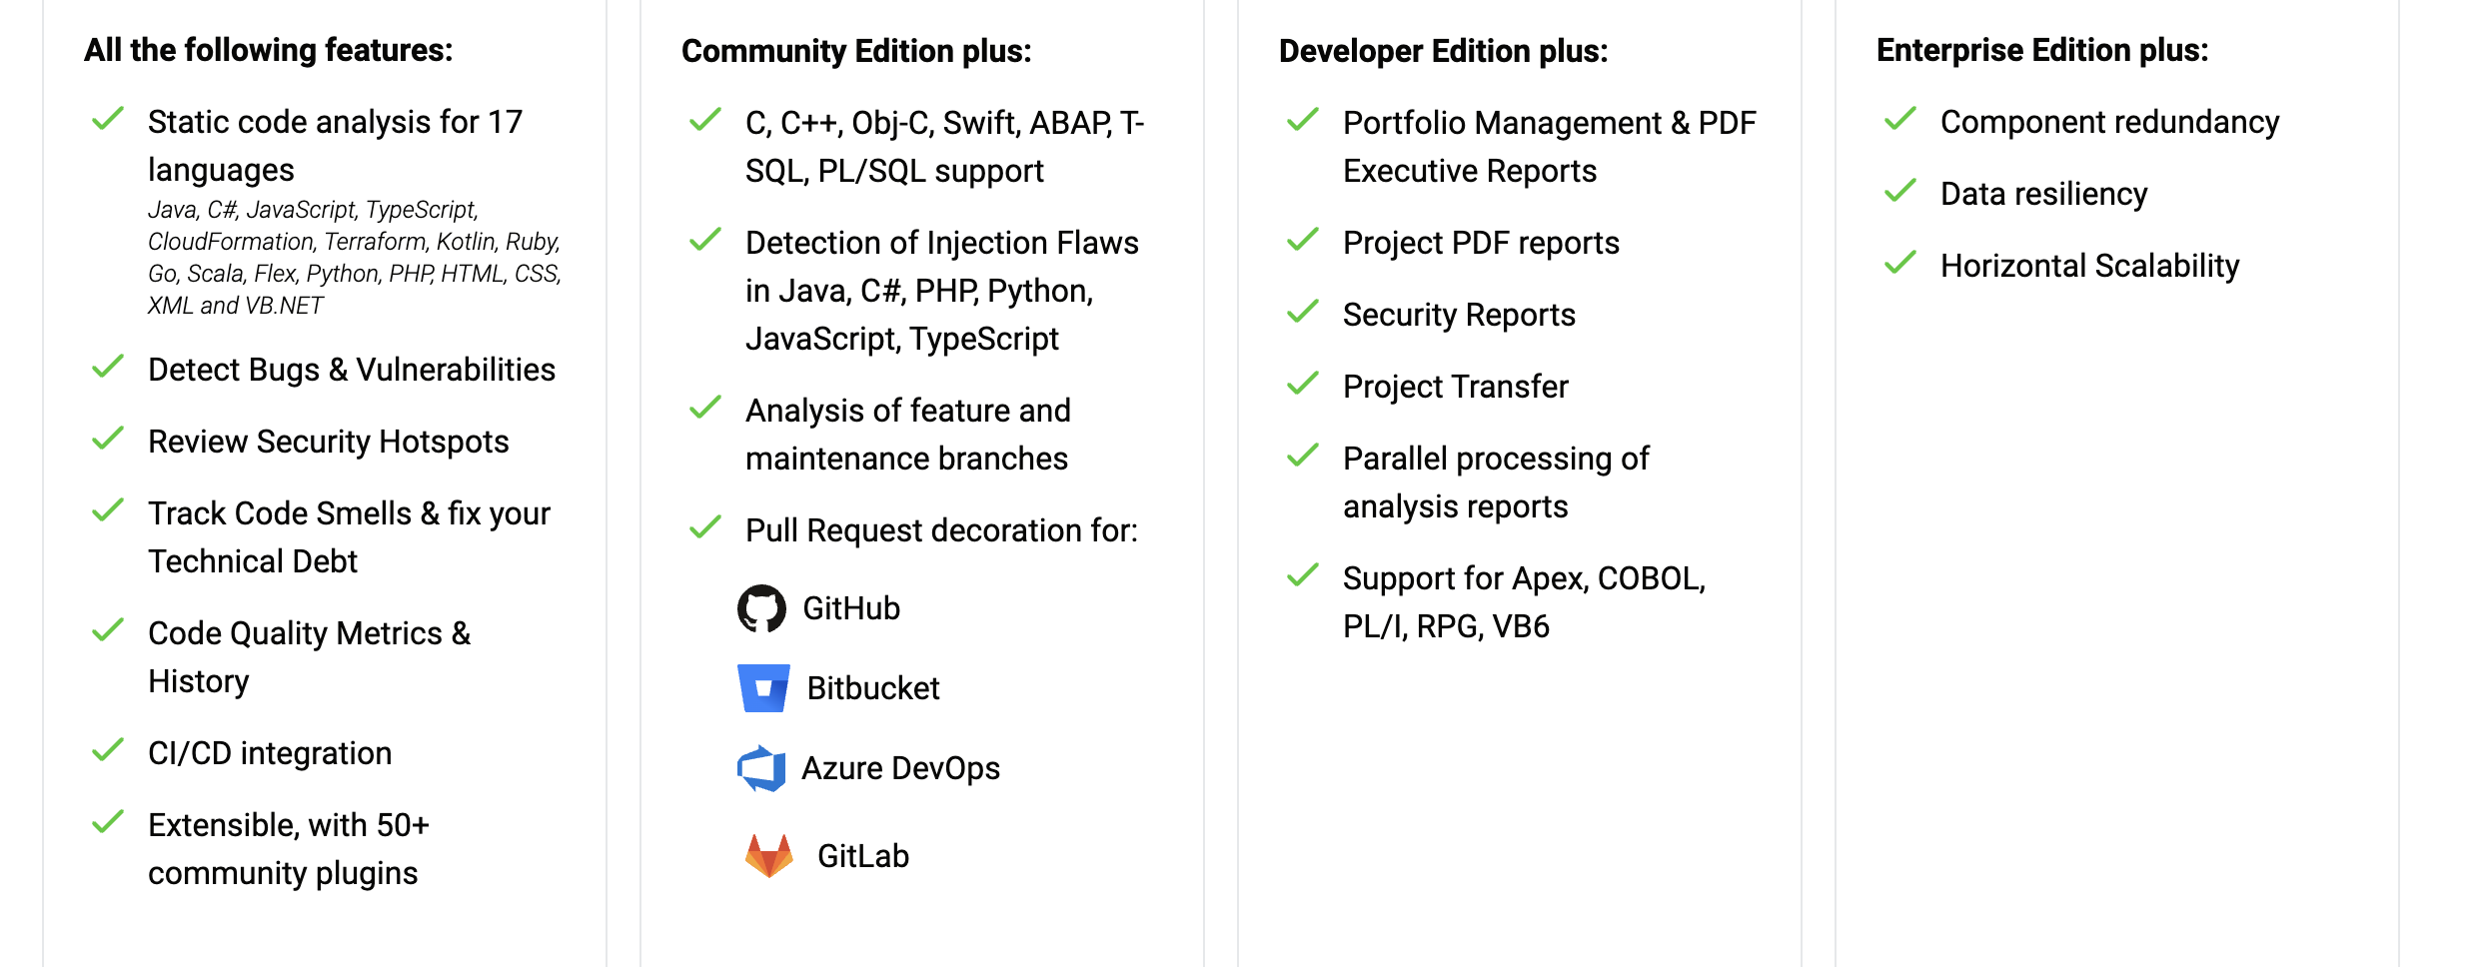
Community Edition
Developer Edition
Enterprise Edition
Data Center Edition

Slide 17
SonarQube Architecture

Slide 18


Scanner
(CI/CD)
SonarQube
Server
Web Server
Scanner and language analyzers
http(s)
Analysis
Report
queues
Compute
Engine
Search
Server
Database
Server

Slide 19
Sonarqube
The SonarQube server runs the following processes:
A web server that serves the SonarQube user interface.
A search server based on Elasticsearch.
The compute engine oversees processing code analysis reports and saving them in the SonarQube database.
The database to store the following:
Metrics and issues for code quality and security generated during code scans.
The SonarQube instance configuration.
One or more scanners running on your build or continuous integration servers to analyze projects.

Slide 20
Issues lifecycle

Slide 21
Issues
While running an analysis, SonarQube raises an issue every time a code breaks a coding rule.
The set of coding rules is defined through the associated Quality Profile for each language in the project.

Slide 22
Issue Types
There are three types of issues:
Bug – A coding mistake that can lead to an error or unexpected behaviour at runtime.
Vulnerability – A point in your code that's open to attack.
Code Smell – A maintainability issue that makes your code confusing and difficult to maintain.

Slide 23
Issue Severity
Each issue has one of five severities:
BLOCKER -- Bug with a high probability to impact the behaviour of the application in production: memory leak, unclosed JDBC connection; the code MUST be fixed immediately.
CRITICAL -- Either a bug with a low probability to impact the behaviour of the application in production or an issue which represents a security flaw: empty catch block, SQL injection; the code MUST be immediately reviewed.
MAJOR -- Quality flaw which can highly impact the developer’s productivity: an uncovered piece of code, duplicated blocks, unused parameters.
MINOR -- Quality flaw which can slightly impact the developer productivity: lines should not be too long, "switch" statements should have at least 3 cases
INFO -- Neither a bug nor a quality flaw, just a finding.

Slide 24
Issues Lifecyle
Statuses
After creation, issues flow through a lifecycle, taking one of the following statuses:
Open - set by SonarQube on new issues
Confirmed - set manually to indicate that the issue is valid
Resolved - set manually to indicate that the next analysis should Close the issue
Reopened - set automatically by SonarQube when a Resolved issue hasn't been corrected
Closed - set automatically by SonarQube for automatically created issues.

Slide 25
Resolutions
Closed issues will have one of the following resolutions:
Fixed - set automatically when a subsequent analysis shows that the issue has been corrected or the file is no longer available (removed from the project, excluded or renamed)
Removed - set automatically when the related rule is no longer available. The rule may not be available either because it has been removed from the Quality Profile or because the underlying plugin has been uninstalled.
Resolved issues will have one of the following resolutions:
False Positive - set manually
Won't Fix - set manually

Slide 26
Statuses
After creation, issues flow through a lifecycle, taking one of the following statuses:
Open - set by SonarQube on new issues
Confirmed - set manually to indicate that the issue is valid
Resolved - set manually to indicate that the next analysis should Close the issue
Reopened - set automatically by SonarQube when a Resolved issue hasn't been corrected
Closed - set automatically by SonarQube for automatically created issues.

Slide 27
Issue Workflow
Issues are automatically closed (status: Closed) when:
an issue (of any status) has been properly fixed = Resolution: Fixed
an issue no longer exists because the related coding rule has been deactived or is no longer available (ie: plugin has been removed) = Resolution: Removed
Issues are automatically reopened (status: Reopened) when:
an issue that was manually Resolved as Fixed(but Resolution is not False positive) is shown by a subsequent analysis to still exist.

Slide 28
Metrics Definitions
Complexity
Duplications
Issues
Maintainability
Quality Gates
Reliability
Security
Size
Tests

Slide 29
Complexity
It is the Cyclomatic Complexity calculated based on the number of paths through the code.
Whenever the control flow of a function splits, the complexity counter gets incremented by one. Each function has a minimum complexity of 1. This calculation varies slightly by language because keywords and functionalities do.

Slide 30
Duplications
Duplicated blocks (duplicated_blocks) -- Number of duplicated blocks of lines
Duplicated files (duplicated_files) -- Number of files involved in duplications.
Duplicated lines (duplicated_lines) -- Number of lines involved in duplications.
Duplicated lines (%) (duplicated_lines_density) -- duplicated_lines / lines * 100

Slide 31
Maintainability
Code Smells (code_smells) -- Total count of Code Smell issues.
New Code Smells (new_code_smells) -- Total count of Code Smell issues raised for the first time on New Code.
Maintainability Rating (sqale_rating) (Formerly the SQALE rating.) Rating given to your project related to the value of your Technical Debt Ratio.
The default Maintainability Rating grid is:
A=0-0.05, B=0.06-0.1, C=0.11-0.20, D=0.21-0.5, E=0.51-1

Slide 32
Maintainability
Technical Debt (sqale_index) Effort to fix all Code Smells. The measure is stored in minutes in the database. An 8-hour day is assumed when values are shown in days.
Technical Debt on New Code (new_technical_debt) Effort to fix all Code Smells raised for the first time on New Code.
Technical Debt Ratio (sqale_debt_ratio) Ratio between the cost to develop the software and the cost to fix it. The Technical Debt Ratio formula is: Remediation cost / Development cost Which can be restated as: Remediation cost / (Cost to develop 1 line of code * Number of lines of code) The value of the cost to develop a line of code is 0.06 days.

Slide 33
Maintainability
Technical Debt Ratio on New Code (new_sqale_debt_ratio) Ratio between the cost to develop the code changed on New Code and the cost of the issues linked to it.

Slide 34
Quality Gates
Quality Gate Status (alert_status) State of the Quality Gate associated to your Project. Possible values are : ERROR, OK WARN value has been removed since 7.6.
Quality Gate Details (quality_gate_details) For all the conditions of your Quality Gate, you know which condition is failing and which is not.

Slide 35
Reliability
Bugs (bugs) -- Number of bug issues.
New Bugs (new_bugs) -- Number of new bug issues.
Reliability Rating (reliability_rating) A = 0 Bugs B = at least 1 Minor Bug C = at least 1 Major Bug D = at least 1 Critical Bug E = at least 1 Blocker Bug
Reliability remediation effort (reliability_remediation_effort) Effort to fix all bug issues. The measure is stored in minutes in the DB. An 8-hour day is assumed when values are shown in days.
Reliability remediation effort on new code (new_reliability_remediation_effort) Same as Reliability remediation effort but on the code changed on New Code.

Slide 36
Reliability
Bugs (bugs) -- Number of bug issues.
New Bugs (new_bugs) -- Number of new bug issues.
Reliability Rating (reliability_rating) A = 0 Bugs B = at least 1 Minor Bug C = at least 1 Major Bug D = at least 1 Critical Bug E = at least 1 Blocker Bug
Reliability remediation effort (reliability_remediation_effort) Effort to fix all bug issues. The measure is stored in minutes in the DB. An 8-hour day is assumed when values are shown in days.
Reliability remediation effort on new code (new_reliability_remediation_effort) Same as Reliability remediation effort but on the code changed on New Code.

Slide 37
Security
Vulnerabilities (vulnerabilities) Number of vulnerability issues.
Vulnerabilities on new code (new_vulnerabilities) Number of new vulnerability issues.
Security Rating (security_rating) A = 0 Vulnerabilities B = at least 1 Minor Vulnerability C = at least 1 Major Vulnerability D = at least 1 Critical Vulnerability E = at least 1 Blocker Vulnerability

Slide 38
Security
Security remediation effort (security_remediation_effort) Effort to fix all vulnerability issues. The measure is stored in minutes in the DB. An 8-hour day is assumed when values are shown in days.
Security remediation effort on new code (new_security_remediation_effort) Same as Security remediation effort but on the code changed on New Code.
Security Hotspots (security_hotspots) Number of Security Hotspots
Security Hotspots on new code (new_security_hotspots) Number of new Security Hotspots on New Code.
Security Review Rating (security_review_rating)

Slide 39
Security
Security Review Rating on new code (new_security_review_rating)
Security Review Rating for New Code.
Security Hotspots Reviewed (security_hotspots_reviewed)
Percentage of Reviewed Security Hotspots.
Ratio Formula: Number of Reviewed Hotspots x 100 / (To_Review Hotspots + Reviewed Hotspots)
New Security Hotspots Reviewed
Percentage of Reviewed Security Hotspots on New Cod

Slide 40
Integration with CI/CD tool

Slide 41
1
Run pipeline job
Jenkins Server
(CI/CD Server)
Sonarqube Server
The sonarqube scanner is run against the code project
2
Submit code analysis report
OK Response
3
Complete
Analysis
4
SonarQube sends a pass or failure result back
OK Response
5
Continue or fail pipeline

Slide 42
Rules

Slide 43
Rules
SonarQube evaluates your source code against its set of rules to generate issues.
There are four types of rules:
Code Smell (Maintainability domain)
Bug (Reliability domain)
Vulnerability (Security domain)
Security Hotspot (Security domain)

Slide 44
Filters in Rules
Language: the language to which a rule applies.
Type: Bug, Vulnerability, Code Smell or Security Hotspot rules.
Tag: it is possible to add tags to rules in order to classify them and to help discover them more easily.
Repository: the engine/analyzer that contributes rules to SonarQube.
Default Severity: the original severity of the rule - as defined by SonarQube.

Slide 45
Filters in Rules
Status: rules can have 3 different statuses:
Beta: The rule has been recently implemented and we haven't gotten enough feedback from users yet, so there may be false positives or false negatives.
Deprecated: The rule should no longer be used because a similar, but more powerful and accurate rule exists.
Ready: The rule is ready to be used in production.
Available Since: date when a rule was first added on SonarQube. This is useful to list all the new rules since the last upgrade of a plugin for instance.
Template: display rule templates that allow to create custom rules (see later on this page).
Quality Profile: inclusion in or exclusion from a specific profile

